Slide 1
MIE1624 Assignment 1 -
Predicting Kaggle Data Scientist Compensations
Alex Kwan - 1001559057

Slide 2
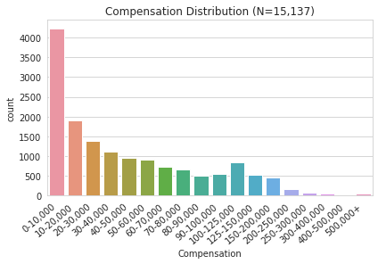
Introduction & Exploratory Data Analysis
Goal: Predict annual compensation range in USD for a given data scientist given various features including: Gender, Age, Country, Education, Industry, Years Experience, etc
→ Ordinal classification problem since target is categorical with 18 ranges from 0-10k to 500k+
Raw Dataset: Kaggle Survey with 15,429 samples and 314 columns
Cleaned Dataset: 15,137 samples with a target label
Note: Target variable is skewed to lower compensations

Slide 3
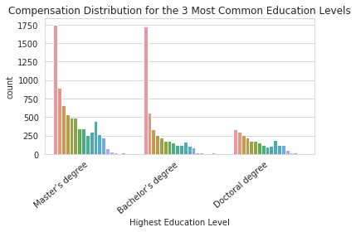
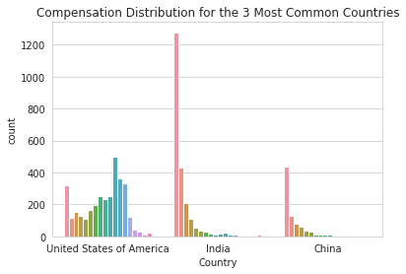
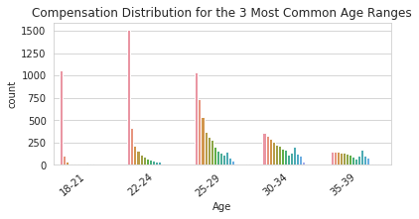
Visualizations
Compensation is higher for those who:
live in America as opposed to India or China
have a high level of education
are older

Slide 4
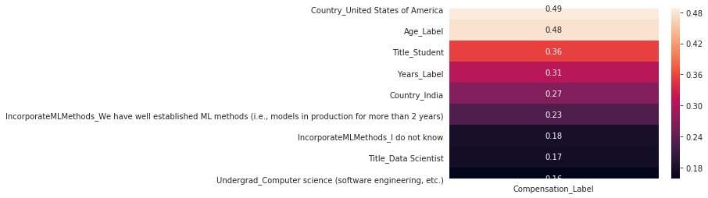
Model Feature Importance
Filled NaN values with 0 for existing binary features in the original dataset
One hot encoded every country and industry since Logistic Regression can’t interpret text directly
Label-encoded compensation as well as Age and Years Experience to capture the ordered relationship
Top 10 correlated features with target (absolute correlation):

Slide 5
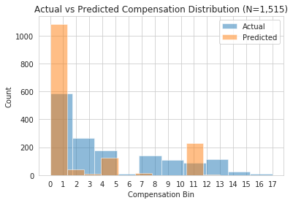
Model Results
Feature Engineering yields 425 available features
Feature Selection done automatically with LASSO, C=0.1 → 378 features were kept
10 fold CV Grid Search yielded hyperparameters:
C = 0.001
Solver = newton-cg
Optimal Logistic Model 10 fold CV performance
Average Accuracy (F1-score): 33.442%
Average Standard Deviation: 5.7%
Clearly room for improvement
Model tends to over-predict the lowest compensation bin and is unable to accurately predict high compensation bins

Slide 6
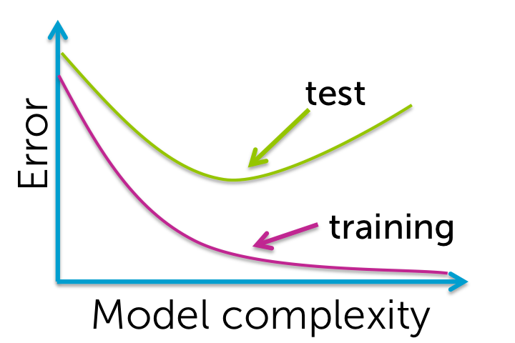
Discussion and Future Work
Overfitting or Underfitting?
Since training set accuracy (34%) and test accuracy (32%) are close, I don’t believe the model is overfitting
Only way to verify underfitting would be to plot the Error/Accuracy vs. Model complexity
Low model complexity would cause underfitting → low values of C means the regularization strength is high
Error is composed of two components the squared bias and the variance (want to minimize both)
Use F1-score to measure accuracy since it considers both precision and recall
Future Work:
Test more C values in the Grid Search and plot Error/Accuracy vs. Model Complexity
Use PCA to reduce feature dimensionality or tune C for LASSO feature selection
Reduce the cardinality of the target variable from 18 compensation bins to >10 bins
Select a subset of data points (focus on a specific country or age bin)

