Slide 1

Helping users navigate data specifications
Data specification navigator
Quoc Anh Nguyen

Slide 2
Motivation – the problem
Users want data but don’t know SPARQL/ontologies.
They rely on a “database person”.
This creates a bottleneck in organizations.

Slide 3
Goals
Maps natural-language questions to items in data specification.
Generates SPARQL queries.
Suggests related items to expand queries.

Slide 4
Inputs and outputs
A picture showing the user providing package info, Dataspecer providing DSV.
A picture showing the user sending a message, the app sending message and OWL to LLM, the app returns reply.
A picture showing the user selecting and sending suggestions, the app processes suggestions and asks for more suggestions from the LLM, returns a reply.
Could be 3 separate slides.

Slide 5
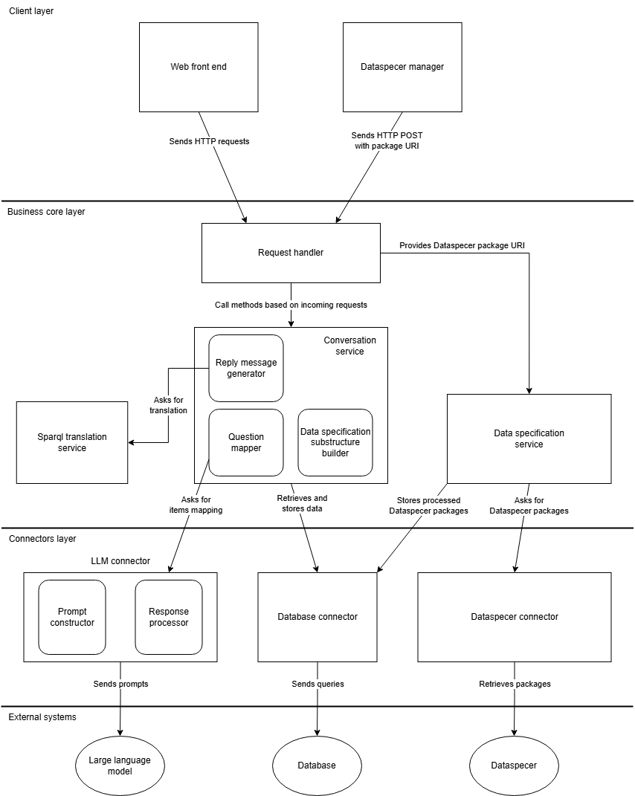
System Architecture

Slide 6





Technologies

Slide 7
Demo
Screenshots

Slide 8
Successfully implemented
DSV to OWL conversion.
SPARQL generation.
Foundation for future extension and research.

