Slide 1
Raven Industries
Kwen Peterson, Senior Software Engineer
@kwenarik
Kwen.peterson@ravenind.com

Slide 2
About me
Graduated from DSU in 2003 with a Computer Science Degree and a handful of minors
Dean Halverson was a new professor here when I was a freshman
Gylling Data Management (5) → Martin Group / CHR Solutions (4) → Raven Industries (1)

Slide 3
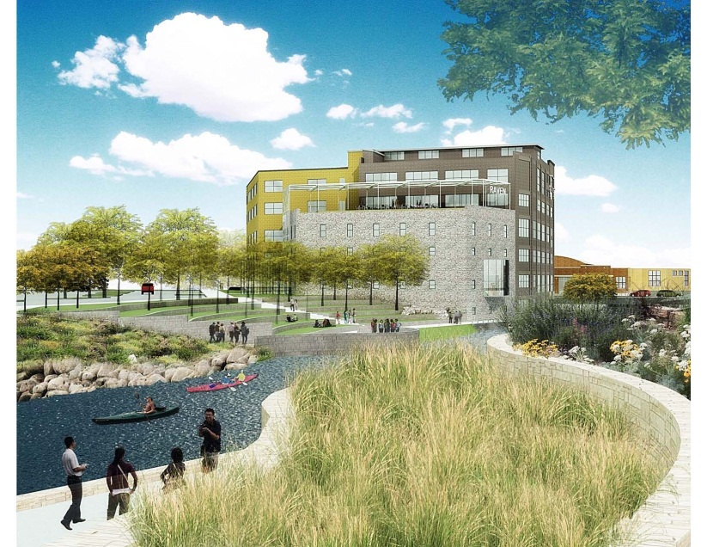
Raven Industries, Inc. CEO- Dan Rykhus
Founded in 1956
Locations
Sioux Falls, SD (HQ)
Madison, SD
St. Louis, MO
Austin, TX
Sulphur Springs, TX
Publicly Traded (NASDAQ: RAVN)
1300+ Team Members
Four Divisions

Slide 4

Applied Technology Division Solutions that Feed the World
ATD is a world leader in precision agriculture, creating groundbreaking ideas and products that improve the position of growers around the world.
Field Computers
Guidance & Steering
Application Controls
Boom Controls
Planter and Seeder Controls
Harvest Controls
Slingshot®

Slide 5

Felix Baumgartner – Red Bull

Slide 6
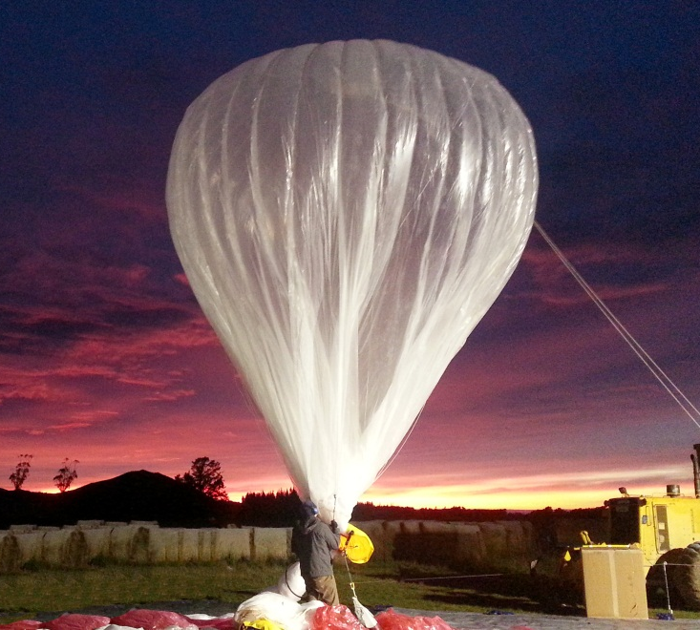


Raven Aerostar Solutions that Save Lives
World leader in the design and manufacture of aerospace, surveillance technology, electronics and specialty sewn products
Tethered Aerostats
Radar Systems
Project Loon, in Collaboration with

Slide 7
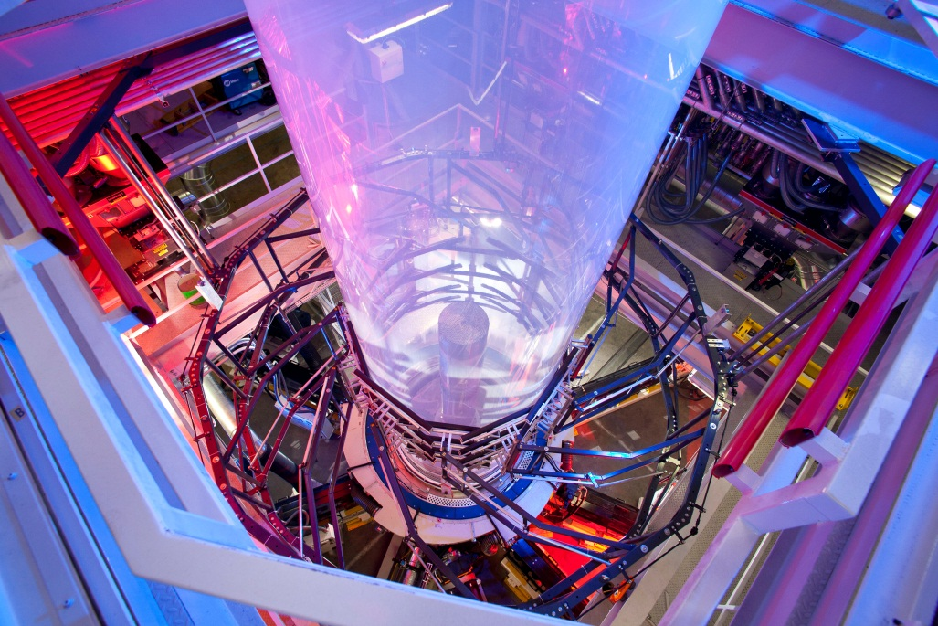
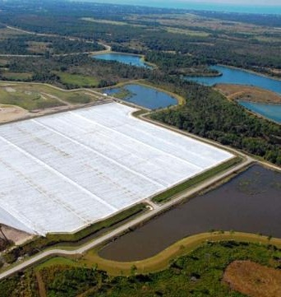
Engineered Films Division Solutions that Protect the Environment
Leading manufacturer of high-quality polymer films and sheeting marketed throughout the United States and abroad.
Ag Covers & Pit Liners
Geo Liners & Covers
Construction Films

Slide 8
Sioux Falls Developers Group
http://www.meetup.com/sfdevs/
~150 members
Hosted ‘monthly’ in Sioux Falls
1-2 hour long discussion/presentation, given by local talent all the way up to Scott Hanselman
Excellent learning opportunity
Excellent networking opportunity

Slide 9
South Dakota Code Camp
http://southdakotacodecamp.net/
November 9th @ Augustana
What’s a code camp?
Collection of 1 hour long talks, spread across multiple tracks.
Angular, Powershell, Fiddler, Web Sockets, MongoDB, NodeJS, ASP.NET Web API, ServiceStack, ASP.NET MVC
Lunch, snacks & raffle prizes
Amazing place to network

Slide 10
My interview questions
What technical blogs to you read?
Do you follow any technical people on Twitter/Facebook/Google+?
Do you have a StackOverFlow/GitHub/BitBucket etc. account?
Have you been to any code camps or conferences? Have you spoken at any?
Have you contributed to any open source projects?

Slide 11
Closing
Twitter: @kwenarik
kwen.peterson@ravenind.com
http://www.meetup.com/sfdevs/
http://southdakotacodecamp.net/ (Nov. 9th!)
http://ravenind.com/

