Slide 1

Raven Industries
Free pizza in EH201 today at noon!
900 person headquartered in Sioux Falls with offices in California, Texas, Maryland and the Netherlands
Publicly traded, has 4 diverse divisions
Aerostar
Partnered with Google as part of the Google Loon project
Almost all of the Macy’s Day parade balloons come from Raven
NASA weather balloons, Red Bull balloon used by Felix Baumgartner
High altitude aerospace balloons
Applied Technology Division (ATD)
Precision GPS, steering assist devices for major farm implement dealers, such as John Deere
Embedded C++ work, PHP, Node, MySQL, AWS
Corporate (CSD)
C#, ASP.NET, Angular, SQL, Azure
Engineered Films Division (EFD)
High polymer films and plastics

Slide 2
About Me
Kwen Peterson, Senior Software Developer at Raven Industries
Graduated from DSU in 2003 with a Computer Science Degree and a handful of minors
I was one of Professor Halverson’s inaugural graduates
Gylling Data Management (5) → Martin Group / CHR Solutions (4) → Raven Industries (4)
Members of my graduating class work at the following:
Microsoft | Zuercher Technologies
Blizzard Entertainment | Raven
nVidia | DocuTAP
Askozia (Founder, in Germany) | Sencore
MarketBeat.com (Founder, $1m/month in revenue)

Slide 3
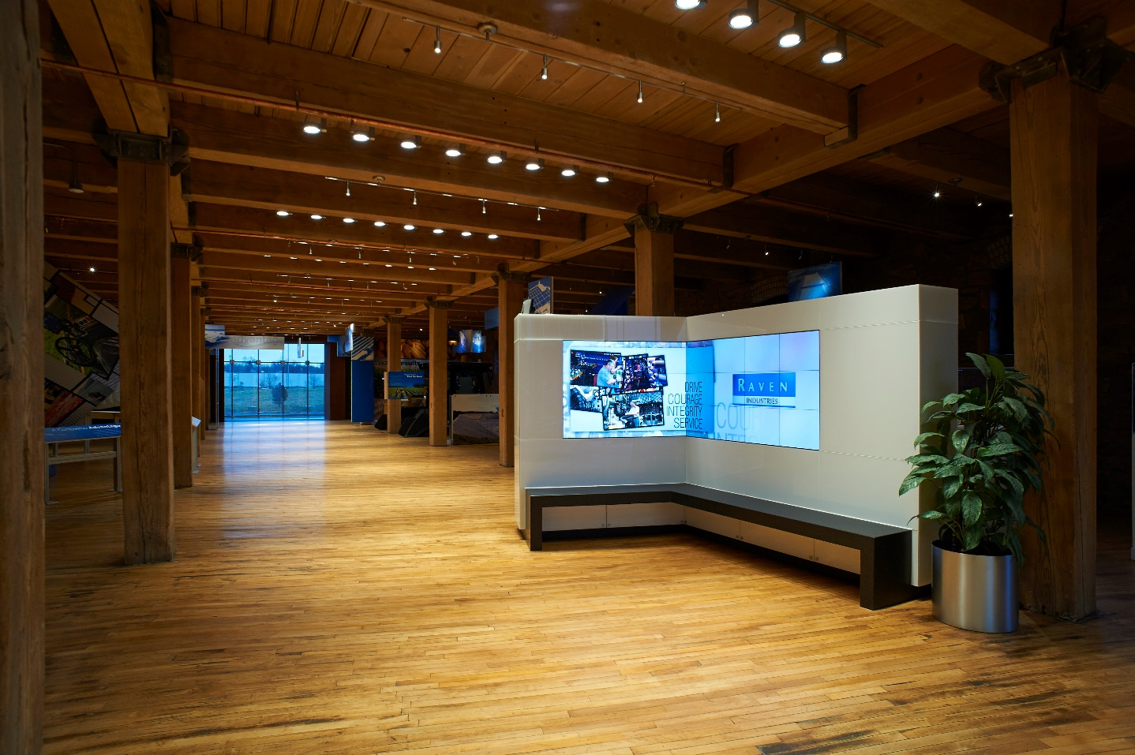
Sioux Falls Developers Group
http://www.meetup.com/sfdevs/
Almost 400 members
Hosted monthly in Sioux Falls
~1 hour presentation/discussion on <random topic>
given by local talent, all the way up to Scott Hanselman from Microsoft.
Excellent learning opportunity
Excellent networking opportunity

Slide 4

South Dakota Code Camp
http://www.southdakotacodecamp.com/
Just had it on November 5th at STI in Sioux Falls
100 attendees
Lunch, snacks & raffle prizes
Amazing place to network
What’s a Code Camp?
Free event, normally on a Saturday
Collection of 1 hour long talks on various topics, spread out across multiple tracks
Topics ranged from Android development, Functional Patterns, .NET Core, & ORMs to Remote Work
My talk was .NET Core or .NET Framework: Which One Should I Choose?

Slide 5
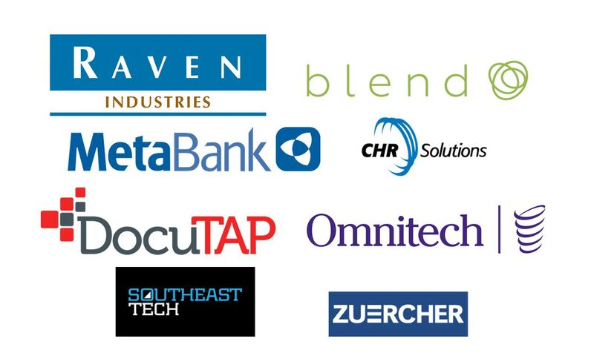

Slide 6
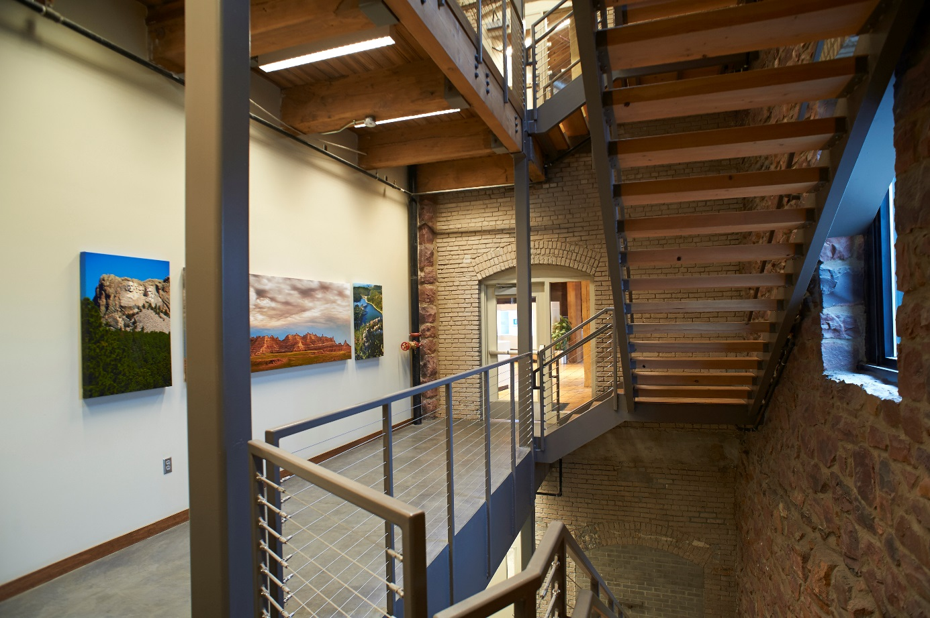
Things to focus on
Technical Skills:
Source Control (Git)
SQL (You are going to have to query databases.)
Debugging (Breakpoints, logfiles)
Things you can share/demo: phone apps, things you are passionate about
A group of us wrote Frogger in Assembly.
My classmate got the job at Blizzard because he created a statistical model in VB6 that simulated Warrior DPS based off gear/stats/talent choices to optimize his DPS.
Do you code anything outside of what’s required for classes?
Exposure to multiple languages, even if you “know” you’ll never use them. (Smalltalk, F#, Lisp)
Classes:
Statistics!
Doc & Pres, Speech
Notes:
Basketball analogy of shooting free throws after practice

Slide 7


My interview Questions
What technical blogs do you read?
Do you follow any technical people on Twitter/Facebook?
Do you have a StackOverFlow / GitHub account?
Have you been to any code camps, conferences or tech groups?
Have you spoken at any?
Have you contributed to any open source projects?

