Slide 1


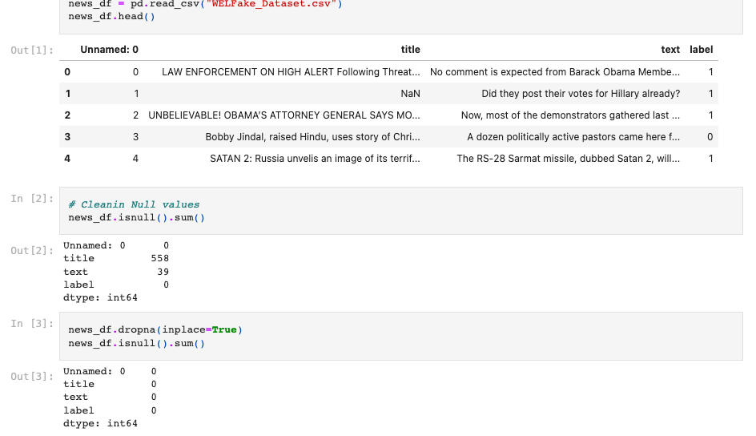
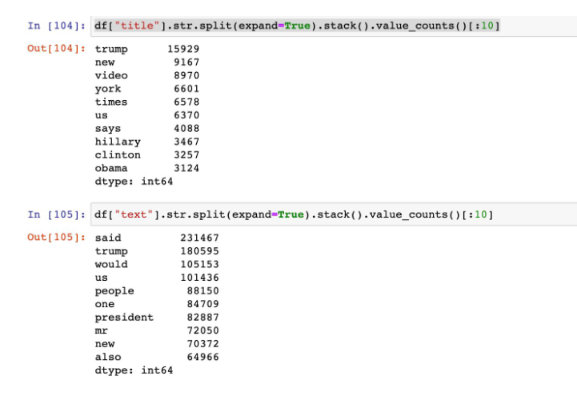
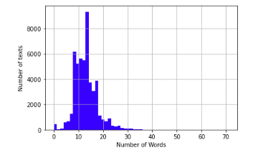
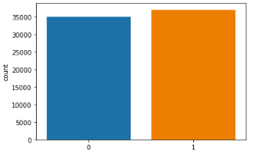
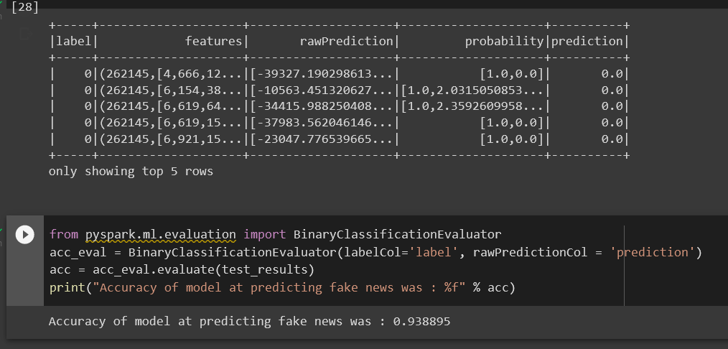
Fake News identifier
Group 5 – MythBusters
Project by: Amanda Goguen, Anthony Marquez, Kevin Whitiak, Salih Ayhan
1. What is our source of data?
We obtained our dataset from opensource Kaggle, where the dataset had a usability score of 10/10
Our dataset uses binary numbers to represent true vs. false articles where “0” = true and “1” = false
2. What is the Question we want to answer?
We are trying to create machine learning algorithm that can predict fake news by training it on a dataset with identifiers
3. What type of ML was used for our model?
-For our model, we used Natural Language Processing (NLP) and BinaryClassificationEvaluator
4. Where will we store the data?
-For data storage, our plan is to utilize PostgreSQL using PgAdmin
Cleaning Data Basics : Dropping Null Values
Cleaning Data Regex : Counting Popular Values
Cleaning Data Visualizations: Text Count vs. Word Count
Cleaning Data Visualizations : Counting with both plot labels
BinaryClassificationEvaluator and accuracy score

