Slide 1
Aviation VR Training Exploratory Data Analysis
Quinn Meyer

Slide 2
Objective and Outline
The objective of this PowerPoint presentation is to simulate my presentation abilities for a full-stack data analytics project.
This PowerPoint is split into three sections:
Data ingestion (Audience: Data Engineers, Data Analysts)
Data analysis (Audience: Data Analysts)
Results and next steps (Audience: Customer, Data Analysts)

Slide 3
Project Background
An aviation customer has provided uncleaned data from their VR training simulation. They wish to make their VR training better as well as extract any additional insights that are present.

Slide 4
Part 1: Data Ingestion

Slide 5
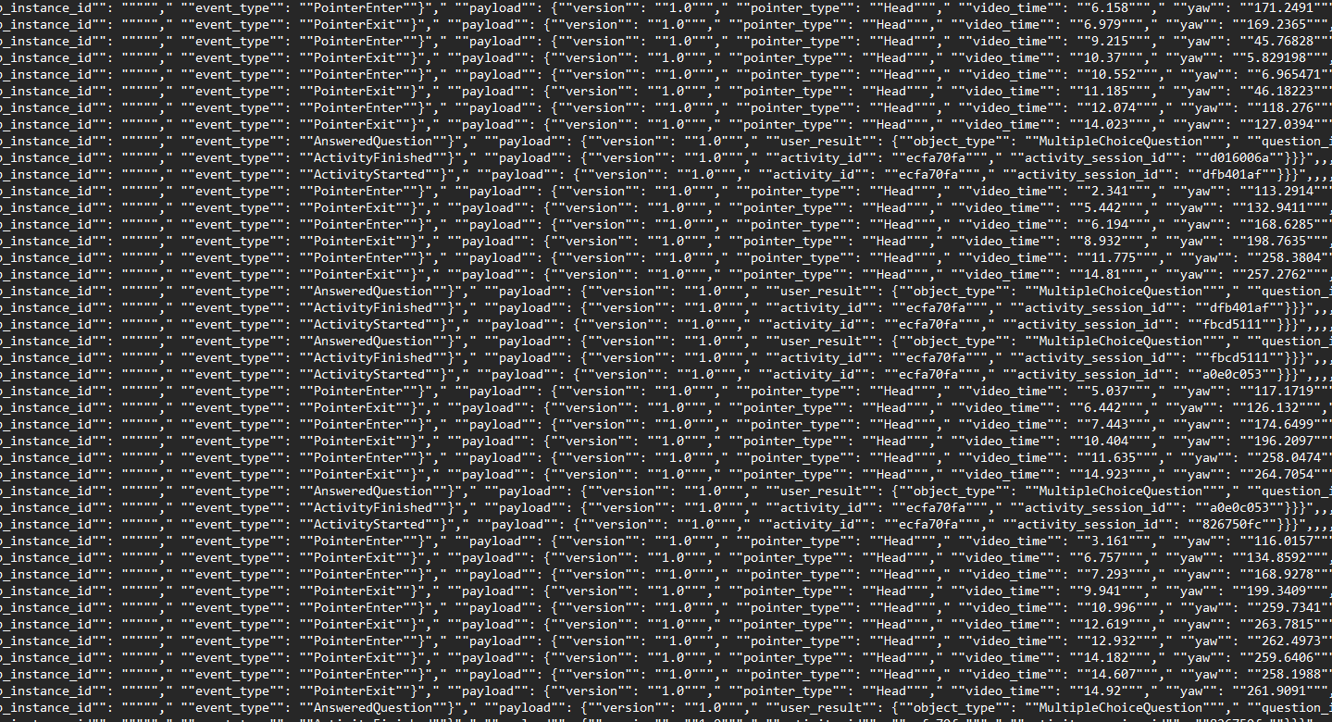
Data Format Recap
A .csv file is provided by the customer containing telemetry data from VR training consisting of 40 learners
In this provided .csv file…
A complete activity instance is designated by the learner starting and finishing the training
Specific events and their corresponding data are stored when a learner either enters or exits a ‘hotspot’ in the aircraft (denoted by the learner’s gaze entering or exiting the ‘hotspot’)
The learner’s response to a multiple-choice question is stored sequentially just before the activity instance’s end
Each event is stored as a JSON blob in its own row of the .csv file

Slide 6
Data Ingestion Issues
JSON blobs are not stored in proper JSON notation, so preprocessing was required
There are two instances of inconsistent notation in the .csv file
Row 21 in .csv […"}}“…] should be […"}}}“…]
Row 283 in .csv file […,,,,,…] should be […,,,,,,…]
There is one instance of irrelevant extra data in .csv file
Row 123 contains an activity_id of 200dca6b instead of ecfa70fa
These inconsistencies should be investigated further internally to ensure there is no data corruption during ingestion

Slide 7
Part 2: Data Analysis

Slide 8
Objective
The objective of the data analysis is to determine key insights hidden in the data set that may offer the customer actionable items on how to improve their VR training simulation

Slide 9
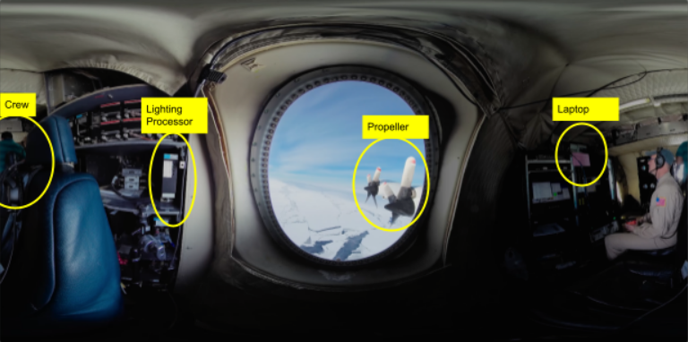
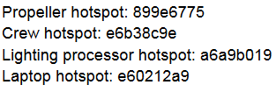
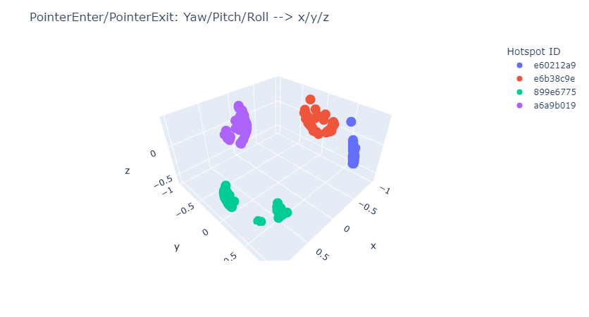
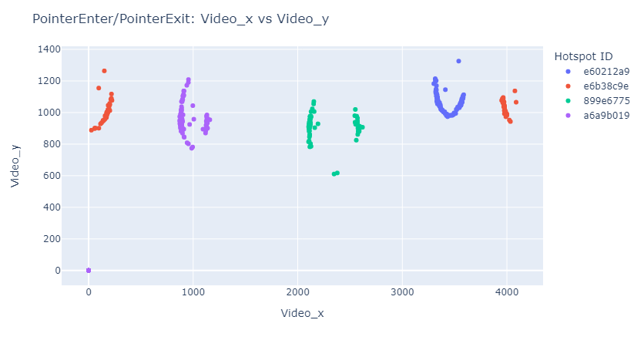
Visualizing the Geometric Data
Yaw/Pitch/Roll directly translate to the (video_x, video_y) coordinates
Location data should not be further included in data analysis
Location data matches what is expected!
(0,0) is due to user exit

Slide 10
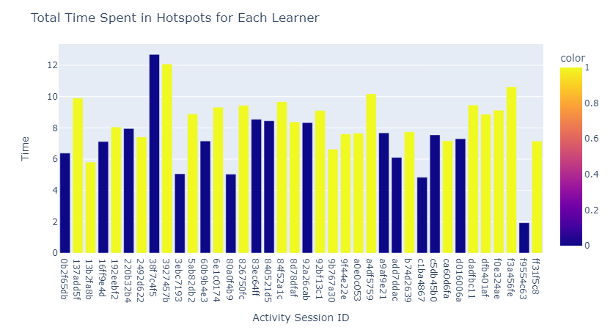
T-test: Total Time Spent in Hotspots vs the Correct Multiple-Choice Response
T-test was performed to understand if population averages are statistically significant for the total time spent in the training hotspots and getting the multiple-choice question correctly or incorrectly
P-value < 0.05 shows that the population difference is statistically significant

Slide 11
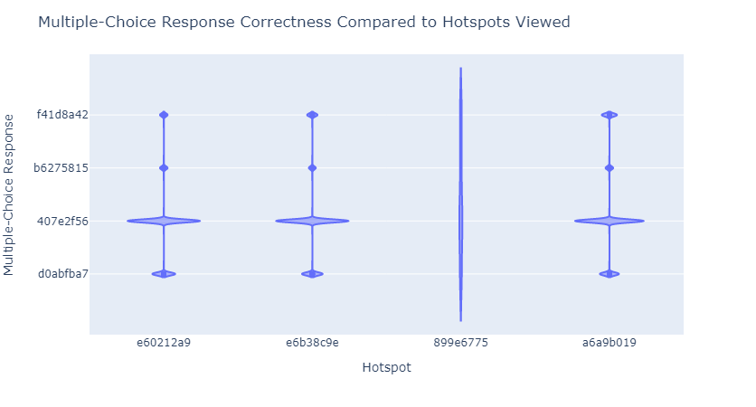
ANOVA: Hotspot ID vs Multiple-Choice Question Response
ANOVA Analysis showed that there is a statistical significance in the population averages of Hotspot IDs and Correct Multiple-Choice Question
Post hoc test implemented and it was found that learners that viewed the Propeller Hotspot were more likely to guess the question incorrectly
Less learners overall viewed the propeller hotspot compared to the rest of the hotspots
There are not correlations between multiple-choice answers and hotspot views
Hotspot ID | Total Amount of Learners that Viewed it
e6b38c9e (crew) | 32
a6a9b019 (lighting) | 29
e60212a9 (laptop) | 29
899e6775 (propeller) | 18

Slide 12
Prediction Models
Logistic Regression and Decision Tree models are appropriate for quickly identifying any trends since the predictor variable is categorical binary
It is important to keep the models simple since there is limited data
Both logistic regression and decision tree models are inadequate in predicting appropriate multiple-choice responses as their accuracies, residuals, and correlations are poor
While Hotspot ID and time have individual statistical significance with multiple-choice question correctness, their relationships cannot be correlated using these simple linear models

Slide 13
Part 3: Summary and Next Steps

Slide 14
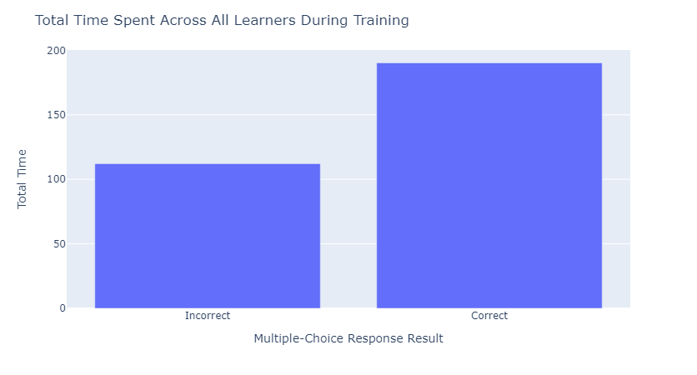
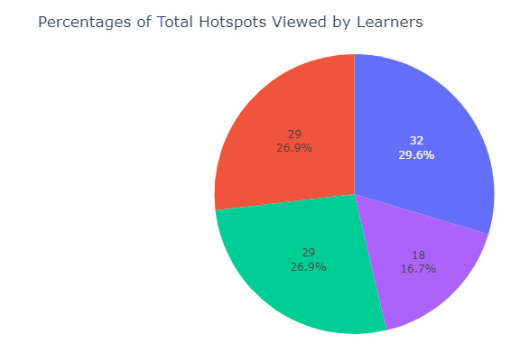

Results
The longer the learner trains, the more likely they are to guess the multiple-choice question correctly
Time spent individually in each hotspot location does not correlate to answering the question correctly
Learners that viewed the propeller hotspot are less likely to guess the correct question
Missing
Learners view the propeller less frequently than the other hotspots in the training
(Laptop)
(Crew)
(Propeller)
(Lighting Processor)

Slide 15
Next Steps
Learner engagement initiatives should be implemented to maximize the time spent that learners are in the training to improve information retention for questionnaires
Supplementary training data needs to be acquired to further understand the following about the propeller hotspot concerns:
Why fewer learners gaze into the propeller hotspot than the other hotspots
Propeller could be less engaging than the other hotspots, awkward to gaze into, or requires less focus as it is easier to see in the peripheral vision
Why learners that do enter the hotspot are more likely to answer the multiple-choice question incorrectly
Training duration (time) and gazing into other hotspots do not correlate with answering the question correctly, so supplementary data is needed
There are less learners that gazed into this hotspot than others, so more sampling could correct the issue

Slide 16
Thank you!

