Slide 1
1. Animation showing what my company does (camera calibration)
The camera sees something
The camera outputs the location of the object
You don’t need to use the particular scenario with a stop sign and a car. All I want to show is that the camera can determine 3D coordinates if it is calibrated.

Slide 2





Y
Z
X

Slide 3
Y
Z
X

Slide 4
Y
Z
X
X=3m

Slide 5
Y
Z
X
X=3m
Y=1m

Slide 6
Y
Z
X
X=3m
Y=1m
Z=10m

Slide 7
Y
Z
X
XYZ = (3, 1, 10)
X=3m
Y=1m
Z=10m

Slide 8
2. Animation showing the image capture pattern
I want to show the camera seeing a calibration target that’s physically in the world, and show the resulting image on the camera’s imager
Total of three capture images

Slide 9
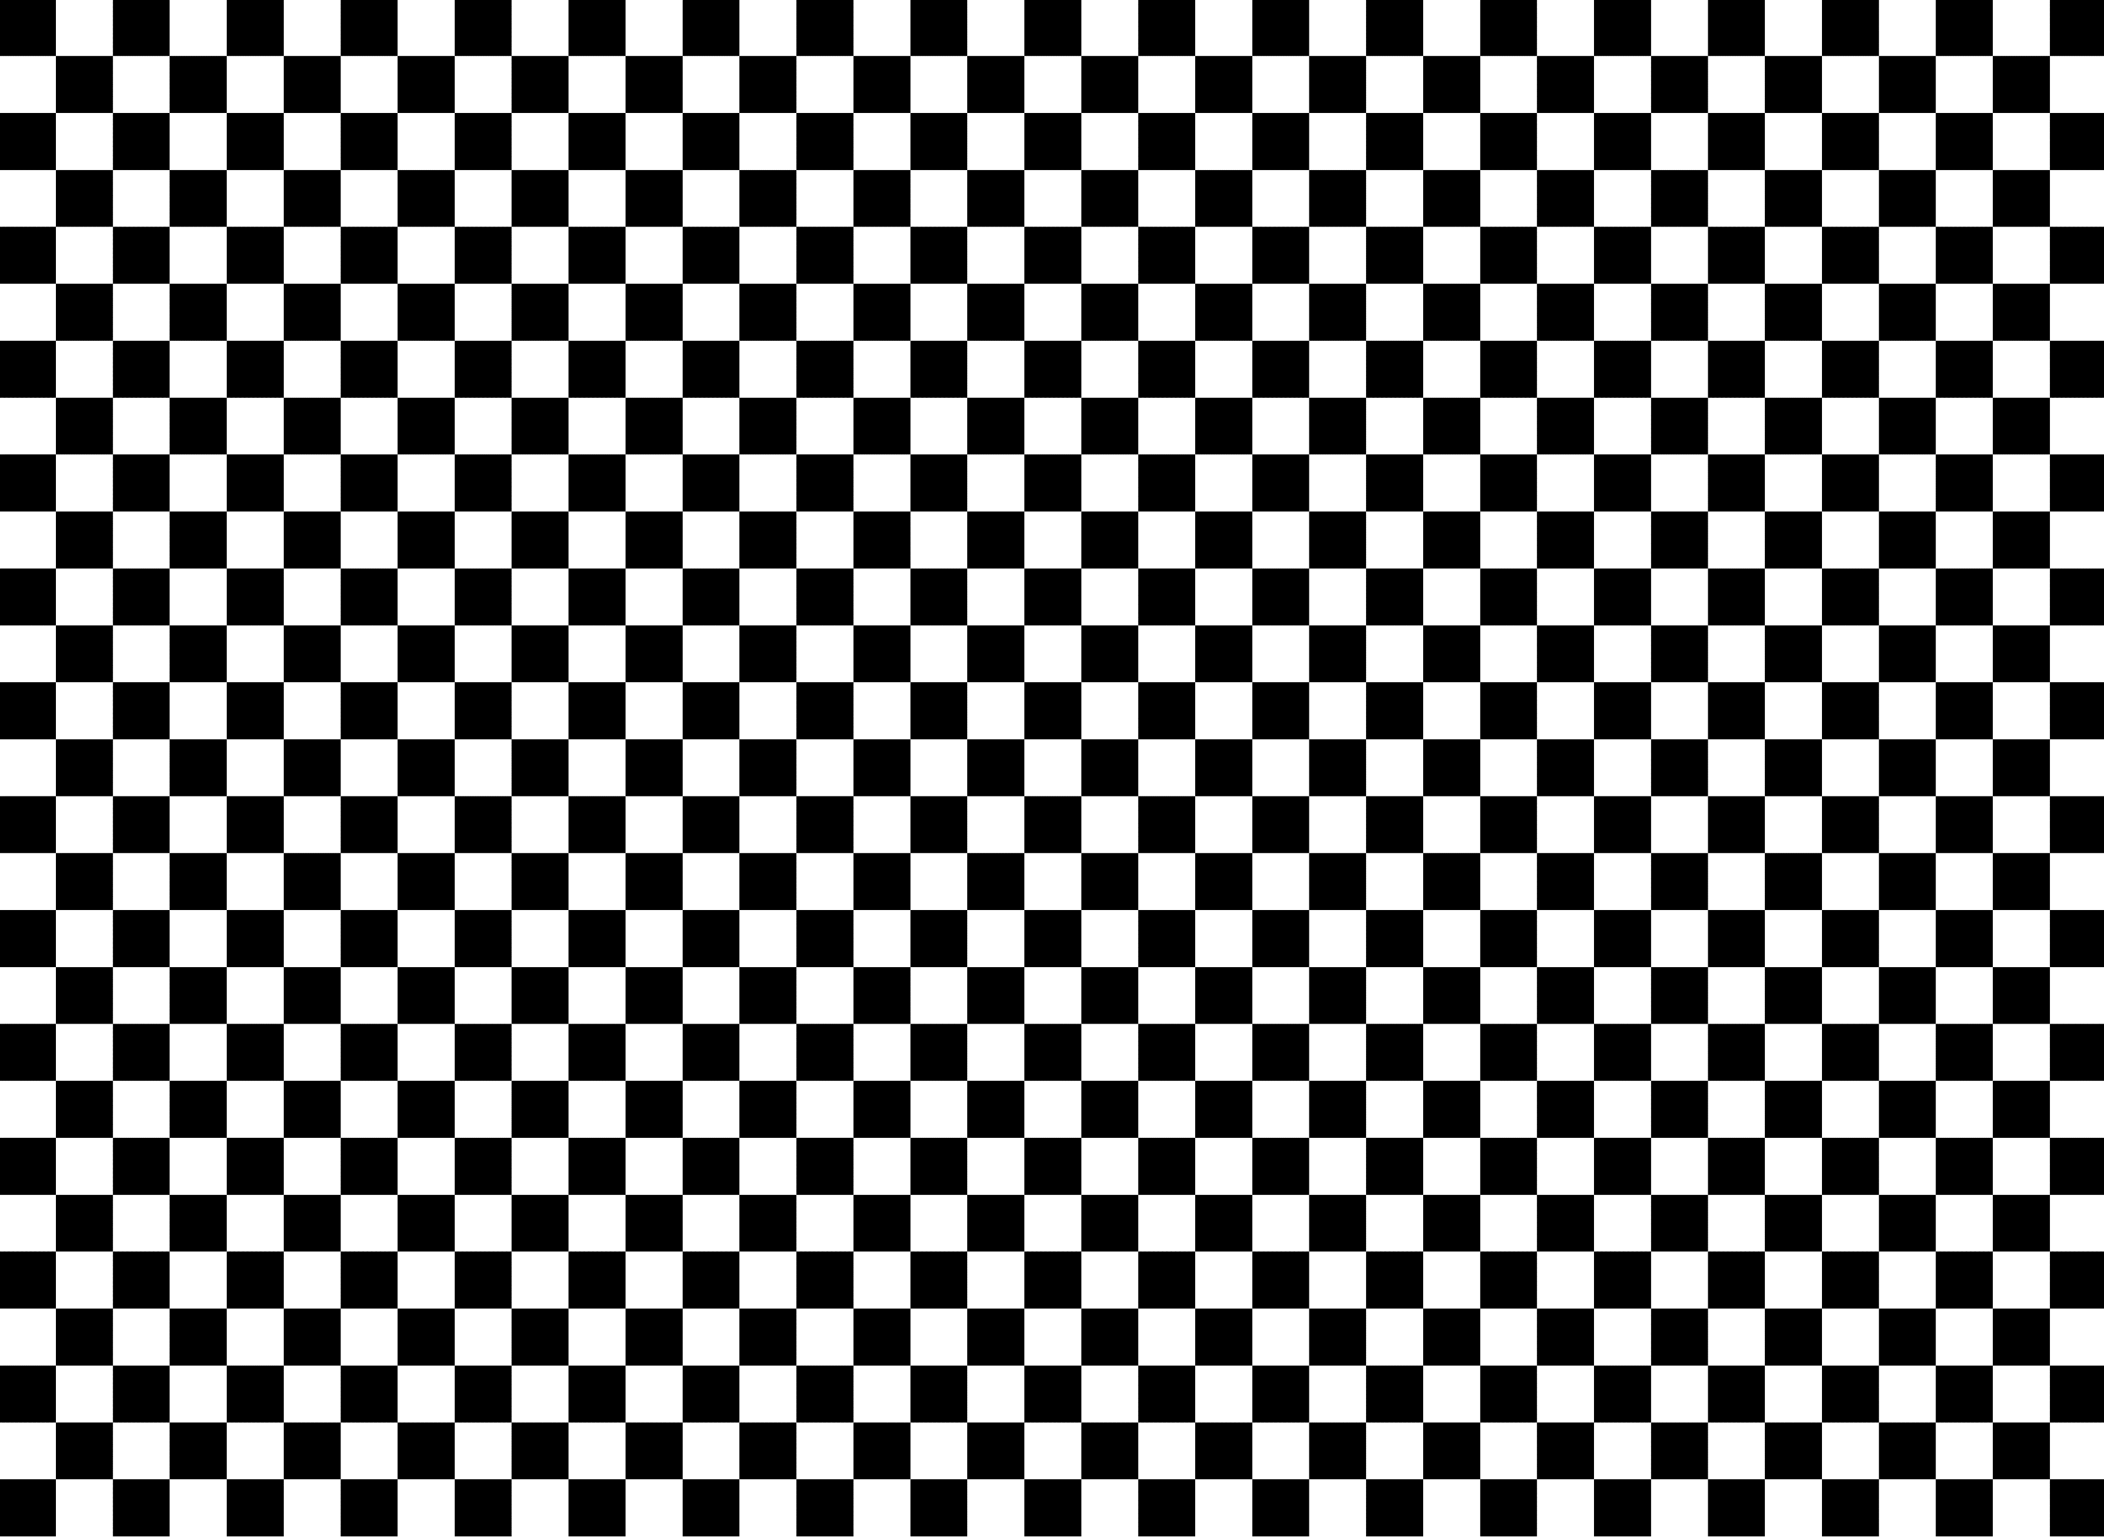
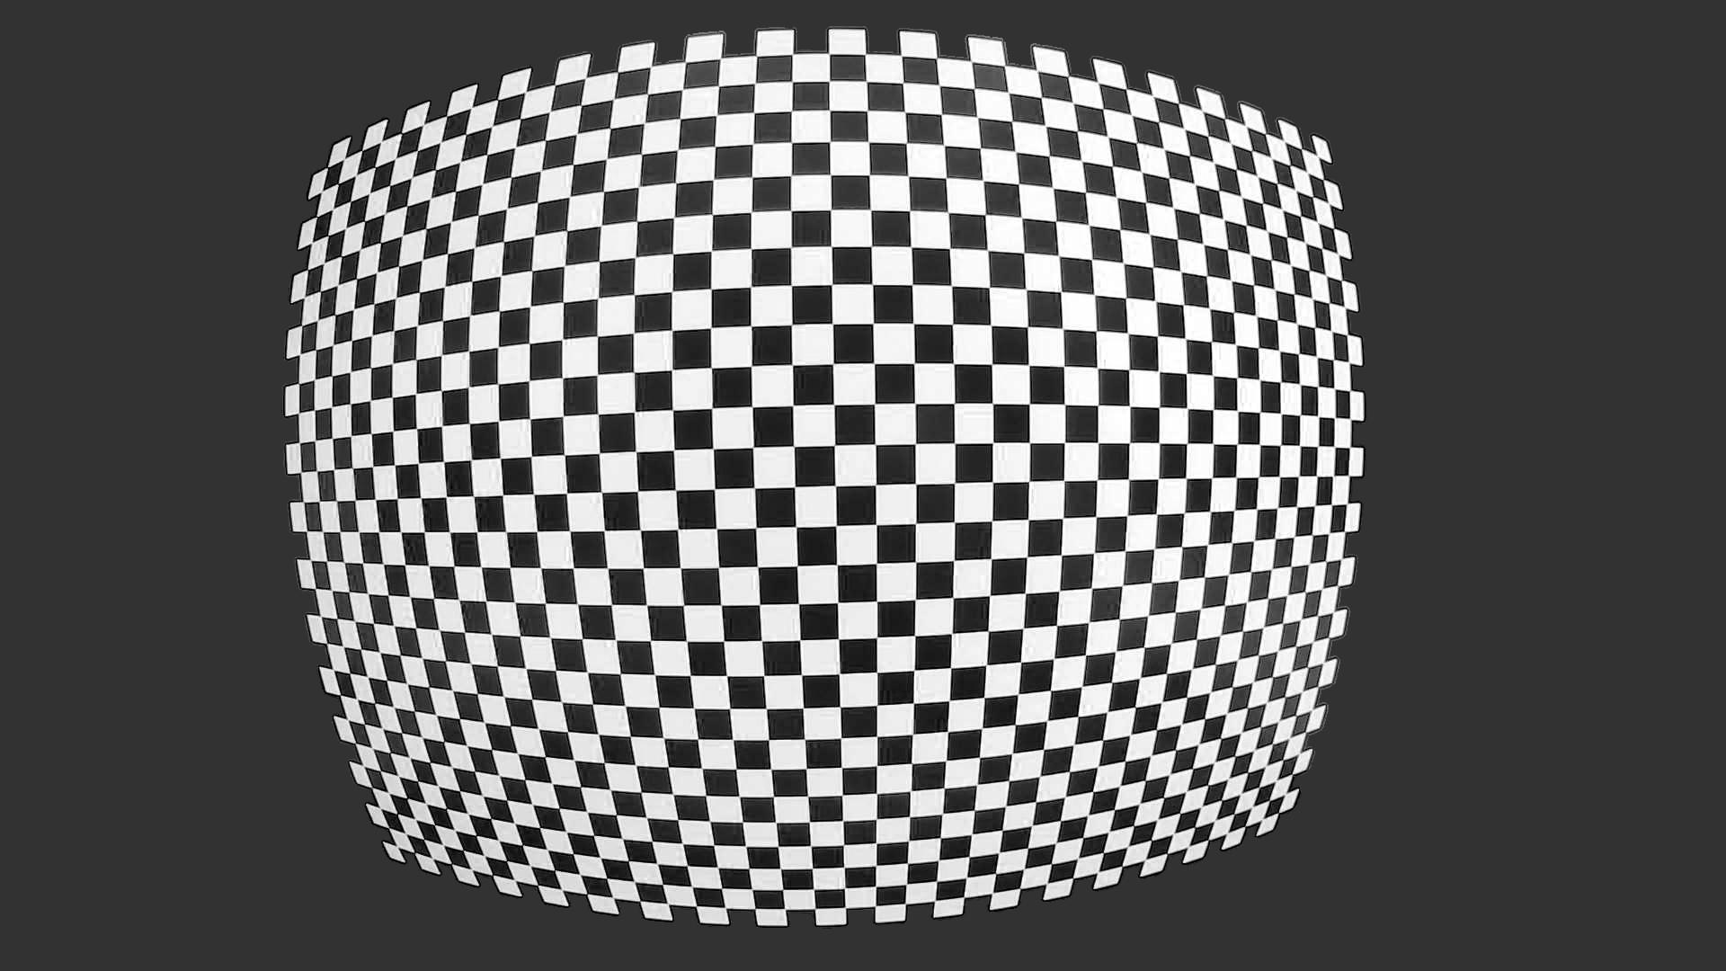

Physical Checkerboard
Resulting Image

Slide 10
Physical Checkerboard
Resulting Image

Slide 11
Physical Checkerboard
Resulting Image

Slide 12
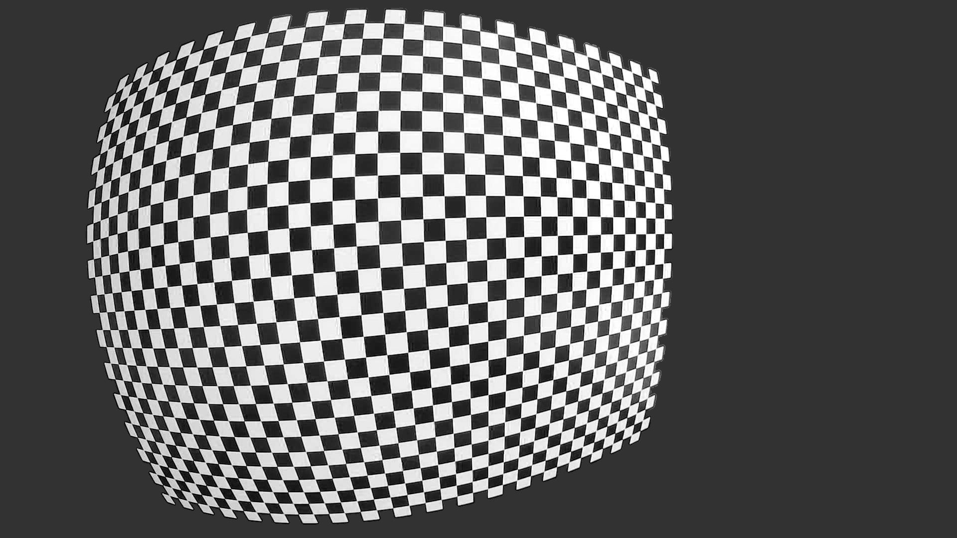
Physical Checkerboard
Resulting Image

Slide 13
Physical Checkerboard
Resulting Image

Slide 14
Physical Checkerboard
Resulting Image

Slide 15
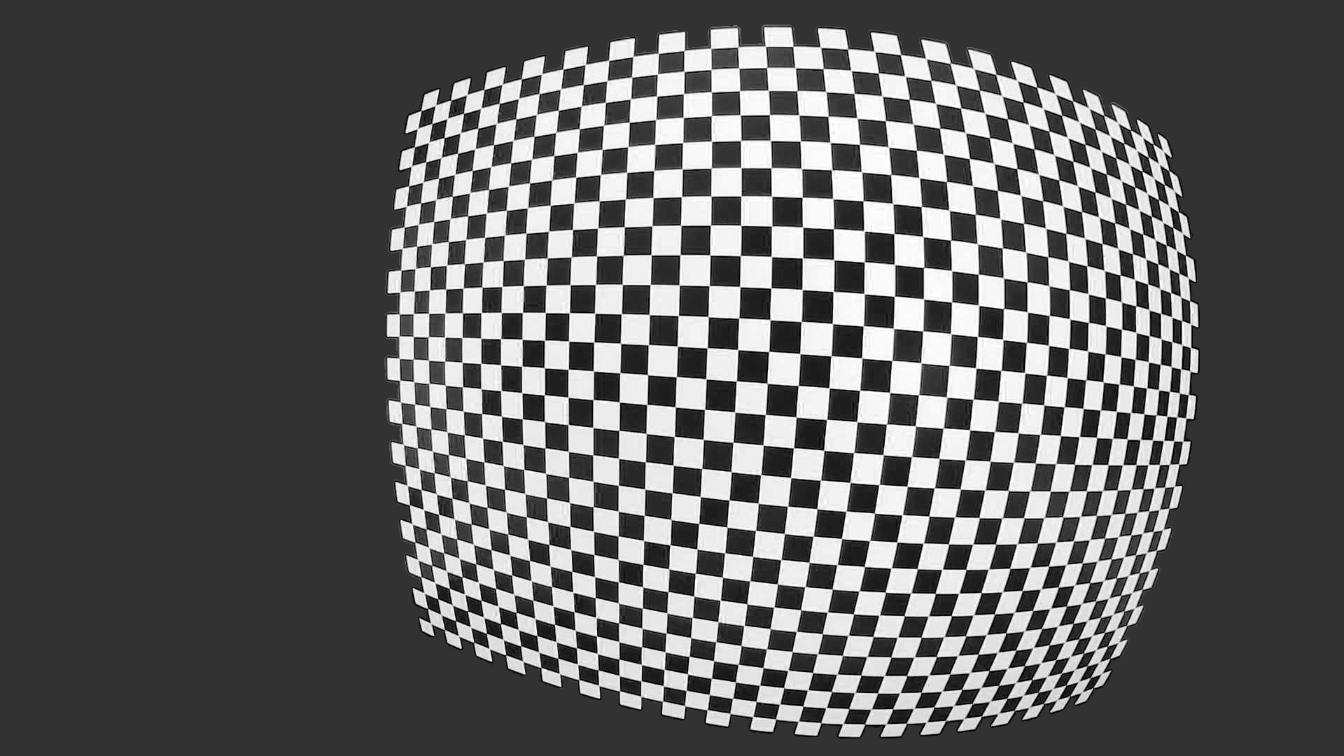
Physical Checkerboard
Resulting Image

Slide 16
Physical Checkerboard
Resulting Image

Slide 17
Physical Checkerboard
Resulting Image

Slide 18
3. Animation showing the accuracy of validation
Series of zooms and camera movements showing how images are captured

Slide 19

Example Validation Setup
14 meters
7 meters
14 meters
*0.15% Error Corresponds to 10.5mm Difference Between Measured and Model Distance at 7.000m!
Example: 7.000m Measured and 7.0105m Model is 0.15% Measurement Error

Slide 20
Example Validation Setup
14 meters
7 meters
14 meters
*0.15% Error Corresponds to 10.5mm Difference Between Measured and Model Distance at 7.000m!
Example: 7.000m Measured and 7.0105m Model is 0.15% Measurement Error

Slide 21
Efovee Error is 0.15%!

Slide 22
Zoom out
14 meters
7 meters
14 meters

Slide 23
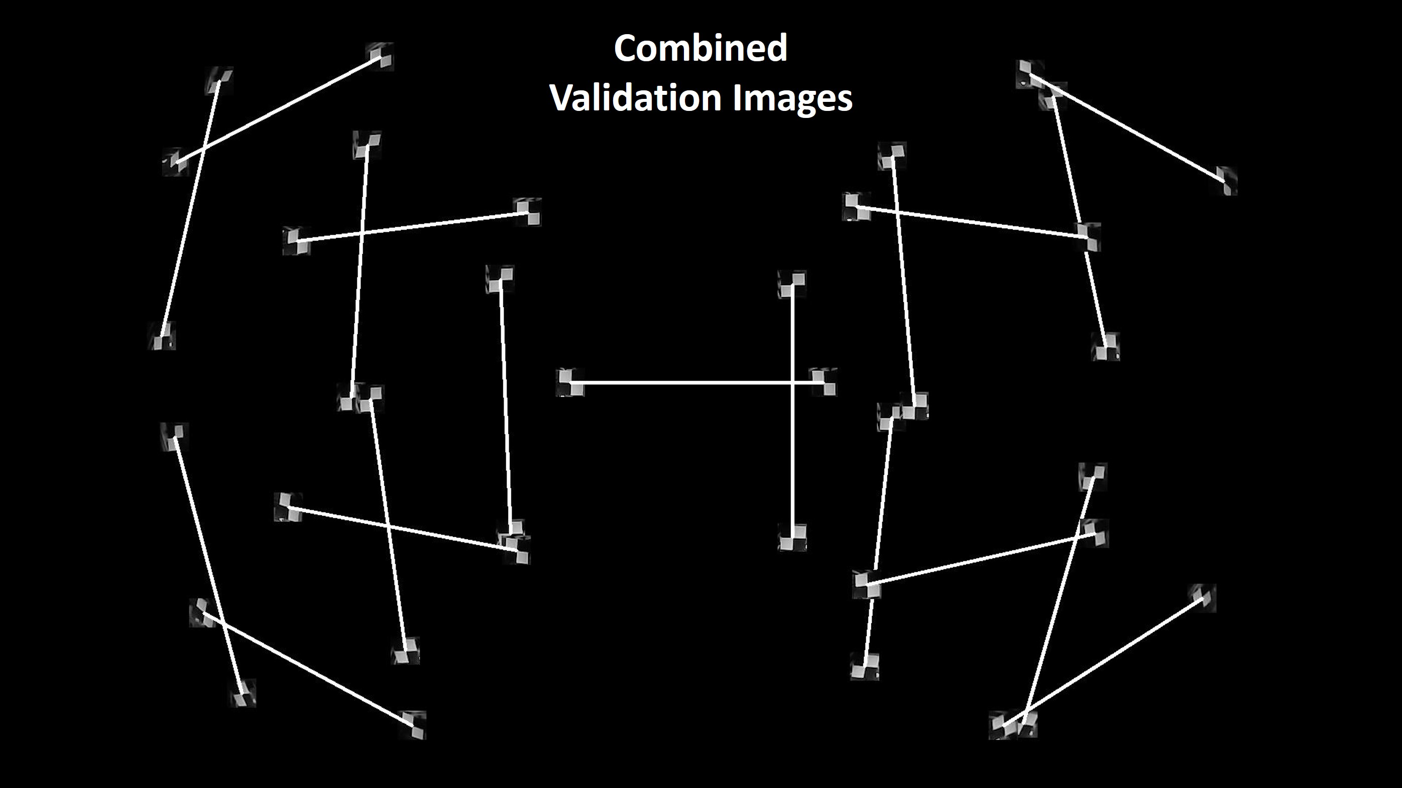
Show how a few validation images are captured
14 meters
7 meters
14 meters

Slide 24
Show how a few validation images are captured
14 meters
14 meters
7 meters

Slide 25
Show how a few validation images are captured
14 meters
7 meters
14 meters
Etc…

