Slide 1
Detected Points
Reprojected Points

Slide 2
OpenCV
Efovee

Slide 3

Example Validation Setup

Slide 4
Example Validation Setup
14 meters
7 meters
14 meters
*0.30% Error Corresponds to 42mm Difference Between Measured and Model Distance at 7.000m!
Example: 7.000m Measured and 7.042m Model is 0.30% Measurement Error

Slide 5
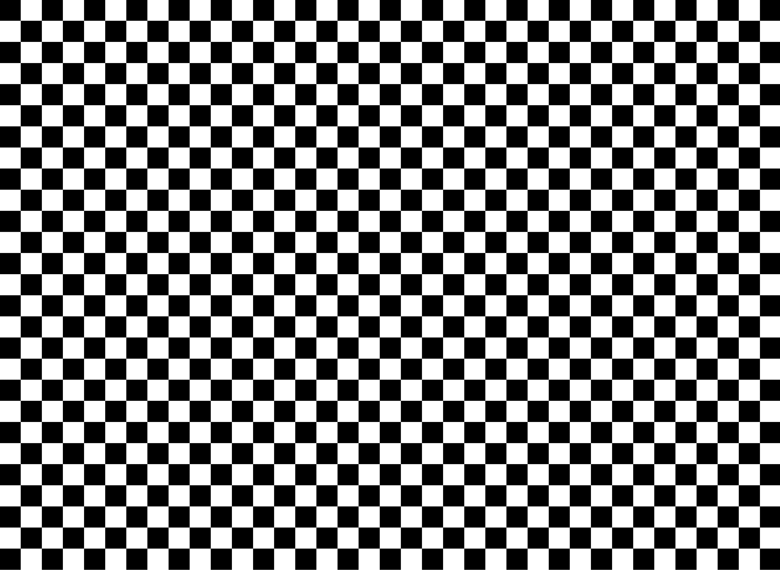
Example Capture Plan

Slide 6
Example Capture Plan

Slide 7
Example Capture Plan

