Slide 1
Detected Points
Reprojected Points

Slide 2
OpenCV
Efovee

Slide 3

Example Validation Setup

Slide 4
Example Validation Setup
14 meters
7 meters
14 meters
*0.15% Error Corresponds to 10.5mm Difference Between Measured and Model Distance at 7.000m!
Example: 7.000m Measured and 7.0105m Model is 0.15% Measurement Error

Slide 5
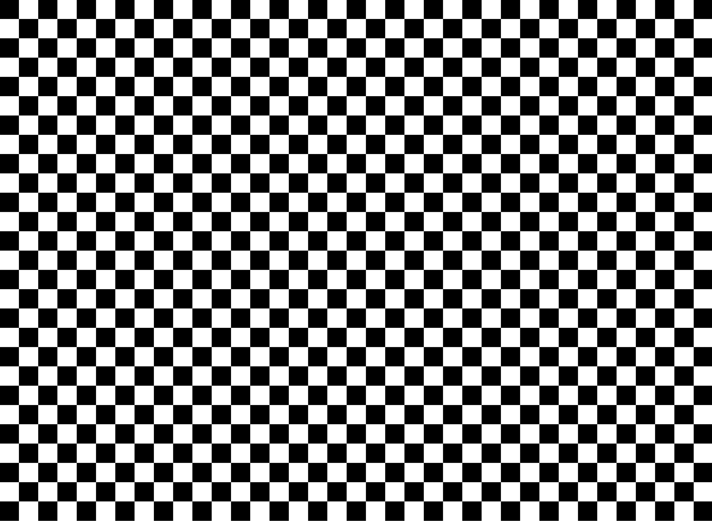

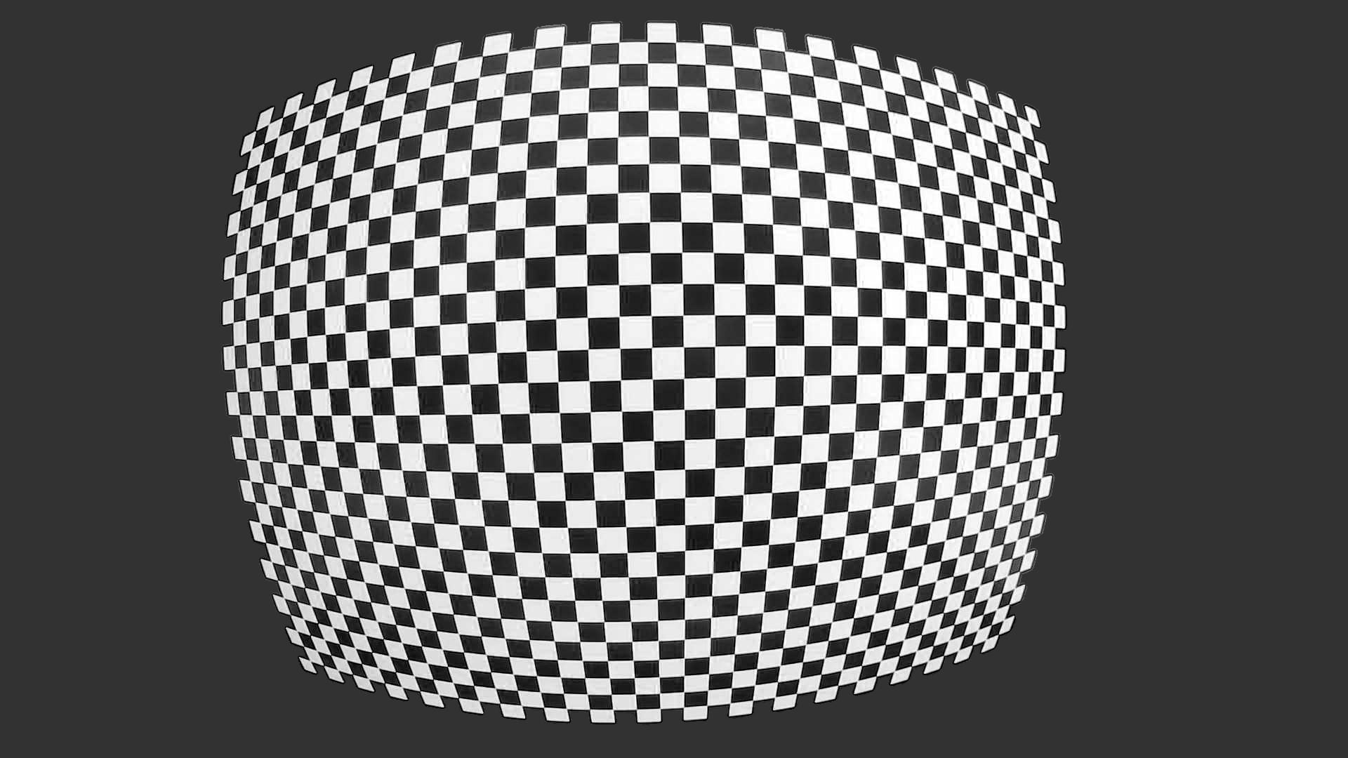
Example Capture Plan

Slide 6

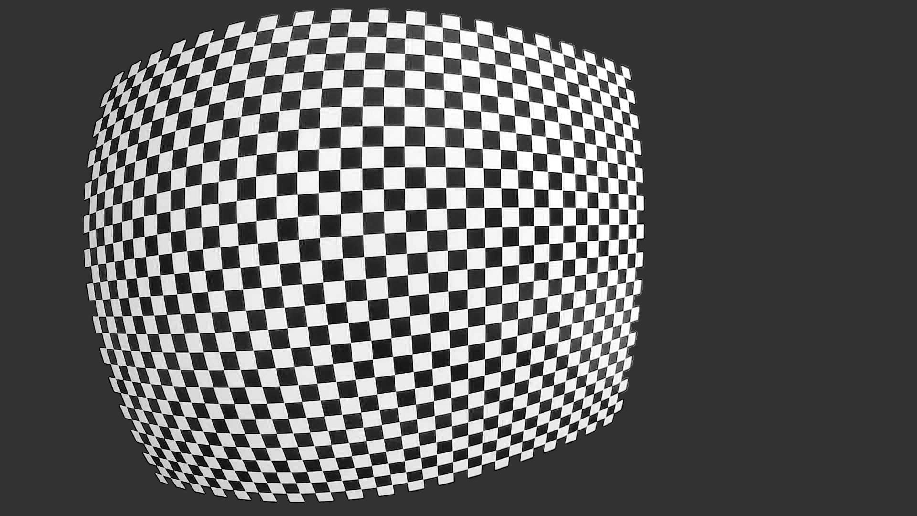
Example Capture Plan

Slide 7
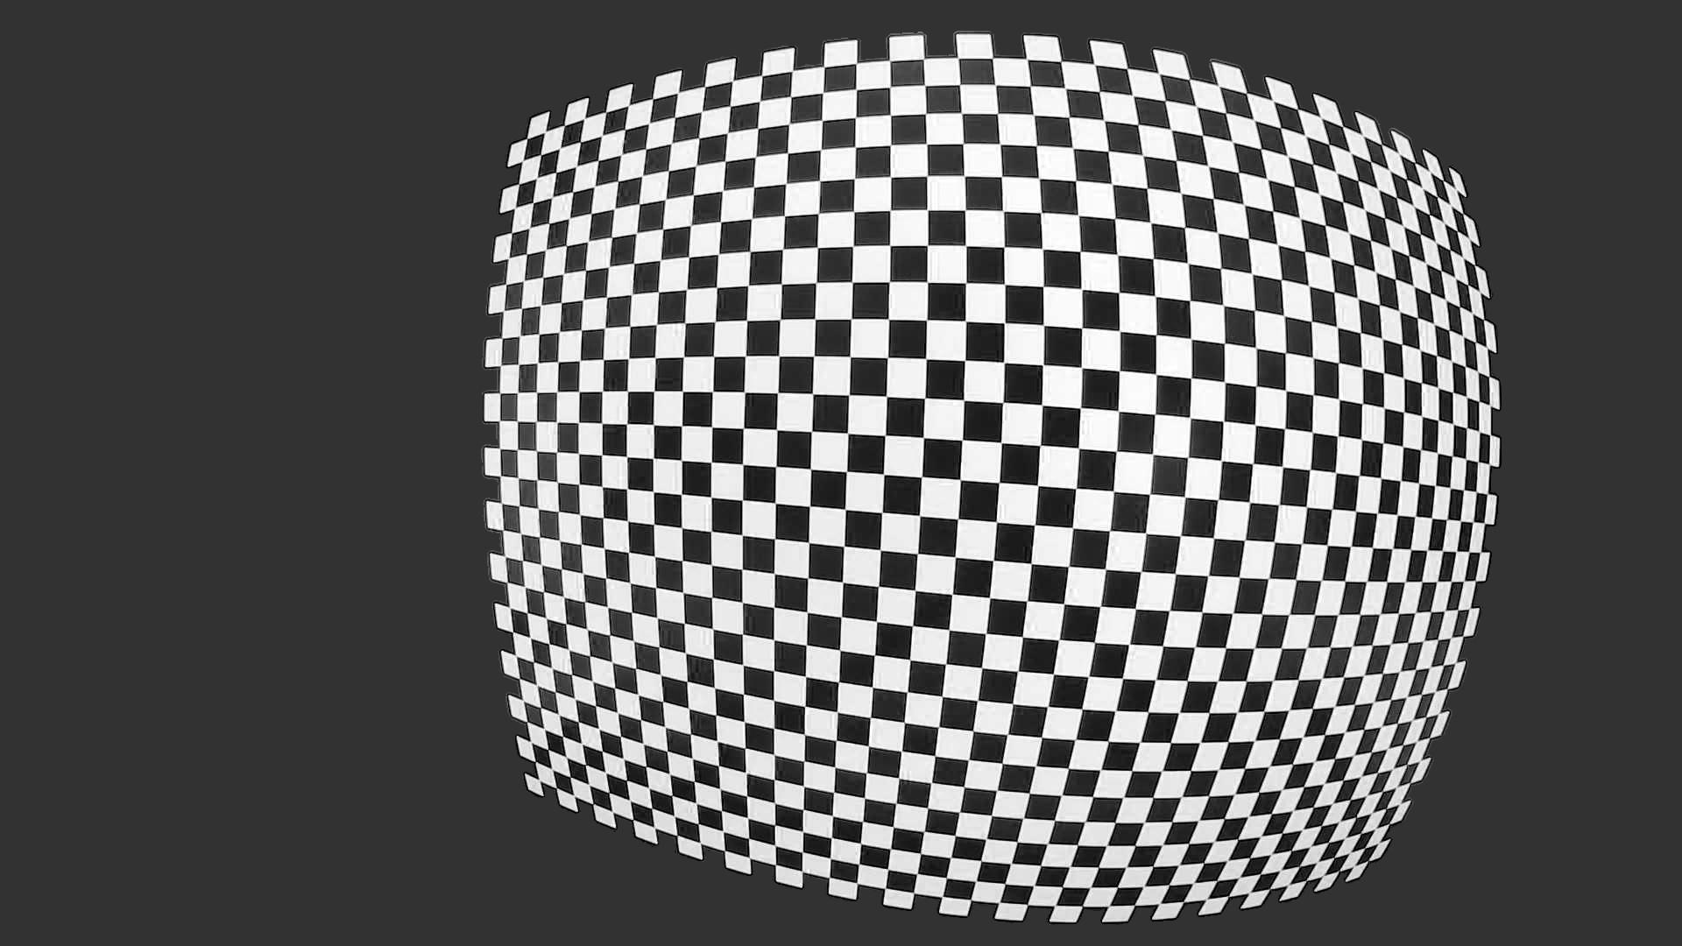
Example Capture Plan

