Slide 1
1. Animation showing what my company does (camera calibration)
The camera sees something
The camera outputs the location of the object
You don’t need to use the particular scenario with a stop sign and a car. All I want to show is that the camera can determine 3D coordinates if it is calibrated.

Slide 2





Y
Z
X

Slide 3
Y
Z
X

Slide 4
Y
Z
X
X=3m

Slide 5
Y
Z
X
X=3m
Y=1m

Slide 6
Y
Z
X
X=3m
Y=1m
Z=10m

Slide 7
Y
Z
X
XYZ = (3, 1, 10)
X=3m
Y=1m
Z=10m

Slide 8
2. Animation showing the image capture pattern
I want to show the camera seeing a calibration target that’s physically in the world, and show the resulting image on the camera’s imager
Total of three capture images

Slide 9
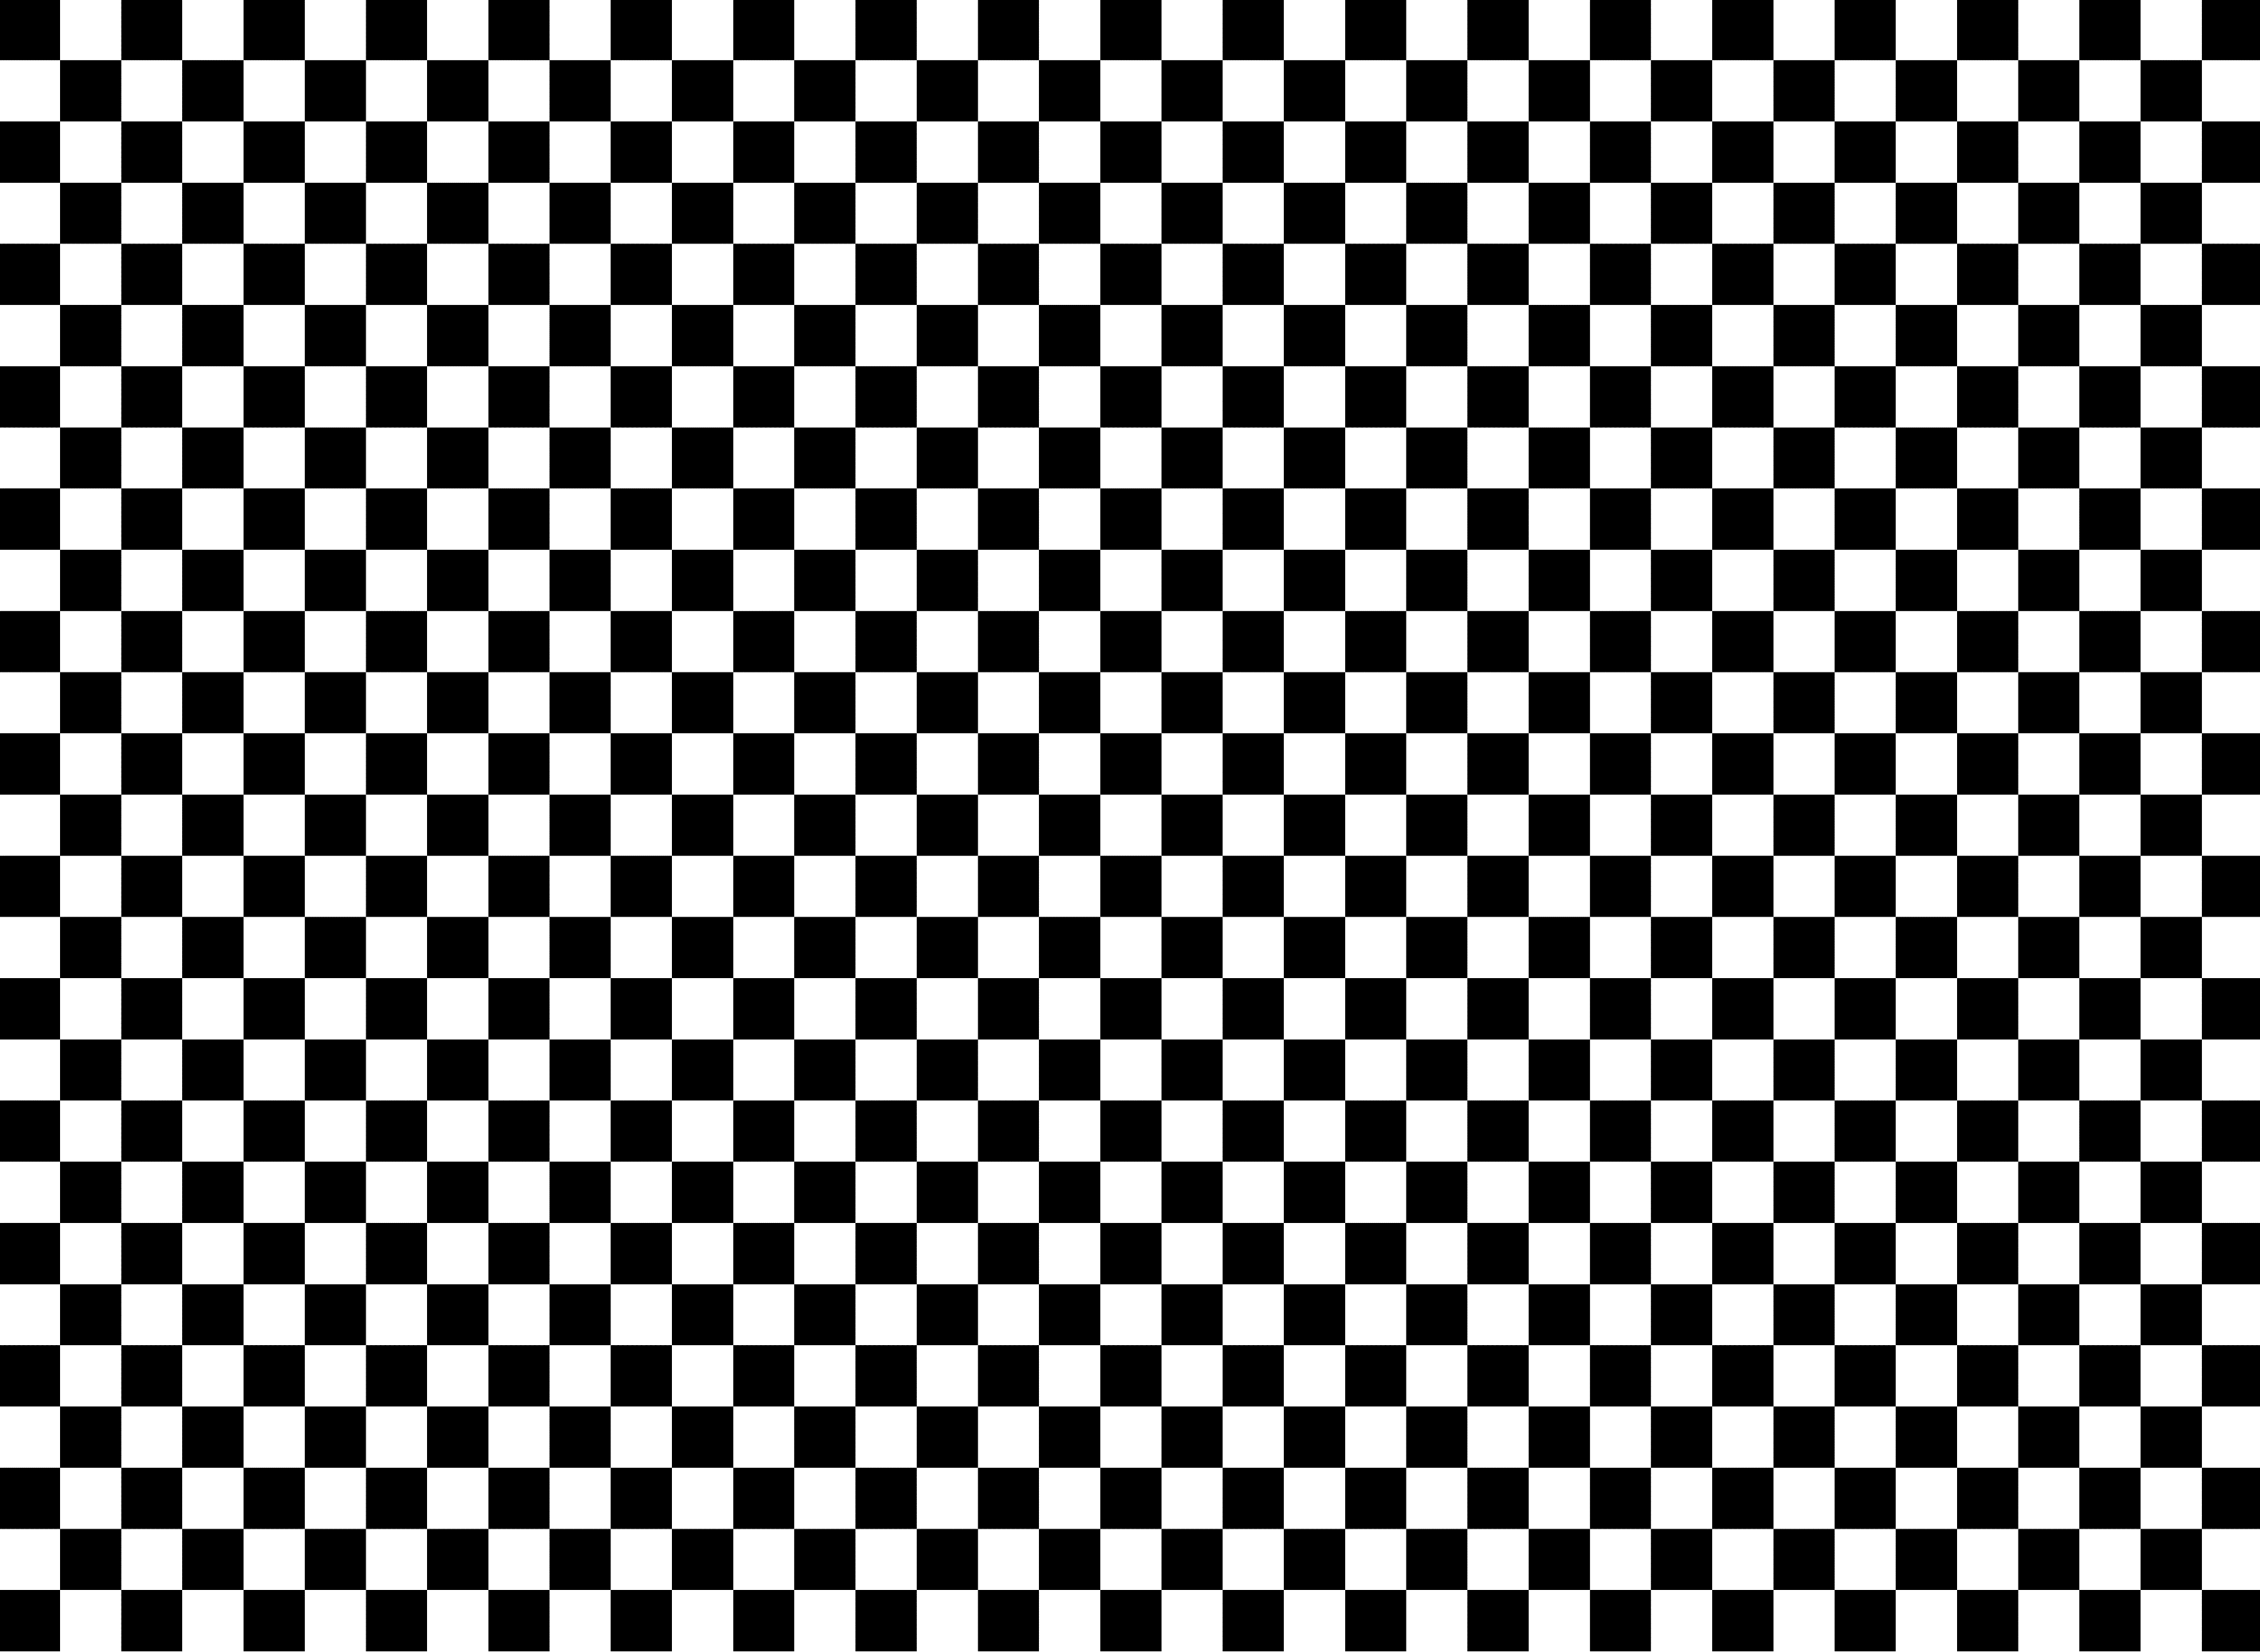
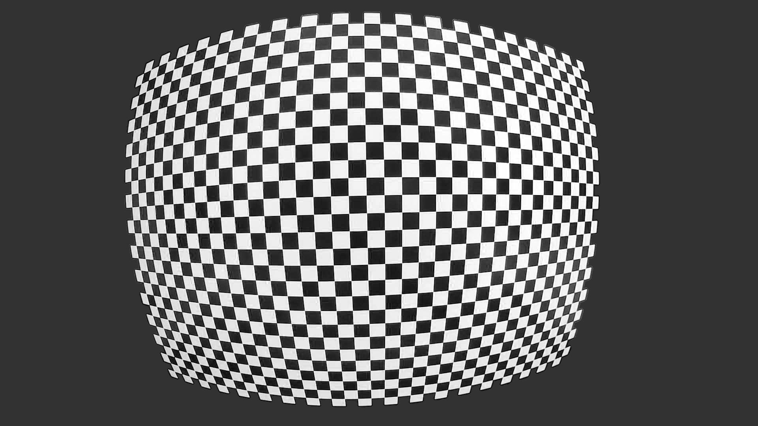

Physical Checkerboard
Resulting Image

Slide 10
Physical Checkerboard
Resulting Image

Slide 11
Physical Checkerboard
Resulting Image

Slide 12
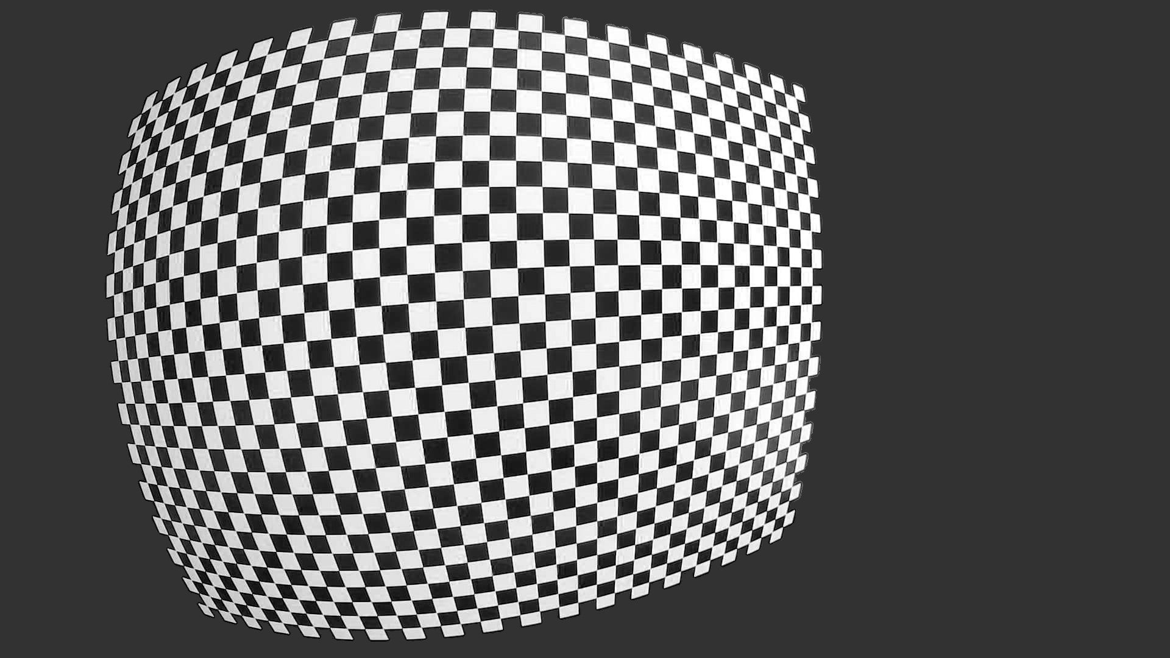
Physical Checkerboard
Resulting Image

Slide 13
Physical Checkerboard
Resulting Image

Slide 14
Physical Checkerboard
Resulting Image

Slide 15
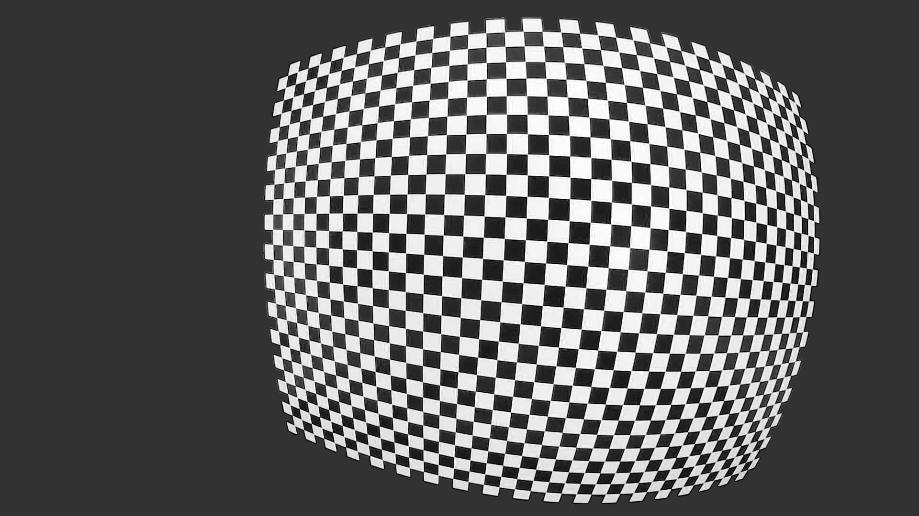
Physical Checkerboard
Resulting Image

Slide 16
Physical Checkerboard
Resulting Image

Slide 17
Physical Checkerboard
Resulting Image

Slide 18
3. Animation showing the accuracy of validation
Series of zooms and camera movements showing how images are captured

Slide 19

Example Validation Setup
14 meters
7 meters
14 meters
*0.15% Error Corresponds to 10.5mm Difference Between Measured and Model Distance at 7.000m!
Example: 7.000m Measured and 7.0105m Model is 0.15% Measurement Error

Slide 20
Example Validation Setup
14 meters
7 meters
14 meters
*0.15% Error Corresponds to 10.5mm Difference Between Measured and Model Distance at 7.000m!
Example: 7.000m Measured and 7.0105m Model is 0.15% Measurement Error

Slide 21
Efovee Error is 0.15%!

Slide 22
Zoom out
14 meters
7 meters
14 meters

Slide 23
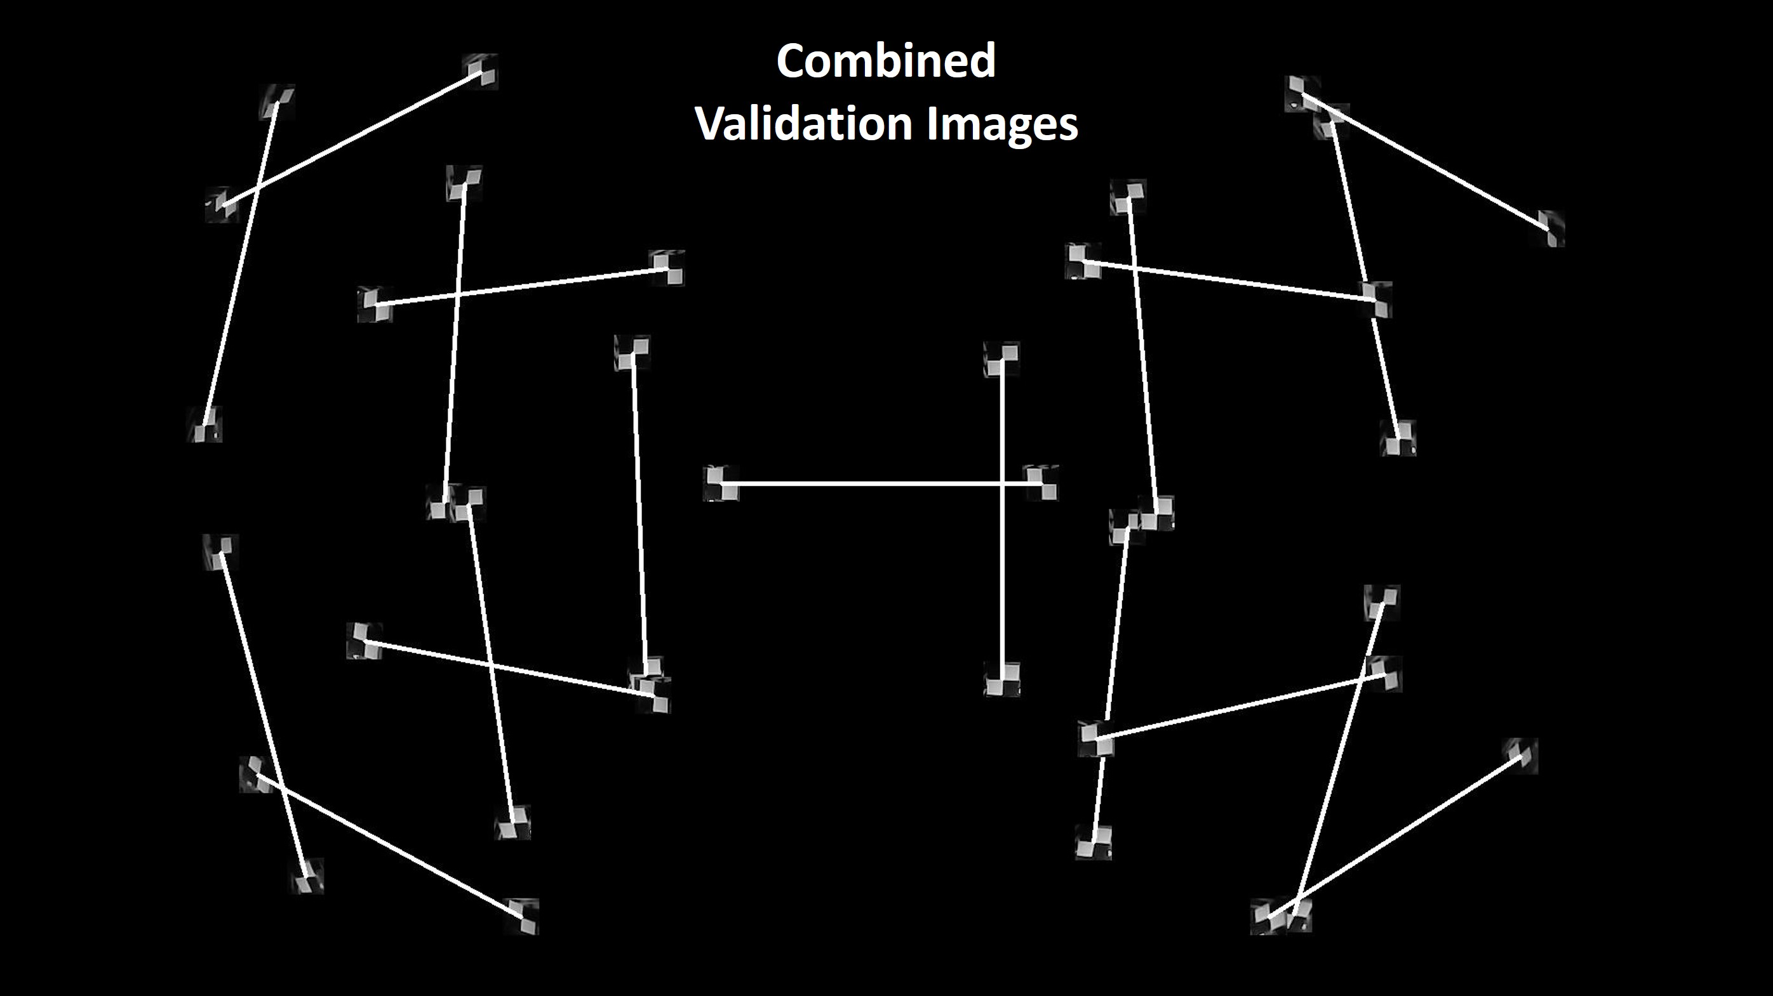
14 meters
7.002 meters
14 meters
Actual Distance: 7.000 meters

Slide 24
14 meters
14 meters
7.008 meters
Actual Distance: 7.000 meters

Slide 25
14 meters
6.997 meters
14 meters
Actual Distance: 7.000 meters

Slide 26
14 meters
14 meters
7.004 meters
Actual Distance: 7.000 meters

Slide 27
14 meters
14 meters
7.007 meters
Actual Distance: 7.000 meters

Slide 28
14 meters
14 meters
6.990 meters
Actual Distance: 7.000 meters

Slide 29
14 meters
14 meters
6.991 meters
Actual Distance: 7.000 meters

Slide 30
14 meters
14 meters
7.001 meters
Actual Distance: 7.000 meters

Slide 31
14 meters
7.004 meters
14 meters
Actual Distance: 7.000 meters

Slide 32
14 meters
14 meters
6.992 meters
Actual Distance: 7.000 meters

Slide 33
6.998 meters
14 meters
14 meters
Actual Distance: 7.000 meters

Slide 34
14 meters
14 meters
Actual Distance: 7.000 meters
6.990 meters

Slide 35
14 meters
7.003 meters
14 meters
Actual Distance: 7.000 meters

Slide 36
14 meters
14 meters
7.000 meters
Actual Distance: 7.000 meters

Slide 37
14 meters
14 meters
7.002 meters
Actual Distance: 7.000 meters

Slide 38
14 meters
6.995 meters
14 meters
Actual Distance: 7.000 meters

Slide 39
14 meters
14 meters
6.996 meters
Actual Distance: 7.000 meters

Slide 40
6.999 meters
14 meters
14 meters
Actual Distance: 7.000 meters

Slide 41
14 meters
14 meters
6.992 meters
Actual Distance: 7.000 meters

