Slide 1
Detected Points
Reprojected Points

Slide 2
OpenCV
Efovee

Slide 3

Example Validation Setup

Slide 4
Triangulation Accuracy Test
14 meters
7 meters
14 meters
Efovee calibrations measures the target between distance with an accuracy less than 11mm at this range!

Slide 5
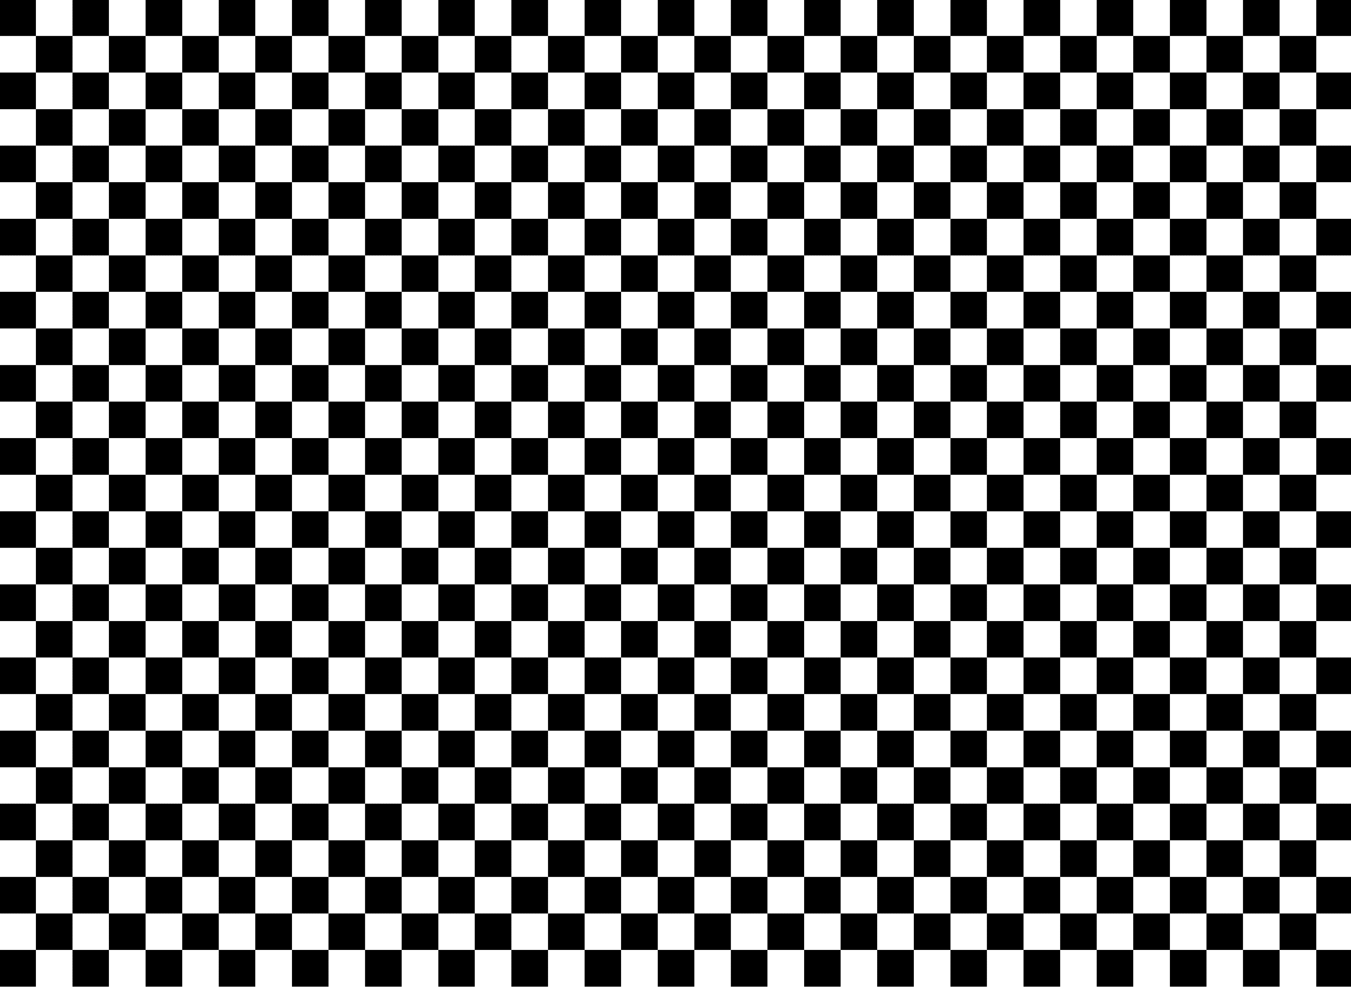
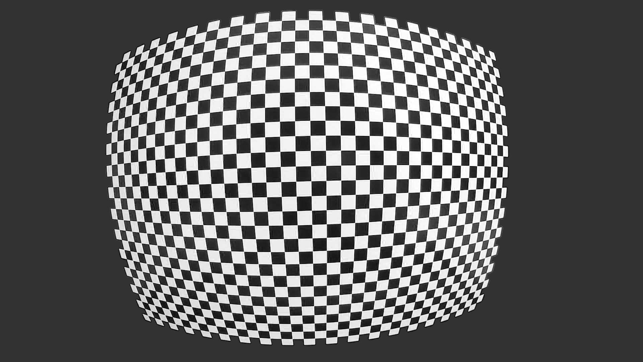

Example Capture Plan

Slide 6

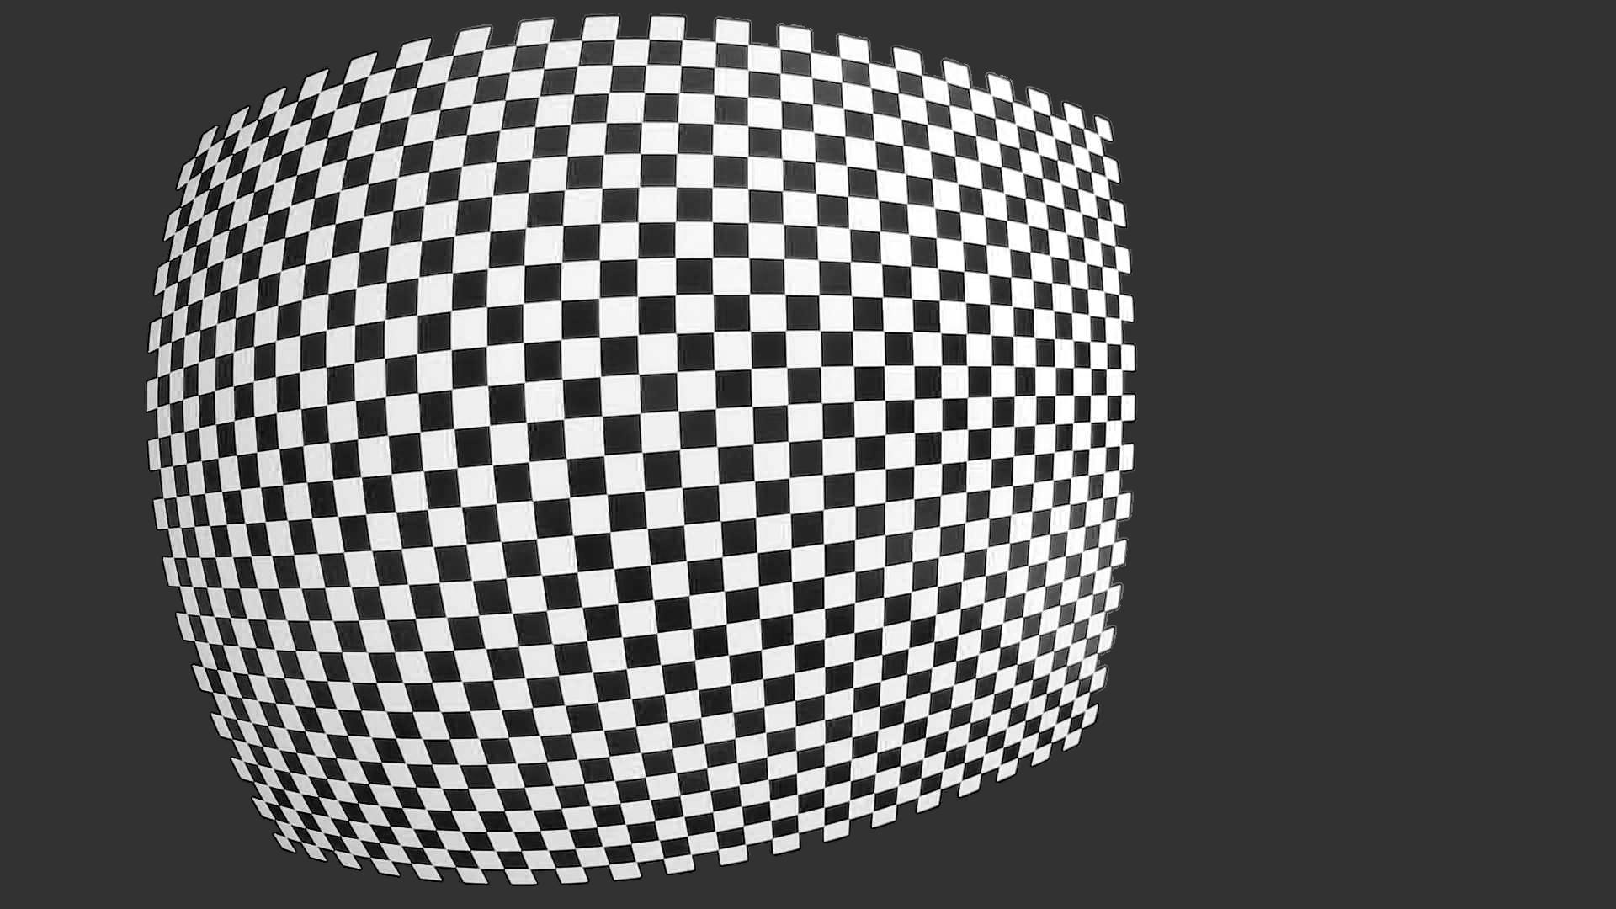
Example Capture Plan

Slide 7
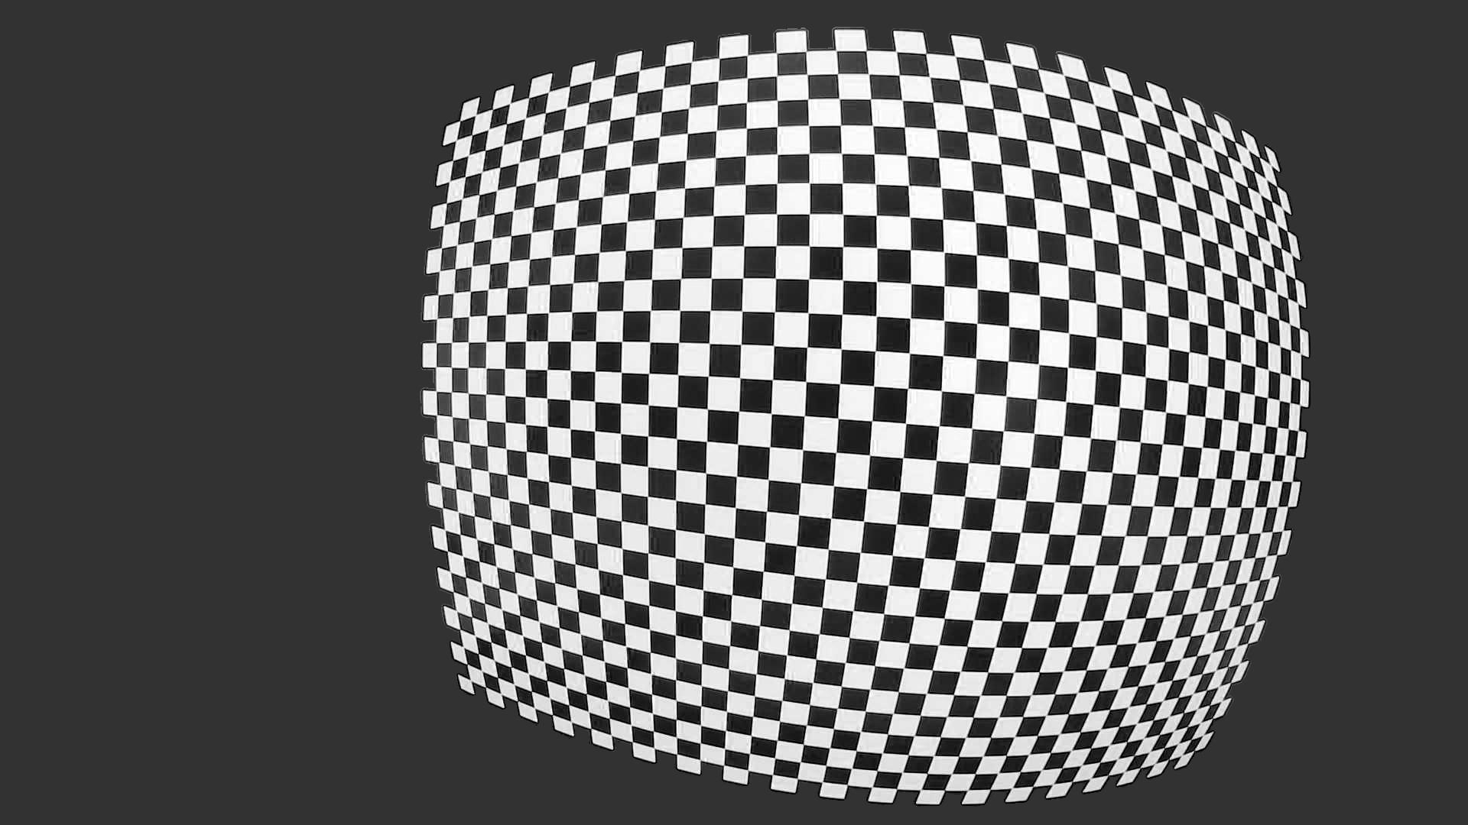
Example Capture Plan

