Slide 1
PHM Technology Development in IoT Device
Eunsong Sim
Jaesung An
Jaehyun Kwon
Taehoon Yu

Slide 2
INDEX
1
2
3
4
What is PHM?
Application field
Effection
Schedule

Slide 3

PHM (Prognostics and Health Management)
1980s
1990s
Nowdays~
Corrective Maintenance
Preventive Maintenance
Predictive Maintenance
“PHM”

Slide 4
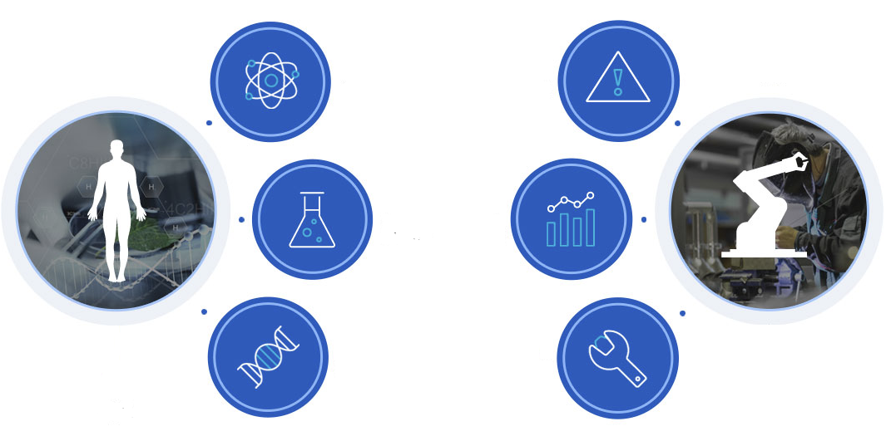

PHM (Prognostics and Health Management)
Immune System of Human
Diagnosis of industrial facilities

Slide 5
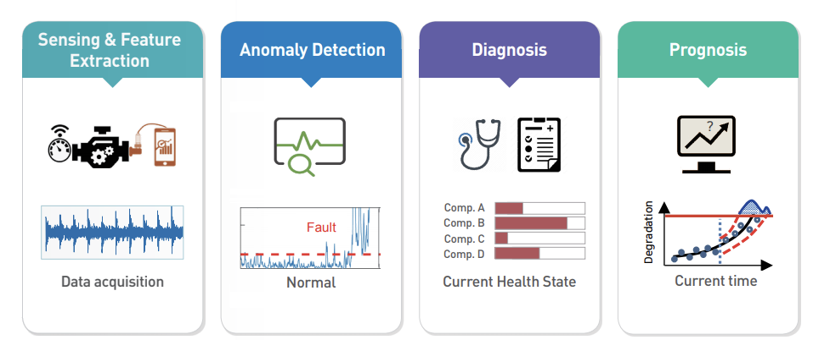
Steps of PHM
RUL(Remaining Useful Life)

Slide 6


Application field

Slide 7
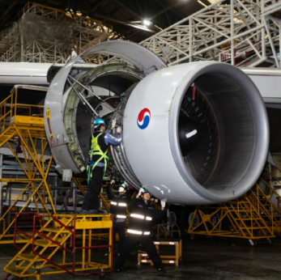
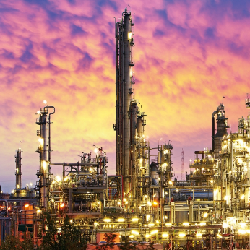
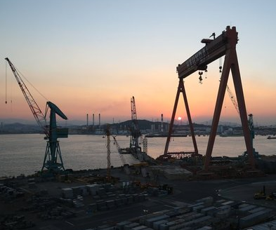
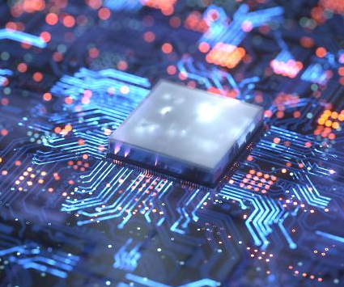
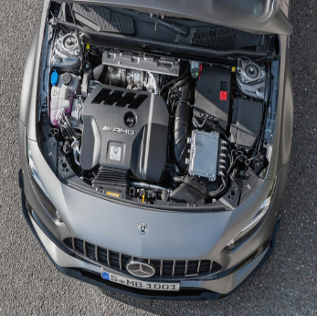
Application field
Aviation
Plant
Heavy Industry
Semiconductor
Car Engine

Slide 8

Effection
Comprehensive Optimization
Reliability
Performance
Cost
Safety
Emission

Slide 9
Schedule
Application Device & Data Selection
Material purchase
Data Analysis
GUI Development
APR
JUN
MAR
MAY
Data Collection
Writing Report
Final announcement

Slide 10
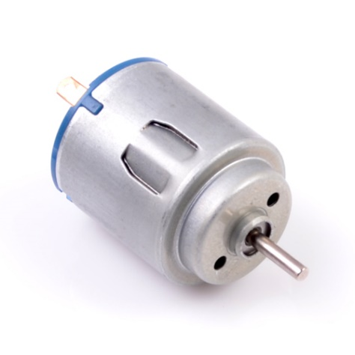
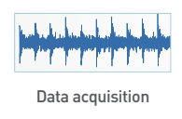


Schedule
Application Device & Data Selection
Data Collection
Factors
-Electric current
-Voltage
-Temperature
-Vibration
-Noise
Motor

Slide 11
Thank you

