Slide 1
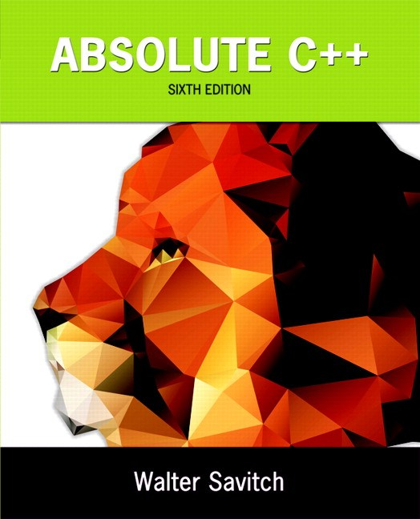
Chapter 10
Pointers and Dynamic Arrays
Copyright © 2016 Pearson, Inc. All rights reserved.

Slide 2
Learning Objectives
Pointers
Pointer variables
Memory management
Dynamic Arrays
Creating and using
Pointer arithmetic
Classes, Pointers, Dynamic Arrays
The this pointer
Destructors, copy constructors

Slide 3
Pointer Introduction
Pointer definition:
Memory address of a variable
Recall: memory divided
Numbered memory locations
Addresses used as name for variable
You’ve used pointers already!
Call-by-reference parameters
Address of actual argument was passed

Slide 4
Pointer Variables
Pointers are "typed"
Can store pointer in variable
Not int, double, etc.
Instead: A POINTER to int, double, etc.!
Example: double *p;
p is declared a "pointer to double" variable
Can hold pointers to variables of type double
Not other types! (unless typecast, but could be dangerous)

Slide 5
Declaring Pointer Variables
Pointers declared like other types
Add "*" before variable name
Produces "pointer to" that type
"*" must be before each variable
int *p1, *p2, v1, v2;
p1, p2 hold pointers to int variables
v1, v2 are ordinary int variables

Slide 6
Addresses and Numbers
Pointer is an address
Address is an integer
Pointer is NOT an integer!
Not crazy → abstraction!
C++ forces pointers be used as addresses
Cannot be used as numbers
Even though it "is a" number

Slide 7
Pointing
Terminology, view
Talk of "pointing", not "addresses"
Pointer variable "points to" ordinary variable
Leave "address" talk out
Makes visualization clearer
"See" memory references
Arrows

Slide 8
Pointing to …
int *p1, *p2, v1, v2; p1 = &v1;
Sets pointer variable p1 to "point to" int variable v1
Operator, &
Determines "address of" variable
Read like:
"p1 equals address of v1"
Or "p1 points to v1"

Slide 9
Pointing to …
Recall: int *p1, *p2, v1, v2; p1 = &v1;
Two ways to refer to v1 now:
Variable v1 itself: cout << v1;
Via pointer p1: cout *p1;
Dereference operator, *
Pointer variable "derereferenced"
Means: "Get data that p1 points to"

Slide 10
"Pointing to" Example
Consider: v1 = 0; p1 = &v1; *p1 = 42; cout << v1 << endl; cout << *p1 << endl;
Produces output: 42 42
p1 and v1 refer to same variable

Slide 11
& Operator
The "address of" operator
Also used to specify call-by-reference parameter
No coincidence!
Recall: call-by-reference parameters pass "address of" the actual argument
Operator’s two uses are closely related

Slide 12
Pointer Assignments
Pointer variables can be "assigned": int *p1, *p2; p2 = p1;
Assigns one pointer to another
"Make p2 point to where p1 points"
Do not confuse with: *p1 = *p2;
Assigns "value pointed to" by p1, to "value pointed to" by p2

Slide 13
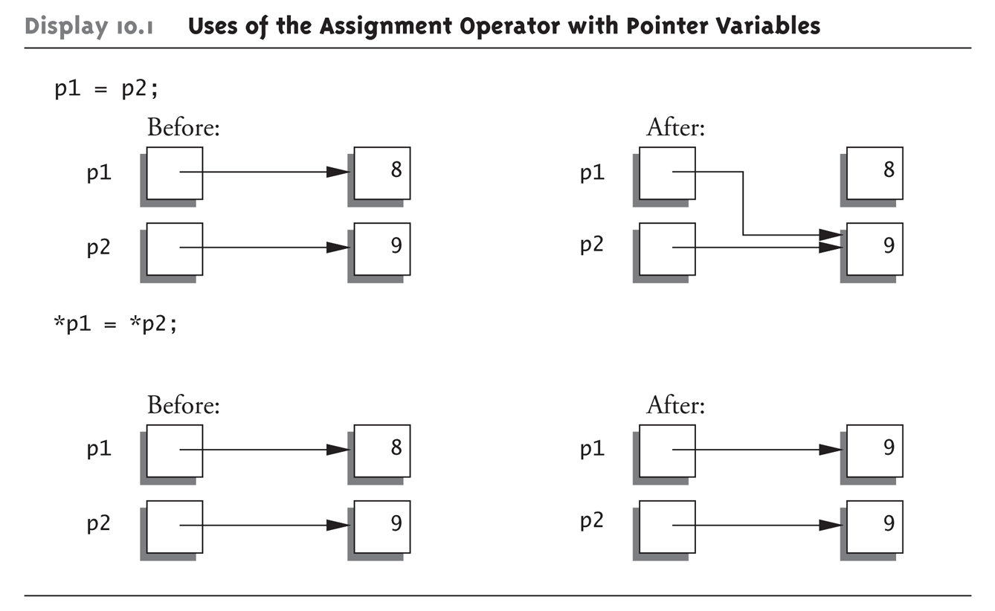
Pointer Assignments Graphic: Display 10.1 Uses of the Assignment Operator with Pointer Variables

Slide 14
The new Operator
Since pointers can refer to variables…
No "real" need to have a standard identifier
Can dynamically allocate variables
Operator new creates variables
No identifiers to refer to them
Just a pointer!
p1 = new int;
Creates new "nameless" variable, and assigns p1 to "point to" it
Can access with *p1
Use just like ordinary variable

Slide 15
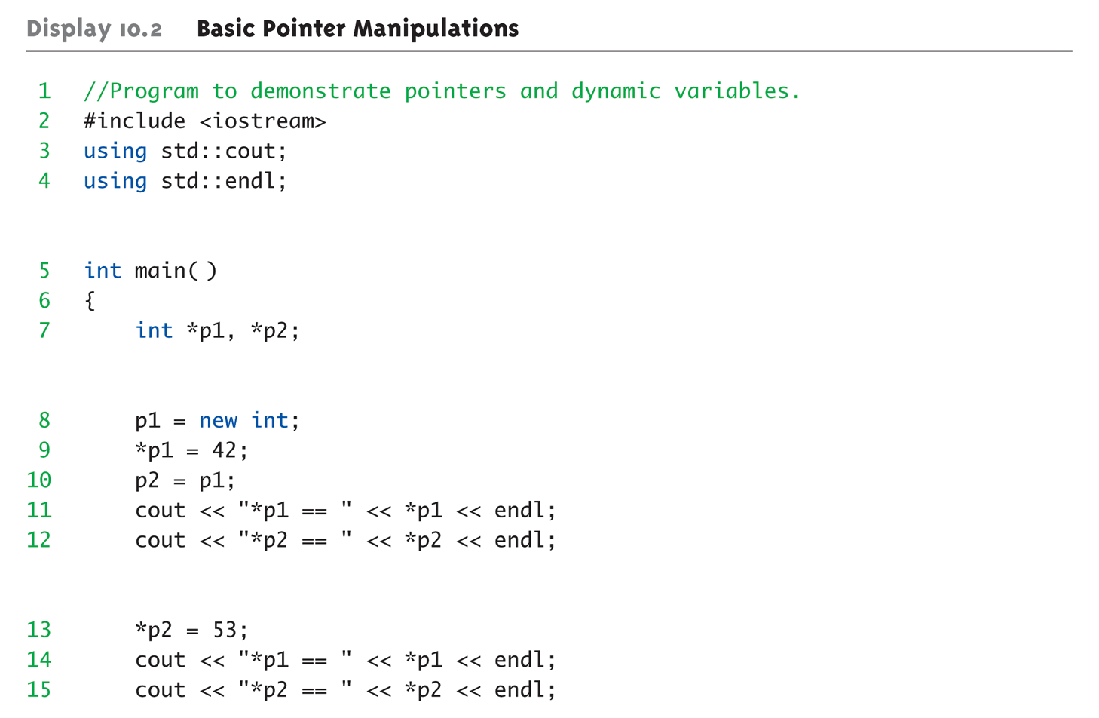
Basic Pointer Manipulations Example: Display 10.2 Basic Pointer Manipulations (1 of 2)

Slide 16
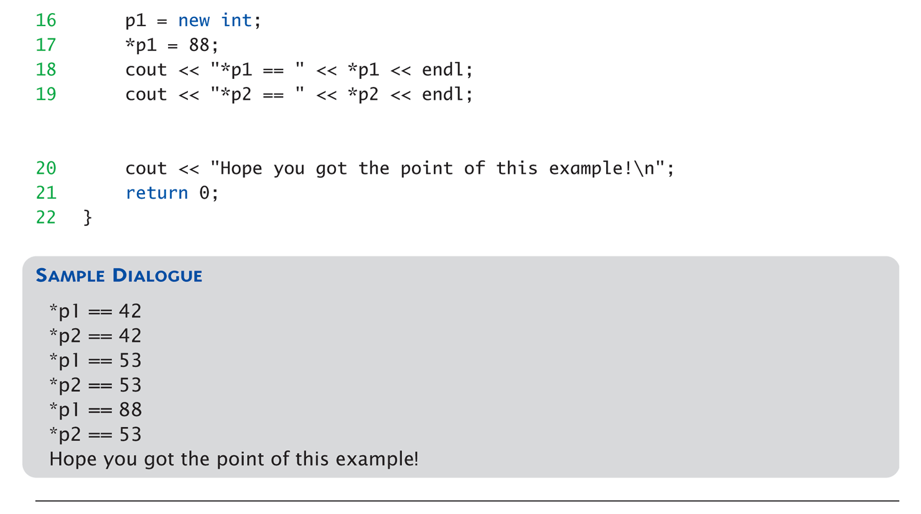
Basic Pointer Manipulations Example: Display 10.2 Basic Pointer Manipulations (2 of 2)

Slide 17
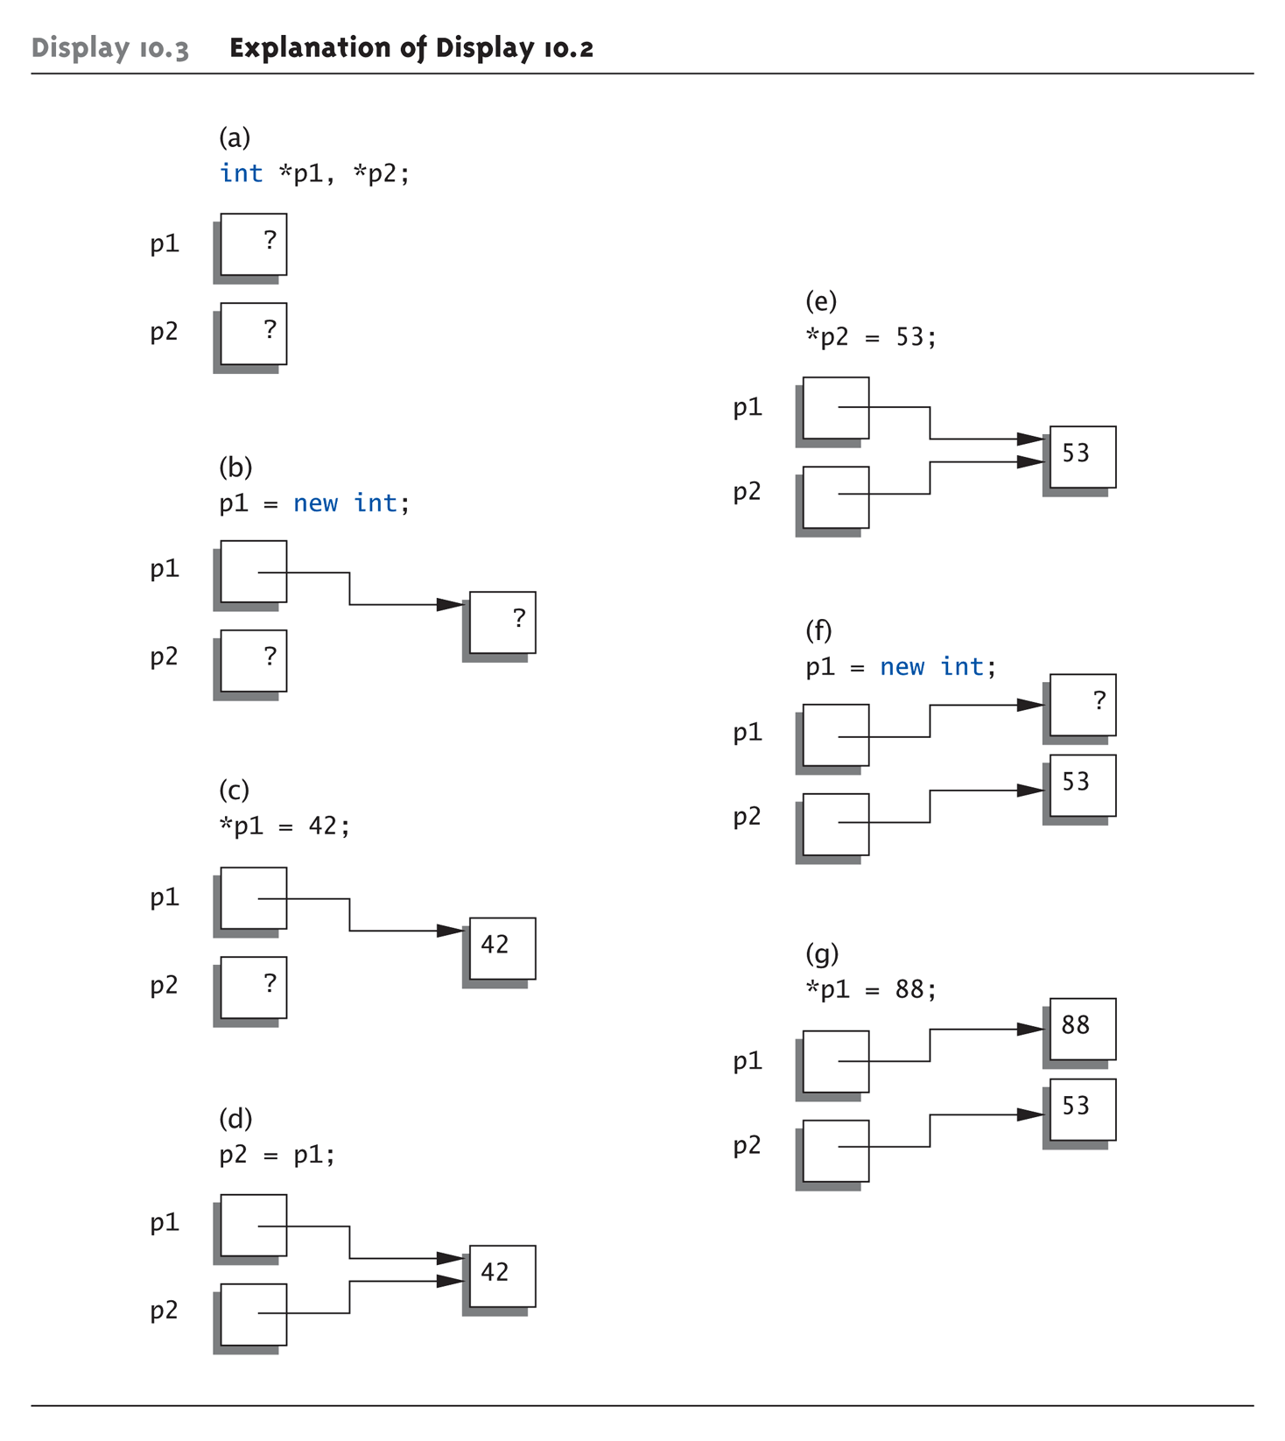
Basic Pointer Manipulations Graphic: Display 10.3 Explanation of Display 10.2

Slide 18
More on new Operator
Creates new dynamic variable
Returns pointer to the new variable
If type is class type:
Constructor is called for new object
Can invoke different constructor with initializer arguments: MyClass *mcPtr; mcPtr = new MyClass(32.0, 17);
Can still initialize non-class types: int *n; n = new int(17); //Initializes *n to 17

Slide 19
Pointers and Functions
Pointers are full-fledged types
Can be used just like other types
Can be function parameters
Can be returned from functions
Example: int* findOtherPointer(int* p);
This function declaration:
Has "pointer to an int" parameter
Returns "pointer to an int" variable

Slide 20
Memory Management
Heap
Also called "freestore"
Reserved for dynamically-allocated variables
All new dynamic variables consume memory in freestore
If too many → could use all freestore memory
Future "new" operations will fail if freestore is "full"

Slide 21
Checking new Success
Older compilers:
Test if null returned by call to new: int *p; p = new int; if (p == NULL) // NULL represents empty pointer { cout << "Error: Insufficient memory.\n"; exit(1); }
If new succeeded, program continues

Slide 22
new Success – New Compiler
Newer compilers:
If new operation fails:
Program terminates automatically
Produces error message
Still good practice to use NULL check
NULL represents the empty pointer or a pointer to nothing and will be used later to mark the end of a list

Slide 23
C++11 nullptr
NULL is actually the number 0 and can lead to ambiguity
Which func is invoked given func(NULL)? Both are equally valid since NULL is 0
C++11 resolves this problem by introducing a new constant, nullptr
nullptr is not 0
Can use anywhere you could use NULL
void func(int *p); void func(int i);

Slide 24
Freestore Size
Varies with implementations
Typically large
Most programs won’t use all memory
Memory management
Still good practice
Solid software engineering principle
Memory IS finite
Regardless of how much there is!

Slide 25
delete Operator
De-allocate dynamic memory
When no longer needed
Returns memory to freestore
Example: int *p; p = new int(5); … //Some processing… delete p;
De-allocates dynamic memory "pointed to by pointer p"
Literally "destroys" memory

Slide 26
Dangling Pointers
delete p;
Destroys dynamic memory
But p still points there!
Called "dangling pointer"
If p is then dereferenced ( *p )
Unpredicatable results!
Often disastrous!
Avoid dangling pointers
Assign pointer to NULL after delete: delete p; p = NULL;

Slide 27
Dynamic and Automatic Variables
Dynamic variables
Created with new operator
Created and destroyed while program runs
Local variables
Declared within function definition
Not dynamic
Created when function is called
Destroyed when function call completes
Often called "automatic" variables
Properties controlled for you

Slide 28
Define Pointer Types
Can "name" pointer types
To be able to declare pointers like other variables
Eliminate need for "*" in pointer declaration
typedef int* IntPtr;
Defines a "new type" alias
Consider these declarations: IntPtr p; int *p;
The two are equivalent

Slide 29
Pitfall: Call-by-value Pointers
Behavior subtle and troublesome
If function changes pointer parameter itself → only change is to local copy
Best illustrated with example…

Slide 30
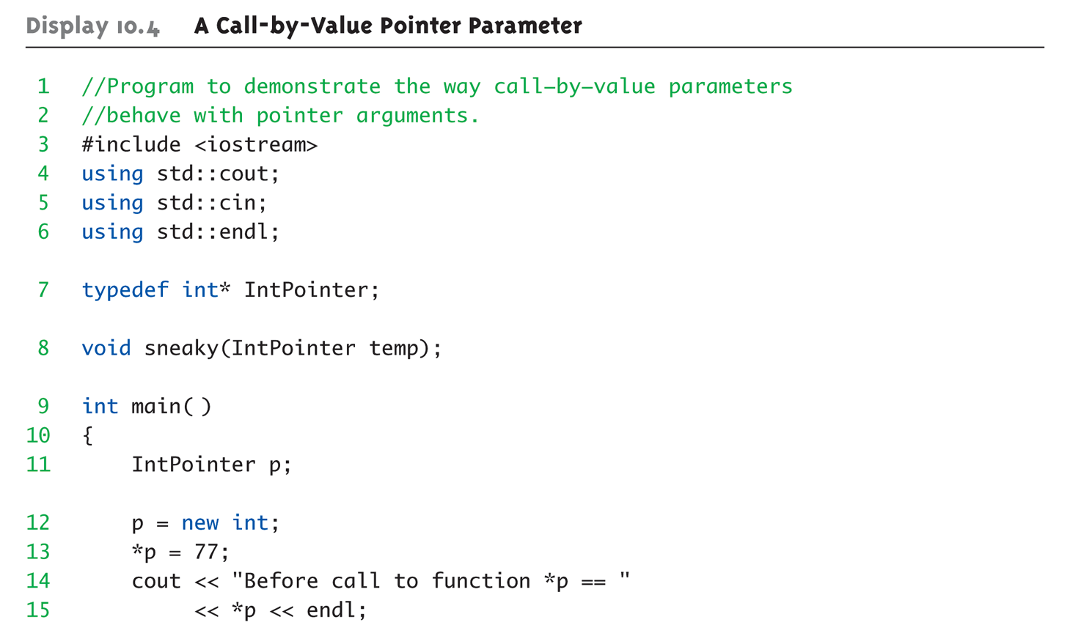
Call-by-value Pointers Example: Display 10.4 A Call-by-Value Pointer Parameter (1 of 2)

Slide 31
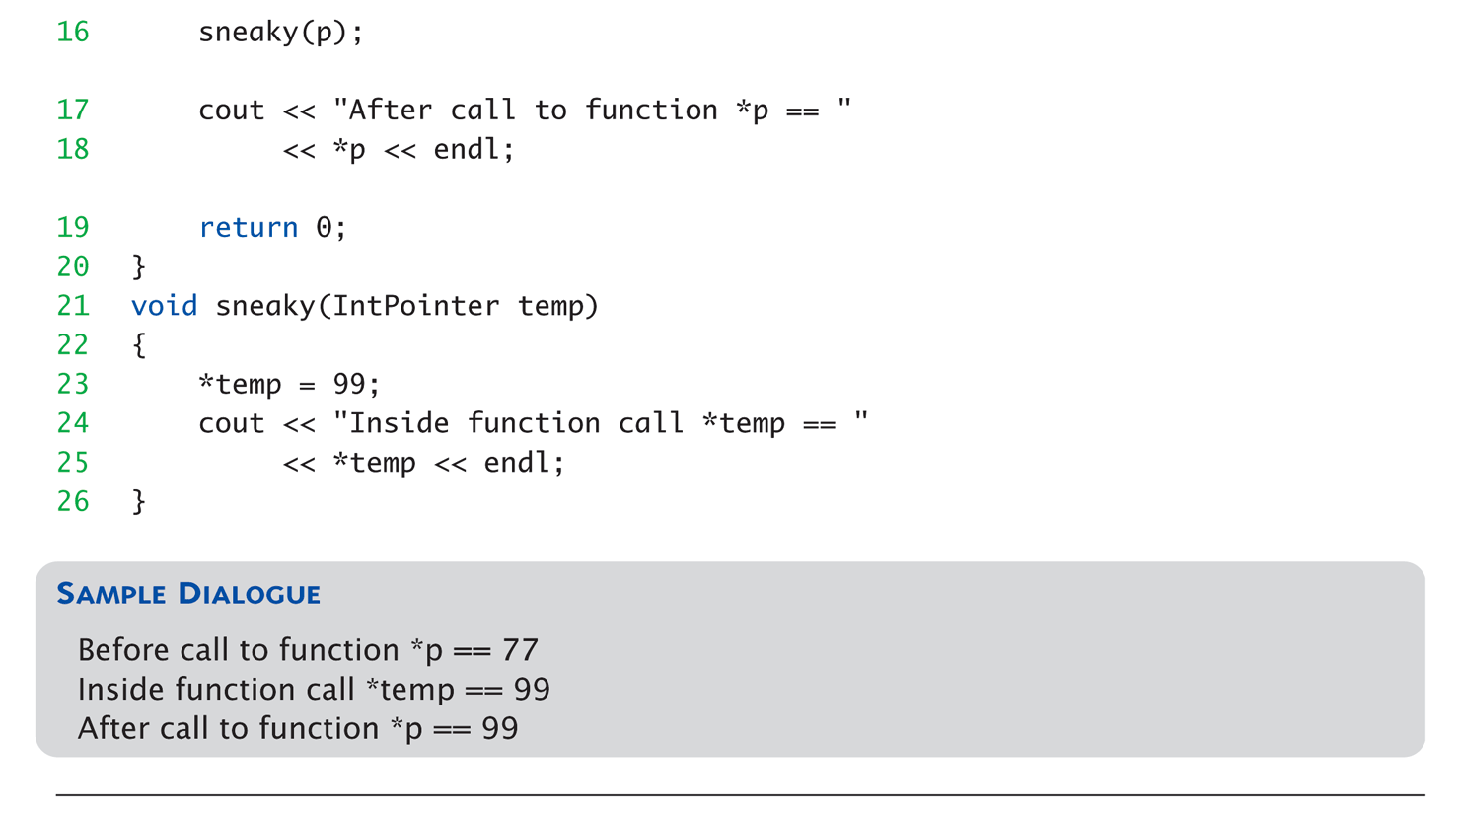
Call-by-value Pointers Example: Display 10.4 A Call-by-Value Pointer Parameter (2 of 2)

Slide 32
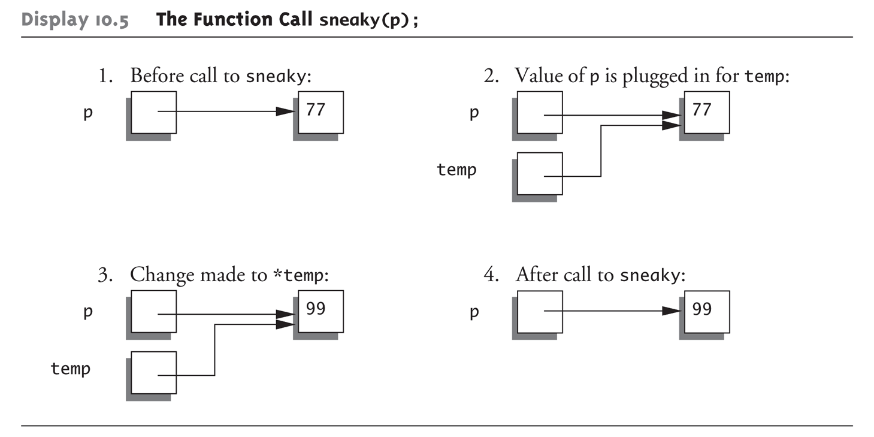
Call-by-value Pointers Graphic: Display 10.5 The Function Call sneaky(p);

Slide 33
Dynamic Arrays
Array variables
Really pointer variables!
Standard array
Fixed size
Dynamic array
Size not specified at programming time
Determined while program running

Slide 34
Array Variables
Recall: arrays stored in memory addresses, sequentially
Array variable "refers to" first indexed variable
So array variable is a kind of pointer variable!
Example: int a[10]; int * p;
a and p are both pointer variables!

Slide 35
Array Variables → Pointers
Recall previous example: int a[10]; typedef int* IntPtr; IntPtr p;
a and p are pointer variables
Can perform assignments: p = a; // Legal.
p now points where a points
To first indexed variable of array a
a = p; // ILLEGAL!
Array pointer is CONSTANT pointer!

Slide 36
Array Variables → Pointers
Array variable int a[10];
MORE than a pointer variable
"const int *" type
Array was allocated in memory already
Variable a MUST point there…always!
Cannot be changed!
In contrast to ordinary pointers
Which can (& typically do) change

Slide 37
Dynamic Arrays
Array limitations
Must specify size first
May not know until program runs!
Must "estimate" maximum size needed
Sometimes OK, sometimes not
"Wastes" memory
Dynamic arrays
Can grow and shrink as needed

Slide 38
Creating Dynamic Arrays
Very simple!
Use new operator
Dynamically allocate with pointer variable
Treat like standard arrays
Example: typedef double * DoublePtr; DoublePtr d; d = new double[10]; //Size in brackets
Creates dynamically allocated array variable d, with ten elements, base type double

Slide 39
Deleting Dynamic Arrays
Allocated dynamically at run-time
So should be destroyed at run-time
Simple again. Recall Example: d = new double[10]; … //Processing delete [] d;
De-allocates all memory for dynamic array
Brackets indicate "array" is there
Recall: d still points there!
Should set d = NULL;

Slide 40
Function that Returns an Array
Array type NOT allowed as return-type of function
Example: int [] someFunction(); // ILLEGAL!
Instead return pointer to array base type: int* someFunction(); // LEGAL!

Slide 41
Pointer Arithmetic
Can perform arithmetic on pointers
"Address" arithmetic
Example: typedef double* DoublePtr; DoublePtr d; d = new double[10];
d contains address of d[0]
d + 1 evaluates to address of d[1]
d + 2 evaluates to address of d[2]
Equates to "address" at these locations

Slide 42
Alternative Array Manipulation
Use pointer arithmetic!
"Step thru" array without indexing: for (int i = 0; i < arraySize; i++) cout << *(d + I) << " " ;
Equivalent to: for (int i = 0; i < arraySize; i++) cout << d[I] << " " ;
Only addition/subtraction on pointers
No multiplication, division
Can use ++ and -- on pointers

Slide 43
Multidimensional Dynamic Arrays
Yes we can!
Recall: "arrays of arrays"
Type definitions help "see it": typedef int* IntArrayPtr; IntArrayPtr *m = new IntArrayPtr[3];
Creates array of three pointers
Make each allocate array of 4 ints
for (int i = 0; i < 3; i++) m[i] = new int[4];
Results in three-by-four dynamic array!

Slide 44
Back to Classes
The -> operator
Shorthand notation
Combines dereference operator, *, and dot operator
Specifies member of class "pointed to" by given pointer
Example: MyClass *p; p = new MyClass; p->grade = "A"; Equivalent to: (*p).grade = "A";

Slide 45
The this Pointer
Member function definitions might need to refer to calling object
Use predefined this pointer
Automatically points to calling object: Class Simple { public: void showStuff() const; private: int stuff; };
Two ways for member functions to access: cout << stuff; cout << this->stuff;

Slide 46
Overloading Assignment Operator
Assignment operator returns reference
So assignment "chains" are possible
e.g., a = b = c;
Sets a and b equal to c
Operator must return "same type" as it’s left-hand side
To allow chains to work
The this pointer will help with this!

Slide 47
Overloading Assignment Operator
Recall: Assignment operator must be member of the class
It has one parameter
Left-operand is calling object s1 = s2;
Think of like: s1.=(s2);
s1 = s2 = s3;
Requires (s1 = s2) = s3;
So (s1 = s2) must return object of s1"s type
And pass to " = s3";

Slide 48
Overloaded = Operator Definition
Uses string Class example: StringClass& StringClass::operator=(const StringClass& rtSide) { if (this == &rtSide) // if right side same as left side return *this; else { capacity = rtSide.length; length length = rtSide.length; delete [] a; a = new char[capacity]; for (int I = 0; I < length; I++) a[I] = rtSide.a[I]; return *this; } }

Slide 49
Shallow and Deep Copies
Shallow copy
Assignment copies only member variable contents over
Default assignment and copy constructors
Deep copy
Pointers, dynamic memory involved
Must dereference pointer variables to "get to" data for copying
Write your own assignment overload and copy constructor in this case!

Slide 50
Destructor Need
Dynamically-allocated variables
Do not go away until "deleted"
If pointers are only private member data
They dynamically allocate "real" data
In constructor
Must have means to "deallocate" when object is destroyed
Answer: destructor!

Slide 51
Destructors
Opposite of constructor
Automatically called when object is out-of-scope
Default version only removes ordinary variables, not dynamic variables
Defined like constructor, just add ~
MyClass::~MyClass() { //Perform delete clean-up duties }

Slide 52
Copy Constructors
Automatically called when:
Class object declared and initialized to other object
When function returns class type object
When argument of class type is "plugged in" as actual argument to call-by-value parameter
Requires "temporary copy" of object
Copy constructor creates it
Default copy constructor
Like default "=", performs member-wise copy
Pointers → write own copy constructor!

Slide 53
Summary 1
Pointer is memory address
Provides indirect reference to variable
Dynamic variables
Created and destroyed while program runs
Freestore
Memory storage for dynamic variables
Dynamically allocated arrays
Size determined as program runs

Slide 54
Summary 2
Class destructor
Special member function
Automatically destroys objects
Copy constructor
Single argument member function
Called automatically when temp copy needed
Assignment operator
Must be overloaded as member function
Returns reference for chaining

