Slide 1

Chapter 11
Separate Compilation and Namespaces
Copyright © 2016 Pearson, Inc. All rights reserved.

Slide 2
Learning Objectives
Separate Compilation
Encapsulation reviewed
Header and implementation files
Namespaces
using directives
Qualifying names
Unnamed namespaces
Hiding helping functions
Nested namespaces

Slide 3
Separate Compilation
Program Parts
Kept in separate files
Compiled separately
Linked together before program runs
Class definitions
Separate from "using" programs
Build library of classes
Re-used by many different programs
Just like predefined libraries

Slide 4
Class Separation
Class Independence
Separate class definition/specification
Called "interface"
Separate class implementation
Place in two files
If implementation changes → only that file need be changed
Class specification need not change
"User" programs need not change

Slide 5
Encapsulation Reviewed
Encapsulation principle:
Separate how class is used by programmer from details of class’s implementation
"Complete" separation
Change to implementation → NO impact on any other programs
Basic OOP principle

Slide 6
Encapsulation Rules
Rules to ensure separation:
All member variables should be private
Basic class operations should be:
Public member functions
Friend or ordinary functions
Overloaded operators
Group class definition and prototypes together
Called "interface" for class
Make class implementation unavailable to users of class

Slide 7
More Class Separation
Interface File
Contains class definition with function and operator declarations/prototypes
Users "see" this
Separate compilation unit
Implementation File
Contains member function definitions
Separate compilation unit

Slide 8
Class Header Files
Class interface always in header file
Use .h naming convention
Programs that use class will "include" it
#include "myclass.h"
Quotes indicate you wrote header
Find it in "your" working directory
Recall library includes, e.g., <iostream>
< > indicate predefined library header file
Find it in library directory

Slide 9
Class Implementation Files
Class implementation in .cpp file
Typically give interface file and implementation file same name
myclass.h and myclass.cpp
All class’s member function defined here
Implementation file must #include class’s header file
.cpp files in general, typically contain executable code
e.g., Function definitions, including main()

Slide 10
Class Files
Class header file #included by:
Implementation file
Program file
Often called "application file" or "driver file"
Organization of files is system dependent
Typical IDE has "project" or "workspace"
Implementation files "combined" here
Header files still "#included"

Slide 11
Multiple Compiles of Header Files
Header files
Typically included multiple times
e.g., class interface included by class implementation and program file
Must only be compiled once!
No guarantee "which #include" in which file, compiler might see first
Use preprocessor
Tell compiler to include header only once

Slide 12
Using #ifndef
Header file structure:
#ifndef FNAME_H #define FNAME_H … //Contents of header file … #endif
FNAME typically name of file for consistency, readability
This syntax avoids multiple definitions of header file

Slide 13
Other Library Files
Libraries not just for classes
Related functions
Prototypes → header file
Definitions → implementation file
Other type definitions
structs, simple typedefs → header file
Constant declarations → header file

Slide 14
Namespaces
Namespace defined: A collection of name definitions
Class definitions
Variable declarations
Programs use many classes, functions
Commonly have same names
Namespaces deal with this
Can be "on" or "off"
If names might conflict → turn off

Slide 15
using Directive
using namespace std;
Makes all definitions in std namespace available
Why might you NOT want this?
Can make cout, cin have non-standard meaning
Perhaps a need to redefine cout, cin
Can redefine any others

Slide 16
Namespace std
We’ve used namespace std
Contains all names defined in many standard library files
Example: #include <iostream>
Places all name definitions (cin, cout, etc.) into std namespace
Program doesn’t know names
Must specify this namespace for program to access names

Slide 17
Global Namespace
All code goes in some namespace
Unless specified → global namespace
No need for using directive
Global namespace always available
Implied "automatic" using directive

Slide 18
Multiple Names
Multiple namespaces
e.g., global, and std typically used
What if name defined in both?
Error
Can still use both namespaces
Must specify which namespace used at what time

Slide 19
Specifying Namespaces
Given namespaces NS1, NS2
Both have void function myFunction() defined differently
{ using namespace NS1; myFunction(); } { using namespace NS2; myFunction(); }
using directive has block-scope

Slide 20
Creating a Namespace
Use namespace grouping: namespace Name_Space_Name { Some_Code }
Places all names defined in Some_Code into namespace Name_Space_Name
Can then be made available: using namespace Name_Space_Name

Slide 21
Creating a Namespace Example
Function declaration: namespace Space1 { void greeting(); }
Function definition: namespace Space1 { void greeting() { cout << "Hello from namespace Space1.\n"; } }

Slide 22
using Declarations
Can specify individual names from namespace
Consider: Namespaces NS1, NS2 exist Each have functions fun1(), fun(2)
Declaration syntax: using Name_Space::One_Name;
Specify which name from each: using NS1::fun1; using NS2::fun2;

Slide 23
using Definitions and Declarations
Differences:
using declaration
Makes ONE name in namespace available
Introduces names so no other uses of name are allowed
using directive
Makes ALL names in namespace available
Only "potentially" introduces names

Slide 24
Qualifying Names
Can specify where name comes from
Use "qualifier" and scope-resolution operator
Used if only intend one use (or few)
NS1::fun1();
Specifies that fun() comes from namespace NS1
Especially useful for parameters: int getInput(std::istream inputStream);
Parameter found in istream’s std namespace
Eliminates need for using directive or declaration

Slide 25
Naming Namespaces
Include unique string
Like last name
Reduces chance of other namespaces with same name
Often multiple programmers write namespaces for same program
Must have distinct names
Without → multiple definitions of same name in same scope
Results in error

Slide 26
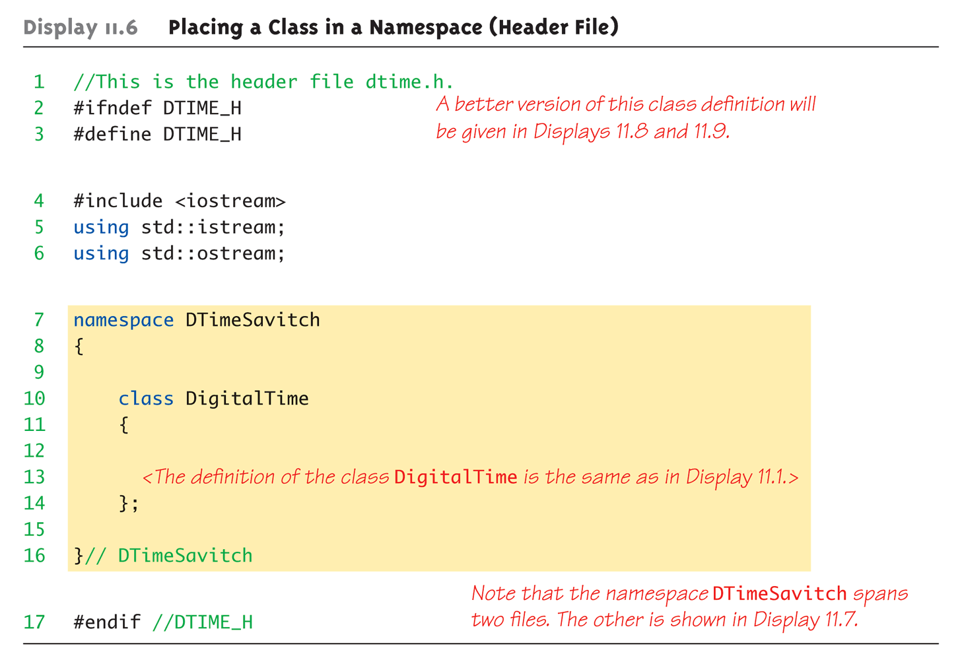
Class Namespace Example: Display 11.6 Placing a Class in a Namespace (Header File)

Slide 27
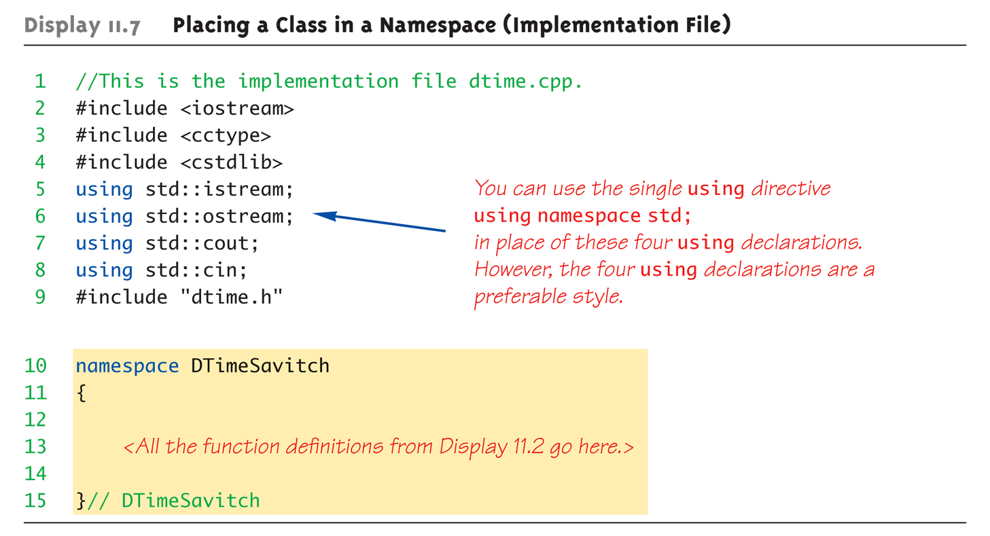
Class Namespace Example: Display 11.7 Placing a Class in a Namespace (Implementation File)

Slide 28
Unnamed Namespaces
Compilation unit defined:
A file, along with all files #included in file
Every compilation unit has unnamed namespace
Written same way, but with no name
All names are then local to compilation unit
Use unnamed namespace to keep things "local"
Scope of unnamed namespace is compilation unit

Slide 29
Global vs. Unnamed Namespaces
Not same
Global namespace:
No namespace grouping at all
Global scope
Unnamed namespace:
Has namespace grouping, just no name
Local scope

Slide 30
Nested Namespaces
Legal to nest namespaces namespace S1 { namespace S2 { void sample() { … } }
Qualify names twice:
S1::S2::sample();

Slide 31
Hiding Helping Functions
Recall helping function:
Low-level utility
Not for public use
Two ways to hide:
Make private member function
If function naturally takes calling object
Place in class implementation’s unnamed namespace!
If function needs no calling object
Makes cleaner code (no qualifiers)

Slide 32
Summary 1
Can separate class definition and implementation → separate files
Separate compilation units
Namespace is a collection of name definitions
Three ways to use name from namespace:
Using directive
Using declaration
Qualifying

Slide 33
Summary 2
Namespace definitions are placed inside namespace groupings
Unnamed namespace
Used for local name definitions
Scope is compilation unit
Global namespace
Items not in a namespace grouping at all
Global scope

