Slide 1
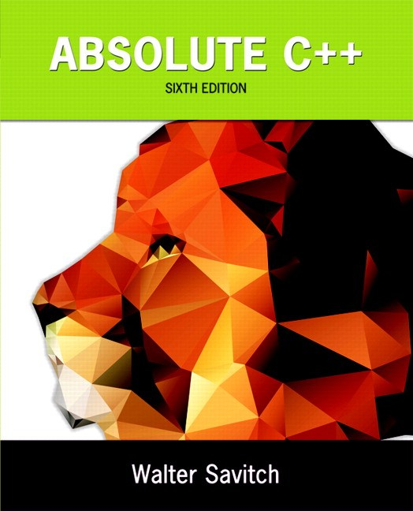
Chapter 13
Recursion
Copyright © 2016 Pearson, Inc. All rights reserved.

Slide 2
Learning Objectives
Recursive void Functions
Tracing recursive calls
Infinite recursion, overflows
Recursive Functions that Return a Value
Powers function
Thinking Recursively
Recursive design techniques
Binary search

Slide 3
Introduction to Recursion
A function that "calls itself"
Said to be recursive
In function definition, call to same function
C++ allows recursion
As do most high-level languages
Can be useful programming technique
Has limitations

Slide 4
Recursive void Functions
Divide and Conquer
Basic design technique
Break large task into subtasks
Subtasks could be smaller versions of the original task!
When they are → recursion

Slide 5
Recursive void Function Example
Consider task:
Search list for a value
Subtask 1: search 1st half of list
Subtask 2: search 2nd half of list
Subtasks are smaller versions of original task!
When this occurs, recursive function can be used.
Usually results in "elegant" solution

Slide 6
Recursive void Function: Vertical Numbers
Task: display digits of number vertically, one per line
Example call: writeVertical(1234); Produces output: 1 2 3 4

Slide 7
Vertical Numbers: Recursive Definition
Break problem into two cases
Simple/base case: if n<10
Simply write number n to screen
Recursive case: if n>=10, two subtasks:
1- Output all digits except last digit
2- Output last digit
Example: argument 1234:
1st subtask displays 1, 2, 3 vertically
2nd subtask displays 4

Slide 8
writeVertical Function Definition
Given previous cases: void writeVertical(int n) { if (n < 10) //Base case cout << n << endl; else { //Recursive step writeVertical(n/10); cout << (n%10) << endl; } }

Slide 9
writeVertical Trace
Example call: writeVertical(123); → writeVertical(12); (123/10) → writeVertical(1); (12/10) → cout << 1 << endl; cout << 2 << endl; cout << 3 << endl;
Arrows indicate task function performs
Notice 1st two calls call again (recursive)
Last call (1) displays and "ends"

Slide 10
Recursion—A Closer Look
Computer tracks recursive calls
Stops current function
Must know results of new recursive call before proceeding
Saves all information needed for current call
To be used later
Proceeds with evaluation of new recursive call
When THAT call is complete, returns to "outer" computation

Slide 11
Recursion Big Picture
Outline of successful recursive function:
One or more cases where function accomplishes it’s task by:
Making one or more recursive calls to solve smaller versions of original task
Called "recursive case(s)"
One or more cases where function accomplishes it’s task without recursive calls
Called "base case(s)" or stopping case(s)

Slide 12
Infinite Recursion
Base case MUST eventually be entered
If it doesn’t → infinite recursion
Recursive calls never end!
Recall writeVertical example:
Base case happened when down to 1-digit number
That’s when recursion stopped

Slide 13
Infinite Recursion Example
Consider alternate function definition: void newWriteVertical(int n) { newWriteVertical(n/10); cout << (n%10) << endl; }
Seems "reasonable" enough
Missing "base case"!
Recursion never stops

Slide 14
Stacks for Recursion
A stack
Specialized memory structure
Like stack of paper
Place new on top
Remove when needed from top
Called "last-in/first-out" memory structure
Recursion uses stacks
Each recursive call placed on stack
When one completes, last call is removed from stack

Slide 15
Stack Overflow
Size of stack limited
Memory is finite
Long chain of recursive calls continually adds to stack
All are added before base case causes removals
If stack attempts to grow beyond limit:
Stack overflow error
Infinite recursion always causes this

Slide 16
Recursion Versus Iteration
Recursion not always "necessary"
Not even allowed in some languages
Any task accomplished with recursion can also be done without it
Nonrecursive: called iterative, using loops
Recursive:
Runs slower, uses more storage
Elegant solution; less coding

Slide 17
Recursive Functions that Return a Value
Recursion not limited to void functions
Can return value of any type
Same technique, outline:
One+ cases where value returned is computed by recursive calls
Should be "smaller" sub-problems
One+ cases where value returned computed without recursive calls
Base case

Slide 18
Return a Value Recursion Example: Powers
Recall predefined function pow(): result = pow(2.0,3.0);
Returns 2 raised to power 3 (8.0)
Takes two double arguments
Returns double value
Let’s write recursively
For simple example

Slide 19
Function Definition for power()
int power(int x, int n) { if (n<0) { cout << "Illegal argument"; exit(1); } if (n>0) return (power(x, n-1)*x); else return (1); }

Slide 20
Calling Function power()
Example calls:
power(2, 0); → returns 1
power(2, 1); → returns (power(2, 0) * 2); → returns 1
Value 1 multiplied by 2 & returned to original call

Slide 21
Calling Function power()
Larger example: power(2,3); → power(2,2)*2 → power(2,1)*2 →power(2,0)*2 →1
Reaches base case
Recursion stops
Values "returned back" up stack

Slide 22
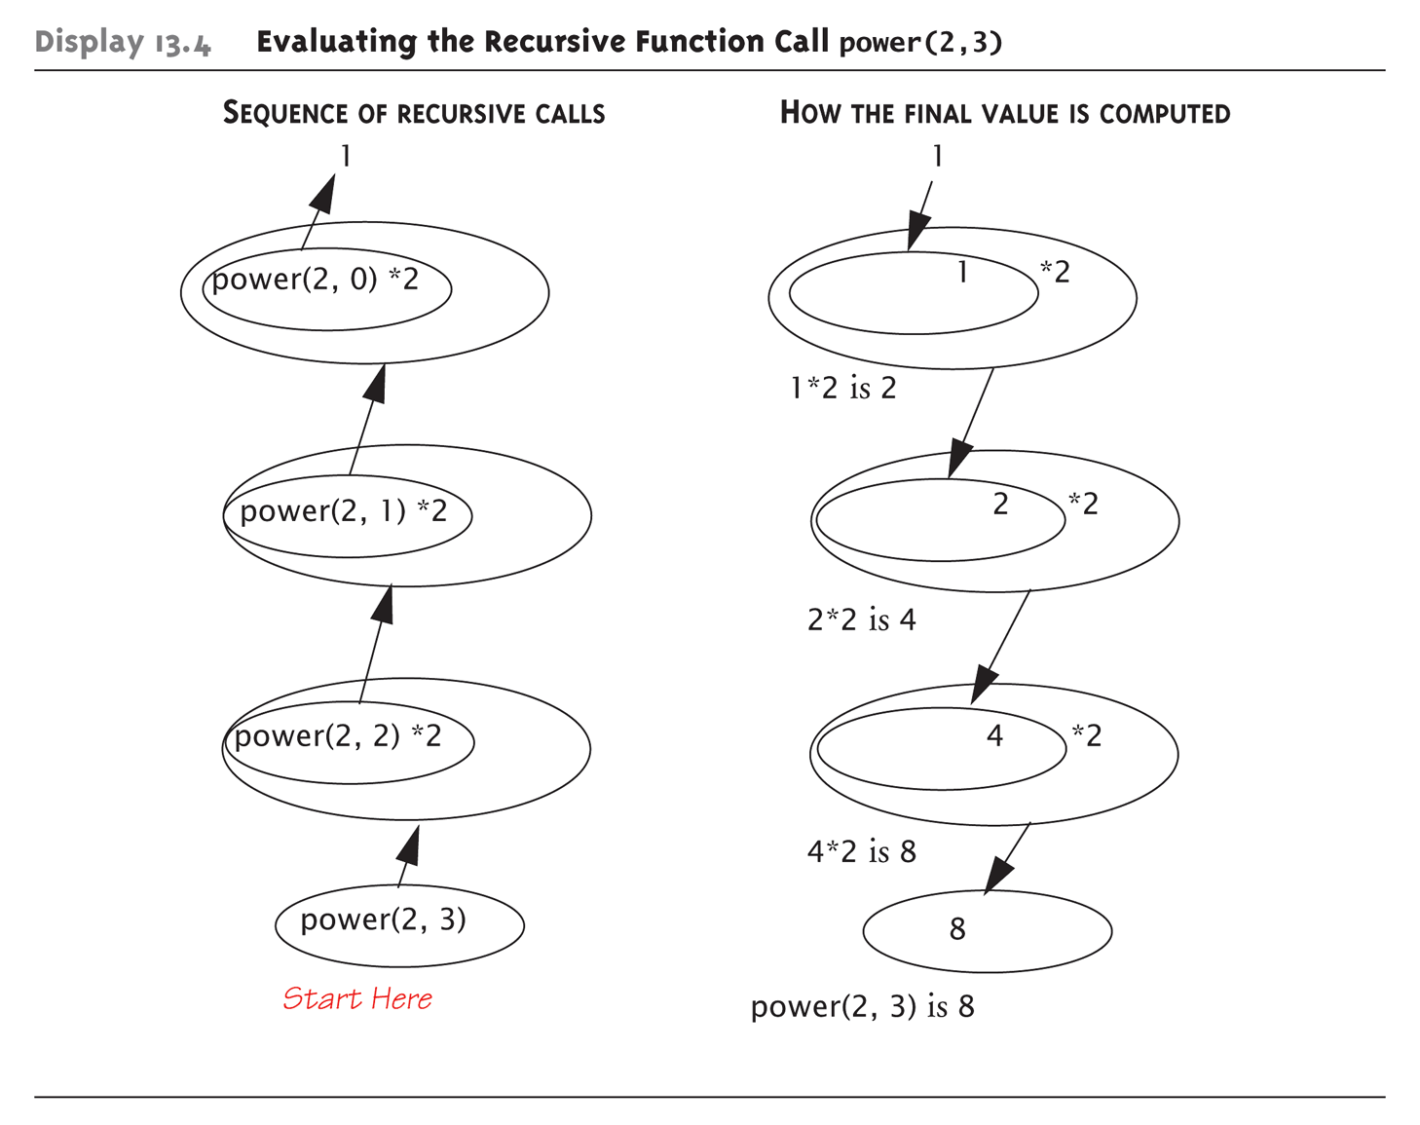
Tracing Function power(): Display 13.4 Evaluating the Recursive Function Call power(2,3)

Slide 23
Thinking Recursively
Ignore details
Forget how stack works
Forget the suspended computations
Yes, this is an "abstraction" principle!
And encapsulation principle!
Let computer do "bookkeeping"
Programmer just think "big picture"

Slide 24
Thinking Recursively: power
Consider power() again
Recursive definition of power: power(x, n) returns: power(x, n – 1) * x
Just ensure "formula" correct
And ensure base case will be met

Slide 25
Recursive Design Techniques
Don’t trace entire recursive sequence!
Just check 3 properties:
No infinite recursion
Stopping cases return correct values
Recursive cases return correct values

Slide 26
Recursive Design Check: power()
Check power() against 3 properties:
No infinite recursion:
2nd argument decreases by 1 each call
Eventually must get to base case of 1
Stopping case returns correct value:
power(x,0) is base case
Returns 1, which is correct for x⁰
Recursive calls correct:
For n>1, power(x,n) returns power(x,n-1)*x
Plug in values → correct

Slide 27
Tail recursion
A function that is tail recursive if it has the property that no further computation occurs after the recursive call; the function immediately returns.
Tail recursive functions can easily be converted to a more efficient iterative solution
May be done automatically by your compiler

Slide 28
Mutual Recursion
When two or more functions call each other it is called mutual recursion
Example
Determine if a string has an even or odd number of 1’s by invoking a function that keeps track if the number of 1’s seen so far is even or odd
Would result in stack overflow for long strings

Slide 29
Mutual Recursion Example (1 of 2)
// Recursive program to determine if a string has an even number of 1's.
#include <iostream>
#include <string>
using namespace std;
// Function prototypes
bool evenNumberOfOnes(string s);
bool oddNumberOfOnes(string s);
// If the recursive calls end here with an empty string
// then we had an even number of 1's.
bool evenNumberOfOnes(string s)
{
if (s.length() == 0)
return true; // Is even
else if (s[0]=='1')
return oddNumberOfOnes(s.substr(1));
else
return evenNumberOfOnes(s.substr(1));
}

Slide 30
Mutual Recursion Example (2 of 2)
// if the recursive calls end up here with an empty string
// then we had an odd number of 1's.
bool oddNumberOfOnes(string s)
{
if (s.length() == 0)
return false; // Not even
else if (s[0]=='1')
return evenNumberOfOnes(s.substr(1));
else
return oddNumberOfOnes(s.substr(1));
}
int main()
{
string s = "10011";
if (evenNumberOfOnes(s))
cout << "Even number of ones." << endl;
else
cout << "Odd number of ones." << endl;
return 0;
}

Slide 31
Binary Search
Recursive function to search array
Determines IF item is in list, and if so:
Where in list it is
Assumes array is sorted
Breaks list in half
Determines if item in 1st or 2nd half
Then searches again just that half
Recursively (of course)!

Slide 32
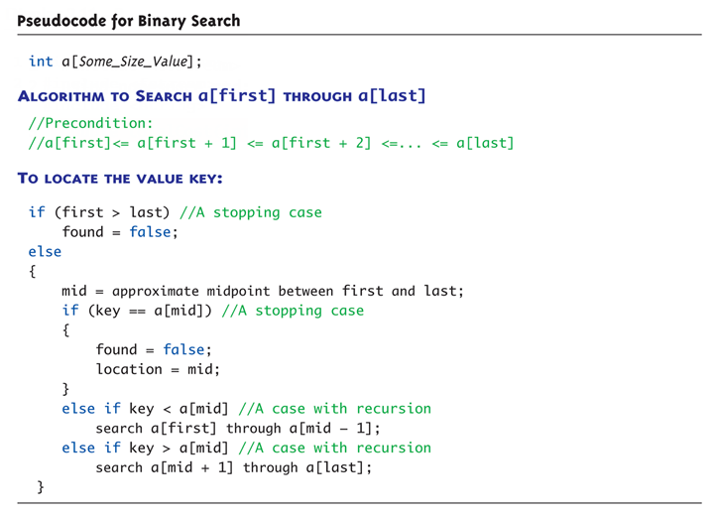
Display 13.6 Pseudocode for Binary Search

Slide 33
Checking the Recursion
Check binary search against criteria:
No infinite recursion:
Each call increases first or decreases last
Eventually first will be greater than last
Stopping cases perform correct action:
If first > last → no elements between them, so key can’t be there!
IF key == a[mid] → correctly found!
Recursive calls perform correct action
If key < a[mid] → key in 1st half – correct call
If key > a[mid] → key in 2nd half – correct call

Slide 34
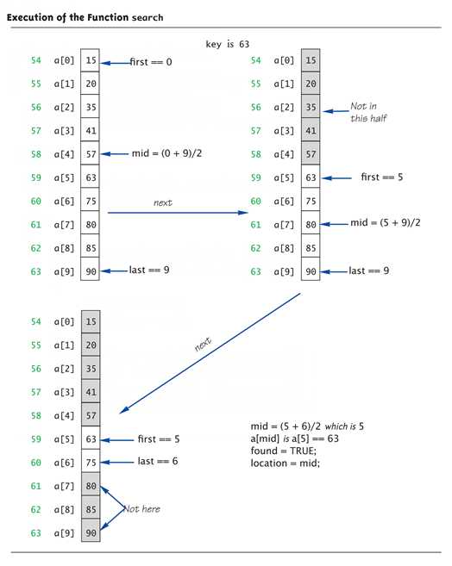
Execution of Binary Search: Display 13.8 Execution of the Function search

Slide 35
Efficiency of Binary Search
Extremely fast
Compared with sequential search
Half of array eliminated at start!
Then a quarter, then 1/8, etc.
Essentially eliminate half with each call
Example: Array of 100 elements:
Binary search never needs more than 7 compares!
Logarithmic efficiency (log n)

Slide 36
Recursive Solutions
Notice binary search algorithm actually solves "more general" problem
Original goal: design function to search an entire array
Our function: allows search of any interval of array
By specifying bounds first and last
Very common when designing recursive functions

Slide 37
Summary 1
Reduce problem into smaller instances of same problem -> recursive solution
Recursive algorithm has two cases:
Base/stopping case
Recursive case
Ensure no infinite recursion
Use criteria to determine recursion correct
Three essential properties
Typically solves "more general" problem

