Slide 1

Chapter 14
Inheritance
Copyright © 2016 Pearson, Inc. All rights reserved.

Slide 2
Learning Objectives
Inheritance Basics
Derived classes, with constructors
protected: qualifier
Redefining member functions
Non-inherited functions
Programming with Inheritance
Assignment operators and copy constructors
Destructors in derived classes
Multiple inheritance

Slide 3
Introduction to Inheritance
Object-oriented programming
Powerful programming technique
Provides abstraction dimension called inheritance
General form of class is defined
Specialized versions then inherit properties of general class
And add to it/modify it’s functionality for it’s appropriate use

Slide 4
Inheritance Basics
New class inherited from another class
Base class
"General" class from which others derive
Derived class
New class
Automatically has base class’s:
Member variables
Member functions
Can then add additional member functions and variables

Slide 5
Derived Classes
Consider example: Class of "Employees"
Composed of:
Salaried employees
Hourly employees
Each is "subset" of employees
Another might be those paid fixed wage each month or week

Slide 6
Derived Classes
Don’t "need" type of generic "employee"
Since no one’s just an "employee"
General concept of employee helpful!
All have names
All have social security numbers
Associated functions for these "basics" are same among all employees
So "general" class can contain all these "things" about employees

Slide 7
Employee Class
Many members of "employee" class apply to all types of employees
Accessor functions
Mutator functions
Most data items:
SSN
Name
Pay
We won’t have "objects" of this class, however

Slide 8
Employee Class
Consider printCheck() function:
Will always be "redefined" in derived classes
So different employee types can have different checks
Makes no sense really for "undifferentiated" employee
So function printCheck() in Employee class says just that
Error message stating "printCheck called for undifferentiated employee!! Aborting…"

Slide 9
Deriving from Employee Class
Derived classes from Employee class:
Automatically have all member variables
Automatically have all member functions
Derived class said to "inherit" members from base class
Can then redefine existing members and/or add new members

Slide 10
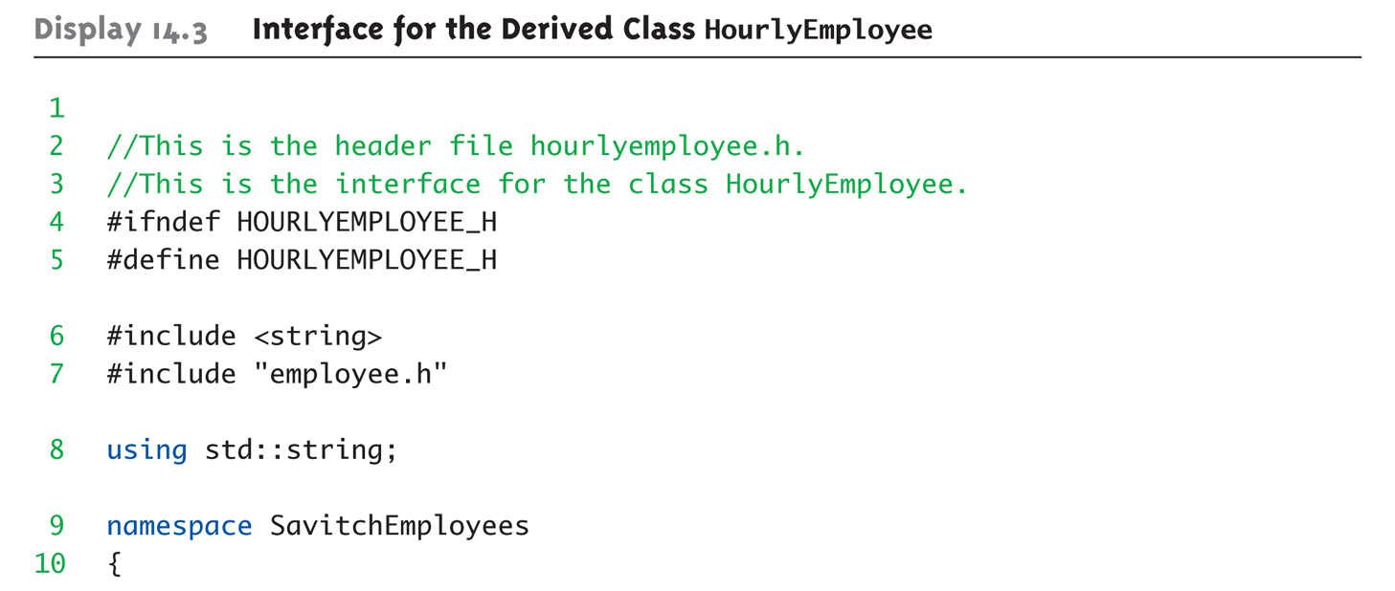
Display 14.3 Interface for the Derived Class HourlyEmployee (1 of 2)

Slide 11
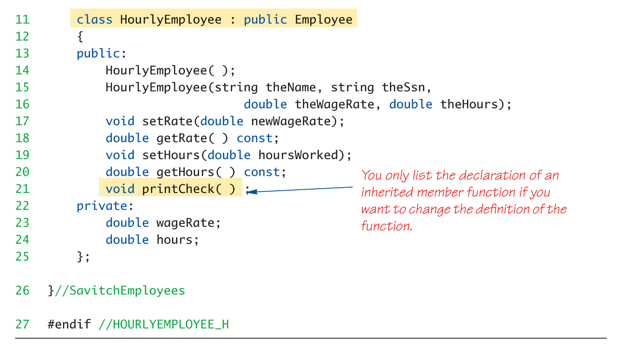
Display 14.3 Interface for the Derived Class HourlyEmployee (2 of 2)

Slide 12
HourlyEmployee Class Interface
Note definition begins same as any other
#ifndef structure
Includes required libraries
Also includes employee.h!
And, the heading: class HourlyEmployee : public Employee { …
Specifies "publicly inherited" from Employee class

Slide 13
HourlyEmployee Class Additions
Derived class interface only lists new or "to be redefined" members
Since all others inherited are already defined
i.e.: "all" employees have ssn, name, etc.
HourlyEmployee adds:
Constructors
wageRate, hours member variables
setRate(), getRate(), setHours(), getHours() member functions

Slide 14
HourlyEmployee Class Redefinitions
HourlyEmployee redefines:
printCheck() member function
This "overrides" the printCheck() function implementation from Employee class
It’s definition must be in HourlyEmployee class’s implementation
As do other member functions declared in HourlyEmployee’s interface
New and "to be redefined"

Slide 15
Inheritance Terminology
Common to simulate family relationships
Parent class
Refers to base class
Child class
Refers to derived class
Ancestor class
Class that’s a parent of a parent …
Descendant class
Opposite of ancestor

Slide 16
Constructors in Derived Classes
Base class constructors are NOT inherited in derived classes!
But they can be invoked within derived class constructor
Which is all we need!
Base class constructor must initialize all base class member variables
Those inherited by derived class
So derived class constructor simply calls it
"First" thing derived class constructor does

Slide 17
Derived Class Constructor Example
Consider syntax for HourlyEmployee constructor: HourlyEmployee::HourlyEmployee(string theName, string theNumber, double theWageRate, double theHours) : Employee(theName, theNumber), wageRate(theWageRate), hours(theHours) { //Deliberately empty }
Portion after : is "initialization section"
Includes invocation of Employee constructor

Slide 18
Another HourlyEmployee Constructor
A second constructor: HourlyEmployee::HourlyEmployee() : Employee(), wageRate(0), hours(0) { //Deliberately empty }
Default version of base class constructor is called (no arguments)
Should always invoke one of the base class’s constructors

Slide 19
Constructor: No Base Class Call
Derived class constructor should always invoke one of the base class’s constructors
If you do not:
Default base class constructor automatically called
Equivalent constructor definition: HourlyEmployee::HourlyEmployee() : wageRate(0), hours(0) { }

Slide 20
Pitfall: Base Class Private Data
Derived class "inherits" private member variables
But still cannot directly access them
Not even through derived class member functions!
Private member variables can ONLY be accessed "by name" in member functions of the class they’re defined in

Slide 21
Pitfall: Base Class Private Member Functions
Same holds for base class member functions
Cannot be accessed outside interface and implementation of base class
Not even in derived class member function definitions

Slide 22
Pitfall: Base Class Private Member Functions Impact
Larger impact here vs. member variables
Member variables can be accessed indirectly via accessor or mutator member functions
Member functions simply not available
This is "reasonable"
Private member functions should be simply "helper" functions
Should be used only in class they’re defined

Slide 23
The protected: Qualifier
New classification of class members
Allows access "by name" in derived class
But nowhere else
Still no access "by name" in other classes
In class it’s defined → acts like private
Considered "protected" in derived class
To allow future derivations
Many feel this "violates" information hiding

Slide 24
Redefinition of Member Functions
Recall interface of derived class:
Contains declarations for new member functions
Also contains declarations for inherited member functions to be changed
Inherited member functions NOT declared:
Automatically inherited unchanged
Implementation of derived class will:
Define new member functions
Redefine inherited functions as declared

Slide 25
Redefining vs. Overloading
Very different!
Redefining in derived class:
SAME parameter list
Essentially "re-writes" same function
Overloading:
Different parameter list
Defined "new" function that takes different parameters
Overloaded functions must have different signatures

Slide 26
A Function’s Signature
Recall definition of a "signature":
Function’s name
Sequence of types in parameter list
Including order, number, types
Signature does NOT include:
Return type
const keyword
&

Slide 27
Accessing Redefined Base Function
When redefined in derived class, base class’s definition not "lost"
Can specify it’s use: Employee JaneE; HourlyEmployee SallyH; JaneE.printCheck(); → calls Employee’s printCheck function SallyH.printCheck(); → calls HourlyEmployee printCheck function SallyH.Employee::printCheck(); → Calls Employee’s printCheck function!
Not typical here, but useful sometimes

Slide 28
Functions Not Inherited
All "normal" functions in base class are inherited in derived class
Exceptions:
Constructors (we’ve seen)
Destructors
Copy constructor
But if not defined, generates "default" one
Recall need to define one for pointers!
Assignment operator
If not defined → default

Slide 29
Assignment Operators and Copy Constructors
Recall: overloaded assignment operators and copy constructors NOT inherited
But can be used in derived class definitions
Typically MUST be used!
Similar to how derived class constructor invokes base class constructor

Slide 30
Assignment Operator Example
Given "Derived" is derived from "Base": Derived& Derived::operator =(const Derived & rightSide) { Base::operator =(rightSide); … }
Notice code line
Calls assignment operator from base class
This takes care of all inherited member variables
Would then set new variables from derived class…

Slide 31
Copy Constructor Example
Consider: Derived::Derived(const Derived& Object) : Base(Object), … {…}
After : is invocation of base copy constructor
Sets inherited member variables of derived class object being created
Note Object is of type Derived; but it’s also of type Base, so argument is valid

Slide 32
Destructors in Derived Classes
If base class destructor functions correctly
Easy to write derived class destructor
When derived class destructor is invoked:
Automatically calls base class destructor!
So no need for explicit call
So derived class destructors need only be concerned with derived class variables
And any data they "point" to
Base class destructor handles inherited data automatically

Slide 33
Destructor Calling Order
Consider: class B derives from class A class C derives from class B A ← B ← C
When object of class C goes out of scope:
Class C destructor called 1st
Then class B destructor called
Finally class A destructor is called
Opposite of how constructors are called

Slide 34
"Is a" vs. "Has a" Relationships
Inheritance
Considered an "Is a" class relationship
e.g., An HourlyEmployee "is a" Employee
A Convertible "is a" Automobile
A class contains objects of another class as it’s member data
Considered a "Has a" class relationship
e.g., One class "has a" object of another class as it’s data

Slide 35
Protected and Private Inheritance
New inheritance "forms"
Both are rarely used
Protected inheritance: class SalariedEmployee : protected Employee {…}
Public members in base class become protected in derived class
Private inheritance: class SalariedEmployee : private Employee {…}
All members in base class become private in derived class

Slide 36
Multiple Inheritance
Derived class can have more than one base class!
Syntax just includes all base classes separated by commas: class derivedMulti : public base1, base2 {…}
Possibilities for ambiguity are endless!
Dangerous undertaking!
Some believe should never be used
Certainly should only be used be experienced programmers!

Slide 37
Summary 1
Inheritance provides code reuse
Allows one class to "derive" from another, adding features
Derived class objects inherit members of base class
And may add members
Private member variables in base class cannot be accessed "by name" in derived
Private member functions are not inherited

Slide 38
Summary 2
Can redefine inherited member functions
To perform differently in derived class
Protected members in base class:
Can be accessed "by name" in derived class member functions
Overloaded assignment operator not inherited
But can be invoked from derived class
Constructors are not inherited
Are invoked from derived class’s constructor

