Slide 1
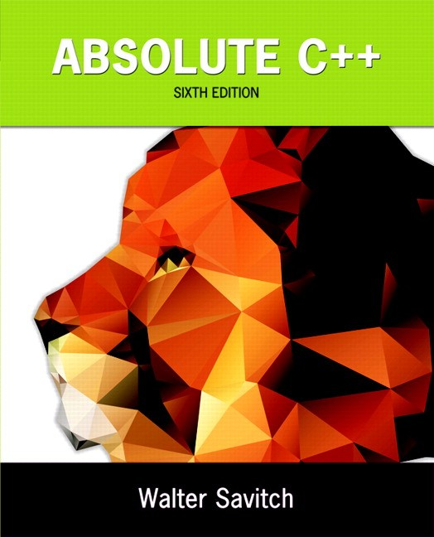
Chapter 16
Templates
Copyright © 2016 Pearson, Inc. All rights reserved.

Slide 2
Learning Objectives
Function Templates
Syntax, defining
Compiler complications
Class Templates
Syntax
Example: array template class
Templates and Inheritance
Example: partially-filled array template class

Slide 3
Introduction
C++ templates
Allow very "general" definitions for functions and classes
Type names are "parameters" instead of actual types
Precise definition determined at run-time

Slide 4
Function Templates
Recall function swapValues: void swapValues(int& var1, int& var2) { int temp; temp = var1; var1 = var2; var2 = temp; }
Applies only to variables of type int
But code would work for any types!

Slide 5
Function Templates vs. Overloading
Could overload function for chars: void swapValues(char& var1, char& var2) { char temp; temp = var1; var1 = var2; var2 = temp; }
But notice: code is nearly identical!
Only difference is type used in 3 places

Slide 6
Function Template Syntax
Allow "swap values" of any type variables: template<class T> void swapValues(T& var1, T& var2) { T temp; temp = var1; var1 = var2; var2 = temp; }
First line called "template prefix"
Tells compiler what’s coming is "template"
And that T is a type parameter

Slide 7
Template Prefix
Recall: template<class T>
In this usage, "class" means "type", or "classification"
Can be confused with other "known" use of word "class"!
C++ allows keyword "typename" in place of keyword "class" here
But most use "class" anyway

Slide 8
Template Prefix 2
Again: template<class T>
T can be replaced by any type
Predefined or user-defined (like a C++ class type)
In function definition body:
T used like any other type
Note: can use other than "T", but T is "traditional" usage

Slide 9
Function Template Definition
swapValues() function template is actually large "collection" of definitions!
A definition for each possible type!
Compiler only generates definitions when required
But it’s "as if" you’d defined for all types
Write one definition → works for all types that might be needed

Slide 10
Calling a Function Template
Consider following call: swapValues(int1, int2);
C++ compiler "generates" function definition for two int parameters using template
Likewise for all other types
Needn’t do anything "special" in call
Required definition automatically generated

Slide 11
Another Function Template
Declaration/prototype: Template<class T> void showStuff(int stuff1, T stuff2, T stuff3);
Definition: template<class T> void showStuff(int stuff1, T stuff2, T stuff3) { cout << stuff1 << endl << stuff2 << endl << stuff3 << endl; }

Slide 12
showStuff Call
Consider function call: showStuff(2, 3.3, 4.4);
Compiler generates function definition
Replaces T with double
Since second parameter is type double
Displays: 2 3.3 4.4

Slide 13
Compiler Complications
Function declarations and definitions
Typically we have them separate
For templates → not supported on most compilers!
Safest to place template function definition in file where invoked
Many compilers require it appear 1st
Often we #include all template definitions

Slide 14
More Compiler Complications
Check your compiler’s specific requirements
Some need to set special options
Some require special order of arrangement of template definitions vs. other file items
Most usable template program layout:
Template definition in same file it’s used
Ensure template definition precedes all uses
Can #include it

Slide 15
Multiple Type Parameters
Can have: template<class T1, class T2>
Not typical
Usually only need one "replaceable" type
Cannot have "unused" template parameters
Each must be "used" in definition
Error otherwise!

Slide 16
Algorithm Abstraction
Refers to implementing templates
Express algorithms in "general" way:
Algorithm applies to variables of any type
Ignore incidental detail
Concentrate on substantive parts of algorithm
Function templates are one way C++ supports algorithm abstraction

Slide 17
Defining Templates Strategies
Develop function normally
Using actual data types
Completely debug "ordinary" function
Then convert to template
Replace type names with type parameter as needed
Advantages:
Easier to solve "concrete" case
Deal with algorithm, not template syntax

Slide 18
Inappropriate Types in Templates
Can use any type in template for which code makes "sense"
Code must behave in appropriate way
e.g., swapValues() template function
Cannot use type for which assignment operator isn’t defined
Example: an array: int a[10], b[10]; swapValues(a, b);
Arrays cannot be "assigned"!

Slide 19
Class Templates
Can also "generalize" classes template<class T>
Can also apply to class definition
All instances of "T" in class definition replaced by type parameter
Just like for function templates!
Once template defined, can declare objects of the class

Slide 20
Class Template Definition
template<class T> class Pair { public: Pair(); Pair(T firstVal, T secondVal); void setFirst(T newVal); void setSecond(T newVal); T getFirst() const; T getSecond() const; private: T first; T second; };

Slide 21
Template Class Pair Members
template<class T> Pair<T>::Pair(T firstVal, T secondVal) { first = firstVal; second = secondVal; } template<class T> void Pair<T>::setFirst(T newVal) { first = newVal; }

Slide 22
Template Class Pair
Objects of class have "pair" of values of type T
Can then declare objects: Pair<int> score; Pair<char> seats;
Objects then used like any other objects
Example uses: score.setFirst(3); score.setSecond(0);

Slide 23
Pair Member Function Definitions
Notice in member function definitions:
Each definition is itself a "template"
Requires template prefix before each definition
Class name before :: is "Pair<T>"
Not just "Pair"
But constructor name is just "Pair"
Destructor name is also just "~Pair"

Slide 24
Class Templates as Parameters
Consider: int addUP(const Pair<int>& the Pair);
The type (int) is supplied to be used for T in defining this class type parameter
It "happens" to be call-by-reference here
Again: template types can be used anywhere standard types can

Slide 25
Class Templates Within Function Templates
Rather than defining new overload: template<class T> T addUp(const Pair<T>& the Pair); //Precondition: Operator + is defined for values of type T //Returns sum of two values in thePair
Function now applies to all kinds of numbers

Slide 26
Restrictions on Type Parameter
Only "reasonable" types can be substituted for T
Consider:
Assignment operator must be "well-behaved"
Copy constructor must also work
If T involves pointers, then destructor must be suitable!
Similar issues as function templates

Slide 27
Type Definitions
Can define new "class type name"
To represent specialized class template name
Example: typedef Pair<int> PairOfInt;
Name "PairOfInt" now used to declare objects of type Pair<int>: PairOfInt pair1, pair2;
Name can also be used as parameter, or anywhere else type name allowed

Slide 28
Friends and Templates
Friend functions can be used with template classes
Same as with ordinary classes
Simply requires type parameter where appropriate
Very common to have friends of template classes
Especially for operator overloads (as we’ve seen)

Slide 29
Predefined Template Classes
Recall vector class
It’s a template class!
Another: basic_string template class
Deals with strings of "any-type" elements
e.g.,
basic_string<char> works for char’s basic_string<double> works for doubles basic_string<YourClass> works for YourClass objects

Slide 30
basic_string Template Class
Already used it!
Recall "string"
It’s an alternate name for basic_string<char>
All member functions behave similarly for basic_string<T>
basic_string defined in library <string>
Definition is in std namespace

Slide 31
Templates and Inheritance
Nothing new here
Derived template classes
Can derive from template or nontemplate class
Derived class is then naturally a template class
Syntax same as ordinary class derived from ordinary class

Slide 32
Summary
Function templates
Define functions with parameter for a type
Class templates
Define class with parameter for subparts of class
Predefined vector and basic_string classes are template classes
Can define template class derived from a template base class

