Slide 1

Chapter 8
Operator Overloading, Friends, and References
Copyright © 2016 Pearson, Inc. All rights reserved.

Slide 2
Learning Objectives
Basic Operator Overloading
Unary operators
As member functions
Friends and Automatic Type Conversion
Friend functions, friend classes
Constructors for automatic type conversion
References and More Overloading
<< and >>
Operators: = , [], ++, --

Slide 3
Operator Overloading Introduction
Operators +, -, %, ==, etc.
Really just functions!
Simply "called" with different syntax: x + 7
"+" is binary operator with x & 7 as operands
We "like" this notation as humans
Think of it as: +(x, 7)
"+" is the function name
x, 7 are the arguments
Function "+" returns "sum" of it’s arguments

Slide 4
Operator Overloading Perspective
Built-in operators
e.g., +, -, = , %, ==, /, *
Already work for C++ built-in types
In standard "binary" notation
We can overload them!
To work with OUR types!
To add "Chair types", or "Money types"
As appropriate for our needs
In "notation" we’re comfortable with
Always overload with similar "actions"!

Slide 5
Overloading Basics
Overloading operators
VERY similar to overloading functions
Operator itself is "name" of function
Example Declaration: const Money operator +( const Money& amount1, const Money& amount2);
Overloads + for operands of type Money
Uses constant reference parameters for efficiency
Returned value is type Money
Allows addition of "Money" objects

Slide 6
Overloaded "+"
Given previous example:
Note: overloaded "+" NOT member function
Definition is "more involved" than simple "add"
Requires issues of money type addition
Must handle negative/positive values
Operator overload definitions generally very simple
Just perform "addition" particular to "your" type

Slide 7
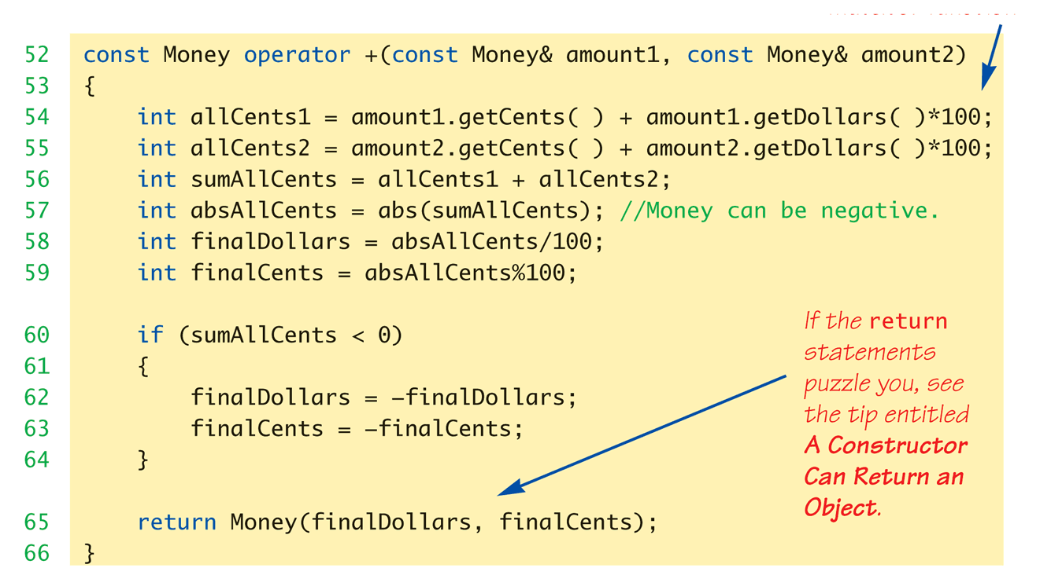
Money "+" Definition: Display 8.1 Operator Overloading
Definition of "+" operator for Money class:

Slide 8
Overloaded "=="
Equality operator, ==
Enables comparison of Money objects
Declaration: bool operator ==(const Money& amount1, const Money& amount2);
Returns bool type for true/false equality
Again, it’s a non-member function (like "+" overload)

Slide 9
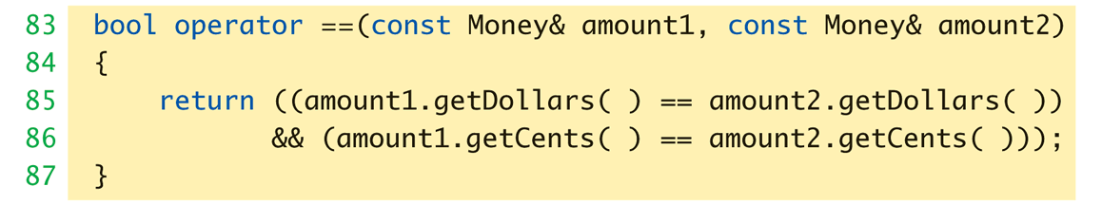
Overloaded "==" for Money: Display 8.1 Operator Overloading
Definition of "==" operator for Money class:

Slide 10
Constructors Returning Objects
Constructor a "void" function?
We "think" that way, but no
A "special" function
With special properties
CAN return a value!
Recall return statement in "+" overload for Money type:
return Money(finalDollars, finalCents);
Returns an "invocation" of Money class!
So constructor actually "returns" an object!
Called an "anonymous object"

Slide 11
Returning by const Value
Consider "+" operator overload again: const Money operator +(const Money& amount1, const Money& amount2);
Returns a "constant object"?
Why?
Consider impact of returning "non-const" object to see…→

Slide 12
Returning by non-const Value
Consider "no const" in declaration: Money operator +( const Money& amount1, const Money& amount2);
Consider expression that calls: m1 + m2
Where m1 & m2 are Money objects
Object returned is Money object
We can "do things" with objects!
Like call member functions…

Slide 13
What to do with Non-const Object
Can call member functions:
We could invoke member functions on object returned by expression m1+m2:
(m1+m2).output(); //Legal, right?
Not a problem: doesn’t change anything
(m1+m2).input(); //Legal!
PROBLEM! //Legal, but MODIFIES!
Allows modification of "anonymous" object!
Can’t allow that here!
So we define the return object as const

Slide 14
Overloading Unary Operators
C++ has unary operators:
Defined as taking one operand
e.g., - (negation)
x = -y; // Sets x equal to negative of y
Other unary operators:
++, --
Unary operators can also be overloaded

Slide 15
Overload "-" for Money
Overloaded "-" function declaration
Placed outside class definition: const Money operator –(const Money& amount);
Notice: only one argument
Since only 1 operand (unary)
"-" operator is overloaded twice!
For two operands/arguments (binary)
For one operand/argument (unary)
Definitions must exist for both

Slide 16
Overloaded "-" Definition
Overloaded "-" function definition: const Money operator –(const Money& amount) { return Money(-amount.getDollars(), -amount.getCents()); }
Applies "-" unary operator to built-in type
Operation is "known" for built-in types
Returns anonymous object again

Slide 17
Overloaded "-" Usage
Consider: Money amount1(10), amount2(6), amount3; amount3 = amount1 – amount2;
Calls binary "-" overload
amount3.output(); //Displays $4.00 amount3 = -amount1;
Calls unary "-" overload
amount3.output() //Displays -$10.00

Slide 18
Overloading as Member Functions
Previous examples: standalone functions
Defined outside a class
Can overload as "member operator"
Considered "member function" like others
When operator is member function:
Only ONE parameter, not two!
Calling object serves as 1st parameter

Slide 19
Member Operator in Action
Money cost(1, 50), tax(0, 15), total; total = cost + tax;
If "+" overloaded as member operator:
Variable/object cost is calling object
Object tax is single argument
Think of as: total = cost.+(tax);
Declaration of "+" in class definition:
const Money operator +(const Money& amount);
Notice only ONE argument

Slide 20
const Functions
When to make function const?
Constant functions not allowed to alter class member data
Constant objects can ONLY call constant member functions
Good style dictates:
Any member function that will NOT modify data should be made const
Use keyword const after function declaration and heading

Slide 21
Overloading Operators: Which Method?
Object-Oriented-Programming
Principles suggest member operators
Many agree, to maintain "spirit" of OOP
Member operators more efficient
No need to call accessor & mutator functions
At least one significant disadvantage
(Later in chapter…)

Slide 22
Overloading Function Application ()
Function call operator, ( )
Must be overloaded as member function
Allows use of class object like a function
Can overload for all possible numbers of arguments
Example: Aclass anObject; anObject(42);
If ( ) overloaded → calls overload

Slide 23
Other Overloads
&&, ||, and comma operator
Predefined versions work for bool types
Recall: use "short-circuit evaluation"
When overloaded no longer uses short-circuit
Uses "complete evaluation" instead
Contrary to expectations
Generally should not overload these operators

Slide 24
Friend Functions
Nonmember functions
Recall: operator overloads as nonmembers
They access data through accessor and mutator functions
Very inefficient (overhead of calls)
Friends can directly access private class data
No overhead, more efficient
So: best to make nonmember operator overloads friends!

Slide 25
Friend Functions
Friend function of a class
Not a member function
Has direct access to private members
Just as member functions do
Use keyword friend in front of function declaration
Specified IN class definition
But they’re NOT member functions!

Slide 26
Friend Function Uses
Operator Overloads
Most common use of friends
Improves efficiency
Avoids need to call accessor/mutator member functions
Operator must have access anyway
Might as well give full access as friend
Friends can be any function

Slide 27
Friend Function Purity
Friends not pure?
"Spirit" of OOP dictates all operators and functions be member functions
Many believe friends violate basic OOP principles
Advantageous?
For operators: very!
Allows automatic type conversion
Still encapsulates: friend is in class definition
Improves efficiency

Slide 28
Friend Classes
Entire classes can be friends
Similar to function being friend to class
Example: class F is friend of class C
All class F member functions are friends of C
NOT reciprocated
Friendship granted, not taken
Syntax: friend class F
Goes inside class definition of "authorizing" class

Slide 29
References
Reference defined:
Name of a storage location
Similar to "pointer"
Example of stand alone reference:
int robert; int& bob = robert;
bob is reference to storage location for robert
Changes made to bob will affect robert
Confusing?

Slide 30
References Usage
Seemingly dangerous
Useful in several cases:
Call-by-reference
Often used to implement this mechanism
Returning a reference
Allows operator overload implementations to be written more naturally
Think of as returning an "alias" to a variable

Slide 31
Returning Reference
Syntax: double& sampleFunction(double& variable);
double& and double are different
Must match in function declaration and heading
Returned item must "have" a reference
Like a variable of that type
Cannot be expression like "x+5"
Has no place in memory to "refer to"

Slide 32
Returning Reference in Definition
Example function definition: double& sampleFunction(double& variable) { return variable; }
Trivial, useless example
Shows concept only
Major use:
Certain overloaded operators

Slide 33
Overloading >> and <<
Enables input and output of our objects
Similar to other operator overloads
New subtleties
Improves readability
Like all operator overloads do
Enables: cout << myObject; cin >> myObject;
Instead of need for: myObject.output(); …

Slide 34
Overloading >>
Insertion operator, <<
Used with cout
A binary operator
Example: cout << "Hello";
Operator is <<
1st operand is predefined object cout
From library iostream
2nd operand is literal string "Hello"

Slide 35
Overloading >>
Operands of >>
Cout object, of class type ostream
Our class type
Recall Money class
Used member function output()
Nicer if we can use >> operator: Money amount(100); cout << "I have " << amount << endl; instead of: cout << "I have "; amount.output()

Slide 36
Overloaded >> Return Value
Money amount(100); cout << amount;
<< should return some value
To allow cascades: cout << "I have " << amount; (cout << "I have ") << amount;
Two are equivalent
What to return?
cout object!
Returns its first argument type, ostream

Slide 37
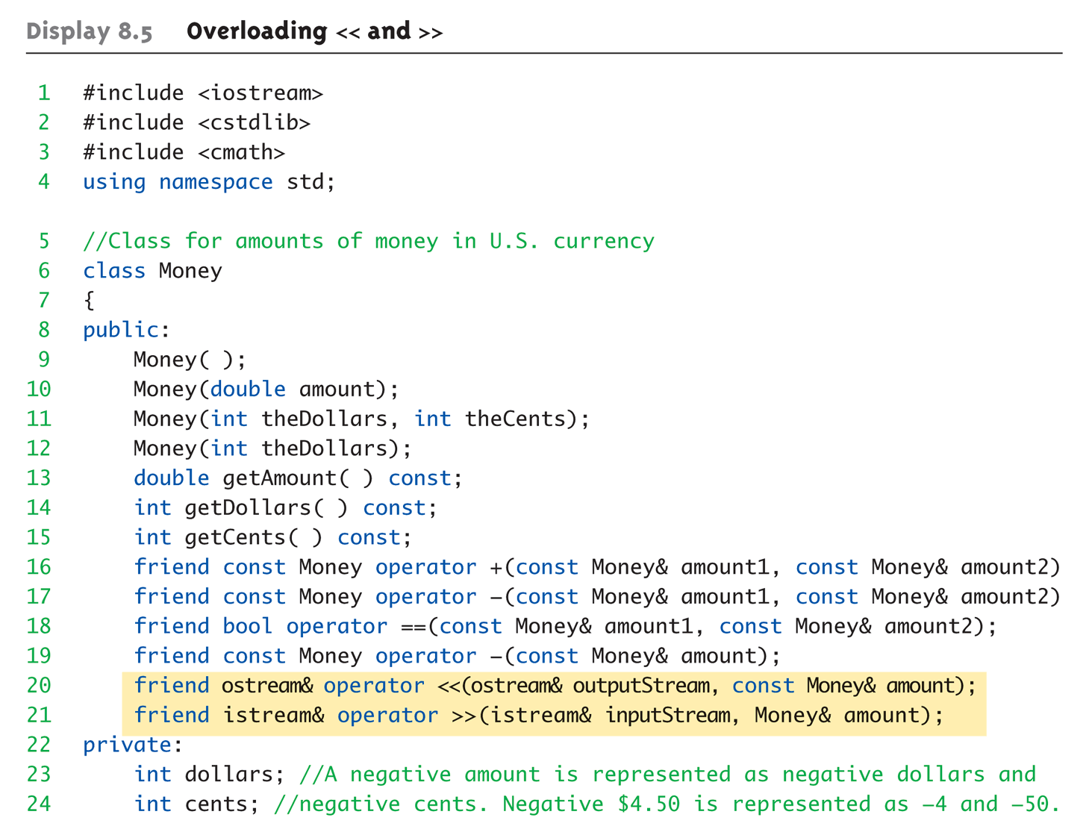
Overloaded >> Example: Display 8.5 Overloading << and >> (1 of 5)

Slide 38
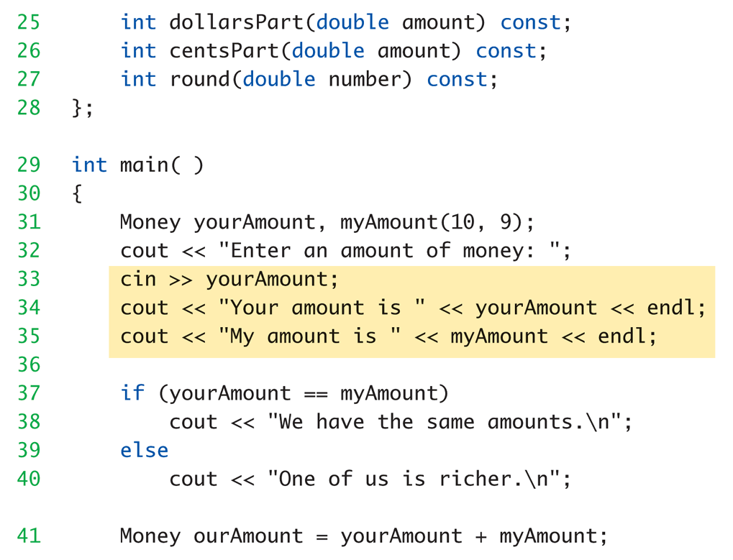
Overloaded >> Example: Display 8.5 Overloading << and >> (2 of 5)

Slide 39
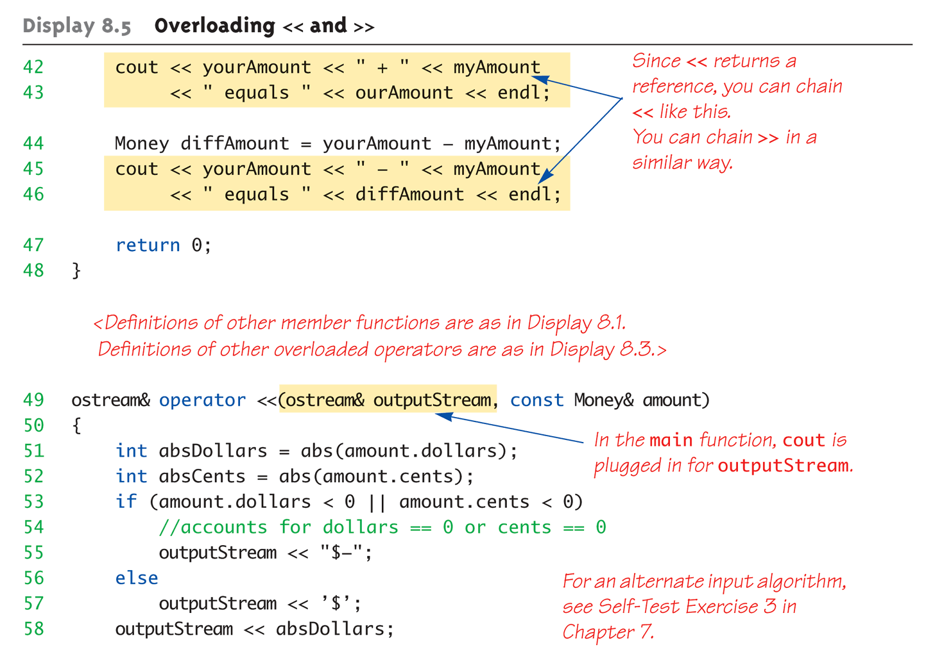
Overloaded >> Example: Display 8.5 Overloading << and >> (3 of 5)

Slide 40
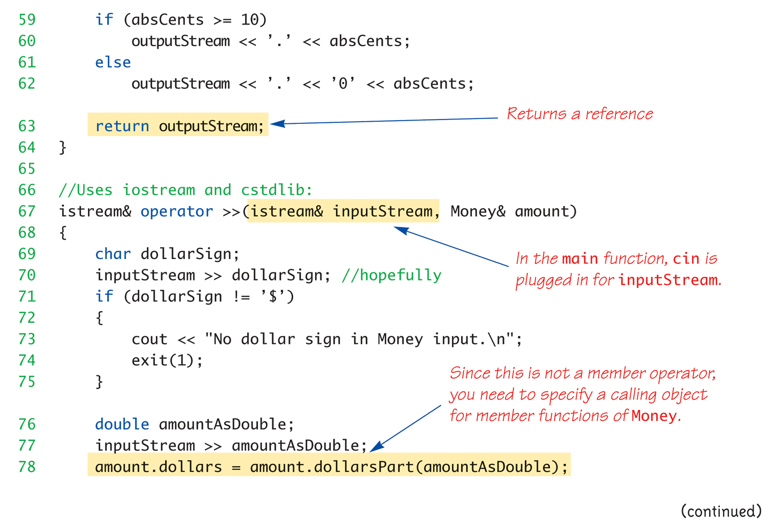
Overloaded >> Example: Display 8.5 Overloading << and >> (4 of 5)

Slide 41
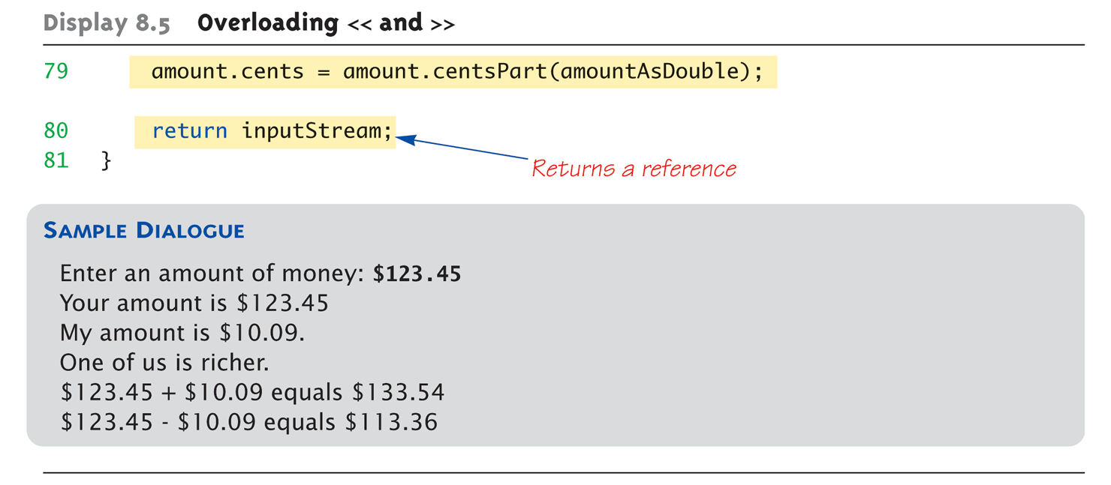
Overloaded >> Example: Display 8.5 Overloading << and >> (5 of 5)

Slide 42
Assignment Operator, =
Must be overloaded as member operator
Automatically overloaded
Default assignment operator:
Member-wise copy
Member variables from one object → corresponding member variables from other
Default OK for simple classes
But with pointers → must write our own!

Slide 43
Increment and Decrement
Each operator has two versions
Prefix notation: ++x;
Postfix notation: x++;
Must distinguish in overload
Standard overload method → Prefix
Add 2d parameter of type int → Postfix
Just a marker for compiler!
Specifies postfix is allowed

Slide 44
Overload Array Operator, [ ]
Can overload [ ] for your class
To be used with objects of your class
Operator must return a reference!
Operator [ ] must be a member function!

Slide 45
Summary 1
C++ built-in operators can be overloaded
To work with objects of your class
Operators are really just functions
Friend functions have direct private member access
Operators can be overloaded as member functions
1st operand is calling object

Slide 46
Summary 2
Friend functions add efficiency only
Not required if sufficient accessors/mutators available
Reference "names" a variable with an alias
Can overload <<, >>
Return type is a reference to stream type

