Slide 1


Pilot project : Argumentation mining
Master of Science in Business Analytics FT 2020-2021
Department of Management Science and Technology
Course: Machine learning & Content Analytics
Professor: Papageorgiou Haris, Perakis Georgios, Fergadis Aris
Author: Lamaj Kostandin (f2822017) , Vaiou Konstantinos (f2822002)

Slide 2

Our Project
Goal: Argumentation mining on scientific abstracts that are linked with the
Sustainable Development Goals of the United Nations
Prediction – Labeling of:
Argumentative Statements
Claim
Evidence
Neither
2. Abstract Structure
Background
Objective
Method
Results
Conclusion
None
3. Abstract Clustering
Graph based on argument embeddings

Slide 3
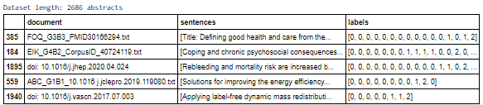
Data Collection – Dataset Overview
Annotated Dataset
- 1669 abstracts or 21429 sentences
Citations (Not Used)
Arguments - 1017 abstracts
Structure - 1014 abstracts
AUEB Dataset

Slide 4
Data Processing
Split to sentences
Split to train – validation – test
Transform to appropriate Fasttext - baseline format
Fasttext Argument
Test: 3201
Validation: 3169
Train: 25634
Format example:
__label__0 The purpose...
Fasttext Structure
Test: 528
Validation: 501
Train: 9519
Format example:
__label__NEITHER the purpose… (lowercase)
Baseline Argument
Test: 3201
Validation: 3169
Train: 25634
Baseline Structure
Test: 912 abstracts
Train: 102 abstracts
Abstract clustering: 785 abstracts or 2748 sentences

Slide 5
Baseline Architecture
Lexicon approach for argument
Label distribution approach for structure
Create 3 lexicons by tokenization
Select the best words in the lexicon from validation testing
Predict labels in test dataset
1. Lexicon with words mostly used in claims
2. Lexicon with words mostly used in evidence
Initialize nested dictionary with keys the number of sentences occurred in an abstract and second key the sentence number in the abstract
Prediction: Select the most encountered label for that number of sentence for abstracts with same number of sentences
Populate dictionary

Slide 6
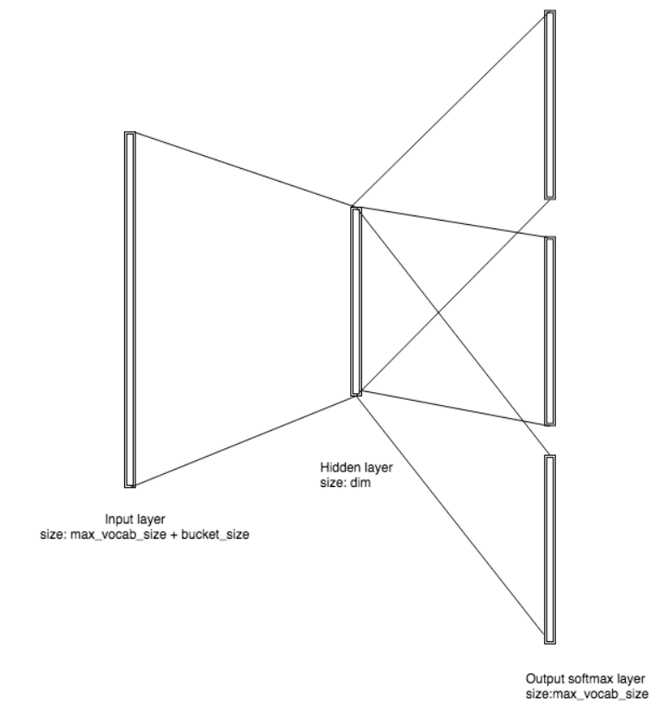
Fasttext Architecture – Abstract clustering
Extract argument embeddings for reduced dataset
Create Undirected Graph
Extract top 5 closest arguments from other abstracts
Create Weighted edges for closest arguments between papers
Extract Cliques & Communities
Implementation of fasttext approach for argumentation, and structure prediction.
Conversion of the dataset to a format ideal for the fasttext model
Autotune to the validation set

Slide 7
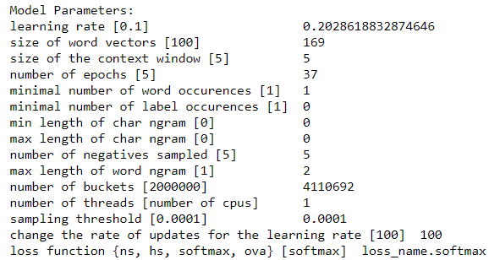
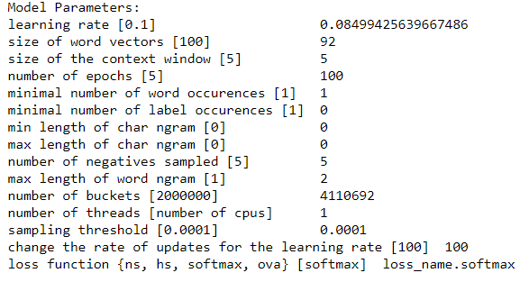



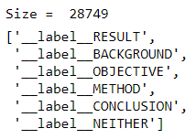
Configuration
Argument
Structure

Slide 8
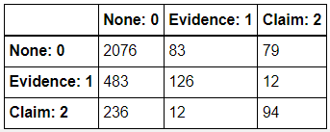
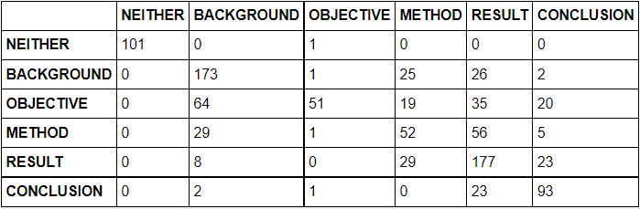
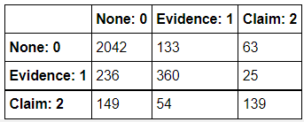
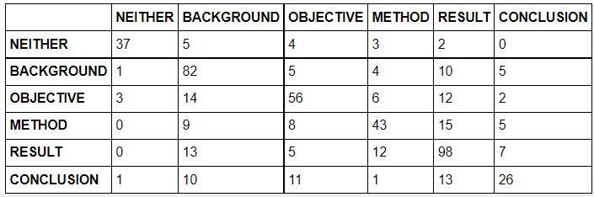
Results & Quantitative Analysis
Argument Baseline Results
Structure Baseline Results
Argument Fasttext Results
Structure Fasttext Results

Slide 9
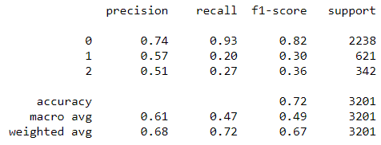
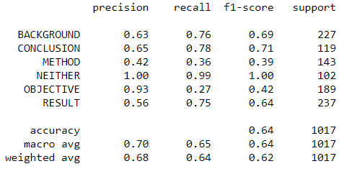
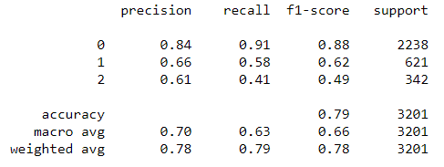
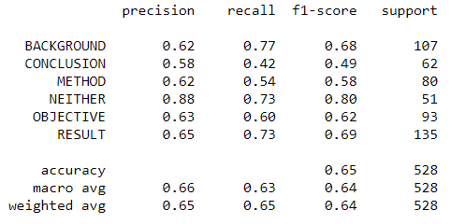
Results & Quantitative Analysis
Argument Baseline Results
Structure Baseline Results
Argument Fasttext Results
Structure Fasttext Results

Slide 10
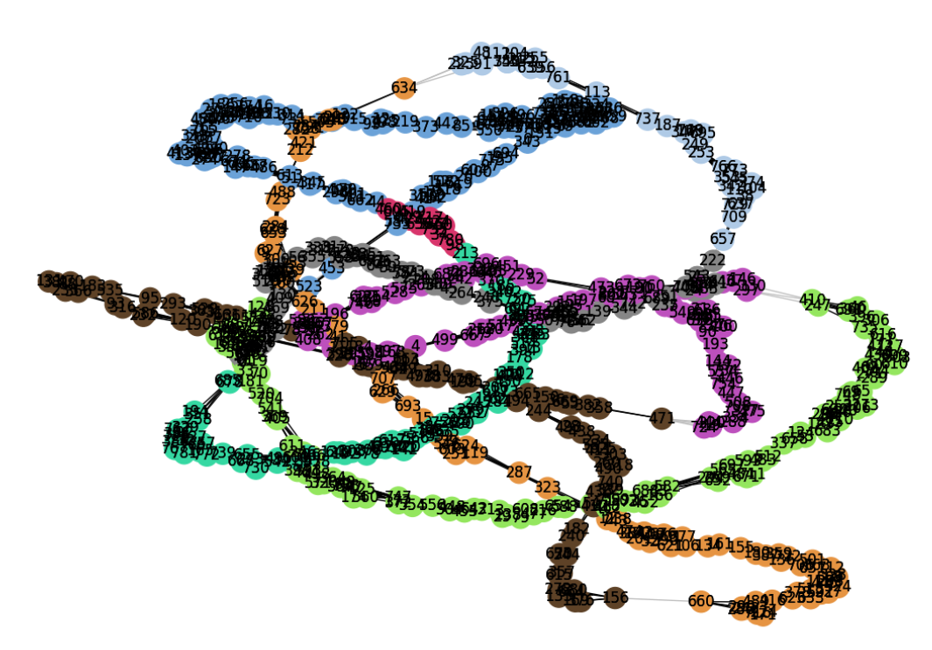
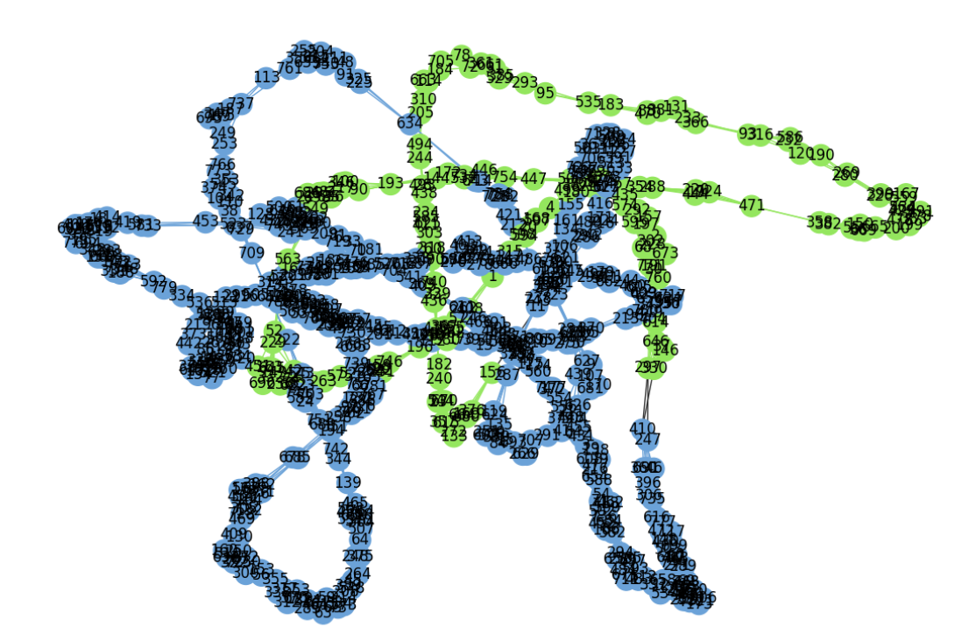
Graphs
Clauset-Newman-Moore communities
Girvan-Newman Community Detection

Slide 11
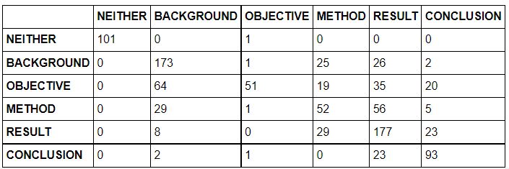
Qualitative & Error Analysis
 | Fasttext
Model | TRAINING | VALIDATION | TESTING
ARGUMENT | 0.99 | 0.78 | 0.79
STRUCTURE | 0.99 | 0.64 | 0.65

Slide 12

Future Work
Improve annotator agreement
Cleaning / Pre-processing of data
Utilize embeddings as inputs to other models
Citation prediction
Use of other attributes

Slide 13

Thank you for your attention!
Questions?

