Slide 1
kx.com
high-end relational database
&
programming languages

Slide 2
50 big customers
banks
hedge funds
stock exchanges
usarmy
..

Slide 3
applications
trading (millisecond response)
realtime risk management
surveillance
select insert update delete
..
any big database

Slide 4
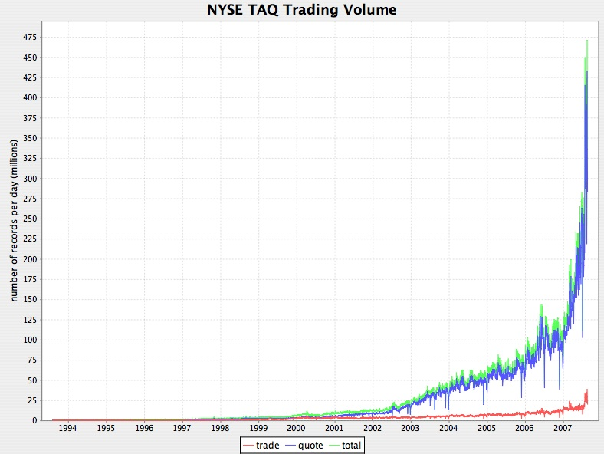
kdb+: 100 billion records

Slide 5
kdb+: 600 billion records
buy/sell orders: add,modify,delete
280 billion buy records
270 billion sell records
14 billion trades

Slide 6
transactions
2 billion complex transactions per day
200,000 transactions per second

Slide 7
machine
64bit linux
cpu: 2 to 4
ram: 32 to 128 GB
disk: 10 to 50 TB
kdb+ is $50,000 per cpu.
users have prod, uat, test & dev..

Slide 8
supported os
64bit and 32bit linux
64bit and 32bit solaris(opteron and sparc)
64bit and 32bit windows
64bit mac

Slide 9
the os we want?
minimal os
page table access
acid files

Slide 10
why kdb+?
faster
better (timeseries, asof joins, ..)
comprehensive (one-stop shopping)
database server
application server
webserver
blah blah blah ..

Slide 11
kdb+ languages
sql92 select insert update delete
q array programming + sql
k array programming

Slide 12
tpcd example
l - lineitem
o - order
c - customer
p - part
s - supply
n - nation
r - region

Slide 13
sql92 (query 8)
select year,sum(case when name='BRAZIL' then rev else 0 end)/sum(rev) from(
select extract(year from o.d)as year,l.x*(1-l.xd) as rev,n2.name
from p,s,l,o,c,n n1,n n2,r
where p.p=l.p and s.s=l.s and l.o=o.o and o.c=c.c and c.n=n1.n and n1.r=r.r and r.name='AMERICA' and s.n=n2.n and o.d between date'1995-01-01' and date'1996-12-31' and
p.t='ECONOMY ANODIZED STEEL')t
group by year order by year

Slide 14
q (query 8)
select rev wavg s.n=`BRAZIL
by o.d.year from l
where
o.c.n.r=`AMERICA,
o.d.year in 1995 1996,
p.t=`$"ECONOMY ANODIZED STEEL"

Slide 15
programming
"less code is the only metric." bill gates
"complexity kills. it sucks the life out of developers. it makes products difficult to plan, build and test. it introduces security challenges and it causes end-user and administrator frustration." ray ozzie

Slide 16
k&q
q uses words
k uses symbols
e.g. longest sequence of heads or tails..
q) max deltas where differ x
k) |/-':&~=':x

Slide 17
k5
"hello world"

Slide 18
sudoku
200370009
009200007
001004002
050000800
008000900
006000040
900100500
800007600
400089001
>javac s.java;java s 20037..
>python s.py 20037..
>k s.k 20037..

Slide 19
s.java
class s{static void r(char[]b,int p){
long u=0;
if(--p<0)System.out.print(b);
else if(b[p]>48)r(b,p);
else{
for(int i=81;i-->0;)u|=(p-i)%9*(p/9^i/9)*
(p/27^i/27|p%9/3^i%9/3)==0?1L<<b[i]:0;
for(b[p]=58;--b[p]>48;)if((u>>b[p]&1)<1)r(b,p);}}
public static void main(String[]a){
r(a[0].toCharArray(),81);}}

Slide 20
s.py
def r(a):
i=a.find('0')
if i<0:print a
[m in[(i-j)%9*(i/9^j/9)*(i/27^j/27|i%9/3^j%9/3)
or a[j]for j in range(81)]
or r(a[:i]+m+a[i+1:])for m in'123456789']
r(raw_input())

Slide 21
s.k
x(,/{@[x;y]’”1-9”^x@&|/p[;y]=p,:3/3\p:!9 9}')/&48=*x

Slide 22
sudoku
code time
java 294 875
python 170 56000
k 52 540

