Slide 1
utdClubs
CS3354.003 Final Project Presentation
Team Members
Alex Nguyen
Angel Villanueva
Arhum Khan
Azaria Rubenstein
Cooper Kelley
Kevin Puga
Raul Hernandez
Rees Blatt

Slide 2
Our objective
utdClubs strives to bring UTD students together through a customizable app that encourages students to attend events tailored to them.

Slide 3
Cost Estimation
Hardware
Software
Personnel
By using VERCEL to host our server, our hardware costs will be $0.
Licensing for Apple will cost $99.
Google APIs will
cost $0.
3 developers
$5000 a month each
8.208 months = $123,000 total

Slide 4
Timeline
01
02
03
04
Start Date
Duration
Hours
End Date
June 1, 2024
Estimation:
10.5 months
40 hours/week
No weekends
April 12, 2025

Slide 5
Requirements
Functional
User account management
Event creation
Event management
Event search and filtering
Messaging
Non-Functional
Performance
Reliability
Availability
Security
Maintainability
Portability
Privacy and Ethics

Slide 6
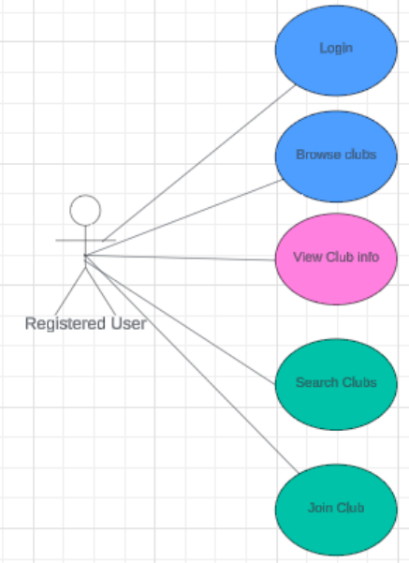
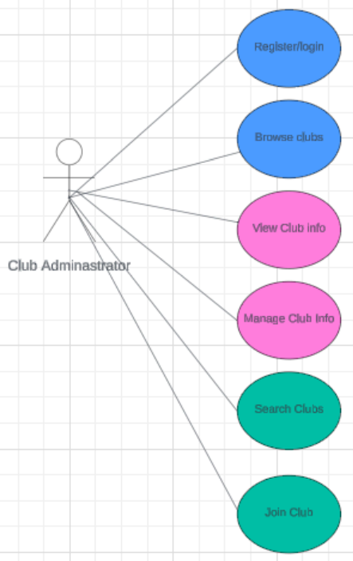
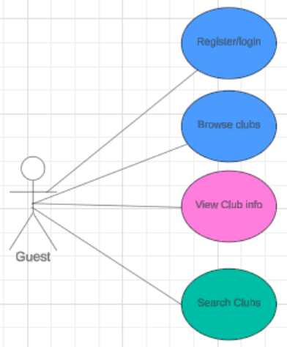
Use Case Diagram

Slide 7
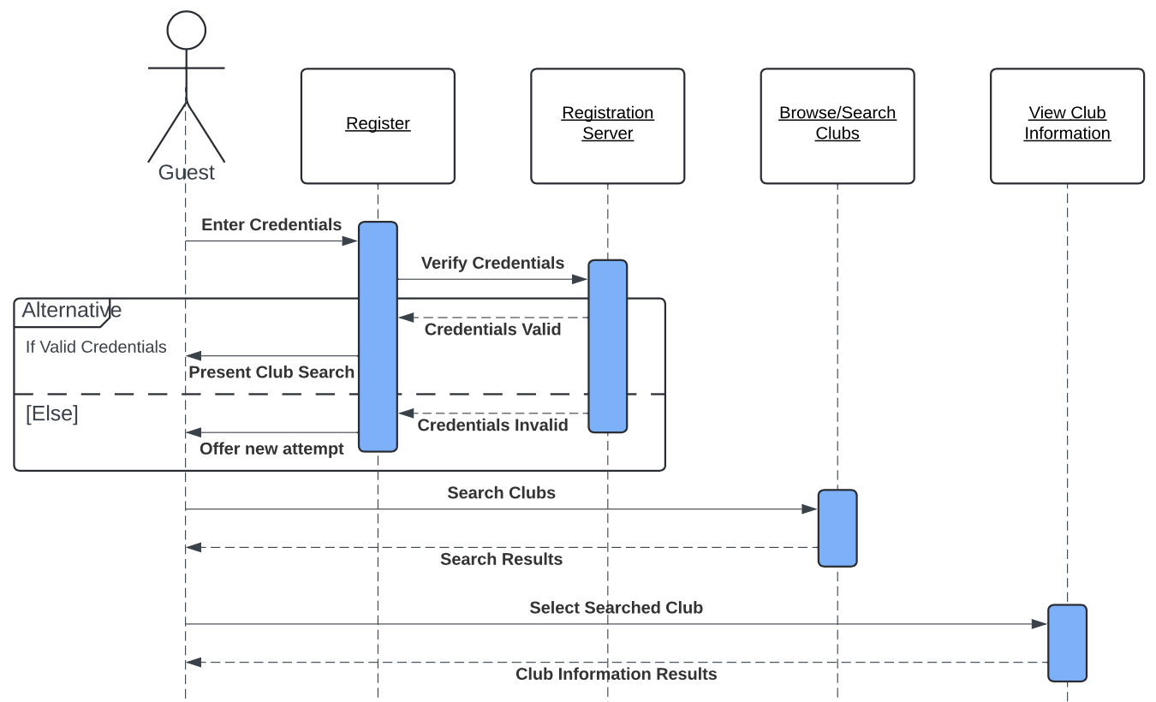
Sequence Diagram

Slide 8
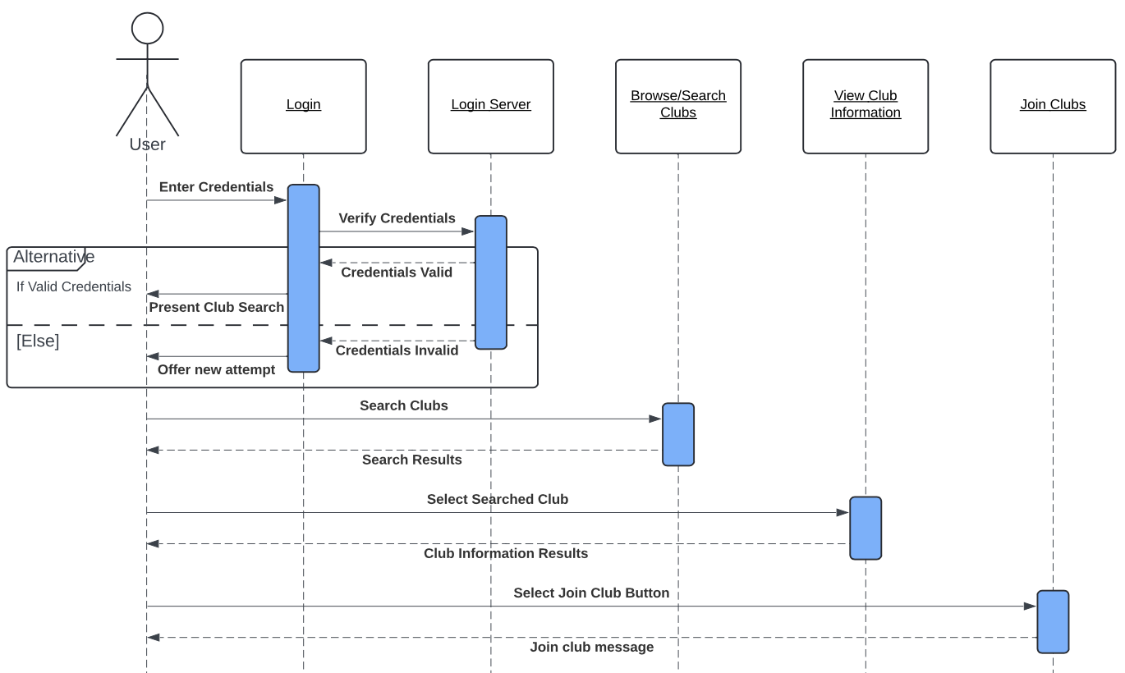
Sequence Diagram

Slide 9
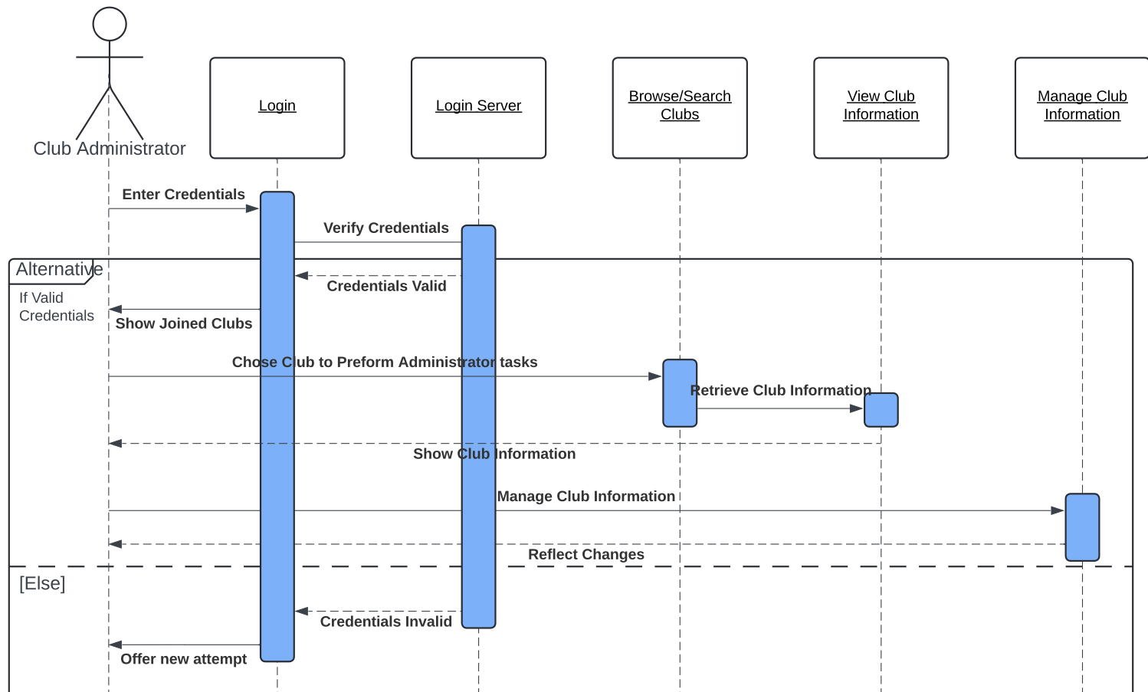
Sequence Diagram

Slide 10
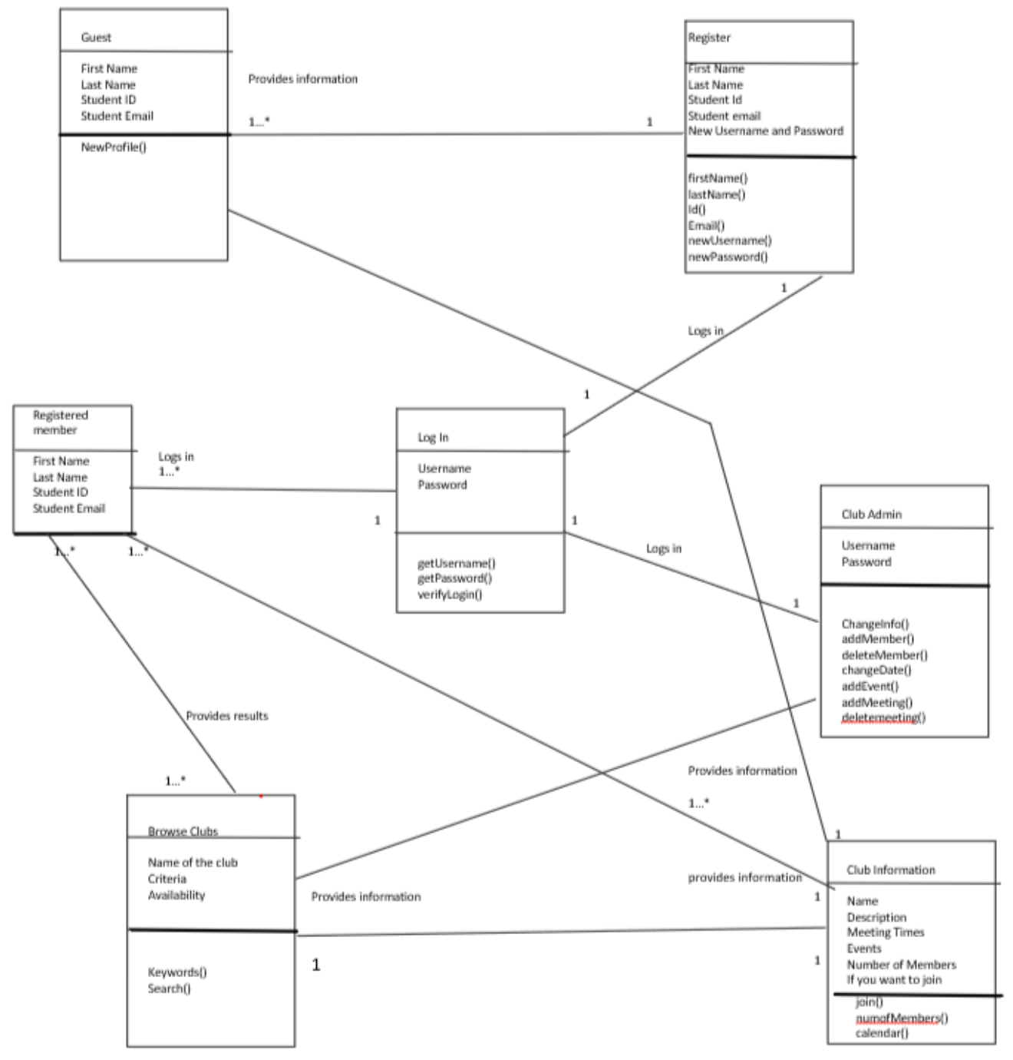
Class Diagram

Slide 11
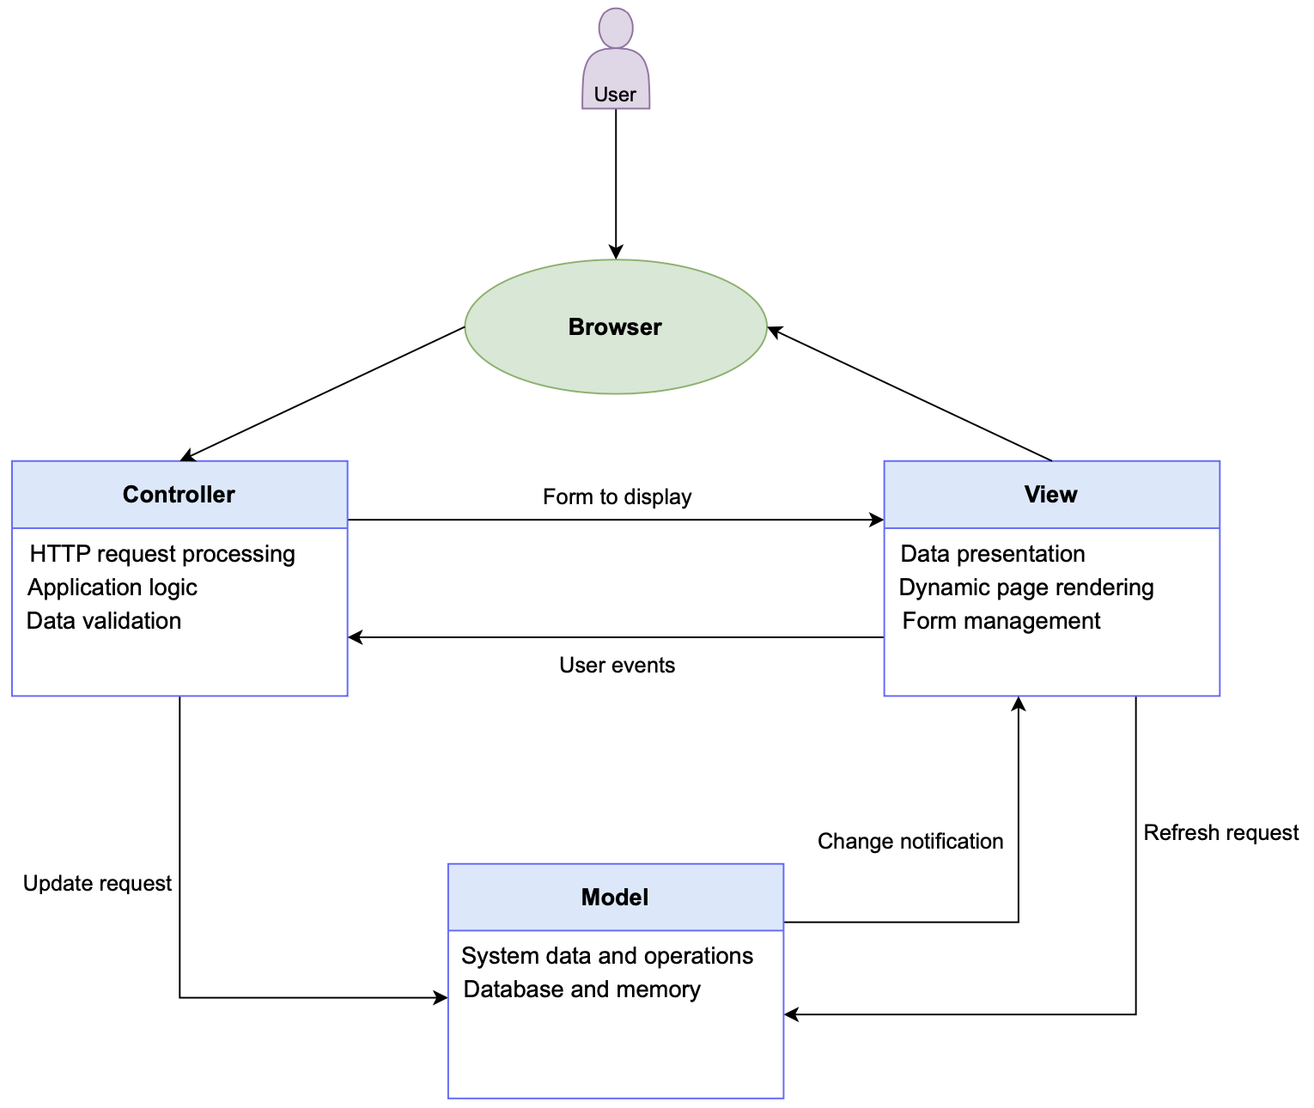
Architectural Design

Slide 12
Thanks!

