Slide 1
MUSE: trustworthy AI when medical scans are missing
Modality-Universal Selective Evidence Fusion — the full story: problem, ideas, code, results
Notes:
This deck tells the MUSE story end to end for a mixed audience: why missing scans matter, the plain meaning of every technical term, how MUSE works, why each design decision was made, how the code is built, and what the experiments show — honestly, including where MUSE does not win.

Slide 2




The story in one slide
1 · Problem
2 · Idea
3 · Build
4 · Result
Brain-tumour AI needs 4 MRI scans, but patients often miss some. Current AI fakes them or breaks.
Treat each scan as an expert giving evidence. A missing scan simply says nothing — no faking.
One 3D network per scan, evidence fusion, uncertainty and explanations, tested on 98 real patients.
Matches the best published-style methods on accuracy, and adds trustworthy uncertainty and explanations.
Notes:
Read left to right: a real clinical problem, one idea, a carefully engineered system, and measured results.

Slide 3
Chapter 1 · The problem
Why missing scans break today's medical AI
Notes:
Start with the patient.

Slide 4




A brain-tumour patient needs four kinds of MRI scan
FLAIR
T1
T1gd
T2
Highlights swelling (edema) around the tumour.
Shows normal anatomy clearly.
T1 after contrast dye: lights up the active, growing tumour.
Fluid-sensitive; shows tumour and swelling together.
The AI's job: outline the tumour and its parts on every 3D pixel (voxel) of the brain.
Notes:
Each MRI 'sequence' is the same brain photographed with a different physical setting, so each highlights different tissue. Radiologists combine them.

Slide 5
In real hospitals, scans are often missing
15
possible combinations of available scans
How today's AI copes — and why it fails
Fake the missing scan with a generative AI — the model then trusts invented data
Fill it with zeros — the network never saw that in training and fails silently
Train 15 separate models — impractical to build, validate and deploy
Drop the patient — the patients who most need help are excluded
Notes:
Emergencies, contrast allergies, scanner availability and different hospital protocols mean many patients lack one or more sequences. With 4 sequences there are 15 possible combinations of what is available.

Slide 6
Chapter 2 · The vocabulary
Every technical word, in plain language
Notes:
Four glossary slides: images, networks, evidence, and how we judge results.

Slide 7
Words about images and results
Segmentation
Colouring every voxel by what it is (healthy, swelling, tumour core, active tumour).
Voxel
A 3D pixel — here 1 mm × 1 mm × 1 mm of brain.
WT / TC / ET
Whole tumour, tumour core, enhancing (active) tumour — the three regions doctors care about.
Dice score
Overlap between AI outline and expert outline: 0 = none, 1 = perfect.
HD95
How far (mm) the AI's border strays from the true border; lower is better.
Missing modality
A scan type that was not acquired for this patient.

Slide 8
Words about neural networks
Neural network
A program that learns patterns from examples instead of hand-written rules.
3D U-Net
The standard medical-image network: shrinks the scan to see context, then expands back to full detail.
Encoder / decoder
The shrinking half (understands) and the expanding half (draws the outline).
Training / validation / test
Learn on one set, choose settings on a second, report on a third never seen before.
Seed
The random starting point of training; repeating with several seeds shows results are not luck.
Graph neural network
A network for data connected like a web (papers citing papers); used for MUSE's second test bed.

Slide 9
Words about evidence and uncertainty
Evidence (α)
How strongly a scan supports each class. α = 1 means 'no evidence at all'.
Dirichlet distribution
The maths that turns evidence counts into probabilities plus uncertainty.
Uncertainty u = C / S
Number of classes ÷ total evidence: little evidence → high uncertainty.
Dempster–Shafer theory
A theory of evidence that can say 'I don't know' instead of forcing a guess.
Vacuous mass
The formal 'I know nothing' opinion — exactly what a missing scan contributes.
Cumulative fusion
Combine opinions by adding their evidence (from subjective logic).
Notes:
These are the heart of MUSE.

Slide 10
Words about judging results fairly
Baseline
An existing method we compare against (HeMIS, RFNet, mmFormer, …).
Ablation
Remove one part of MUSE and re-test, to prove that part actually helps.
Calibration (ECE)
Does 90% confidence mean right 90% of the time? Lower error = more honest.
AUROC (error detection)
How well the uncertainty points at the AI's own mistakes; 1 = perfectly.
p-value (Wilcoxon test)
Chance the difference is luck; below 0.05 counts as significant.
Pull request (PR)
A reviewed, recorded change to the code on GitHub — our audit trail.

Slide 11
Chapter 3 · How MUSE works
A panel of experts that never fakes evidence

Slide 12
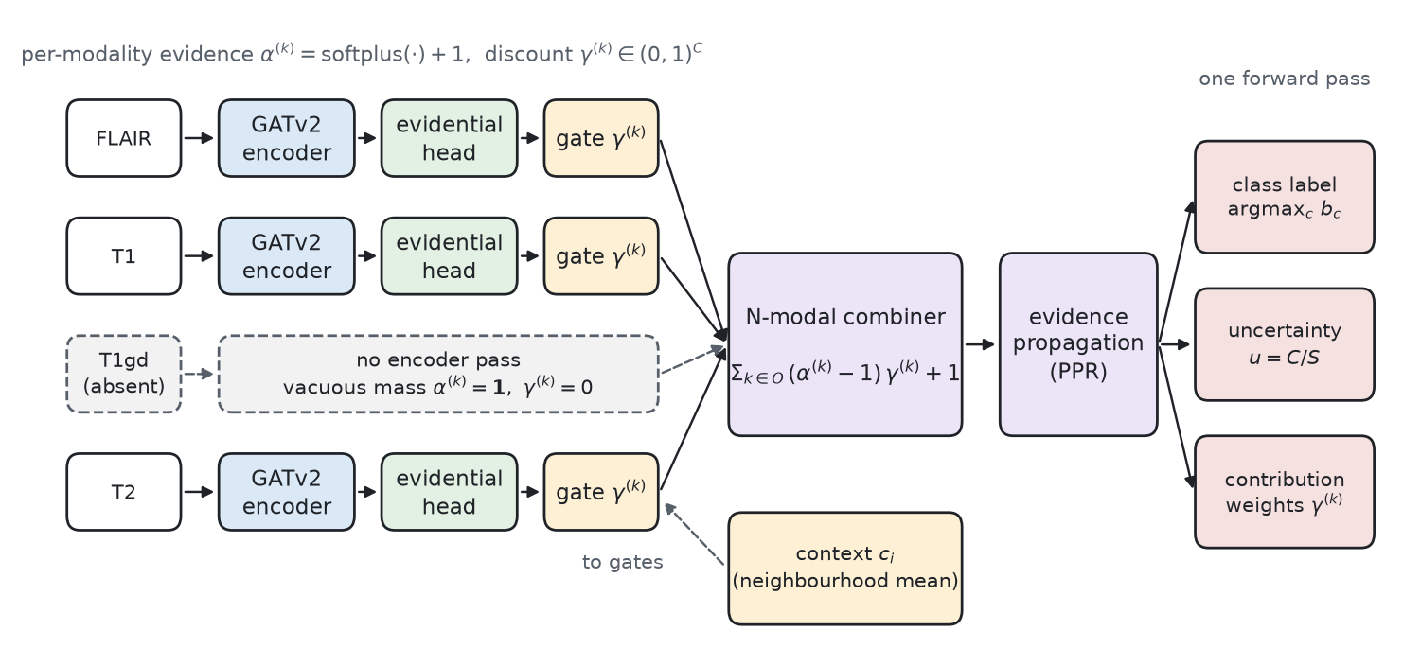
MUSE architecture: one forward pass, three outputs
Own network per scan
Missing scan = vacuous mass
Gate = trust per class & voxel
Fusion = add the evidence
Outputs: outline, uncertainty, who-said-what
Notes:
Each available scan goes through its own 3D U-Net and evidential head. Missing scans skip the network and contribute alpha = 1 (no evidence). A gate learns how much to trust each scan for each class at each voxel. Evidence is summed. Outputs: segmentation, uncertainty map, per-scan contributions.

Slide 13




The same idea as a panel of four experts
Each expert reads one scan
Missing scan → expert stays silent
FLAIR expert, T1 expert, … each marks where it thinks the tumour is.
No guessing, no invented data. Silence adds exactly nothing.
Votes are weighted by trust
Weighted votes are added up
The contrast-scan expert counts more for active tumour — MUSE learns this.
Agreement → confident. Little evidence or conflict → uncertain, and MUSE says so.

Slide 14
Three guarantees MUSE can prove
Order never matters
Fusing FLAIR then T2, or T2 then FLAIR, gives the identical answer (checked: difference 0).
Missing scans are harmless
A missing scan adds exactly zero — one model serves all 15 combinations.
More scans never raise doubt
Adding a scan can only lower uncertainty (checked on real patients: 0 violations).
Honest note: these follow from known 'cumulative fusion' maths; MUSE's novelty is the complete trustworthy system built on them.
Notes:
Because fusion is a sum of non-negative evidence: order does not matter, adding zero changes nothing, and adding evidence can only lower uncertainty. We also checked all three on real model outputs: zero violations.

Slide 15
Chapter 4 · The reasoning journey
What we changed, and why — decided on validation data only

Slide 16



First, we corrected the original plan
False claim removed
Wrong sign fixed
Honest novelty
'Dempster's rule is order-dependent' — it is not. We proved and measured it: difference 3×10⁻¹⁶.
The 'balance' term pushed scans apart instead of balancing them. Fixed; the original is kept as an ablation.
Evidence-sum fusion already exists; MUSE's contribution is the system: gate, vacuous mass, uncertainty, explanations.
Notes:
The design documents contained claims a reviewer would reject. We fixed them rather than copy them.

Slide 17
Each design step was earned on validation data
Bug found: MUSE could not learn on Amazon-Photo → added normalisation
MRI as coarse graphs capped accuracy → rebuilt as full 3D U-Nets
Same fixes given to baselines that broke (ECD, EGNN) — fairness
Notes:
Graph benchmark (Cora) validation accuracy, then the move to real 3D MRI.

Slide 18
Chapter 5 · How the code is built
From raw scans to tables and figures, reproducibly

Slide 19
The pipeline, end to end
1
Download
Public MSD brain-tumour MRI, 484 patients
2
Preprocess
Crop to brain, normalise each scan
3
Train
3D crops, random scans hidden, 12,000 steps
4
Validate
Pick best checkpoint on unseen validation patients
5
Test
98 patients × 15 scan combinations
6
Report
Tables, significance tests, real-scan figures
Every number in the papers is produced by this code from saved result files — never typed by hand.
Notes:
Raw MRI download, preprocessing (crop to brain, normalise each scan), random 3D crops with randomly hidden scans during training, model selection on validation patients, testing on 98 unseen patients across all 15 combinations, then tables and figures straight from the saved results.

Slide 20
How the code is organised
muse3d/models.py
MUSE and every MRI baseline on one shared 3D U-Net backbone
muse3d/losses.py
Evidence loss + Dice loss; each model's own training objective
run_mri3d.py
Preprocess → train (resumable) → test all 15 combinations
muse/ & run_graph.py
Graph version of MUSE and the citation / product benchmarks
aggregate*.py, figures/
Tables with significance tests, and every figure
tests/
14 automatic checks, e.g. a missing scan can never change the output
Notes:
Small, readable modules. Each file has one job.

Slide 21




How we kept it rigorous
Tested code
No peeking at test data
14 automatic tests: properties hold, missing scans have zero effect, fast paths equal slow paths.
All choices on validation data; test results computed once at the end.
Every change reviewed
Compute where it fit
Feature branch → pull request → review → merge: a complete audit trail on GitHub.
Mac for testing, free Colab and Kaggle GPUs for training, resumable from checkpoints.

Slide 22
Chapter 6 · What we found
98 unseen patients, 15 scan combinations, 7 methods

Slide 23
Brain-tumour MRI: overall accuracy
Tie at the top
MUSE matches the strongest specialised methods and significantly beats HeMIS, LateMean and the standard U-Net.
Notes:
Mean Dice over whole tumour, tumour core and enhancing tumour, averaged over all 15 combinations. MUSE vs mmFormer-style and RFNet-style: no significant difference (a tie). MUSE vs HeMIS, LateMean, UNet-MD: significantly better.

Slide 24
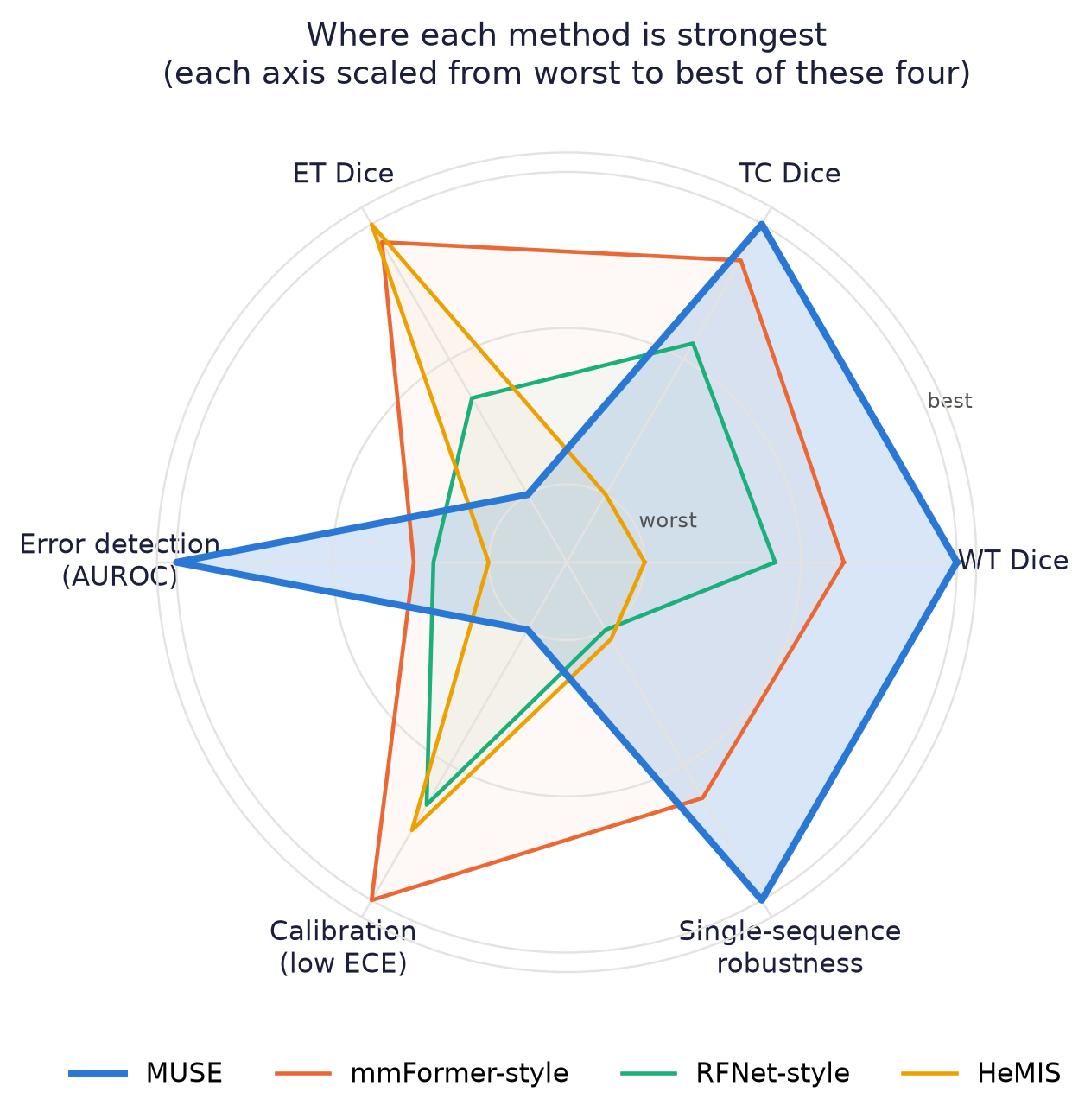
Each method's strengths at a glance
MUSE leads: whole tumour, tumour core, error detection, single-scan robustness
mmFormer-style leads: enhancing tumour, calibration
Axes scaled worst → best of these four, so gaps look larger than they are
Notes:
Each axis is scaled from the worst to the best of these four methods, so differences look larger than they are; the actual numbers are on the previous and next slides. MUSE leads on whole tumour, tumour core, error detection and single-sequence robustness; mmFormer-style on enhancing tumour and calibration.

Slide 25
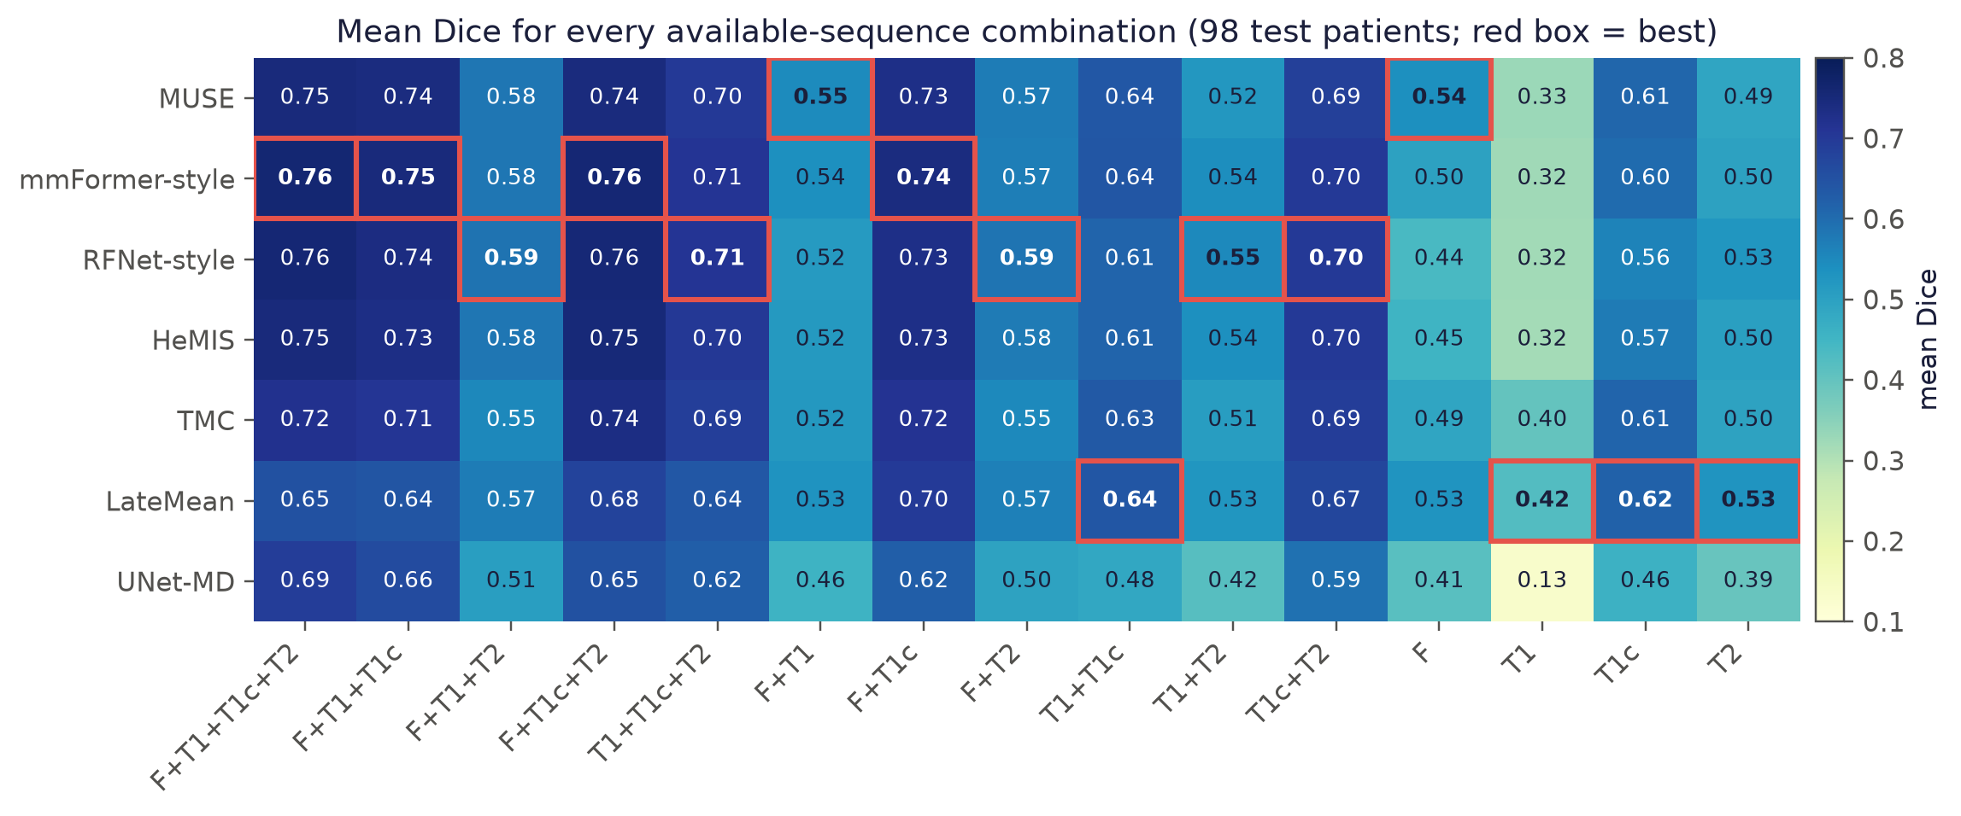
Every scan combination, every method
Notes:
Mean Dice for each of the 15 combinations of available scans (red box = best in that column). The top methods are usually within 0.01 of each other; MUSE is best with all scans but T2 and with FLAIR alone.

Slide 26
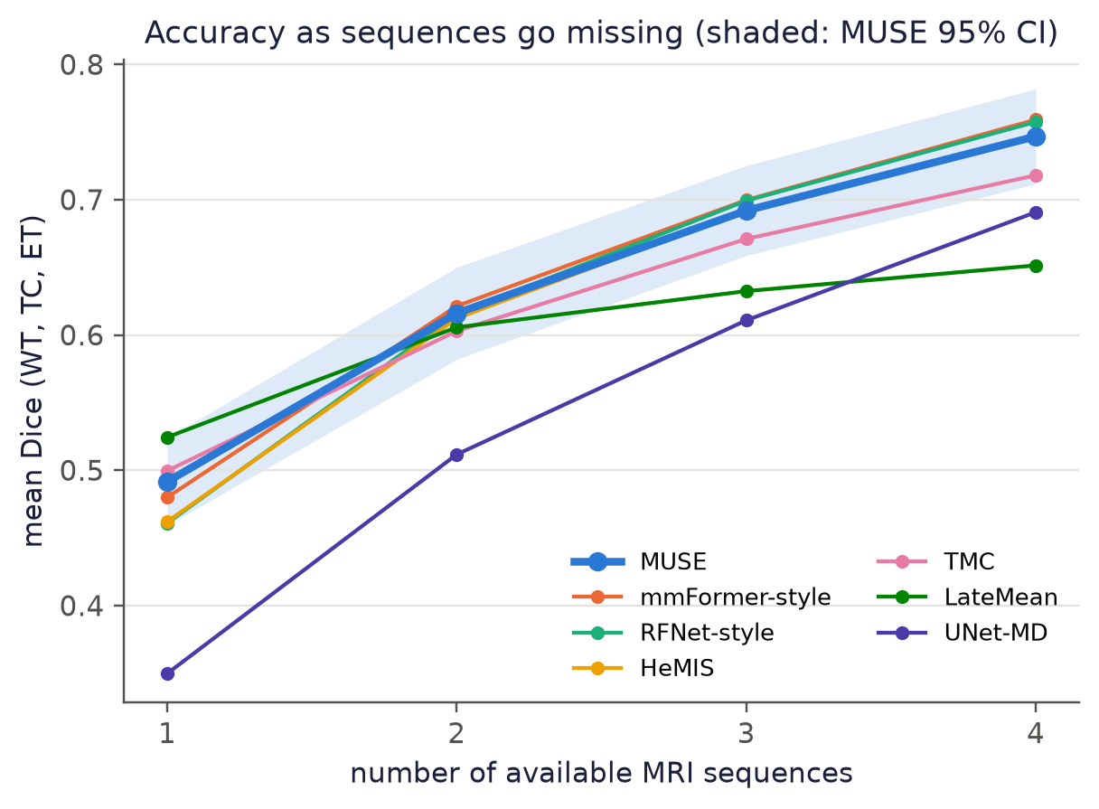
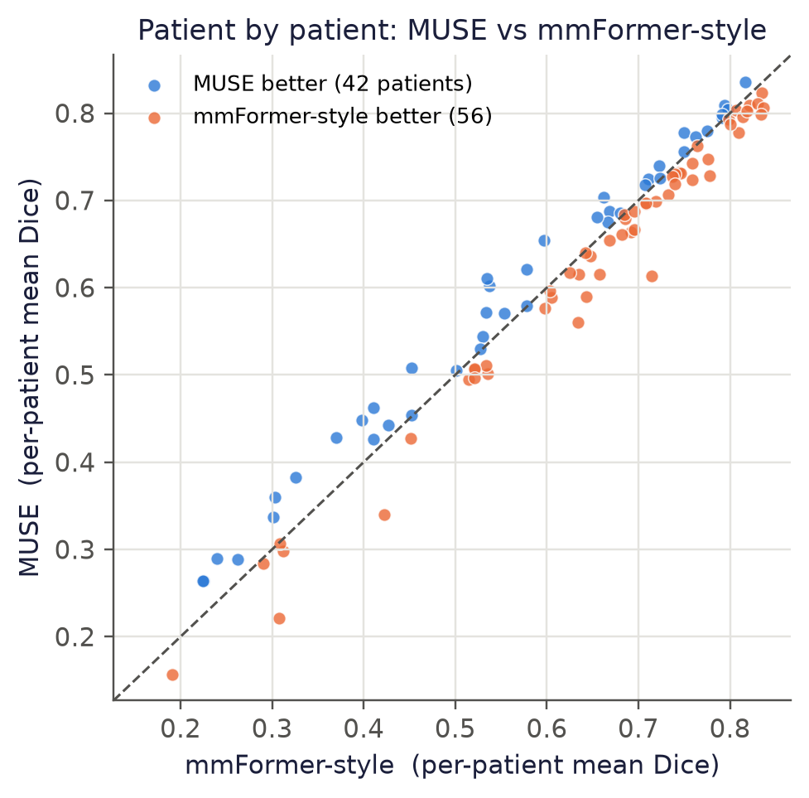
MUSE helps most where segmentation is hardest
On hard patients (lower-left), MUSE is mostly above the line.
Notes:
Left: Dice as scans go missing; all strong methods degrade similarly. Right: each dot is one patient. mmFormer-style wins more patients overall, mostly easy ones; MUSE wins most of the hard, low-Dice patients.

Slide 27
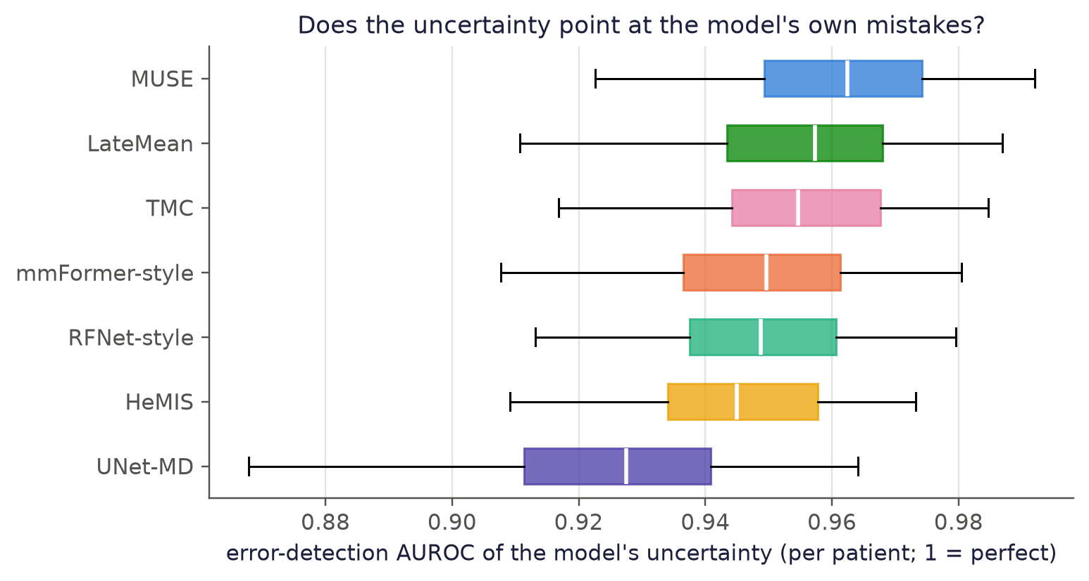
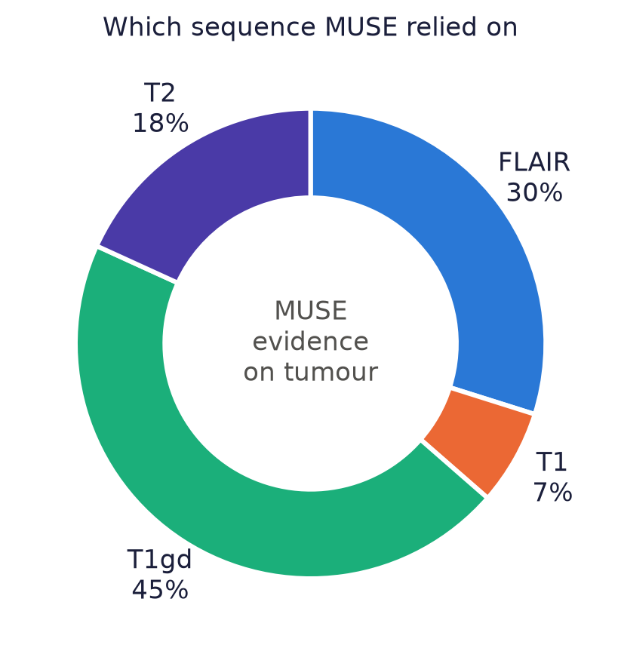
MUSE knows when it is wrong — and shows why
Notes:
Left: how well each method's uncertainty flags its own mistakes, per patient — MUSE is clearly best. Right: the share of evidence MUSE drew from each scan on tumour voxels, matching how radiologists read these scans.

Slide 28
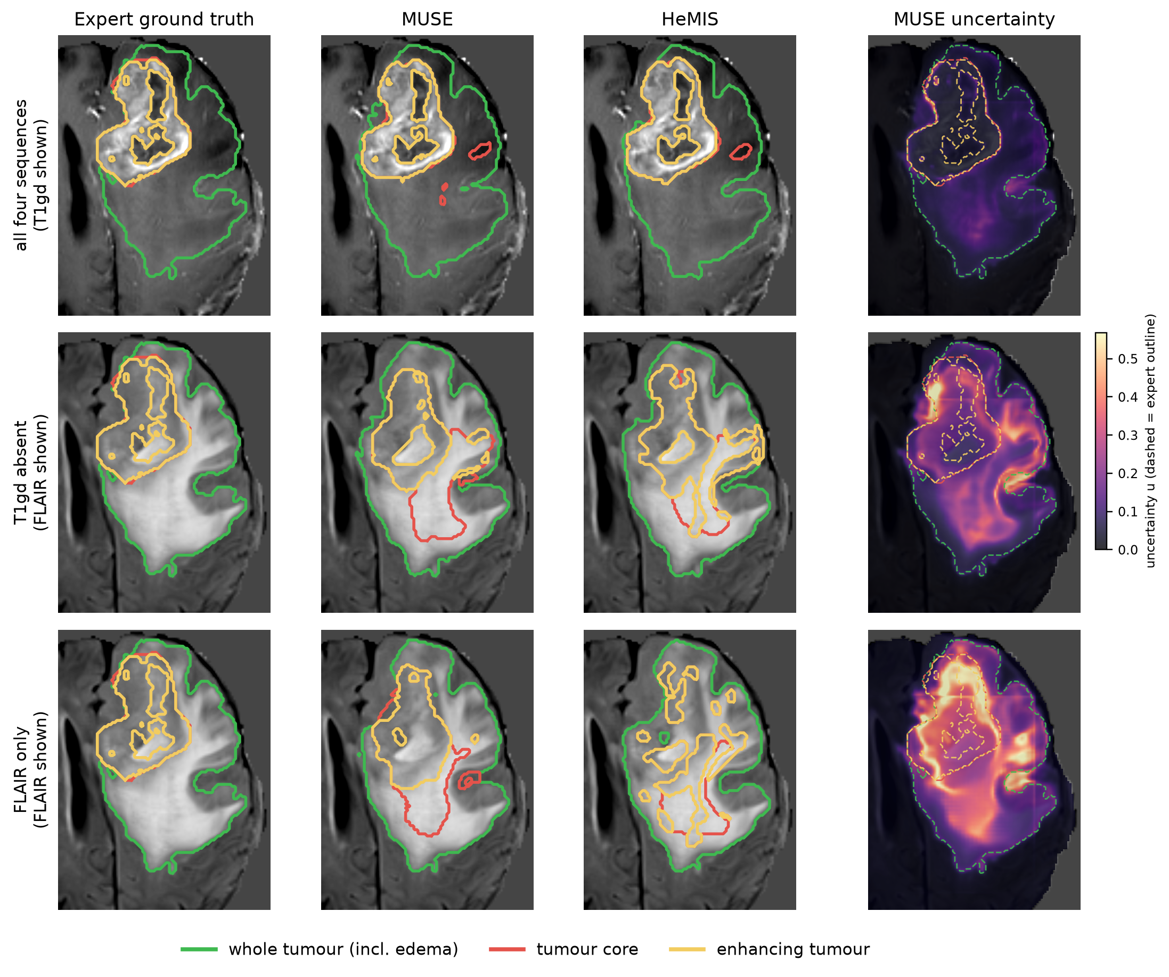
A real unseen patient, scans removed one by one
Notes:
Zoomed real MRI with outlines: green = whole tumour, red = tumour core, gold = enhancing tumour. Columns: expert, MUSE, HeMIS, MUSE's uncertainty (expert outline dashed). As scans disappear, MUSE stays closer to the expert and its uncertainty lights up exactly where it is unsure.

Slide 29
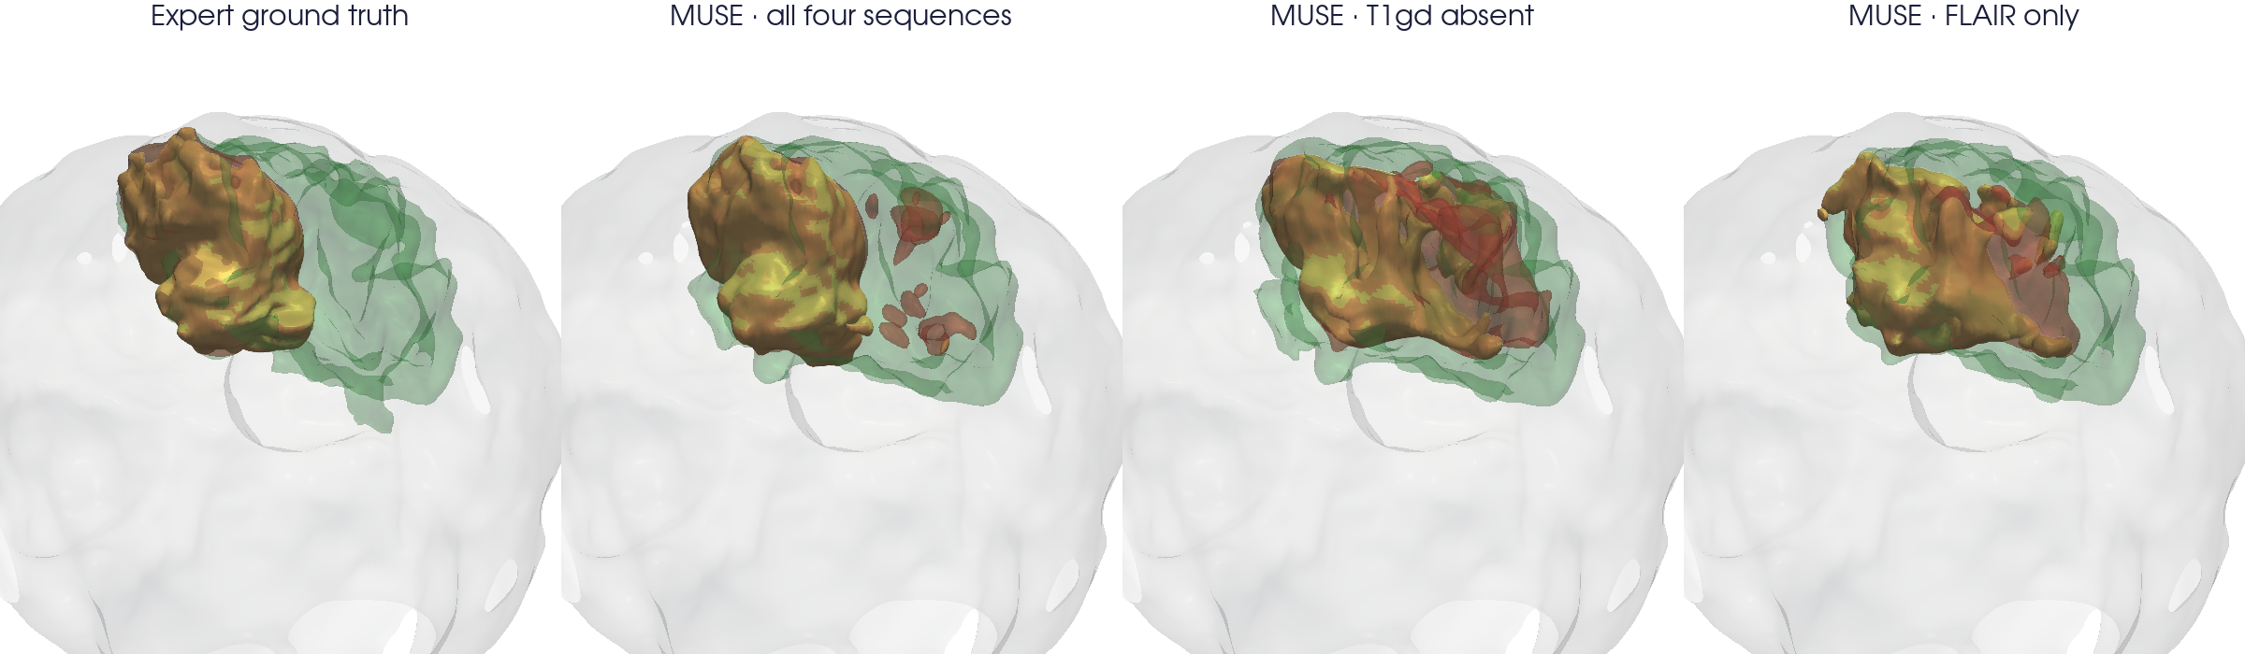
The tumour in 3D: expert vs MUSE
With all four scans MUSE reproduces the expert's tumour shape; with fewer scans it degrades gracefully instead of breaking.
Notes:
Real 3D surfaces inside a translucent brain: swelling (green), tumour core (red) and enhancing tumour (gold). From left: expert, MUSE with all four scans, without T1gd, with FLAIR only.

Slide 30
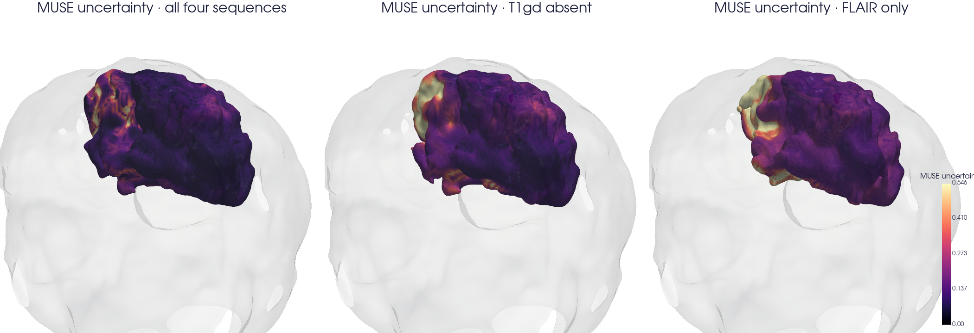
MUSE's doubt, painted on the tumour
Notes:
MUSE's uncertainty on the 3D tumour surface. Dark = confident, bright = unsure. Removing scans makes the doubt grow exactly at the tumour border, where mistakes happen.

Slide 31
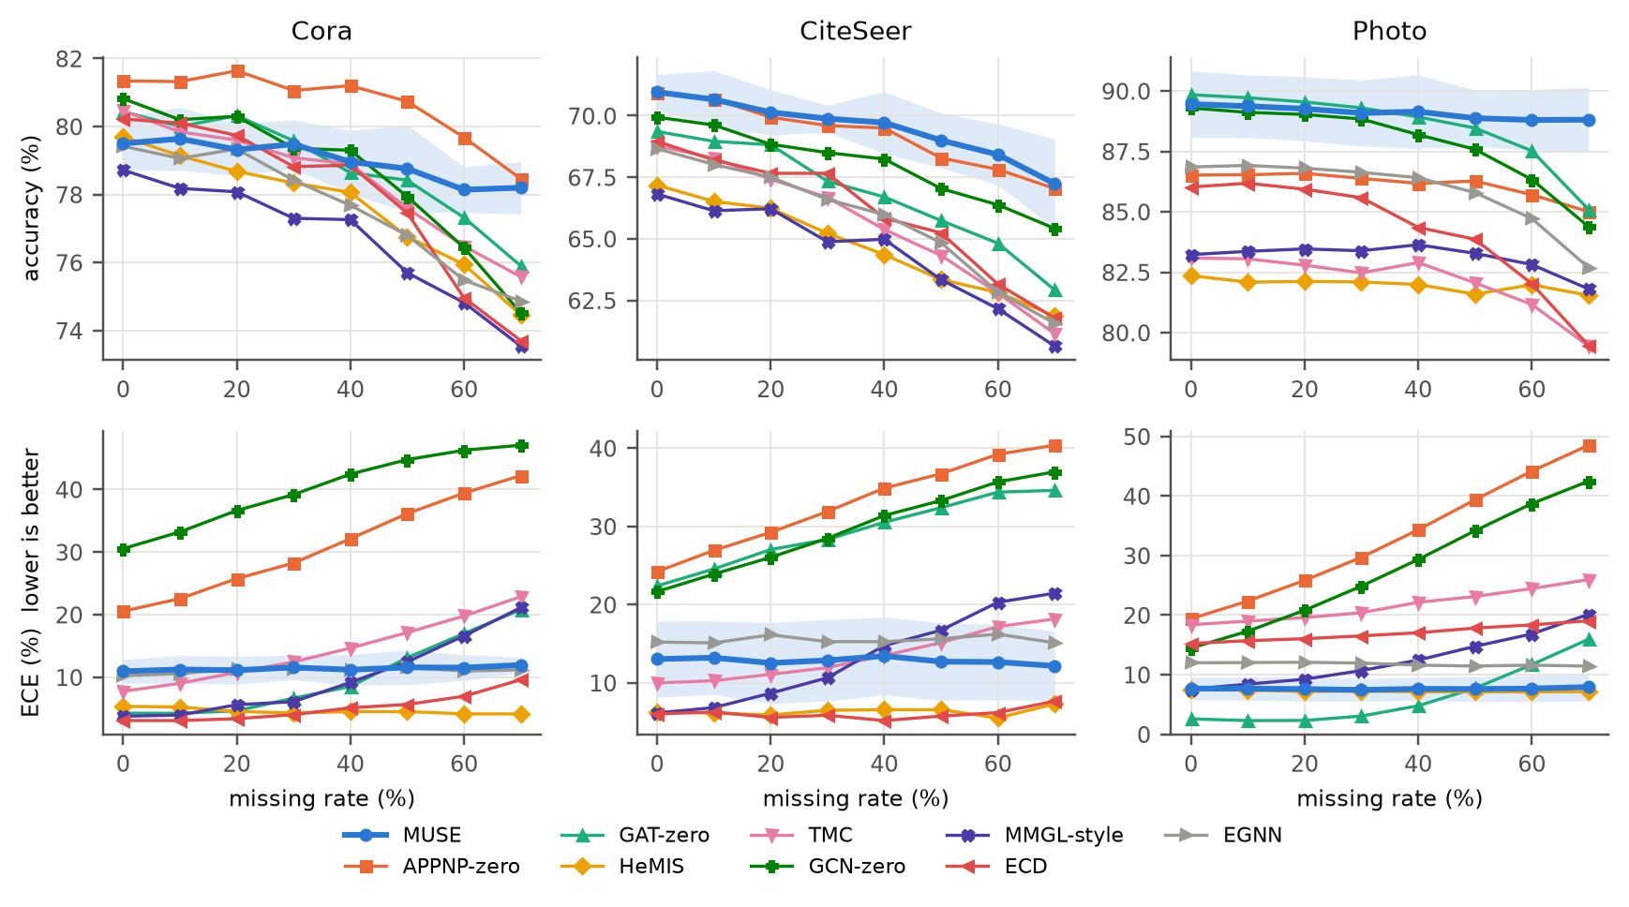
The same idea works beyond MRI: graph data
CiteSeer 69.5%
best of 9
Amazon-Photo 89.1%
best of 9
Cora 79.0%
2nd (APPNP 80.7%)
Notes:
Citation and product graphs with four feature groups as 'modalities', randomly missing per node. Test accuracy over 0–70% missing, 5 seeds; MUSE degrades least as features go missing.

Slide 32
Ablations prove each part earns its place
Removing the gate costs 2.6 points (p = 6×10⁻¹¹)
Dempster's rule instead of sum costs 0.8 points (p = 0.009)
Fusion order: MUSE and Dempster give identical answers in any order; Yager, PCR5 and averaging do not
Notes:
Remove a part, retrain, retest on the same 98 patients. p-values are paired Wilcoxon tests against full MUSE.

Slide 33
Chapter 7 · Where we are
Status, the open question, and the papers

Slide 34




Status and next steps
Done
Running now
All experiments: 7 MRI methods × 98 patients, 9 graph methods × 3 datasets × 5 seeds, ablations, real-scan figures.
MUSE2: lets scans share context inside the network, aiming to pull clearly ahead of mmFormer. Kept only if it wins on validation.
Papers
Reviewers may ask
IEEE Transactions journal (method + theory + MRI + graphs) and CARES 2027 (MRI + explainability).
More training seeds for MRI, and published RFNet/mmFormer numbers on BraTS — we will address both.

Slide 35
MUSE never fakes a missing scan
It says what it knows, how sure it is, and which scan told it — at the accuracy of the best specialised methods.

