Slide 1
FINAL YEAR PROJECT
BASELINE
Visual Regression
Workbench
CURRENT
Visual testing that tells you what broke — not just that something did
DIFF → CLASSIFY
Tan Kia Yen A6 Marketing & Technical Presentation
Notes:
[0:00-0:15] Hi, I'm Tan Kia Yen, and this is the Visual Regression Workbench - a testing platform that catches unintended changes to a website's appearance and names them. First the product pitch, then how it was built.

Slide 2
THE CLIENT AND THE ISSUE
Right translation, broken page
CLIENT
The string is fine
Translation QA checks the words. It does not check that they still fit — expansion, truncation, font fallback and RTL mirroring break layouts that were correct in the source language.
Centific
Enterprise AI data company - multilingual datasets, AI localisation and internationalisation
Delivers data and evaluation across 200+ languages and regional variants
A global expert network performs the human evaluation of localised output
Enterprise customers including Microsoft
2,000 screens
40 screens × 25 locales × 2 devices, for one release. Human review is accurate, and its cost is linear in that number.
A pixel diff cannot help
Every localised page differs from the source by design. "Something changed" carries no information here — the useful question is what changed.
From Centific's published company information.
Nothing in a build pipeline looks at the rendered page.
Illustrative arithmetic, not a Centific figure. The shape is what matters: verification cost multiplies by locale.
Notes:
[0:15-0:57] The client is Centific - an enterprise AI data company doing multilingual datasets, AI localisation and internationalisation across more than two hundred languages, with a global expert network doing the human evaluation. Here is the problem in that line of work. Translation QA checks the string; it does not check that the string still fits. Expansion, truncation, font fallback and right-to-left mirroring break layouts that were perfectly correct in English. The cost multiplies - forty screens across twenty-five locales on two devices is two thousand rendered screens for a single release. And a pixel differ cannot help, because every localised page differs from the source by design.

Slide 3
TARGET MARKET
Who this is for, and what they use today
WHAT THEY BUY TODAY
Primary
Hosting
Cost model
Localisation and globalisation vendors, and the in-house teams they deliver into - anyone signing off the same product in many locales.
Percy (BrowserStack)
Cloud only
Free to 5,000 snapshots/mo,
then from $199/mo
The niche we own
Chromatic
Cloud only
Free to 5,000 snapshots/mo,
paid from $149/mo
Multi-locale UI verification. Locale, timezone and device are part of a baseline's identity, so the Japanese page is judged against the approved Japanese page - never against English. And it self-hosts, which matters when the screens belong to an enterprise client.
Applitools Eyes
Cloud
Quote only — no public price
Secondary
Visual Regression
Workbench
Your own machines
(docker-compose up)
No per-snapshot fee,
no snapshot ceiling
Product teams shipping weekly in one or two languages, and agencies running many client sites on one deployment.
All three meter by snapshot - and a localised product multiplies snapshots by locale count.
Notes:
[0:57-1:40] So who is this for? Primarily localisation vendors and the teams they deliver into - anyone who has to sign off the same product in many locales. The niche is multi-locale verification: locale and device are part of a baseline's identity, so the Japanese page is judged against the approved Japanese page, and it self-hosts, which matters when the screens belong to an enterprise client. Today the alternatives are Percy, Chromatic and Applitools. All three are cloud-only, and all three meter by snapshot - which is the wrong pricing shape here, because a localised product multiplies snapshot count by the number of locales.

Slide 4
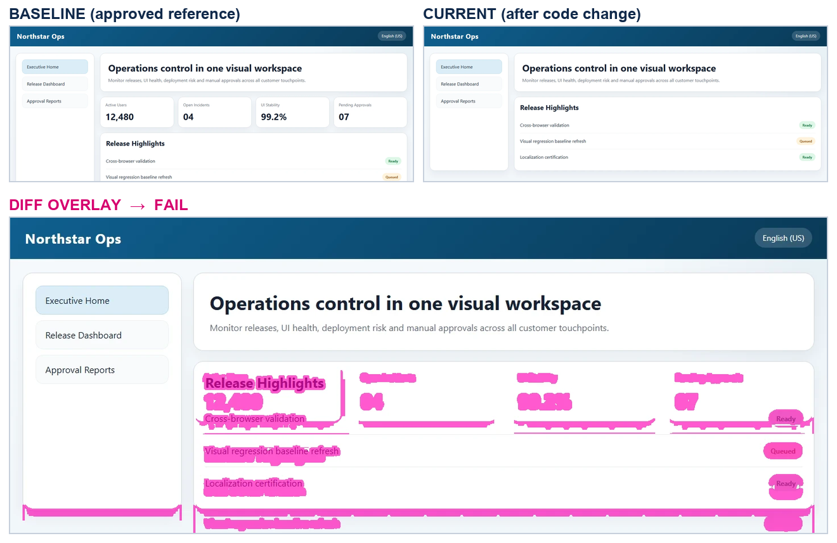
WHY THEY SWITCH
Four things the alternatives do not do
It names the defect
1
Not "2.7% of pixels changed" but "missing-element", with the element and its coordinates. The reviewer acts without opening the page.
It stays trustworthy
2
Structural confirmation and drawable ignore regions keep dynamic content from crying wolf, so the suite does not get muted.
It compares like with like
3
Locale and device are part of a baseline's identity, so the Japanese page is judged against the approved Japanese page - not against the English source.
What the client sees: the approved page, the page after a change, and the difference — already labelled.
It runs on their machines
4
One docker-compose command. No screens leave the network, and no snapshot ceiling to plan around.
Half a day of manual checking becomes a list of named defects waiting for approval.
Notes:
[1:40-2:18] Four things make a team switch. It names the defect - not "2.7% of pixels changed" but which element went missing and where, so the reviewer acts without opening the page. It stays trustworthy, because structural confirmation stops dynamic content from crying wolf, and false alarms are why teams mute these suites. It compares like with like, so the Japanese page is judged against the approved Japanese page rather than the English source. And it runs on their machines with one command. Half a day of clicking becomes a short list of named defects.

Slide 5
MARKETING MIX
Seven Ps, aimed at one buyer
Product
Price
Place
Promotion
A self-hosted platform, not a library: capture, classify, review, approve. The Playwright SDK is the wedge — one line in a suite they already have.
Free and self-hosted. Localisation multiplies snapshots by locale count, which is exactly where per-snapshot pricing hurts most - here that multiplication costs nothing.
GitHub repository and a Docker image. `docker-compose up` and a GitHub Actions template; no procurement, no sales call.
Developer-led. The ablation write-up is the lead content, the reproducible 81/81 benchmark is the proof, and a side-by-side page against Percy is the landing page.
People
Process
Physical evidence
One maintainer, so the docs and the decision records do first-line support. Issues are triaged in public where the answers stay searchable.
Fifteen minutes to first result: install, capture baselines, gate the next pull request, review in the dashboard, approve — and the approval writes back to the report.
A public CI badge, a benchmark anyone can re-run, a live demo portal, and a standalone HTML report for every run.
Every P is answered by something that already exists in the repository — not by a plan for one.
Notes:
[2:18-3:05] The mix is aimed at that buyer. The product is a platform, and the Playwright SDK is the wedge - one line inside a suite they already run. Price is the lever: self-hosted and free, so multiplying snapshots by locale count costs nothing, which is exactly where the metered tools hurt. Place is GitHub and a Docker image, so adopting it needs no procurement. Promotion is developer-led - the ablation write-up is the lead content, the re-runnable benchmark is the proof. People is one maintainer, so the docs and decision records carry first-line support. Process is fifteen minutes to a first result. Evidence is a public CI badge and an HTML report for every run.

Slide 6
PART TWO
How it was built
Technologies and the reason each one is there, the development process, the code, and the evidence that it works.
Playwright
PyTorch
OpenCV
FastAPI
React + Vite
Docker
Notes:
[3:05-3:15] That was the pitch. The rest is for a technical audience: what it is made of, the code that does the work, and the evidence that it works.

Slide 7
TECHNOLOGIES USED
Each choice answers a requirement
Playwright
OpenCV + SSIM
PyTorch — ResNet50 Siamese
Capture must be repeatable across Chromium, Firefox and WebKit, and must pin locale, timezone and device in one API. A capture that drifts makes every later comparison meaningless.
Detection has to be fast, deterministic and inspectable. Pixel deltas are grouped into regions and merged, so the answer is a bounded box, not a scatter of pixels.
The task is literally "compare two images", which is what a siamese head is for, and ImageNet pre-training is what makes it trainable on a project-sized labelled set.
FastAPI
SQLite → PostgreSQL
Docker + GitHub Actions
Async request handling for long captures, dependency injection for the role checks, and an OpenAPI reference generated from the code rather than maintained beside it.
Zero-config by default so setup stays fifteen minutes; one shared base store means a team that outgrows SQLite changes a connection string, not a code path.
Chromium renders text differently per platform, so baselines are captured inside the project's own image. A check that captures its reference on the machine under test cannot fail.
Nothing on this list is a paid service. That is what lets the product ship as something the client runs themselves.
Notes:
[3:15-3:55] Every technology here answers a requirement. Playwright, because capture must be repeatable across three engines and must pin locale, timezone and device - a capture that drifts makes every later comparison meaningless. OpenCV for detection, because that half must be deterministic and inspectable, and the answer needs to be a bounded region. A ResNet50 siamese head, because the task is literally comparing two images, and pre-training makes it trainable on a labelled set this size. And Docker, because Chromium renders text differently on every platform - so baselines are captured inside the project's own image.

Slide 8
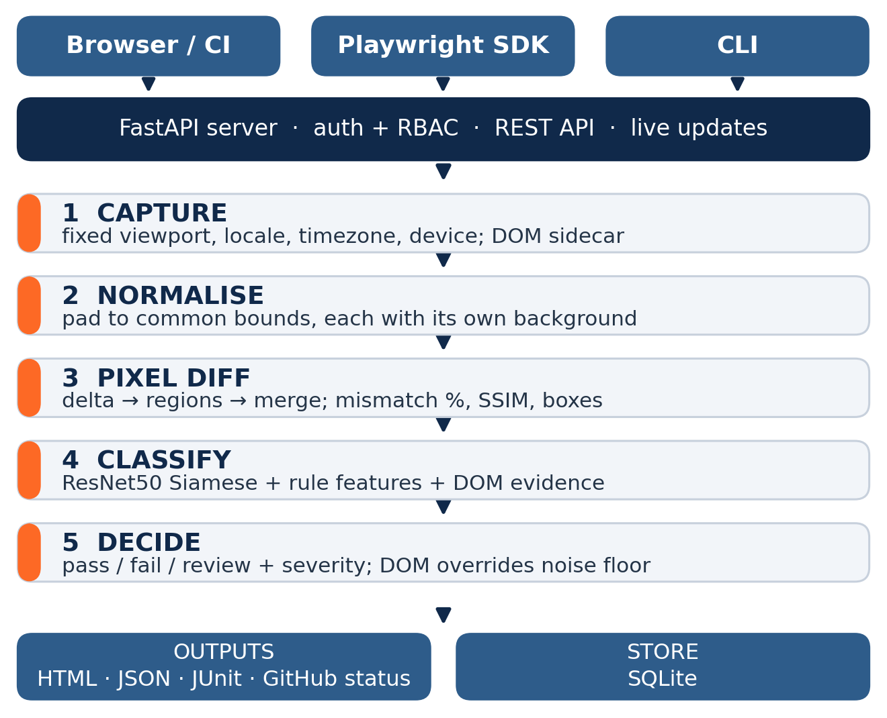
DEVELOPMENT PROCESS
Built so the claims can be checked
Decisions are recorded, not remembered
Every choice that would otherwise look arbitrary has an ADR — why detection and classification are separate metrics, why baselines are committed but models are not.
The DOM capture script lives on the server
The SDK fetches it from an endpoint instead of duplicating it in TypeScript, so a field added to the capture reaches every client without an SDK release.
The ablation drove the code
It exposed four inference paths zero-padding the pixel-structural columns — the model had been trained on evidence it never received in production. Fixing that meant retraining.
Verified continuously 1,098 automated tests, a detection benchmark that fails the build on a single miss, and a separate smoke test proving the AI path actually executed.
Notes:
[3:55-4:35] Three things about the process. Anything that would look arbitrary later is written down as a decision record - why detection and classification are separate metrics, why baselines are committed but models are not. The DOM capture script lives on the server and the SDK fetches it, so the two can never drift. And the ablation drove real code changes: it exposed four inference paths zero-padding the pixel columns, meaning the model was trained on evidence it never received in production. Around eleven hundred tests and a benchmark that fails on one miss gate all of it.

Slide 9
THE CODE
The two lines that make it more than a pixel differ
visual_regression/decision.py
sdk/src/index.ts — used from a client's test
# A CNN score is a probabilistic guess, so it is # gated behind pixel corroboration. # A DOM-diff verdict is not a guess.
dom_confirmed = bool( ai_assessment.get("dom_confirmed"))
passed = not (meaningful and (pixel_fail or dom_confirmed))
decision_source = "hybrid"
test('homepage', async ({ page }) => { await page.goto('https://acme.com');
// uploads the DOM alongside the // screenshot - one evaluate() away, // since we already hold the Page
await visualSnapshot(page, 'homepage');
});
A removed element can be a tiny fraction of the page's pixels and still be a real defect. This is the line that stops the noise floor from swallowing it.
An image-only upload leaves structural comparison nothing to work with. That is why the SDK sends both — and why an existing suite gets the full analysis from one line.
Underneath: diagnose_from_dom_diff() buckets every baseline element, then resolves in priority order — id-backed missing before text, font, colour, then identity-less missing last.
Notes:
[4:35-5:15] Here is what separates this from a pixel differ. On the left, the decision function. A CNN score is a guess, so it is gated behind pixel corroboration - otherwise developers get nagged by false failures and stop trusting the build. But a DOM-diff verdict is not a guess, so it bypasses that gate. Without this line, a removed element covering very few pixels silently passes. On the right is the whole client-side integration: one call, uploading the DOM alongside the screenshot. Image-only would leave structural comparison nothing to work with.

Slide 10
THE CODE
The function the ablation points at
visual_regression/ai_features.py — diagnose_from_dom_diff()
Why this is the contribution
# every baseline element is bucketed, then buckets are # resolved in priority order - not in document order
if failed_to_load:
return "broken-image", ( f"the <img> at ({x},{y}) still occupies its " f"{w}x{h} box but decoded to nothing")
if missing_generic_strong: return "missing-element", ... if text_issue: return "text-issue", ... if font_changed: return "font-change", ... if color_changed: return "color-regression", ...
# identity-less "missing" is the noisiest verdict here, # so it is the fallback rather than the first check
if missing_generic_weak: return "missing-element", ...
It compares real element geometry, tags, fonts and colours from two page loads, so it generalises to a site it has never seen — no training data required.
Scanning in document order picked up whichever side effect came first, not the cause: removing an image reflows everything under it. Bucketing first and resolving by priority fixes that.
The second return value is the evidence sentence printed in the report — a claim the reviewer can check against the page, rather than a confidence score.
Remove this function and the same model scores 38.7% instead of 94.8%.
Notes:
[5:15-5:55] This is the function the ablation points at. It compares real element geometry, tags, fonts and colours from two page loads, so it generalises to a site it has never seen - no training data needed. The ordering is the interesting part. Scanning in document order picked up whichever side effect came first, not the cause - removing an image reflows everything below it. So elements are bucketed, then resolved by priority, with identity-less "missing" last because it is the noisiest verdict. And the second return value is the evidence sentence printed in the report - a claim the reviewer can check.

Slide 11
DOES IT ACTUALLY WORK
Measured, and re-measured on every push
81 / 81
0 / 9
94.80%
injected defects detected
false alarms on clean controls
change type named correctly, n = 500
Notes:
[5:55-6:35] Detection and classification are scored separately, because they fail differently. Detection: eighty-one of eighty-one injected defects caught, zero false alarms on nine clean controls. Classification: 94.8% over five hundred trials on real pages, confidence interval 92.85 to 96.75. The ablation shows where that comes from - removing either feature group moves accuracy under a point, but removing the DOM engine drops it to 38.7, with colour, text and font at zero recall. The structural comparison is the contribution, not the network. Weakest class is missing-element at 87.7%, and that is where the remaining work is.

Slide 12
LIVE DEMONSTRATION
Seven minutes inside the tool
1
0:45
2
1:00
3
1:00
Dashboard tour
Create a baseline
Run the comparison
runs, filters, status and severity at a glance
from a URL, with language and device pinned
against the same page carrying an injected defect
4
1:15
5
1:00
6
2:00
Read the verdict
Ignore region, then approve
The code and the CI gate
overlay, severity, named class, and the DOM evidence sentence
draw over the dynamic block, re-run, approve — written back to the report
the three files in the editor, then the build that fails on one miss
http://127.0.0.1:8130/
Notes:
[6:35-6:45] Now let me show you the tool doing the client's Thursday, and then the code and the CI gate behind it. [SWITCH TO SCREEN RECORDING - dashboard on port 8130, demo portal in the next tab, VS Code behind]

Slide 13
Thank you
Tan Kia Yen
Visual Regression Workbench
Questions welcome.
Try it
docker-compose up --build
Reproduce the number
python scripts/live_eval_multiseed.py
--seeds 10 --trials 50
The buyer
teams shipping weekly, self-hosting, multi-language
The edge
it names the defect, and it runs on their machines
The proof
81/81 detected, 94.80% named, re-run on every push
Notes:
[after the demo, 0:15] To close: the buyer ships weekly, must self-host, and serves more than one language. The edge is that it names the defect instead of reporting a percentage. The proof is 81 of 81 detected and 94.8% named correctly, re-measured on every push. Thank you.

