Slide 1
FINAL YEAR PROJECT
BASELINE
Visual Regression
Workbench
CURRENT
Catching and naming unintended UI changes with DOM-fused deep learning
DIFF → CLASSIFY
Tan Kia Yen Bachelor of Computer Science vr-workbench
Notes:
[0:00-0:15] Hi, I'm Tan Kia Yen. My final year project is the Visual Regression Workbench — a testing platform that catches unintended changes to a website's appearance and tells you what kind of change it is. I'll cover the problem, the system, the results, then show you the tool.

Slide 2
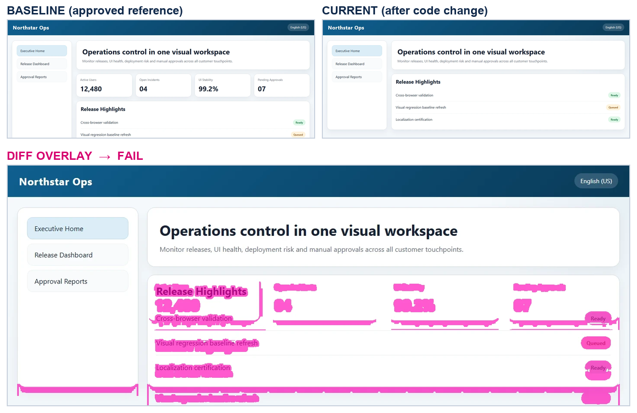
THE PROBLEM
A page can break without anything failing
Tests pass, the page is wrong
1
A missing CTA, a broken image or a shifted card throws no error. Unit and API tests stay green.
Review does not scale
2
Every release means re-checking pages across browsers, devices and locales, by eye.
Cost lands on the user
3
The same page before and after a code change, and the pixel diff the tool produces.
A broken checkout button is found by customers, not by the pipeline.
Notes:
[0:15-0:45] Visual bugs are a blind spot. Nothing throws an exception when a call-to-action disappears or an image fails to decode, so the test suite stays green while the page is broken. The fallback is a human checking every page across browsers, devices and languages, which does not scale. On the right: the approved baseline, the page after a code change, and the difference the tool highlights.

Slide 3
WHERE EXISTING TOOLS STOP
A pixel diff says where. It never says what.
PIXEL-ONLY TOOLS
THIS PROJECT
2.7%
missing-element
of pixels changed — now go look
Every reviewer still opens the screenshot to work out whether the change matters. Dynamic content triggers alarms nobody trusts, so the suite gets muted.
a named change type, with evidence
The verdict comes with a checkable sentence from the DOM — which element, at which coordinates, and what happened to it — so a reviewer can act without opening the page.
Objective — detect the change, classify it into one of six types, and justify the label with structural evidence rather than a percentage.
Notes:
[0:45-1:10] Commercial tools like Percy compare pixels. That says where something changed, not what changed or whether it matters — so a human still opens every screenshot, and false alarms from dynamic content train teams to ignore the suite. My objective was to detect the change, classify it into one of six types, and back that label with structural evidence.

Slide 4
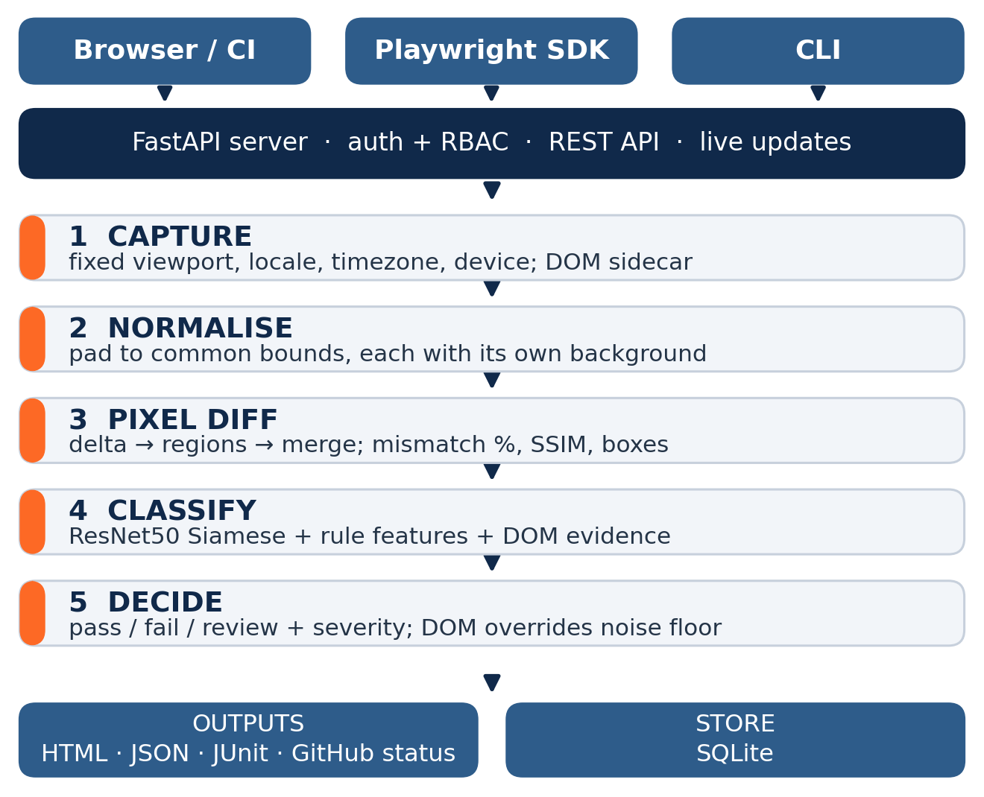
HOW IT WORKS
One pipeline, three ways in
Capture is reproducible
Playwright with animations off and a fixed viewport, locale and timezone — those three define a baseline's identity.
A DOM sidecar travels with the screenshot
The structural snapshot is what turns an image comparison into an explainable one.
The AI is optional at every point
With no model the tool still detects changes, it just stops naming them. CI runs on that path deliberately.
Stack FastAPI · Playwright · PyTorch · OpenCV · React + Vite · SQLite / PostgreSQL · Docker · GitHub Actions
Notes:
[1:10-1:45] Work comes in from three places — the dashboard, a CI pipeline, or a Playwright SDK that drops into an existing suite — and all three hit the same five-stage pipeline: capture, normalise, pixel diff, classify, decide. Two design points. Capture is pinned to a fixed viewport, locale and timezone, so the same page in two languages is two baselines rather than one flaky one. And the screenshot travels with a DOM snapshot — that is what makes classification explainable instead of a guess.

Slide 5
THE MODEL
Three kinds of evidence, one label
FUSION
+
CALIBRATION
SIX OUTPUT CLASSES
DOM structural diff
missing-element
n = 138
elements added, removed, moved, restyled
color-regression
n = 97
ResNet50 Siamese head
insignificant-change
n = 86
crops of the changed region, both sides
text-issue
n = 73
font-change
n = 62
Rule features
mismatch %, SSIM, region geometry
A DOM-confirmed defect bypasses the pixel noise floor — a faint text change is still a defect.
broken-image
n = 44
layout-issue was folded into missing-element: removing an element and the reflow it causes are one event seen from two angles.
Notes:
[1:45-2:15] Classification fuses three kinds of evidence: the DOM diff says which elements were added, removed, moved or restyled; a ResNet50 Siamese head reads crops of the changed region from both sides; and rule features carry mismatch, SSIM and region geometry. Calibrated fusion outputs one of six labels. One rule to note — a DOM-confirmed defect bypasses the pixel noise floor, because a small text change is often too faint to clear it.

Slide 6
MEASURED RESULTS
Detection and classification, scored separately
81 / 81
0 / 9
94.80%
injected defects detected
false alarms on clean controls
classification, n = 500
How it was evaluated
Detection
Injected defects on the demo portal. Ground truth is the injected mode, not the model's own output.
Classification
Real third-party pages with injected DOM mutations. 10 seeds × 50 trials, 95% CI [92.85%, 96.75%], across-seed σ 3.01%.
Notes:
[2:15-2:50] I report detection and classification separately, because they fail for different reasons — detection is pixel arithmetic and close to exact, classification is a learned model and is not. Detection: 81 of 81 injected defects caught, zero false alarms on nine clean controls. Classification: 94.8% over 500 trials on real third-party pages, 95% confidence interval 92.85 to 96.75. The chart is per-class recall — five of six above 93%. Both numbers are re-checked by CI on every push.

Slide 7
WHAT IS DOING THE WORK
Remove the DOM engine and accuracy collapses
Read this as
The structural comparison is the load-bearing part.
Dropping either feature group costs under a point — the two are largely redundant with each other.
Dropping the DOM engine itself takes the system to 38.7%, and colour, text and font changes fall to zero recall. Pixels alone cannot tell those apart.
Ablation runs: 3 seeds × 50 trials (n = 150). Full system: 10 seeds × 50 trials (n = 500).
Notes:
[2:50-3:15] To check the accuracy comes from the design rather than a big model absorbing everything, I ran an ablation. Removing either feature group costs under a point — they overlap. Removing the DOM comparison engine drops the system to 38.7%, with colour, text and font changes at zero recall. The structural comparison is the load-bearing contribution, not the network.

Slide 8
LIMITATIONS
Where it still gets things wrong
missing-element is the weak class
Recall 87.7% — the lowest of the six. Seventeen of the 26 residual errors start there, usually mislabelled as a font or colour change.
Very small real changes get discarded
Four errors were changes the noise floor threw away before the label mattered.
The six-class taxonomy was set after seeing results
Merging layout-issue into missing-element is defensible — they are one event — but it is not independent evidence that the model improved. Under the old seven-way rule the same trials score 92.6%.
Next: raise missing-element recall, and widen evaluation beyond injected mutations to changes taken from real commit history.
Notes:
[3:15-3:40] Three honest limits. missing-element is the weakest class at 87.7% recall and accounts for most residual errors. A few small but real changes are discarded by the noise floor. And the six-class taxonomy was settled after seeing results — defensible, but I don't claim it as independent evidence; under the old seven-class rule the same trials score 92.6%.

Slide 9
LIVE DEMONSTRATION
Now the dashboard itself
1
2
3
4
Capture a baseline
Run a comparison
Read the verdict
Approve or reject
from a URL, with locale and device pinned
against a page carrying an injected defect
diff overlay, severity, class label and DOM evidence
the decision history is written back to the report
http://127.0.0.1:8130/
Dashboard already running, demo portal open in the next tab.
Notes:
[3:40-3:50] Let me show you the tool. I'll capture a baseline, run a comparison against a page with an injected defect, read the verdict and its evidence, and approve the result. [SWITCH TO BROWSER — dashboard already on port 8130] [DEMO: about 2 minutes 30 seconds]

Slide 10
Thank you
Tan Kia Yen
Visual Regression Workbench
Questions welcome.
Repository
README, architecture notes and decision records
Reproduce
python scripts/live_eval_multiseed.py --seeds 10 --trials 50
81 / 81
defects detected, 0 false alarms
94.80%
classification, 95% CI [92.85, 96.75]
1,098
automated tests gating every push
Notes:
[6:20-6:35] To summarise: every injected defect detected with no false alarms, the change type named correctly 94.8% of the time on real pages, and the ablation shows that accuracy comes from the DOM-fused design. Thank you — happy to take questions.

