Slide 1
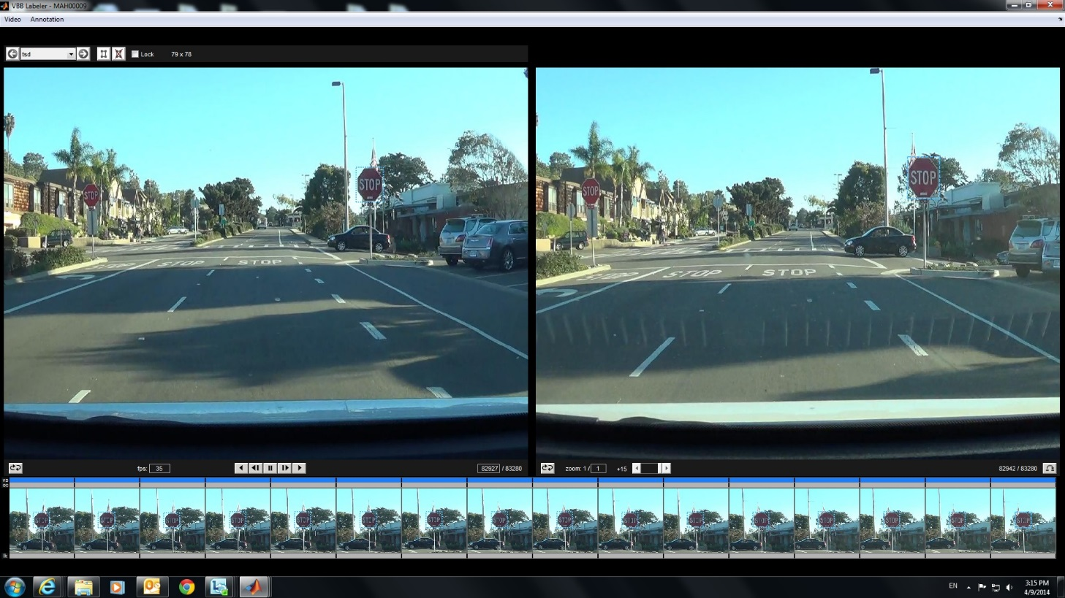
Developed Labelling Tools
Easily Label the bounding box for recorded video;
Easily Extract the bounding box;
It can play back the labelled bounding box in the video, easily insert and delete the bounding box.

Slide 2
ADAS Data Labelling Tool Development
Video database (*.mp4)
Matlab Script based tools
Convert the videos from mp4 into images, it will extract the key frame from videos.
Based on Images, it will create the another video sequence with extension seq.
VbbLabeler tools is used to label the bounding box by labors.
Extracted the bounding box for training.
Images(*.jpg)
Videos database (*.seq)
Labeler Tools
Bounding Box(*.vbb)
Positive Image Database

Slide 3
Instructions
Install_tools
Put the recorded videso “.\data\videos”
Run “createSeqFromMp4.m”
Run vbbLabel to label videos;
Run extract_bounding_box to get the result, which under ./data/Result

