Slide 1
Finance 6500 Assignment 1 Willem van der Schans

Slide 2
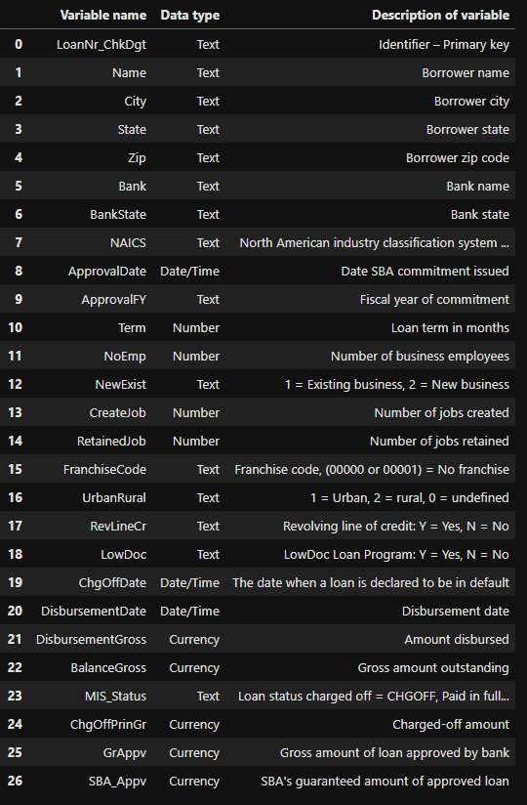
Outline
Codebook
Target Variable
Data Cleaning
Web scraping
Feature Engineering
Machine Learning
Applet

Slide 3
1. Target Variable

Slide 4
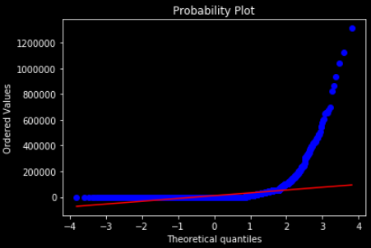
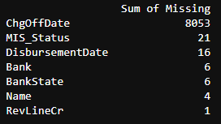
1. Target variable
ChgOffPrinGr
Initially, I looked at ChgOffPrinGr as my target variable; however, due to the zero-inflated probability distribution (see plot) of the variable it was hard to work with. I therefore decided to focus on the categorical variables since the implication for the loan officer would be the same; give the loan or not.
MIS_Status
I chose not to try to predict MIS-Status since according to the codebook there were several faulty entries. The codebook only describes two possible inputs: CHGOFF and P I F. The data itself included a number of missing values (see excerpt). While I mode imputed all the missing entries, these missing values in made MIS_Status a less optimal predictor then ChgOffDate due to losing entries.

Slide 5
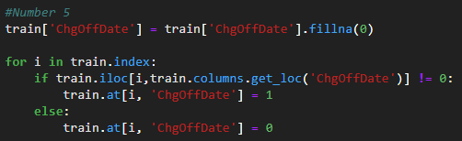
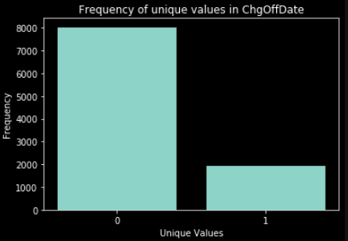
1. Target variable
ChgOffDate
On the previous slide I said that ChgOffDate supposedly is a better predictor then MIS_Status due to the missing values in MIS_Status, while it seems that ChgOffDate has more missing values (see excerpt).
In this case missing values are not a problem however since the implication of them is clear: “ A missing value means no default”. Knowing this I changed the variable to a binominal categorical variable with 0 = no default and 1 = default. (see code).
The final frequencies of 0 and 1 can be seen on the plot to the right. 0 has a frequency of 8028 and 1 has a frequency of 1937, this gives us the majority class predictor accuracy = 80.56%. This 80.56% accuracy is the benchmark score to beat by the machine learning algorithms deployed.

Slide 6
2. Data Cleaning

Slide 7
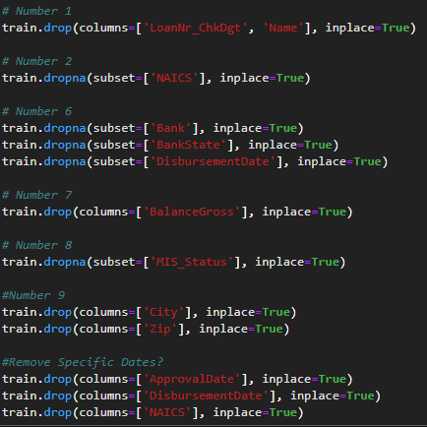
2. Data Cleaning
Considerations
I made all data cleaning decisions based on the codebook entries. If the data did not reflect what the codebook described, then it was considered an error and should therefore be fixed.
2.1 Removal of Variables
The first decision I made was removing all variables that could be used as identifiers by the algorithms. While this is more feature engineering then data cleaning I put it under this header since I made this decision here in my workflow. The removed Identifiers were: LoanNr_ChkDgt, Name, Zip, City and NAICs
I also removed BalanceGross as this variable only consists of 0’s and therefore holds no information.
Lastly, I removed the precise data variables since I did not have enough time to test how the algorithms would interpret these. If I had more time I would test and reassess this decision. The variables affected are ApprovalDate and DisbursementDate

Slide 8
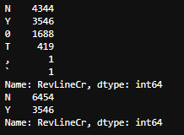
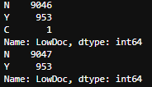
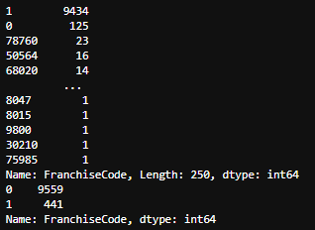
2. Data Cleaning
Data imputation
First off, there is RevLineCr which should only contain Y’s and N’s but also includes 0, T, ‘ and `. I changed all the wrong entries to no. If I would continue on this project I would most likely take this variable out, since the assumption made here is extremely bold.
Then there is LowDoc; this variable should only include N and Y however also includes a C. This C got mode imputed to a N.
Lastly, there is Franchise Code which shows if a business is a franchise and if so, what Franchise code they hold. While I thought this information was useful I wanted to remove the identifiable codes from the data set. I therefore changed all 1’s and 0’s to 0 (no franchise) and the other entries to 1 (franchise)

Slide 9
3. Web Scraping

Slide 10
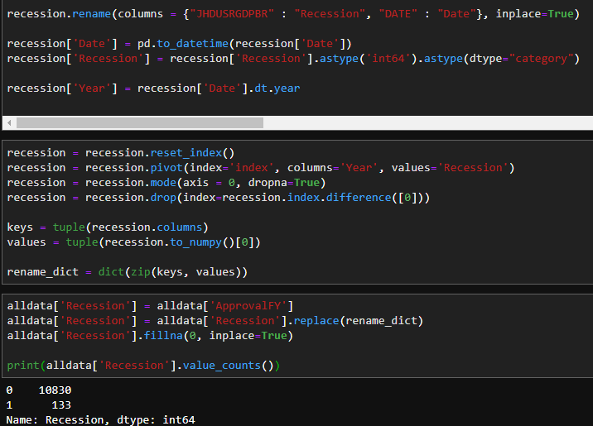
3. Web scraping
Intention
For the web scraping part of the assignment, I wanted to find data that added information to the data set that would help the algorithms predict loan default.
The data I collected was past recession data and came from the St. Louis federal reserve. I created a dictionary with the keys being years and the values a binominal variable that took 0 for no-recession and 1 for recession.
I then created a new data column (recession) based on ApprovedFY and renamed the years in this new column to the values in the dictionary. A code excerpt can be seen on the right.

Slide 11
4. Feature Engineering

Slide 12
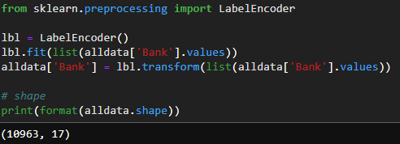
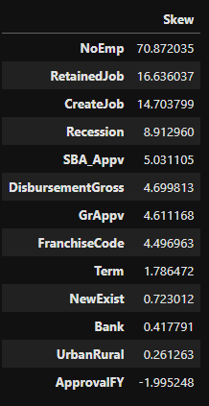
4. Feature Engineering
Label Encoding
I label encoded Bank since one-hot encoding this variable created a data frame of over 5000 columns. The performance impact such a data frame has on the code execution made me decide to opt for label encoding for this variable.
Skewness and Box-Cox Transformations
I box-cox transformed all variables with a skew higher than 0.75 (see the table to the right). I used lambda 0.15 as this seemed to be the most used value and produced the results I wanted.
One-Hot Encoding
Any leftover categorical variables at this point were one-hot encoded. The variables affected were 'State', 'BankState', 'RevLineCr', 'LowDoc’. The resulting all-data data frame had dimensions: (10963, 120)

Slide 13
5. Machine Learning

Slide 14
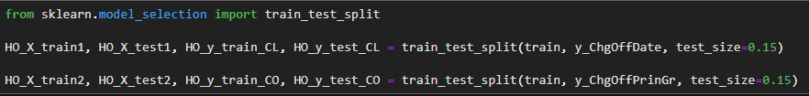
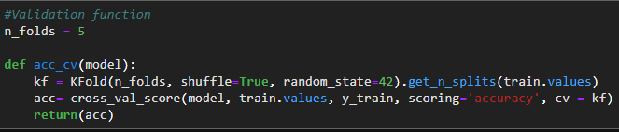
5. Machine Learning
Target Measure
Since I am running classification algorithms my target measure was the accuracy of the algorithms. This measure also allows me to easily compare the score to the benchmark of the majority class predictor at 80.56%
Evaluations
I decided to do both cross-validation and hold-out evaluation. This to make sure that the results correspond. Using both evaluations allows for more insight and also shows errors in, for example, the cross-validation function, which was self-written.
I did my cross-validation with 5 folds and my hold-out evaluation with a 0.85 – 0.15 split, using random seed(123)

Slide 15
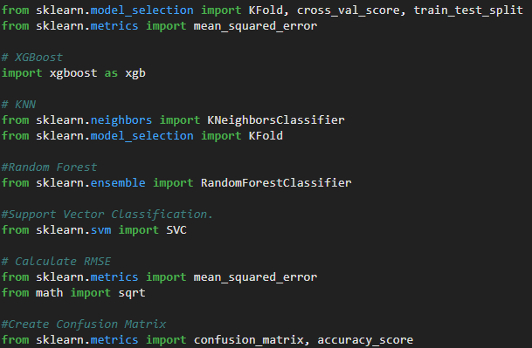
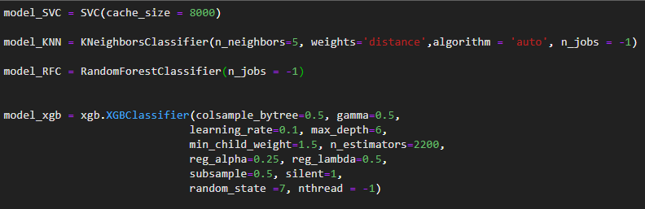
5. Machine Learning
Algorithms
I decided to run 4 classification algorithms, after which I could evaluate each one and select one or two for the final predictions. The algorithms are Random Forest Classification, Support Vector Classification, K Neighbors Classifier, and XGBoost.
Hyperparameters
I wanted my algorithms to be conservative to combat overfitting on the data set. Hyperparameter settings are shown in the excerpt on the right. Conservative settings can be seen in KNN with 5 Neighbors and XGB with a learning rate of 0.1 (default=0.3). Added parameters are settings for parallel processing where possible, which dramatically lowered the run-time of the Notebook with a final time of 101 seconds.

Slide 16
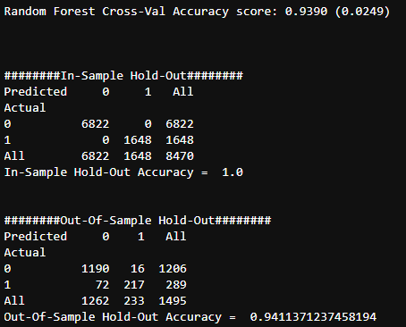
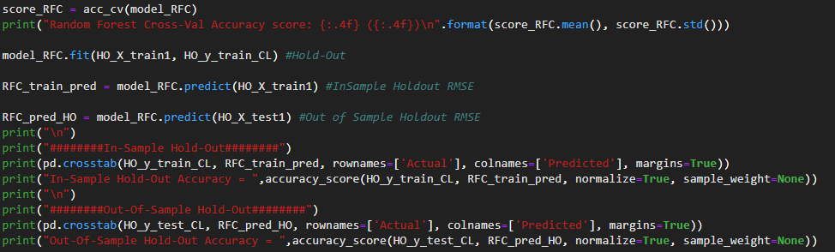
5. Machine Learning
Evaluation Code
The code I used to evaluate all models is shown below. This code outputs a cross-validation accuracy score, an in-sample old-out score, and an out-of-sample hold-out score. An example output can be seen on the right as well.

Slide 17
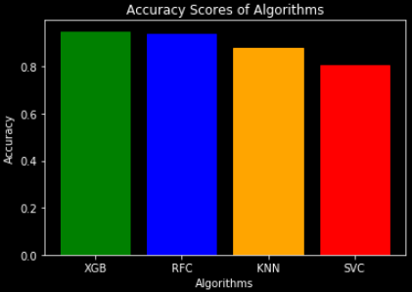
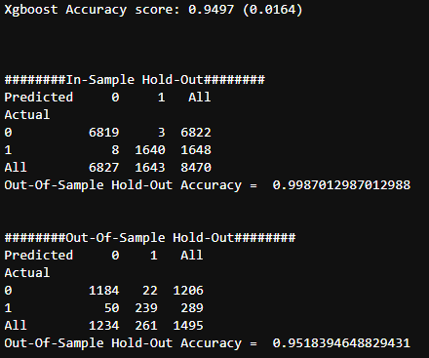
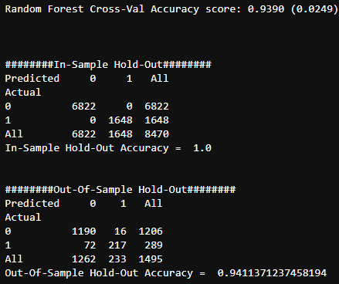
5. Machine Learning
Outcome
To the right, the plotted cross-validation scores per algorithm can be seen. As is evident, Random Forest Classification and XGBoost have the best cross-validation accuracy scores of 93.8% and 94.9% respectively. Below the outputs can be seen of the hold-out evaluation. I chose to predict with both of these algorithms in the Applet since they are both sufficiently accurate.

Slide 18
6. Applet

Slide 19
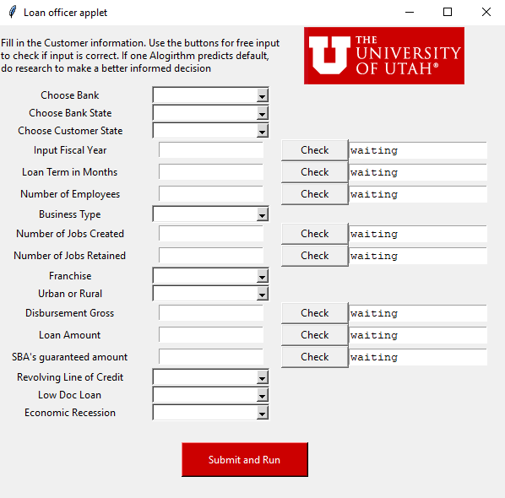
6. Applet
Objective
The objective of the applet is to allow loan officers to qualify a business for a potential loan. I set a personal objective for myself, namely that the applet has to be standalone from the machine learning code. This made the applet code longer (657 lines) however, now it can be used on any computer without having to run trough the Machine learning code first to train models. I also uploaded all data to GitHub to be able to pull data directly from the internet further allowing the app to be standalone from any environment. The applet also incorporates the web scraping column Recession.
Use
The applet is a tool and therefore has an advisory role in the process it, therefore, outputs only objective results and no implication, the means possible output is as follows: e.g., “No Default predicted” and “Only Random Forest predicts Default.”

Slide 20
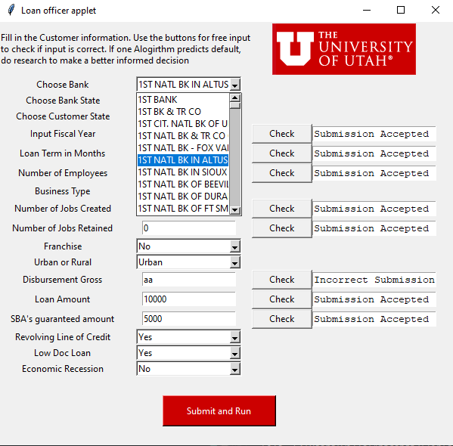
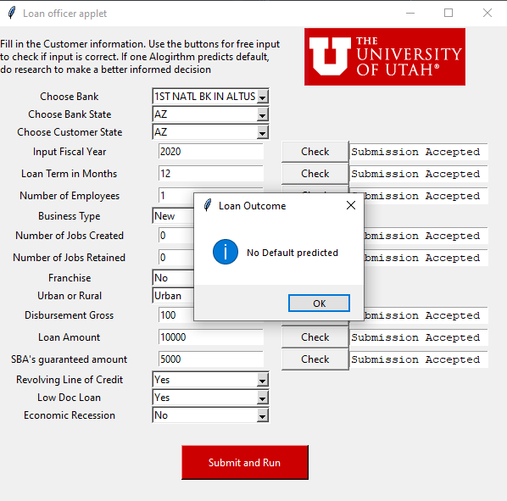
6. Applet
Functions
What the applet does run all of the relevant machine learning and web scraping code in a large function when the submit button has been clicked. The applet downloads, cleans, feature engineers, and submits both train and test data sets to both XGBoost and RFC algorithms and which then individually predict the outcome of the test data set created from user input. An example output is shown on the right.
Additional Features;
A data dump to csv of the last input made by the user so the data can be stored.
Free-submission check buttons. Small functions that check if the data entered is an integer and has the right format.

