Slide 1

Assessing High Level Data Representations for HDM – 4
A dissertation submitted to the University of Birmingham for the degree of Master of Science in Road Management and Engineering
by
Philip Kyeyune Kazibwe
August 2016
Notes:
HDM-4 Inputs and Options

Slide 2
Introduction
HDM4 - computer analysis program used in the economic appraisal of road projects around the world
Customers include governments, consultancies, researchers
Uses:
  Project Analysis
  Maintenance works programming
  Strategic planning
  Research and Policy studies
Notes:
HDM-4 Inputs and Options

Slide 3
Introduction Cont’d
HDM-4 Analysis use four models:
  Road Deterioration Model (RD)
  Works Effect Model (WE)
  Road User Effect Model (RUE)
  Social and Environmental Effects (SEE)
Basic unit of analysis in HDM-4 is a homogeneous road section
Notes:
HDM-4 Inputs and Options

Slide 4
Challenges of Using HDM4
Data Intensive: HDM4 requires a lot of data to simulate the performance of the road over the whole life;
Requires skilled personnel to enter the data and run the analysis and is therefore not accessible to the non technical decision makers;
Difficulties in running many ‘quick and dirty’ analyses before making a choice on which detailed analysis to carry out
Notes:
Laborious data entry process makes it impossible to do trial runs of many different alternatives quickly
HDM-4 Inputs and Options

Slide 5
Potential Benefits of Simplified Entry
Situations where the user does not have detailed data
Enables top level users to access the decision support tool
As a training aid and a tool for beginners

Slide 6
Objectives
Main aim
Evaluate high level descriptors for HDM-4 used in HDMSentry and assess their effects on model outputs
Specifically
Assess representative data descriptors for a typical section run in HDM-Sentry;
Conduct sensitivity analysis of the economic and deterioration model outputs to the data inputs for HDM-Sentry;
Identify the significant high level inputs to HDM-Sentry;
Investigate variations in the output across the input space;
To investigate the applicability of the data descriptors in practice.

Slide 7
Literature Review
HDM Models are deterministic in nature;
Two main methods have been used in sensitivity analyses of HDM models
  Sensitivity analysis of HDM III using Latin Hypercube and Gausian Stochastic methods (Mrawira et al, 1998)
  Ceteris Paribus analysis of HDM III and HDM-4 (Mrawira 1996) and (Bennett 1999)

Slide 8
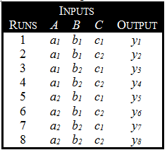
FACTORIAL Experiments
Factorial experiments are used to explore the response of a model to different levels of the input factors;
Suitable for model like HDMSentry;

Slide 9
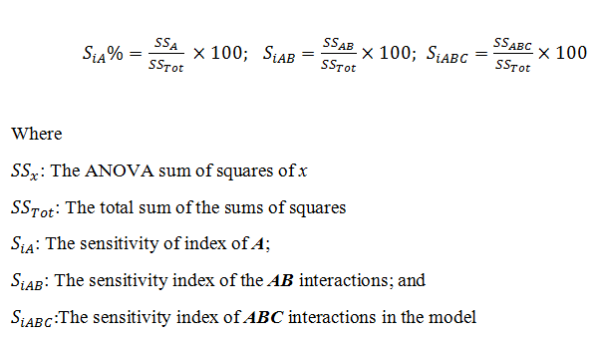
ANOVA Sensitivity Analysis
Core principle in ANOVA analysis: partitioning the observed variance in in an output of a model to the influences of the different inputs and any errors or unexplained variations (Montgomery and Runger, 2010);

Slide 10
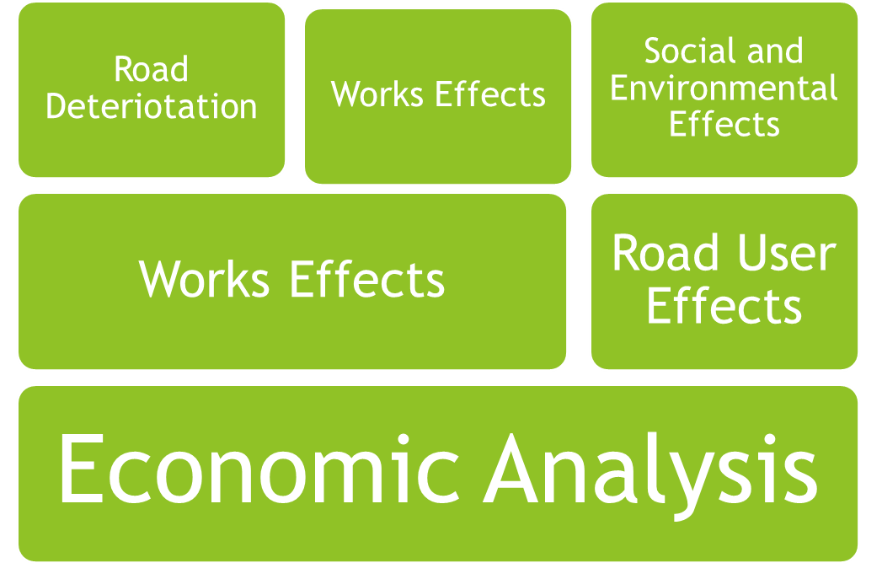
How HDM-4 Works
Notes:
HDM-4 Inputs and Options

Slide 11
HDM - SENTRY
Œ
User defines analysis data.
Definition converted into an
Analysis file-set which is
HDM-4 compatible
(HDM-4 Workspace)
High-Level UI

Results used in
HDMSentry
High-Level UI to
-
display analysis
outcomes
Input
Analysis
File
-
set
Results
HDM

HDM-4 performs the analysis on
the workspace produced
4
Ž
Analysis undertaken
and results written
to results file

Slide 12
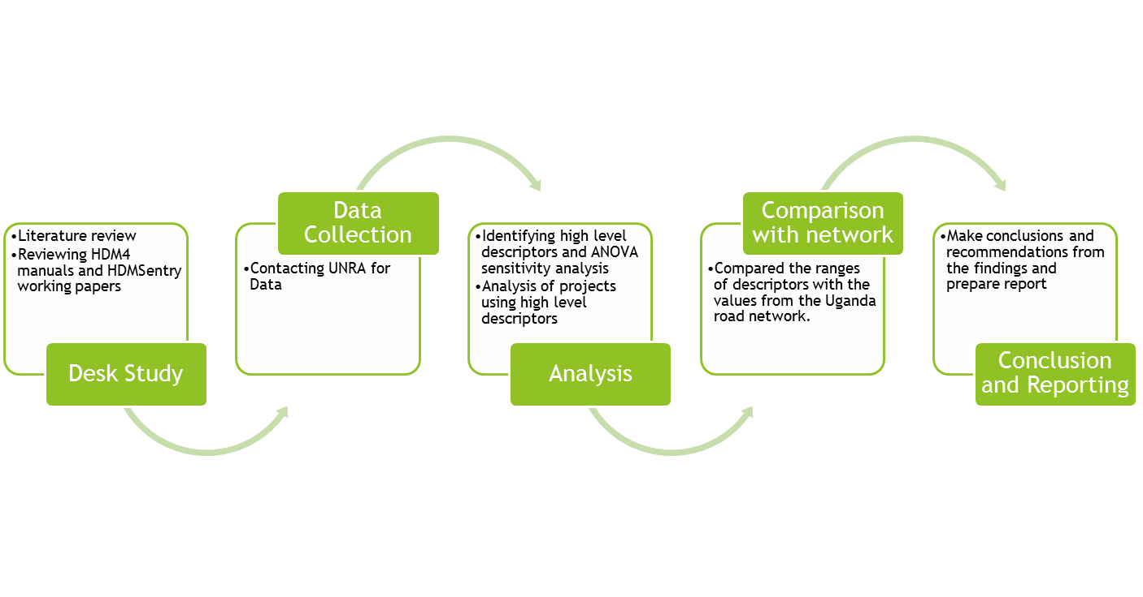
Methodology

Slide 13
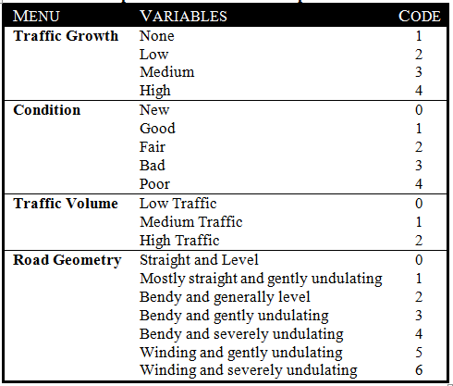
HDMSentry Inputs Analysed
Notes:
Why were these the inputs that were considered? These are the inputs expected to have most variation when chosen by users. A gravel road is a gravel road but what is high traffic? What is straight and level?
HDM-4 Inputs and Options

Slide 14
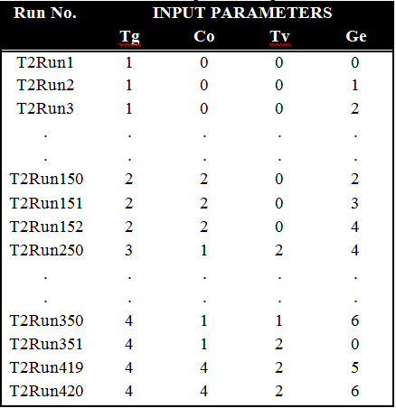
Input Matrix for Analysis

Slide 15
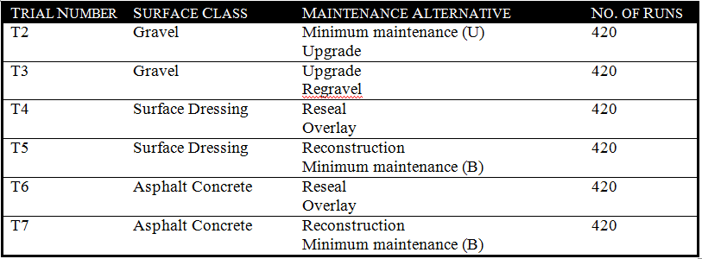
Input Matrix for Analysis
A Total of 2520 Runs of HDMSentry were required for the full factorial experiment

Slide 16
Automation of HDMSentry
Large number of runs required to analyse the output
A Total of 2520 Runs of HDMSentry were required for the full factorial experiment
Python programming used to prepare scripts to automate the data preparation, entry and extraction
This project was done using HDM Sentry 1.0.0.0 and HDM-4 (Version 2.10.00). The automation scripts were written in Python 2.7 (Van Rossum, 2007).

Slide 17
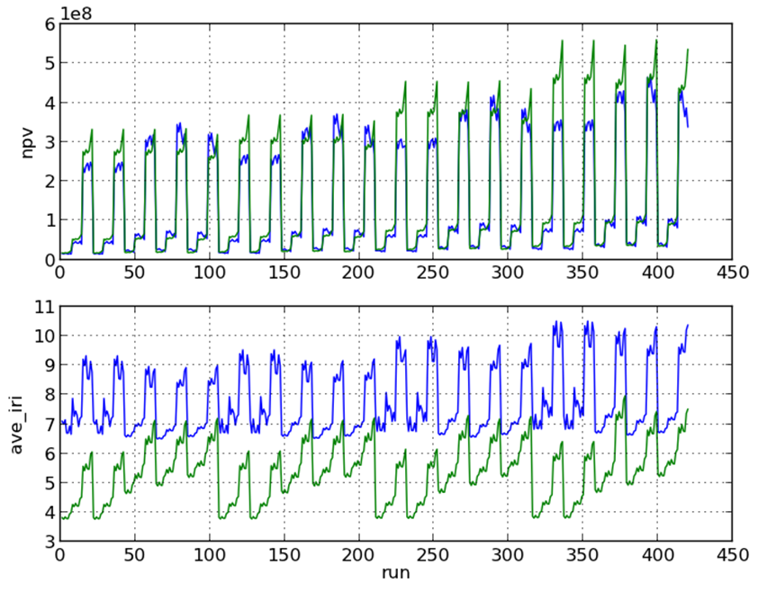
Results

Slide 18
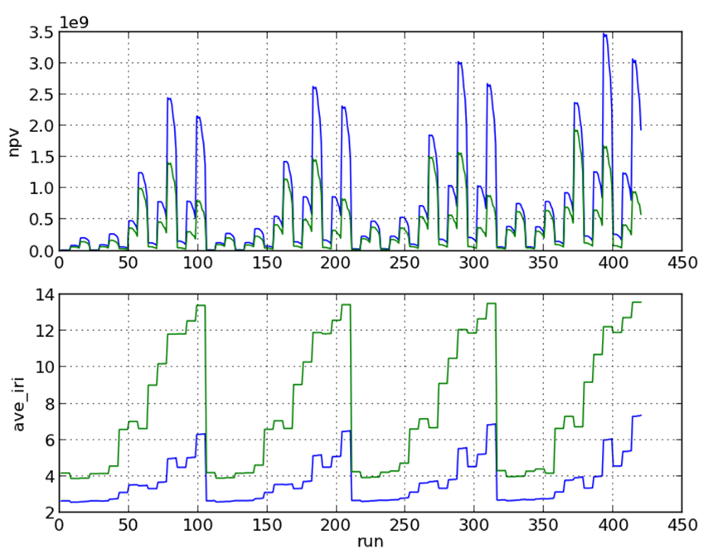
Results

Slide 19
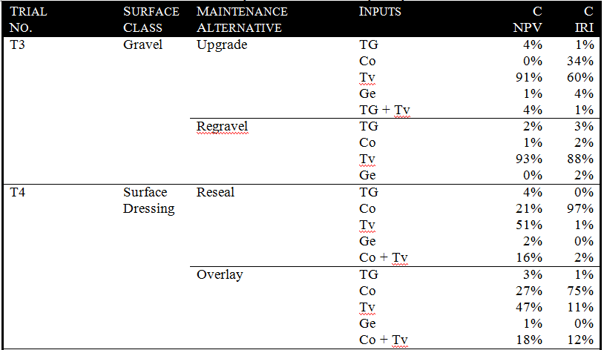
Results-ANOVA Sensitivity

Slide 20
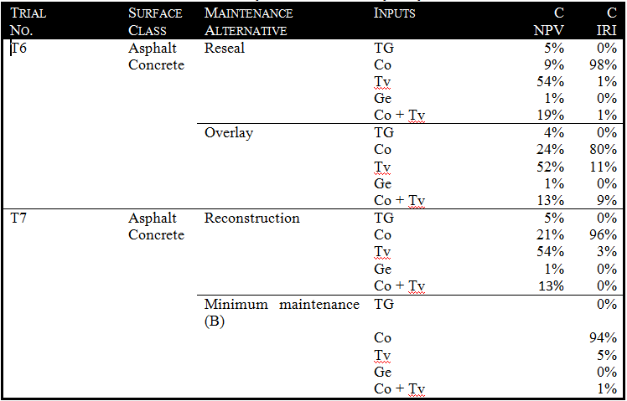
Results-ANOVA Sensitivity cont’d

Slide 21
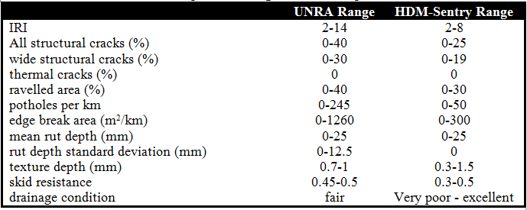
Results-Comparison with UNRA network

Slide 22
Findings
Traffic volume is the main input affecting the NPV and IRI for gravel roads;
Traffic volume and Initial Condition are the main inputs affecting NPV and IRI for bituminous surfaced roads;
There are significant interactions between traffic volume and condition;
The output function for NPV shows large changes between the medium traffic and high traffic levels;
The ranges for traffic volume and condition do not cover the whole possible input space when compared with the UNRA network.

Slide 23
Conclusions and Recommendations
Sensitivity analysis shows that for project appraisal of maintenance alternatives for a gravel road section using HDM-Sentry, the Traffic volume is the dominant input factor in relation to NPV;
Condition also a significant contributor to the NPV for bituminous surface projects. The effect of the condition on NPV observed to depend on the maintenance alternative considered.
Condition is a dominant contributor for average IRI for projects on bituminous surfaced roads. The interaction of the condition and traffic volume inputs is also significant to the NPV for bituminous surfaced roads.
Further work required on ways of reducing the magnitude of the discontinuities in the NPV output
More work needed to ensure the input ranges of the high level data representations cover the possible values expected in practice.

Slide 24
References
Kerali, H.R., 2001. The role of HDM-4 in road management. Birmingham: The University of Birmingham.
Kerali, H.R., Robinson, R. and Paterson, W.D.O., 1998. Role of the new HDM-4 in highway management. In Proceedings Fourth International Conference on Managing Pavements, Durban, South Africa, May (pp. 17-21).
Kerali, H.G., Odoki, J.B. and Stannard, E.E., 2000. Overview of HDM-4. The World Road Association (PIARC).
Montgomery, D.C. and Runger, G.C. (2010) Applied statistics and probability for engineers. John Wiley & Sons
Mrawira, D., Welch, W., Schonlau, M. and Haas, R. (1999) 'Sensitivity Analysis of Computer Models: World Bank HDM-III Model', Journal of Transportation Engineering, 125(5), pp. 421-428. doi: 10.1061/(ASCE)0733-947X(1999)125:5(421).
Stannard, E. and Snaith, M. 'Development of a Simplified HDM-4 User-Interface: HDMSentry', (unpublished).
Thomas Buckland, G.M. HDM-Sentry User Guide (unpublished).
Van Rossum, G., 2007, June. Python Programming Language. In USENIX Annual Technical Conference (Vol. 41).

