Slide 1

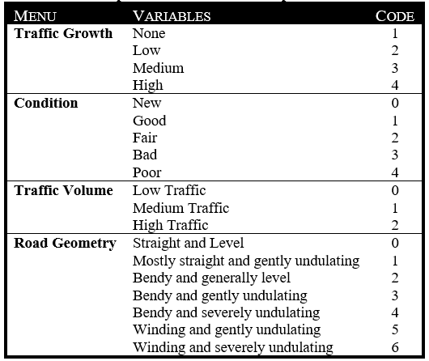
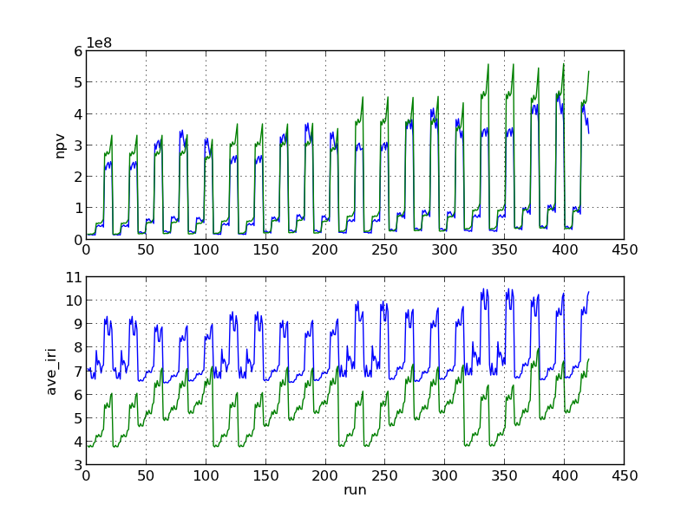
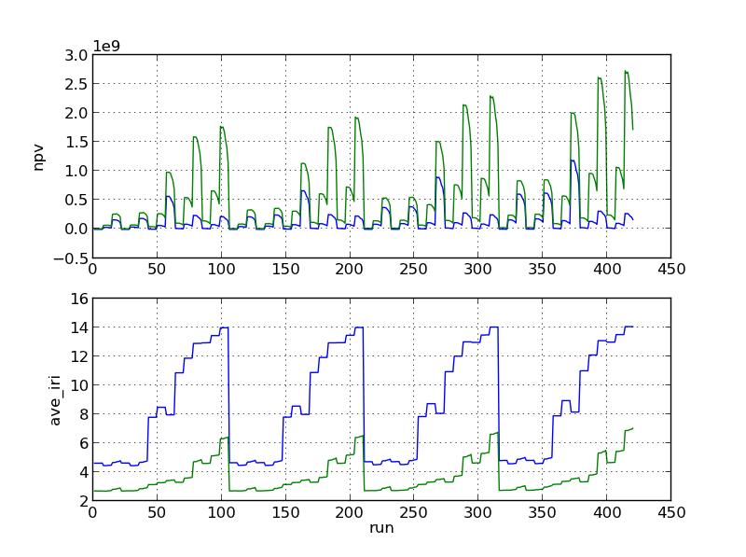
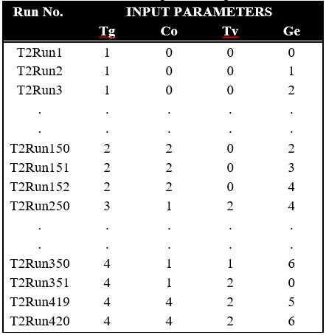
High Level Data Representations For HDM-4
Msc. Road Management & Engineering |By: Philip Kyeyune Kazibwe | Supervisor: Dr. Eric Stannard | University of Birmingham
Background
Input Variables
Results
Economic decision making is vital in highway management. The decisions deal with resource allocation to the most beneficial projects. Computer programs are vital tools in this decision making process.
The Highway Development and Management Model (HDM-4) is a popular appraisal tool for road projects. However adoption of HDM-4 is hindered by the large data requirements to set up and run analyses. High level data representations are a possible solution to these challenges. This project assessed high level data representations for the HDM-4 Model as implemented in HDM-Sentry, a new software aimed at increasing accessibility of the HDM-4 Models
NPV and IRI for Regravelling (Blue) and Upgrading (Green) for gravel road
Four input variables chosen with their respective levels turned into codes for input into the automated HDM-Sentry script.
Results for gravel surface showed a high response to traffic volume
Significant differences between the peak NPV values and the rest of the values
HDM-Sentry (Simplified Entry)
NPV and IRI for Overlay (Green) and Resealing (Blue) of Asphalt Concrete
HDM-Sentry is a ‘simplified HDM-4 data-preparation and analysis tool’ developed as a simpler and improved user interface to the HDM-4 model.
Enables the user to set up and run an analysis in four simple steps
Relies on abstraction of the data required by the HDM-4 workspace into simpler high level data descriptors
Results for bituminous surface showed a high response to both traffic volume and initial condition;
Significant differences between the peak NPV values and the other values
Experiment Input Matrix
Objectives
Each trial run of the full factorial experiment had 420 runs with different each run having different levels of input parameters.
To assess the representative data descriptors for a typical section run in HDM-Sentry;
Conduct a sensitivity analysis of the economic and deterioration model outputs to the data inputs for HDM-Sentry;
Identify the significant high level inputs to HDM-Sentry;
Investigate variations in the output across the input space;
To investigate the applicability of the data descriptors in practice.
Findings
Traffic volume is the main input affecting the NPV and IRI for gravel roads;
Traffic volume and Initial Condition are the main inputs affecting NPV and IRI for bituminous surfaced roads;
There are significant interactions between traffic volume and condition;
The output function for NPV shows large changes between the medium traffic and high traffic levels;
The ranges for traffic volume and condition do not cover the whole possible input space when compared with the UNRA network.
Methodology
Identifying the HDM-Sentry Inputs
Four main inputs to HDM-Sentry were considered
Full Factorial Experiment Design
All levels of each variable combined with all levels of all the other variables and results recorded
Sensitivity Analysis
Sensitivity analysis of NPV and average IRI in relation to the high level inputs
Traffic Volume
Traffic Growth
Initial road Condition
Geometry
Comparison to real network
High level inputs compared to the actual inputs from a real road network from Uganda National roads Authority (UNRA)
All levels run in HDM-Sentry
Conclusions and Recommendations
Sensitivity analysis shows that for project appraisal of maintenance alternatives for a gravel road section using HDM-Sentry, the Traffic volume is the dominant input factor in relation to NPV;
Condition also found to be a significant contributor to the NPV for bituminous projects. The effect of the condition on NPV was observed to depend on the maintenance alternative considered.
Condition is a dominant contributor for average IRI for projects on bituminous surfaced roads. The interaction of the condition and traffic volume inputs is also significant to the NPV for bituminous surfaced roads.
Further work required on ways of reducing the magnitude of the discontinuities in the NPV output
More work needed to ensure the input ranges of the high level data representations cover the possible values expected in practice.
Results of ANOVA Sensitivity Analysis
Sensitivity analysis shows hat for project appraisal of a road section using HDM-Sentry, the Traffic volume is the dominant input factor in relation to NPV.
The road condition was also found to be a significant contributor to the NPV and average IRI for projects on bituminous surfaced roads. The effect of the condition on NPV was observed to depend on the maintenance alternative considered.
The interaction of the condition and traffic volume inputs was observed to be significant to the NPV for bituminous surfaced roads.

