Slide 1
To Do List
Ofer Greenberg
Quan Nguyen
Quang Vu
Allen David El

Slide 2
Contents
Introduction
Process
Sprints
Code
Final Product
Supporting Documents

Slide 3
Introduction
For this project, our team was tasked with designing a to-do-list program with the following functionalities:
Add/Remove/Rename to-do lists
Add/Remove/Rename tasks to the lists
Sort the lists based on due date/ creation date and alphabetically
Mark tasks as done/undone and important
Provide a visual interface
Include an additional feature of our own
Provide proper documentation of the process, testing code and final product
As a team we wanted to deliver a finished product that is esthetically appealing and robust.

Slide 4
Process
For the development of this product, our team worked through three platforms
IDE – per member’s preference
Github – for sharing code
Trello – for managing and documenting progress
Draw.io - for visualization
Discord – as the main line of communication

Slide 5
Sprints
The development cycle included 3 sprints and a last day crunch
Sprint I – in the meeting we decided on program architecture and split the work for building the foundation of the program, the classes and core method headers without implementations.
Sprint II – in the meeting we decided on methods inputs and outputs and split the work of providing implementations to all the methods except the view class
Sprint III – in the meeting we discussed adjustment to the methods inputs/outputs, decided on a wow factor and the GUI implementation. In the sprint we finished and tested the implementation of the entire program.

Slide 6
Sprint I
Formed a line of communication through emails and then discord.
Agreed on a simple MVC model and created a preliminary class diagram (see in supported documents)
Assigned classes or a combination of classes with overall comparable size, for each team member to create method headers based on the UML design.
Lesson Learned:
Decide on inputs and outputs early on
Discuss basic style and formatting before sprint

Slide 7
Sprint II
In this scrum we went method by method and discussed the inputs and outputs.
We randomly assigned an equal number of methods to each team member, for them to create an initial implementation
We also discussed the proper way to document our progress
Lesson Learned:
When assignment methods, we should in the future write peoples names as a comment, right on the file so we don’t accidently work on the same methods or neglect a method.
Read the specs as a team again to make sure we didn’t miss requirements

Slide 8
Sprint III
In this sprint we focused on the view model and test cases.
We decided to work on the backend, model and control, and the frontend, view, separately so team members can work freely on a class without creating conflicts
We alternated roles to make sure everyone touches every aspect of the program, from GUI through model and test cases.
The goal was to get the GUI working, then in the last day crunch, sort out possible bugs.
Lesson Learned:
When working on an interface, getting the aesthetic can be difficult when the class is cluttered, so planning using a diagram what object to use would’ve been useful.
preferably finish the design and then move to implememntation

Slide 9
Code view package
The view package contains the GUI
The code is organized, top to bottom, in a way that allowed us to collaborate most efficiently.
The colors reflect code complexity
GUI Elements declared as fields and grouped by topic
Application start
-> calls set up methods
-> lambda handlers to each button calling methods
Setup methods
-> put elements into grids
-> call styling methods to configure looks and esthetics
Behaviore Implementation
-> Method for each program behavior
-> organized method by topic (list related, task related, sorting, updating, style)

Slide 10
Code Model Package
The model package holds the ToDoModel class as well as the ToDoList and ToDoTask classes.
All contain similar getters and setters with the model holding the data as ArrayList<ToDoList> which is serialized
The ToDoList holds its data as ArrayList<ToDoTask>

Slide 11
Code control package
The control package contains the ToDoControl class which communicates between the view and the model
The control also provide sorting support
When a list is sorted a certain way, the control first update the model, then the view receives current lists through the regular display methods. This reduces number of ways the view is interacting with model through the control.

Slide 12
Code Test package
The test cases were developed and updated to support all the features in the model and control classes
We strived for 100% converge and got over 90% for both the model the control the ToDoTask and ToDoList
The test cases helped us correct many issues with the program while we were working on it rather than at the end.

Slide 13
Final product
In the following slides you will see all the features in the GUI
Using illustrations, we will try to explain how things are set up behind the scene (to be accurate, on the scene… JavaFX humor)

Slide 14
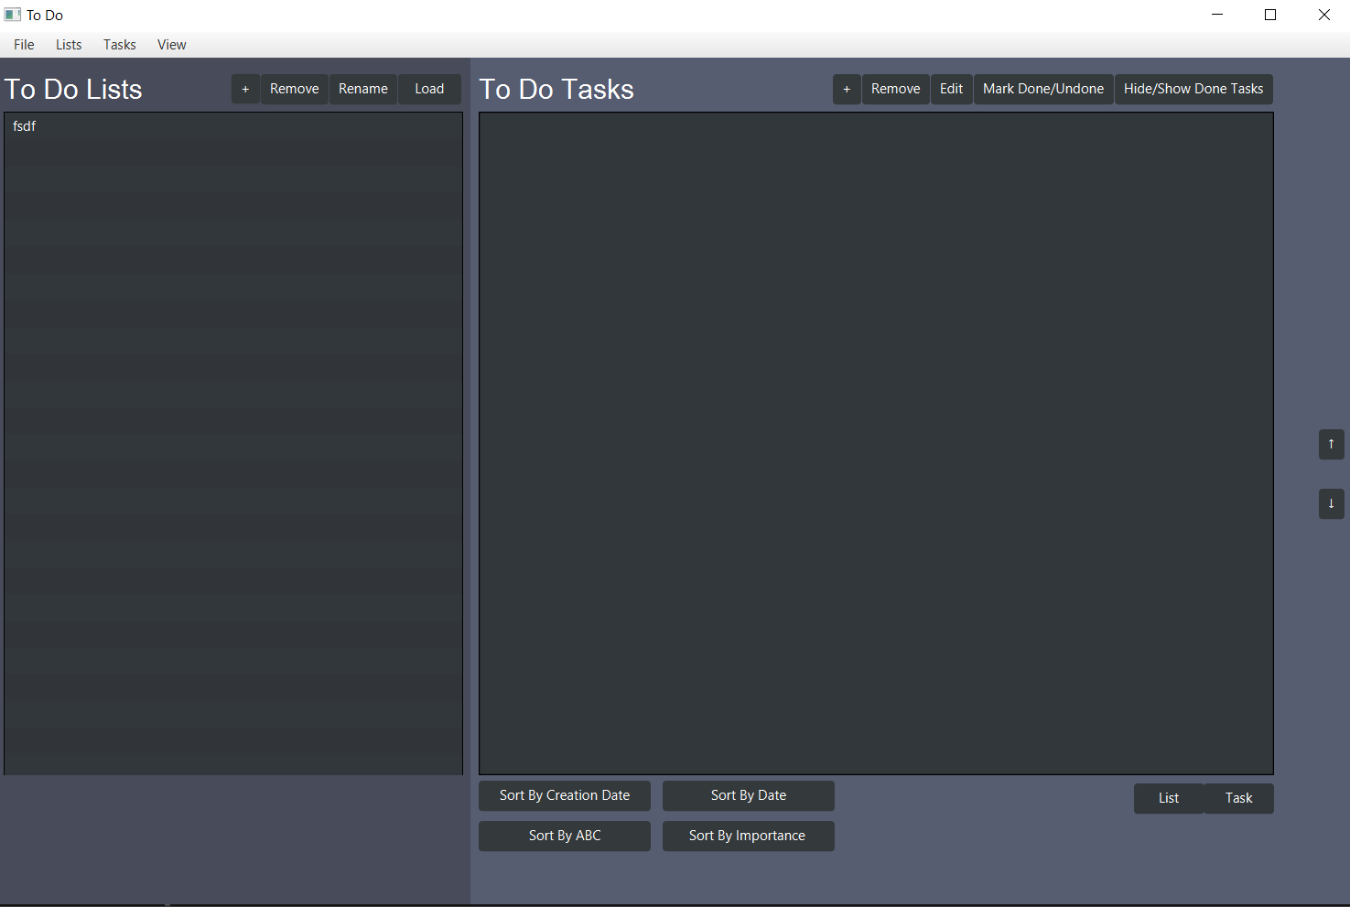
Final product
menu bar
tasks controls panel
lists controls panel
ListView object holding current
ToDoTask objects
ListView object holding all the
ToDoList objects
Moving task placement control, for manual ordering
Random color changer for both list and task panel, try to click it!
Sorting control panel

Slide 15
Final product
menu bar
tasks controls panel
lists controls panel
ListView object holding current
ToDoTask objects
ListView object holding all the
ToDoList objects
Moving task placement control, for manual ordering
Random color changer for both list and task panel, try to click it!
Sorting control panel

Slide 16
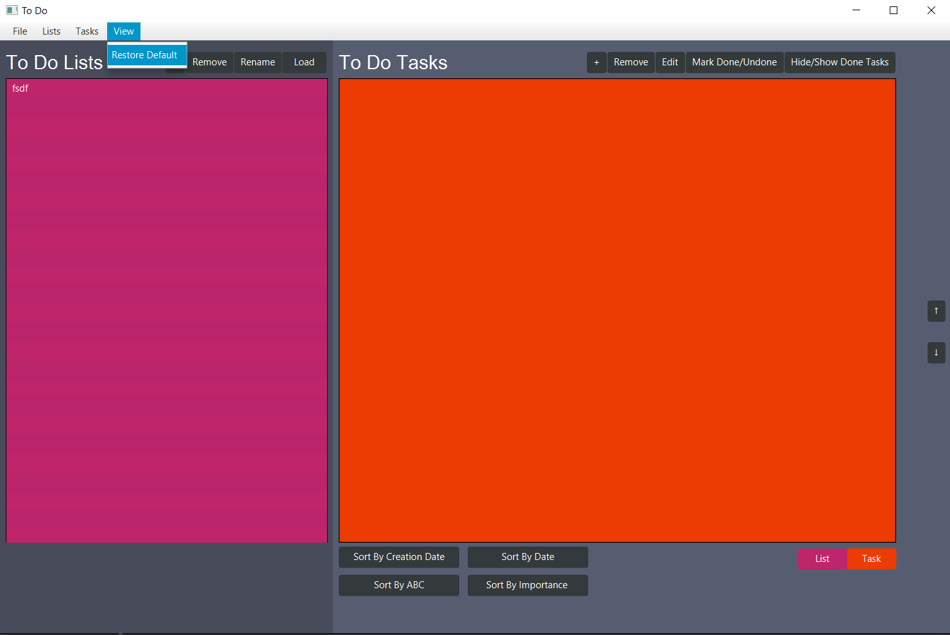
Final product
Restore default colors
Control color of right element
Control color of left element

Slide 17
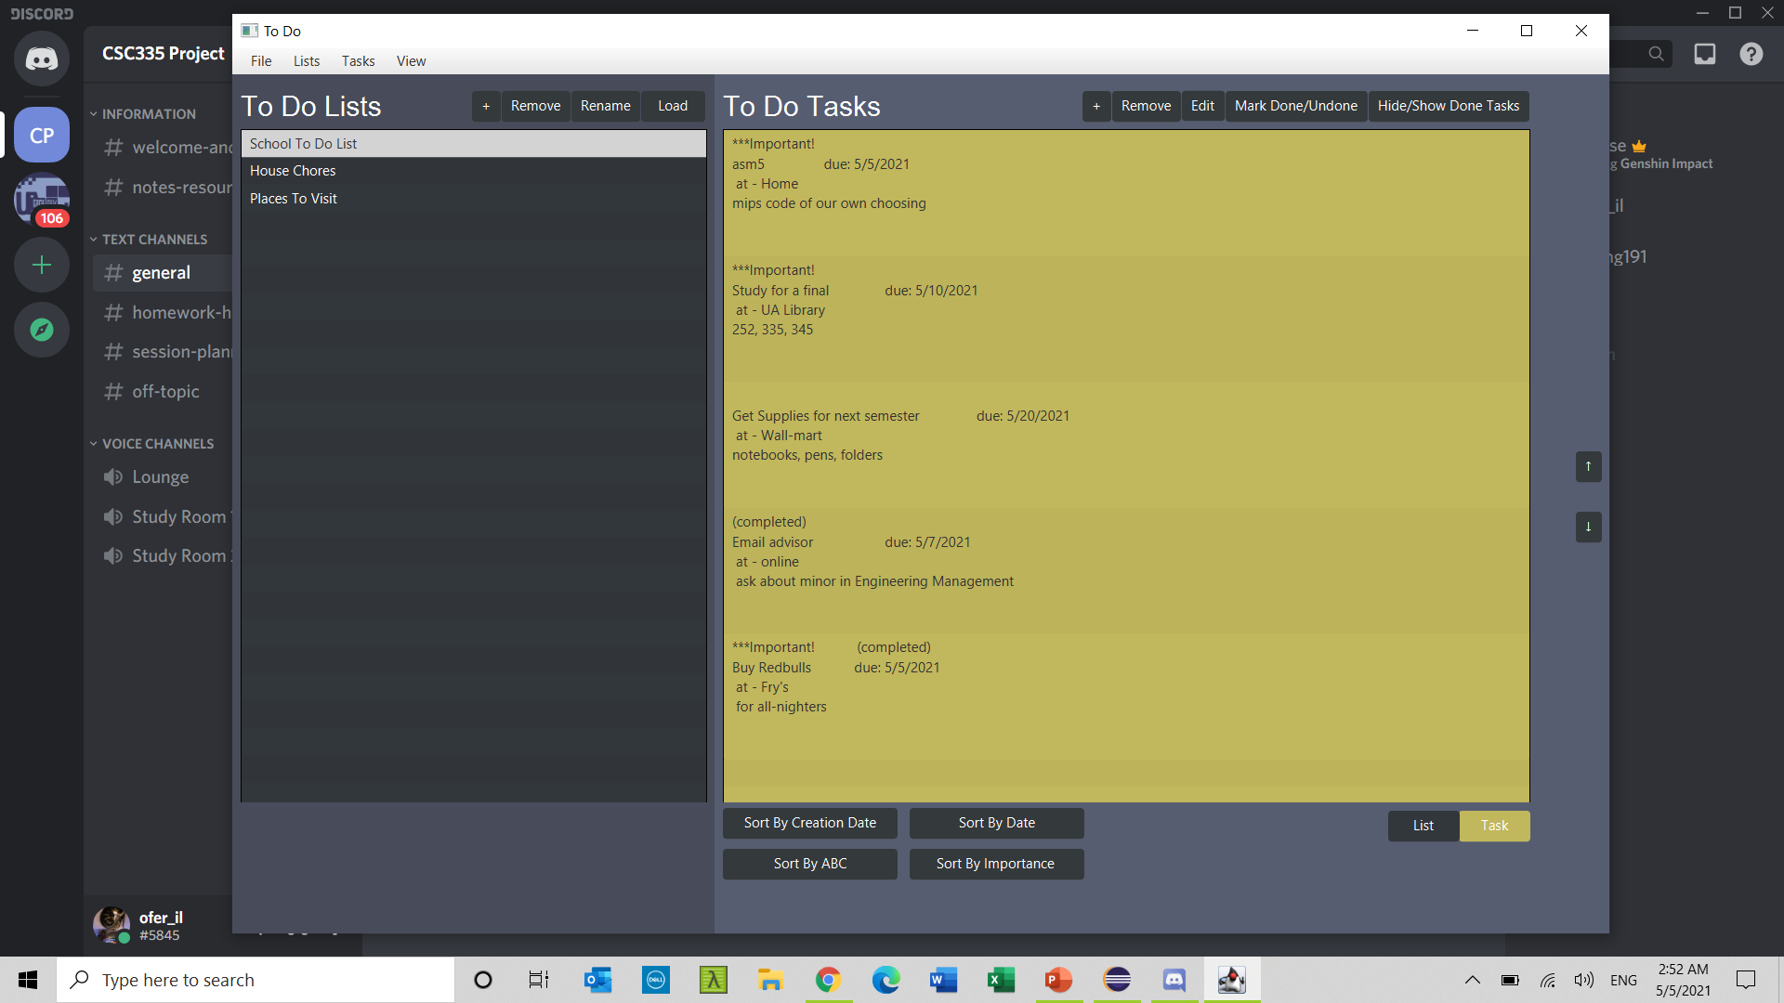
Final product
Status: important and/or completed
Task name - title
Task location
Task notes

Slide 18
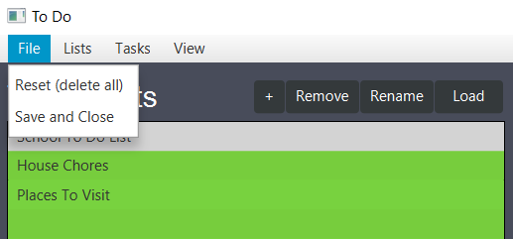
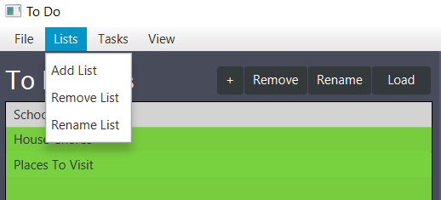
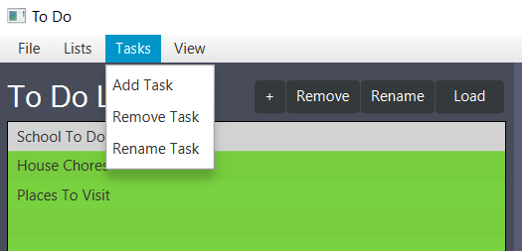
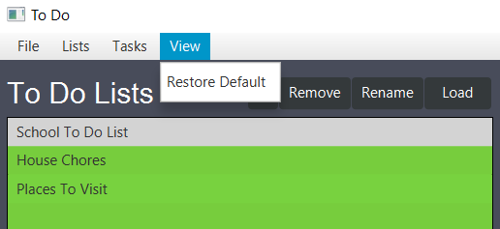
Final product – menu Items

Slide 19
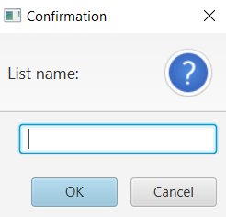
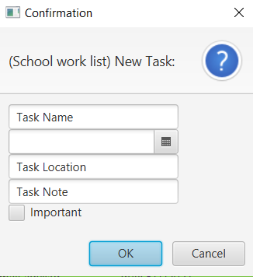
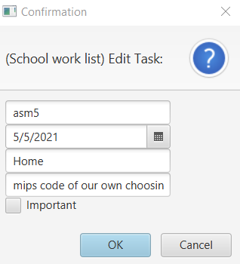
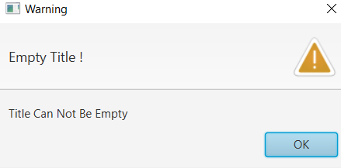
Final product – Input prompts
Add List
Rename List
Add Task
Edit Task
Appropriate error messages if empty

Slide 20
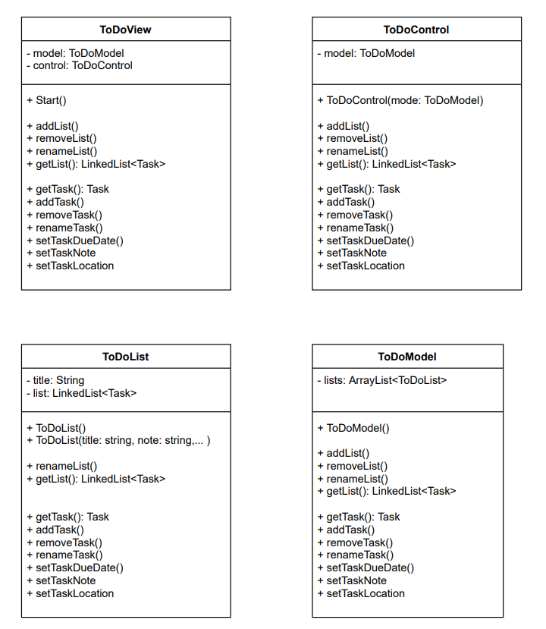
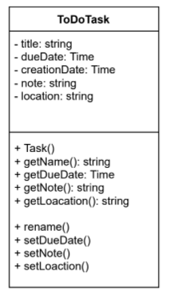
Supporting Documents uml, notes and other docs
Initial class diagram

Slide 21
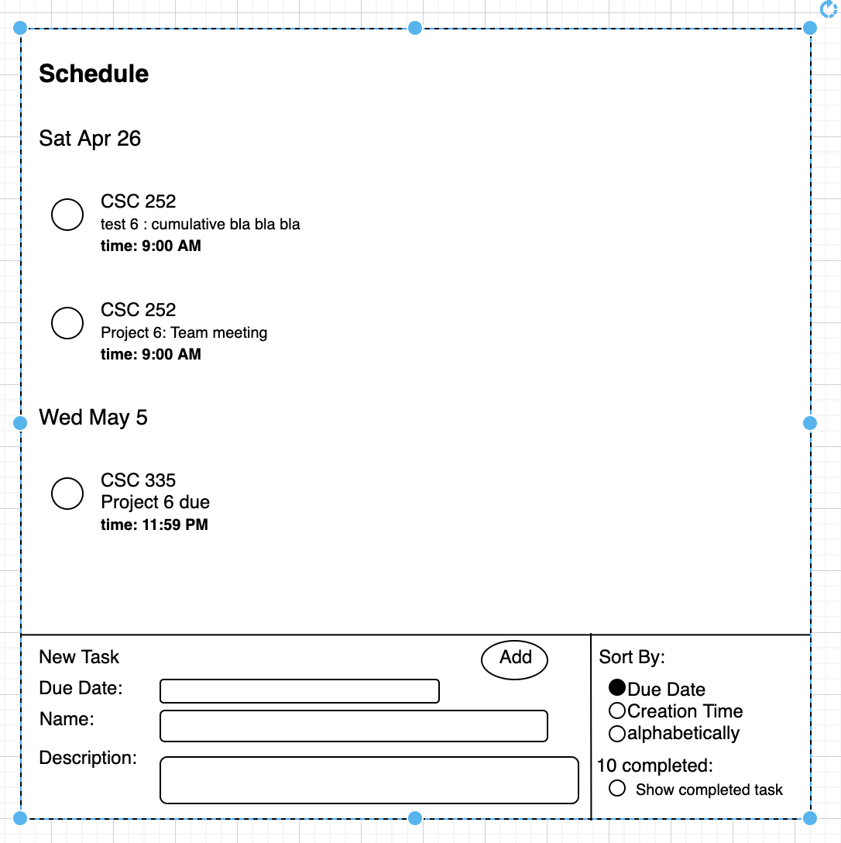
Supporting Documents uml, notes and other docs
Initial UI design

Slide 22
Supporting Documents uml, notes and other docs
Initial methods assignment

Slide 23
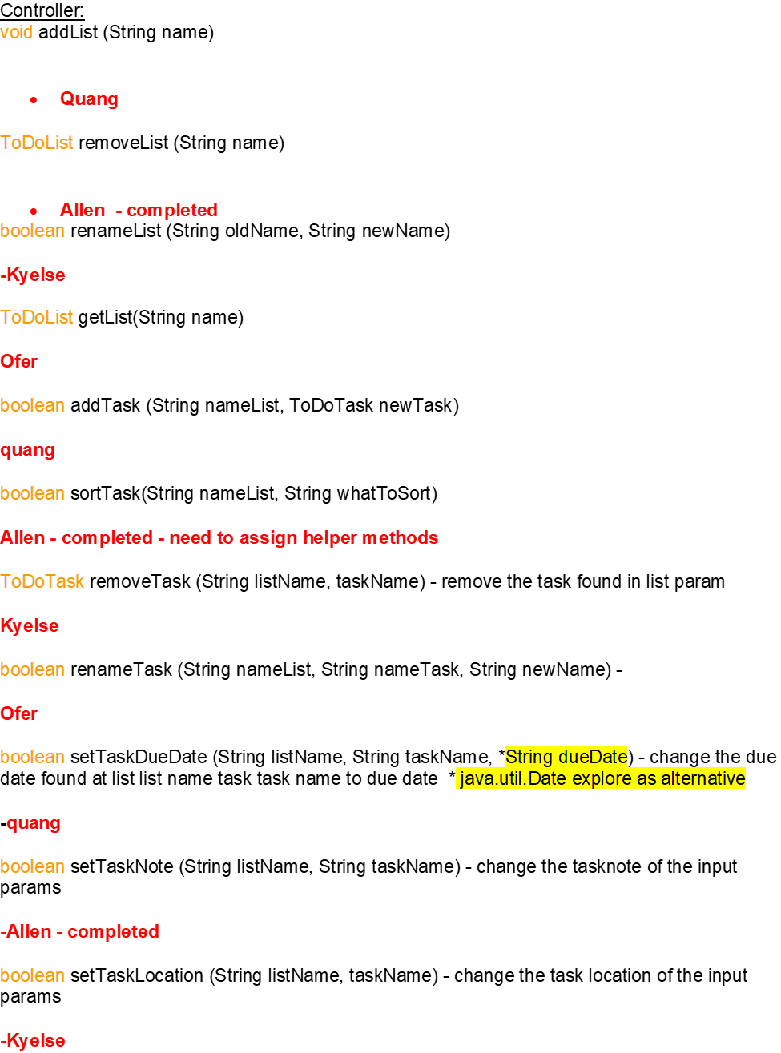
Supporting Documents uml, notes and other docs
Initial methods assignment

Slide 24
Supporting Documents uml, notes and other docs
Initial methods assignment

Slide 25
Thank You

