Slide 1
Novel Generation by Hierarchical Plot Iteration
모델 소개
SNU ECE 박경만.

Slide 2
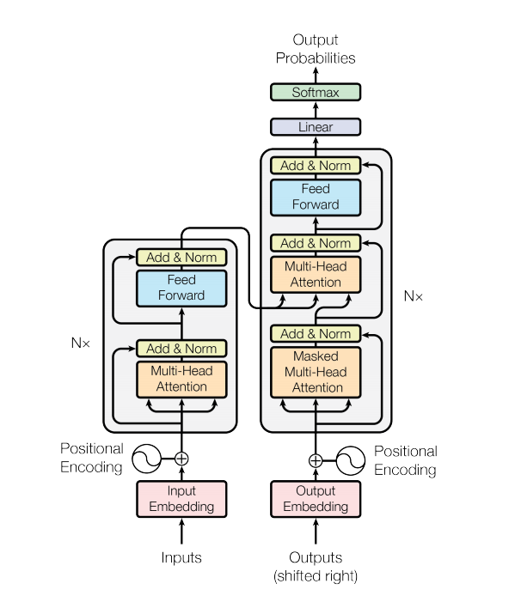
Output
Transformer Cell
Input

Slide 3
One Plot Layer
# (b, input_seq_len, vocab_size)
Fake Input Reconstruction
T5_small Cell
(Decoder Role)
# (b , target_seq_len, embedding dim)
Pretrained
Bart-large-cnn Summary
1
SparseCategorical
CrossEngropyLoss
2
SparseCategorical
CrossEntropy
Loss
Plot I
(Short Summary)
# (b , target_seq_len, vocab_size)
# (b, target_seq_len)
T5_small Cell
(Encoder Role)
Plot i+1(Large Sentences)
# (b, input_seq_len)

Slide 4
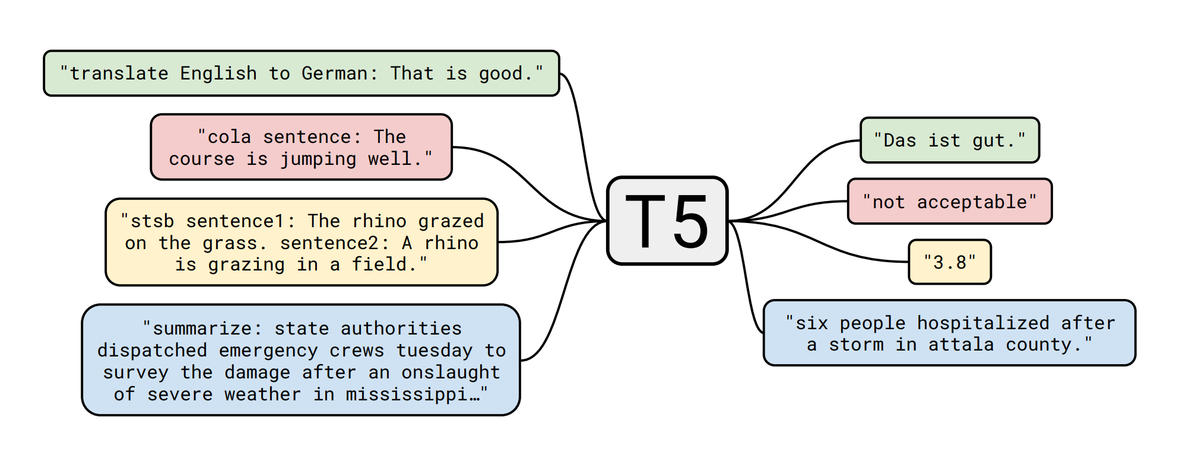
T5 small config
"d_ff": 2048,
"d_kv": 64,
"d_model": 512,
"decoder_start_token_id": 0,
"dropout_rate": 0.1,
"eos_token_id": 1,
"initializer_factor": 1.0,
"is_encoder_decoder": true,
"layer_norm_epsilon": 1e-06,
"model_type": "t5",
"n_positions": 512,
"num_heads": 8,
"num_layers": 6,
"output_past": true,
"pad_token_id": 0,
"relative_attention_num_buckets": 32,
Every Plot Layer uses 2 T5_small Transformers each.

Slide 5
Breif description(글감).
Plot 1
Plot Layer 1
Plot 2
Plot Layer 2
Plot 3
Plot Layer 3
# Maximum Input/Output Sequence Length is 1024
(Temporary)
Plot 4
Plot Layer 4
Plot 5 ( Too Long)
Very Long Story
Severe Coherence Error Occur

Slide 6

Make Very Long Story without Severe Coherece Error
Plot 3(mother plot)
Plot 3(mother plot)
Plot 4
Plot 5 _ t1
Plot 5 _ t2
Plot 5 is extended from plot 4 and mother plot(plot 3).

Slide 7
Breif description(글감).
Plot 1
Plot Layer 1
Plot 2
Plot Layer 2
Plot 3
Plot Layer 3
Plot 3
Plot 4.1
Plot 4.2
Plot 3
Plot Layer 4
Plot 5.1
Plot 5.2
Very Long Story

Slide 8
Training Session
The Whole Large Story
Part 1
Part 1
Part 1
Part 1
EndPoint Plot Layer 1
EndPoint Plot Layer 2
EndPoint Plot Layer 3
EndPoint Plot Layer 4
Create at the same time
Plot(summary)
Mother plot_1
Training until converge
SparseCategorical
CrossEntropy
Loss
Real Mother plot

