Slide 1
토픽모델링과 시각화
고려대학교 DAVIAN Lab
강경필

Slide 2
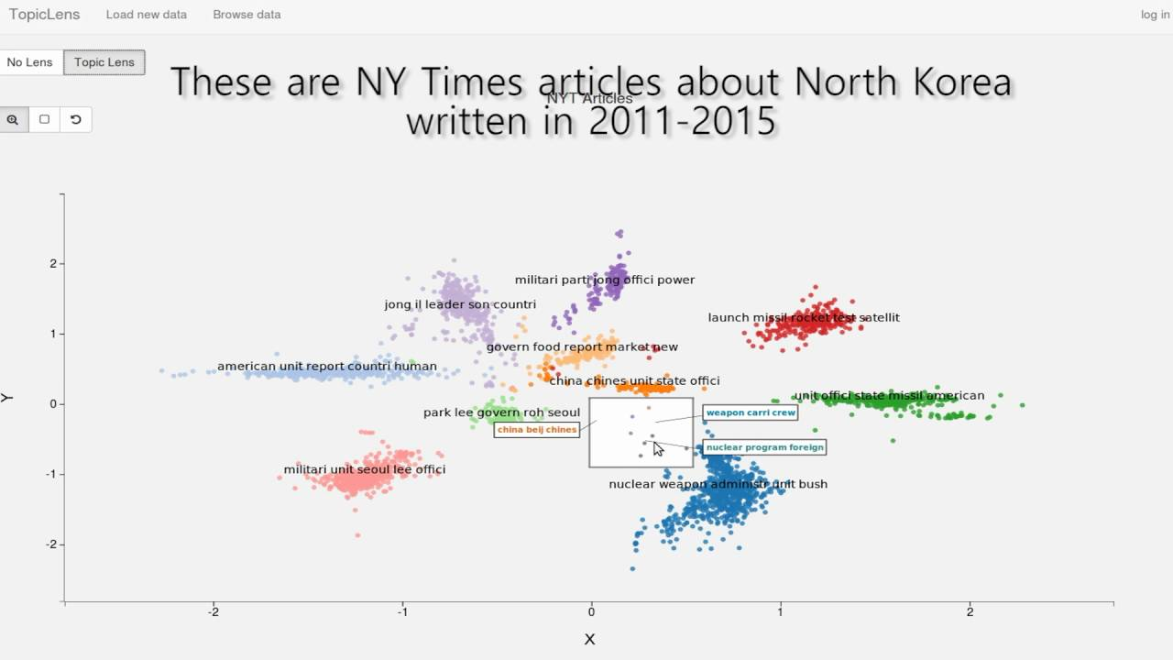
Topic modeling & Visualization

Slide 3
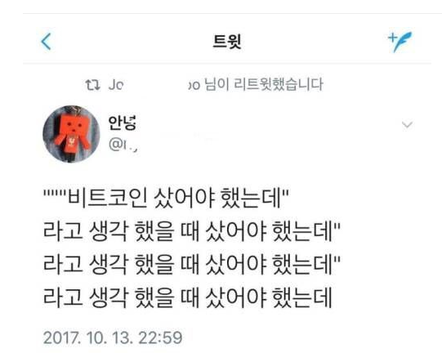
Bitcoin

Slide 4
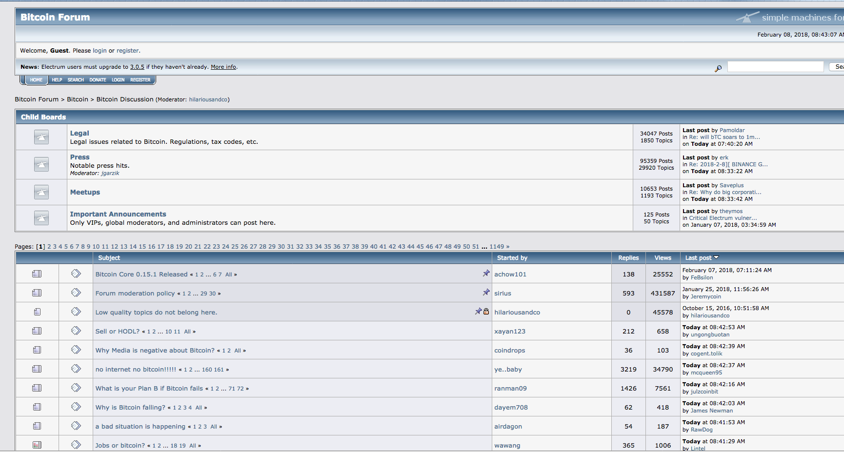
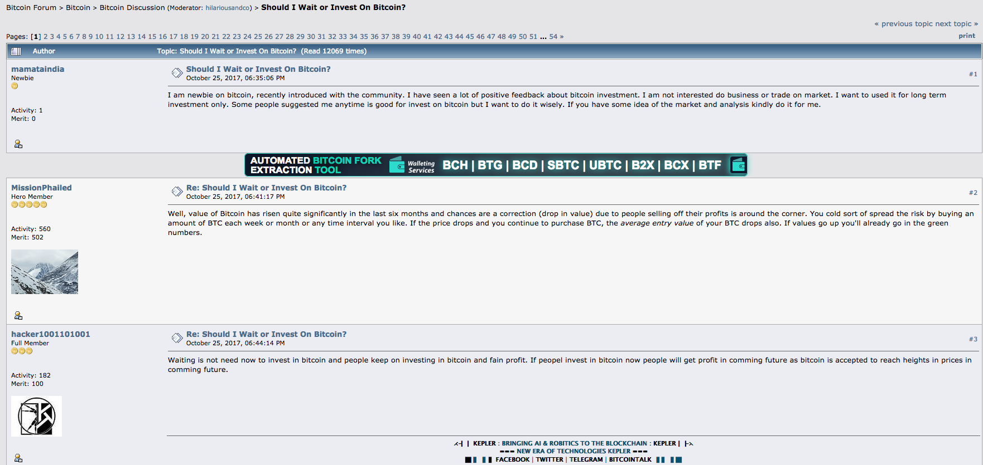
Bitcoin Forum data

Slide 5
Bitcoin Forum data

Slide 6
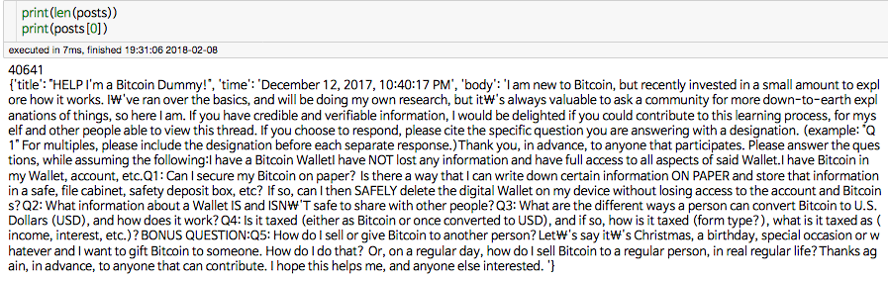
Bitcoin Forum data

Slide 7
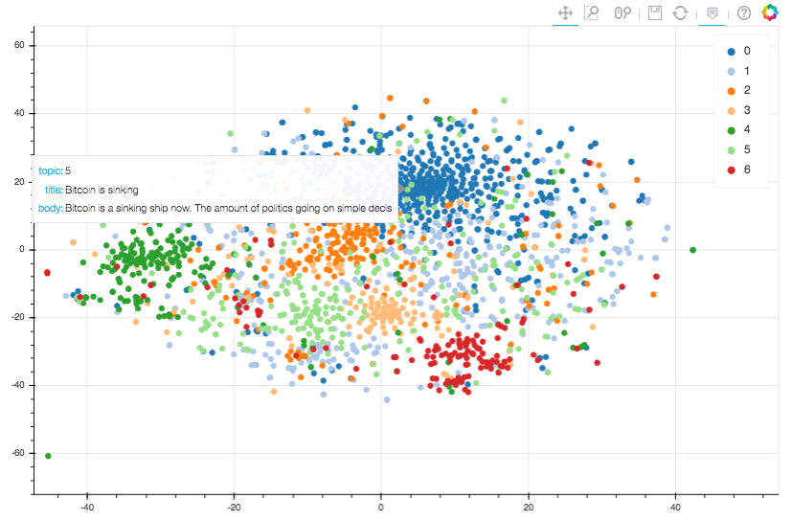
What we will implement…

Slide 8
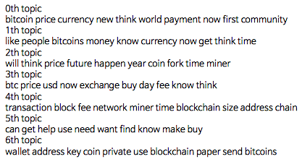
What we will implement…

Slide 9
Before we start…
- Anaconda python 3.6
- Library
pip install ujson (만약 설치 안되면 넘어가도 괜찮습니다.)
pip install stop_words
python 실행 후
import nltk
nltk.download() 실행 후 wordnet 설치
- Code & dataset:
https://github.com/rudvlf0413/bitcoin_topicmodeling

Slide 10
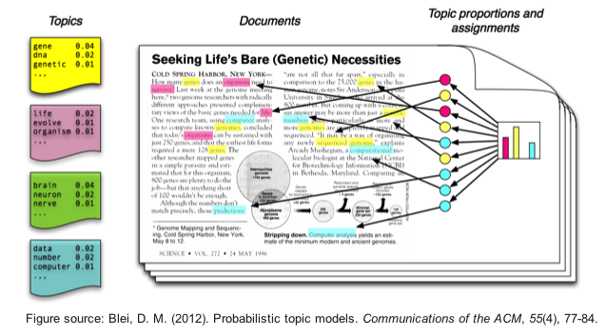
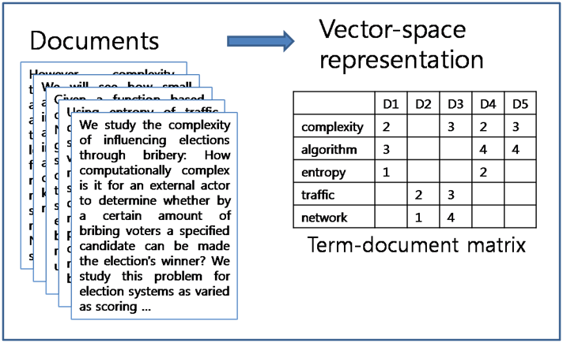
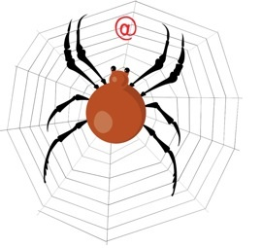
Workflow
Topic modeling
Term document matrix
Crawling
Data preprocessing
Visualization

Slide 11
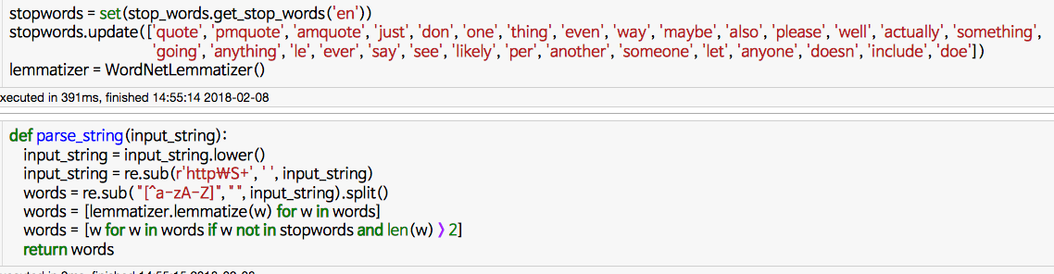

Preprocessing

Slide 12
Term document matrix

Slide 13
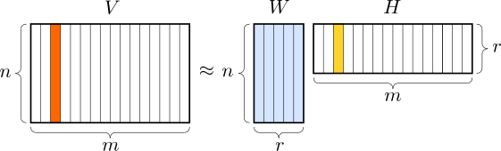
Topic modeling
Nonnegative matrix factorization

Slide 14
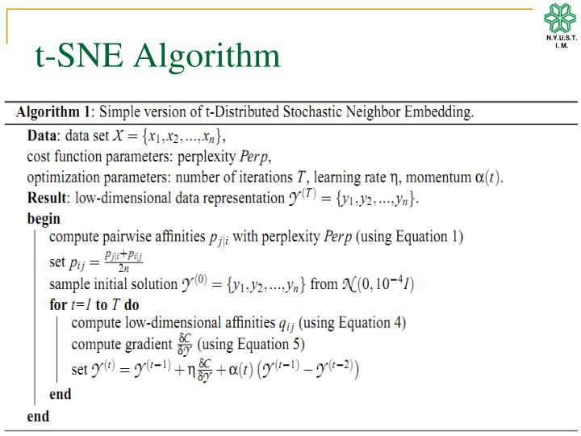
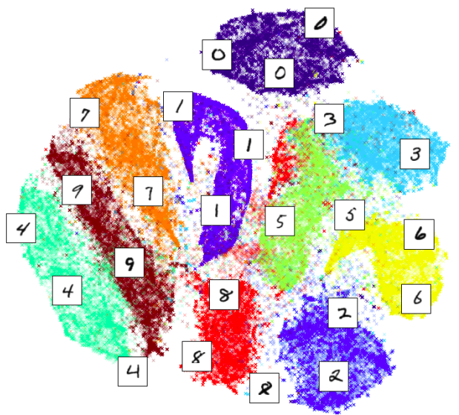
Visualization

Slide 15
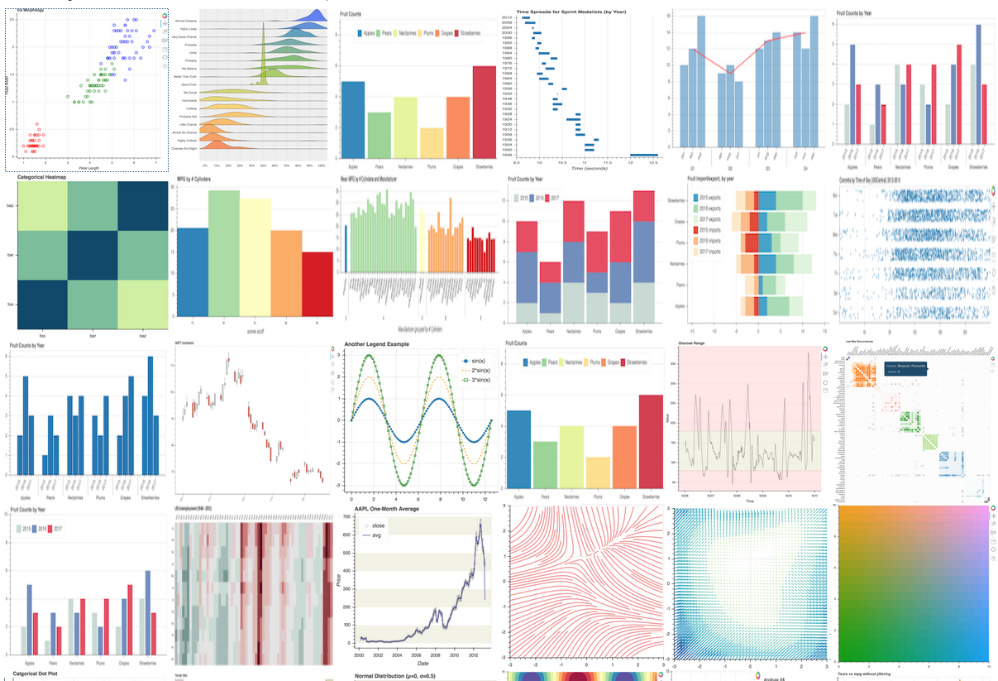
Visualization

Slide 16
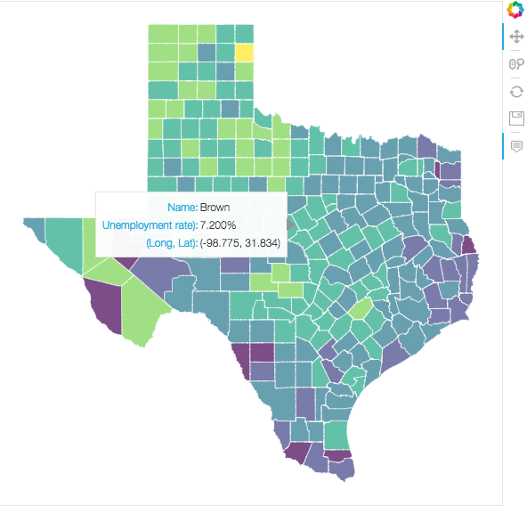
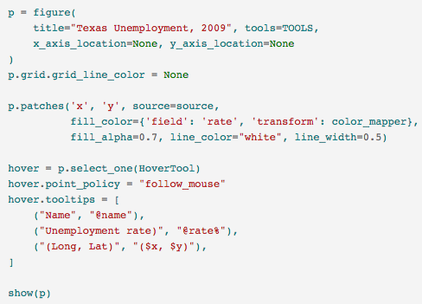
Visualization

Slide 17
Let’s do it!

Slide 18


