Slide 1

Lesson 2
Android Development Introduction

Slide 2
Android App’s Anatomy
Android applications are usually created using the Java programming language ^{[1]}
Apps must import various Android Libraries (such as android.jar, maps.jar, etc ) to gain the functionality needed to work inside the Android OS.
The various app components are given to the compiler to obtain a single signed and deployable Android Package (an .apk file).
Like “.class” files in Java, “.apk” files are the byte-code version of the app that finally will be ‘executed’ by interpretation inside either a Dalvik Virtual Machine (DVM) or an Android-Runtime Engine (ART).

Slide 3
What is Android Studio?
Android integrated development environment (IDE)
Project and Activity templates
Layout editor
Testing tools
Gradle-based build
Log console and debugger
Emulators

Slide 4
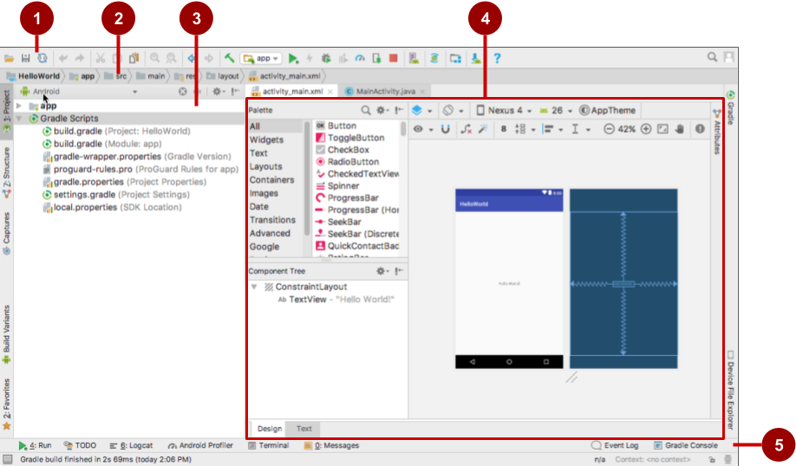
Android Studio interface
Toolbar
Navigation bar
Project pane
Editor
Tabs for other panes

Slide 5
Installation Overview
Mac, Windows, or Linux
Install Java (JDK) (at least version 1.7)
Download and install Android Studio from https://developer.android.com/studio/

Slide 6
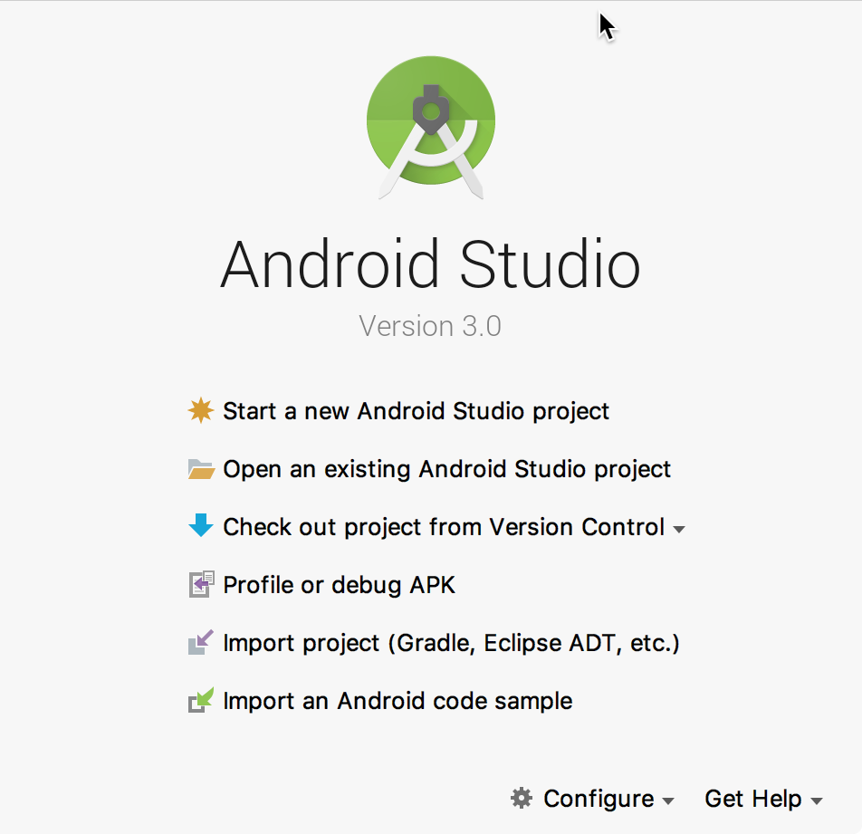

Start Android Studio

Slide 7
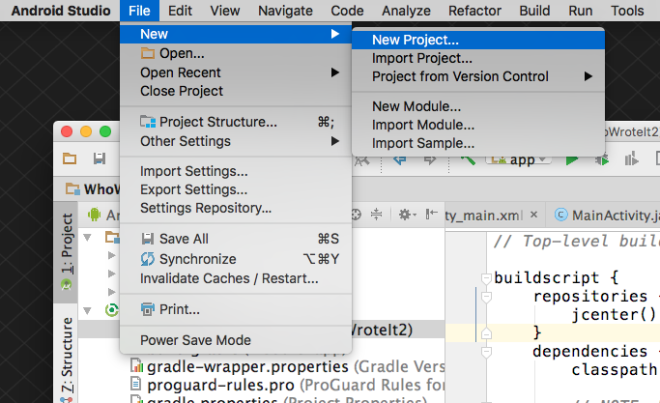
Create a project inside Android Studio

Slide 8
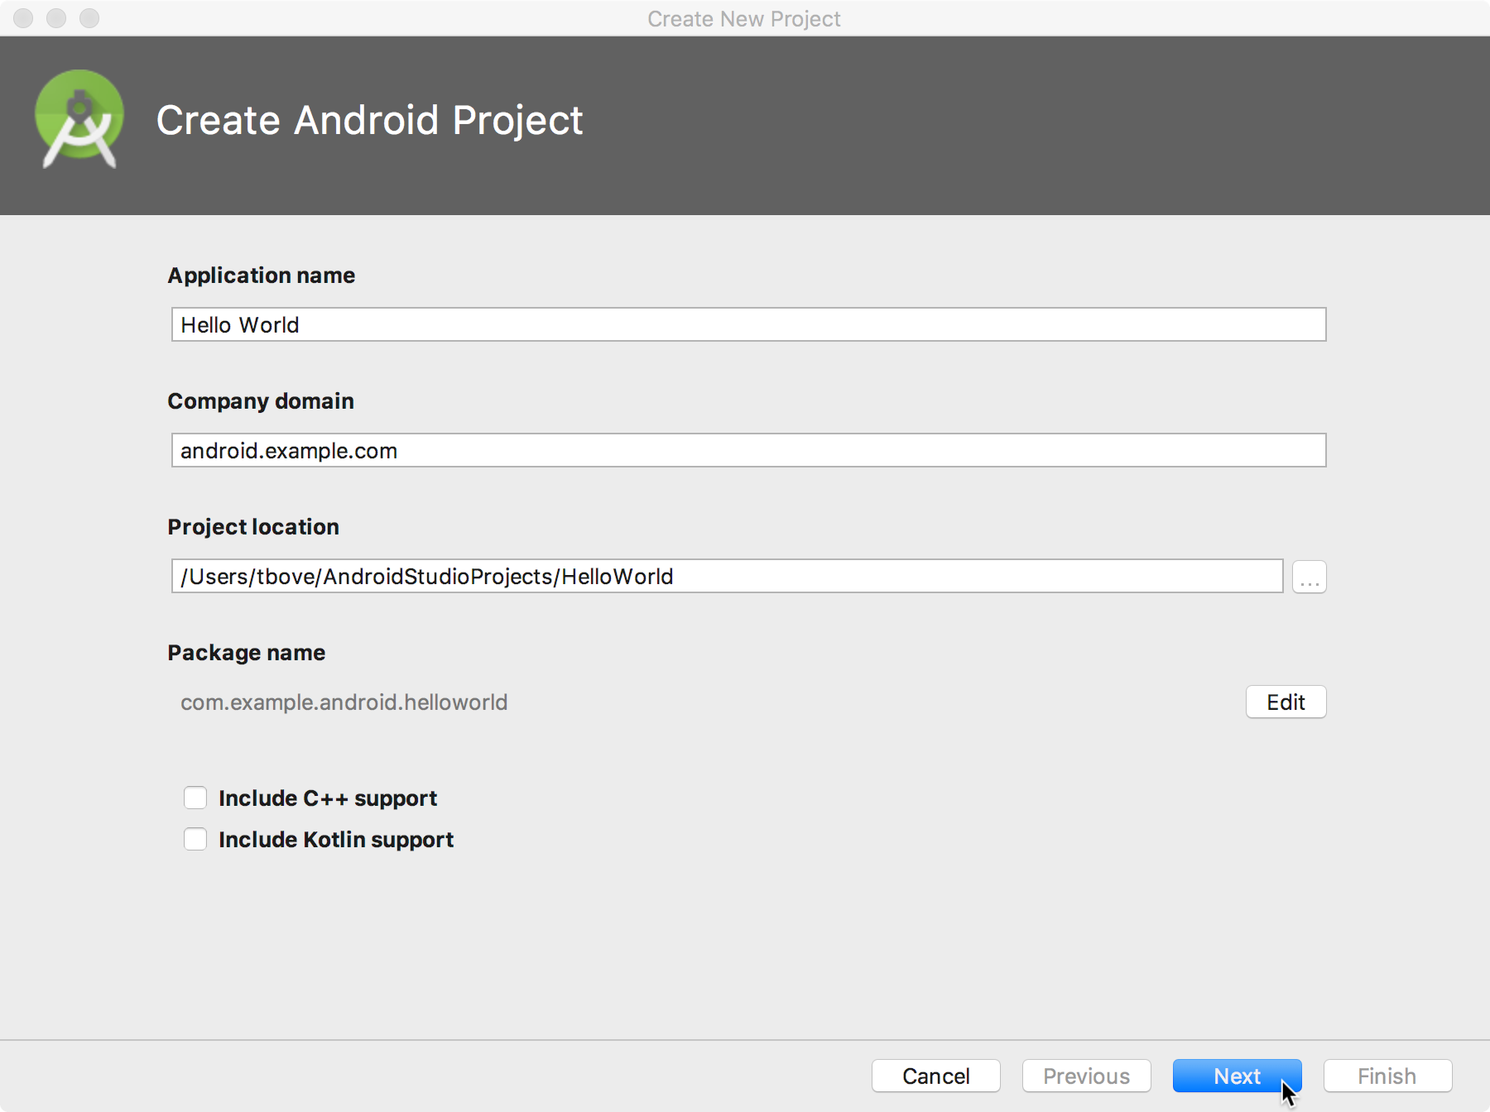
Name your app

Slide 9
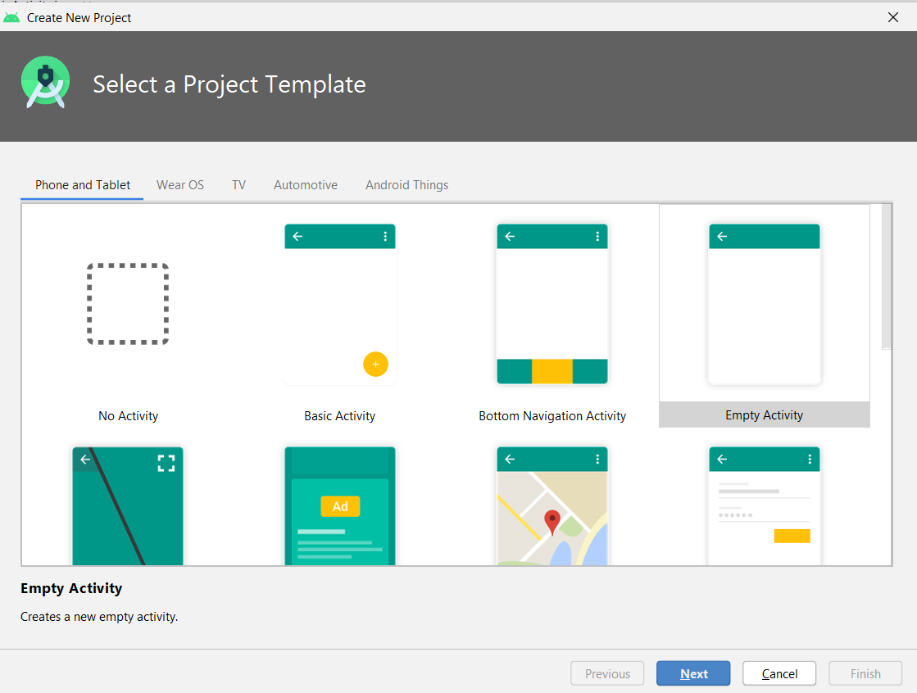
Pick a Project template
Choose templates for common activities, such as maps or navigation drawers.
Pick Empty Activity or Basic Activity for simple and custom activities.

Slide 10
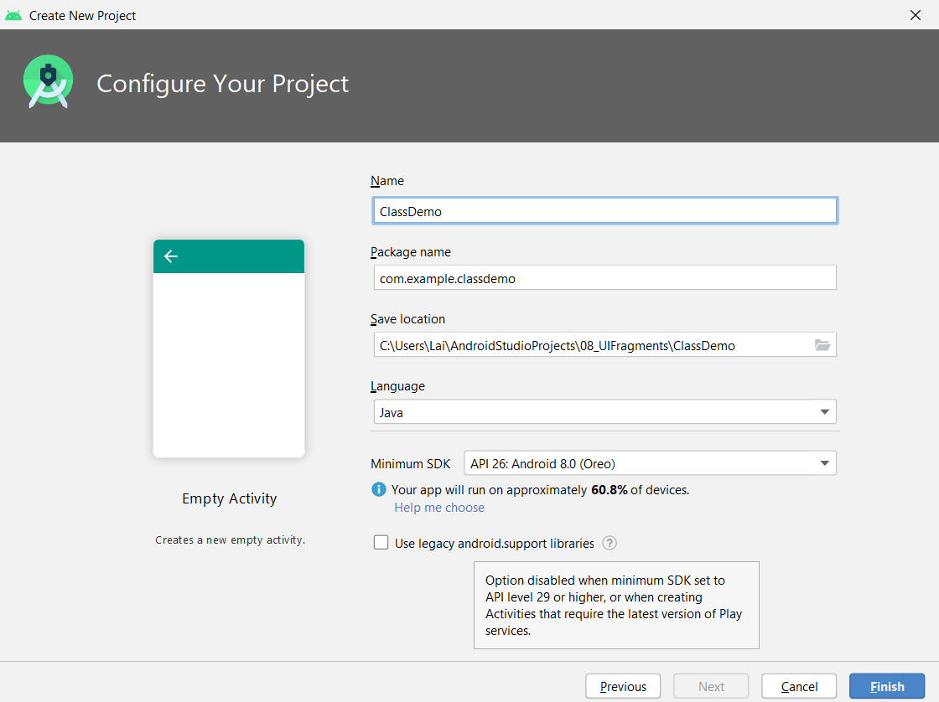
Configuring Project

Slide 11
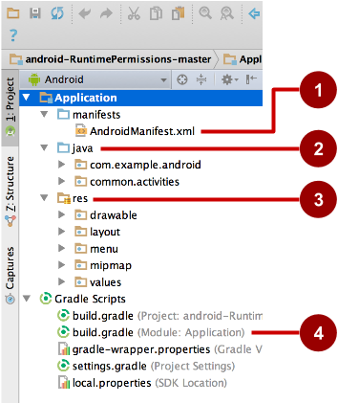
Project folders
manifests—Android Manifest file - description of app read by the Android runtime
java—Java source code packages
res—Resources (XML) - layout, strings, images, dimensions, colors...
build.gradle—Gradle build files

Slide 12
Resource folders of a small app
Put resources in your project's res folder
MyProject/ src/ res/ drawable/ graphic.png layout/ activity_main.xml list_iteminfo.xml mipmap/ ic_launcher_icon.png values/ strings.xml

Slide 13
Common resource directories
drawable/, layout/, menu/
values/—XML files of simple values, such as string or color
xml/—arbitrary XML files
raw/—arbitrary files in their raw form
mipmap/—drawables for different launcher icon densities

Slide 14
What are alternative resources?
Different device configurations may require different resources
Localized strings
Image resolutions
Layout dimensions
Android loads appropriate resources automatically

Slide 15
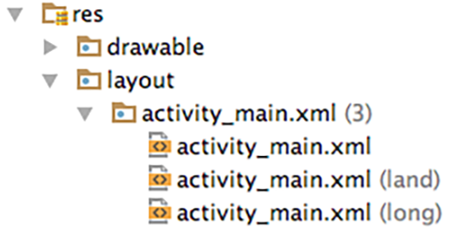
Create alternative resource folders
Use alternative folders for resources for different device configurations

Slide 16
Names for alternative resource
Resource folder names have the format resources name-config qualifier
drawable-hdpi | drawables for high-density displays
layout-land | layout for landscape orientation
layout-v7 | layout for version of platform
values-fr | all values files for French locale

Slide 17
Screen Orientation
Use res/layout and provide alternatives for landscape where necessary
res/layout-port for portrait-specific layouts
res/layout-land for landscape specific layouts
Avoid hard-coded dimensions to reduce need for specialized layouts

Slide 18
Gradle build system
Modern build subsystem in Android Studio
Three build.gradle:
project
module
settings
Typically not necessary to know low-level Gradle details
Learn more about gradle at https://gradle.org/

Slide 19
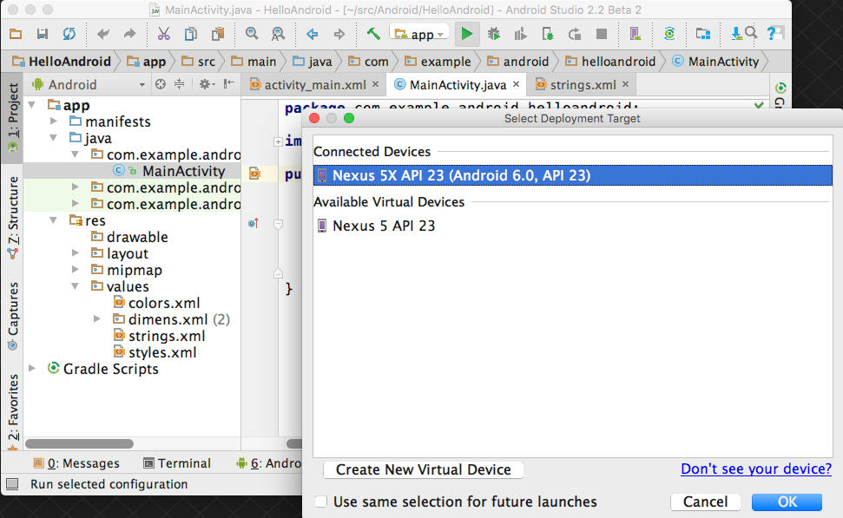
Run your app
1. Run
2. Select virtual or physical device
3. OK

Slide 20
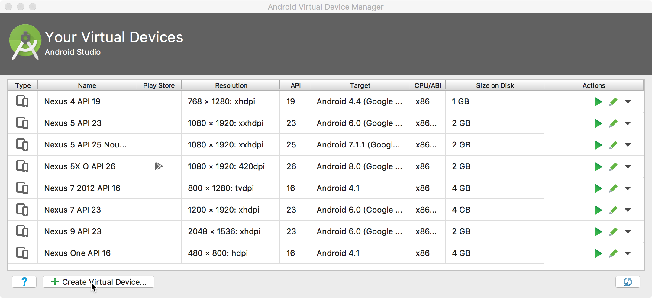
Create a virtual device
Use emulators to test app on different versions of Android and form factors.
Tools > Android > AVD Manager

Slide 21
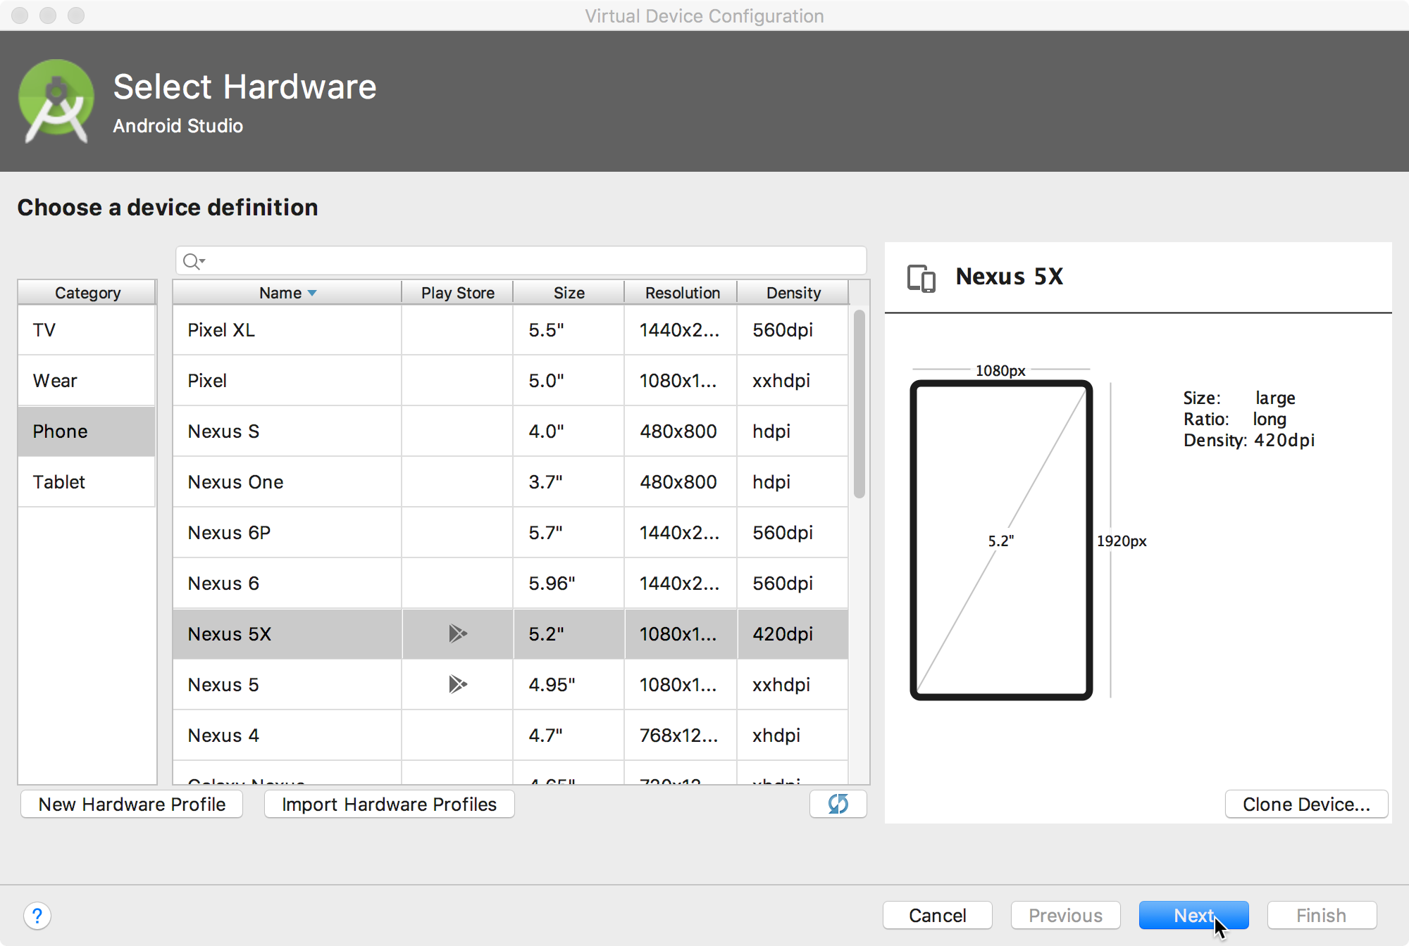
Configure virtual device
Choose hardware
Select Android version
Finalize

Slide 22
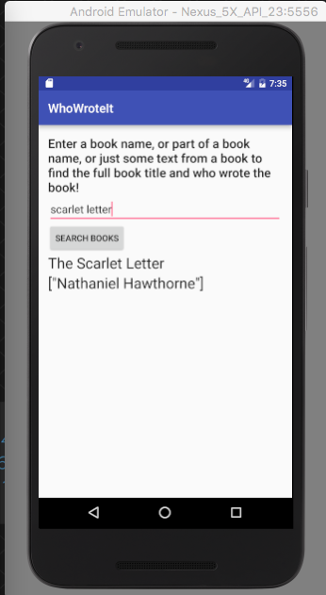

Run on a virtual device

Slide 23
Running in Emulator
Pros:
Conveniently test app on basic hardware by clicking in software
Easy to test app on various devices (phones, tablets, TVs, etc), various screen sizes
Cons:
Some hardware missing, especially hardware for sensing environment e.g. GPS, camera, video recording, etc
No support for USB connections & Bluetooth
SLOW!!!!!!!!

Slide 24
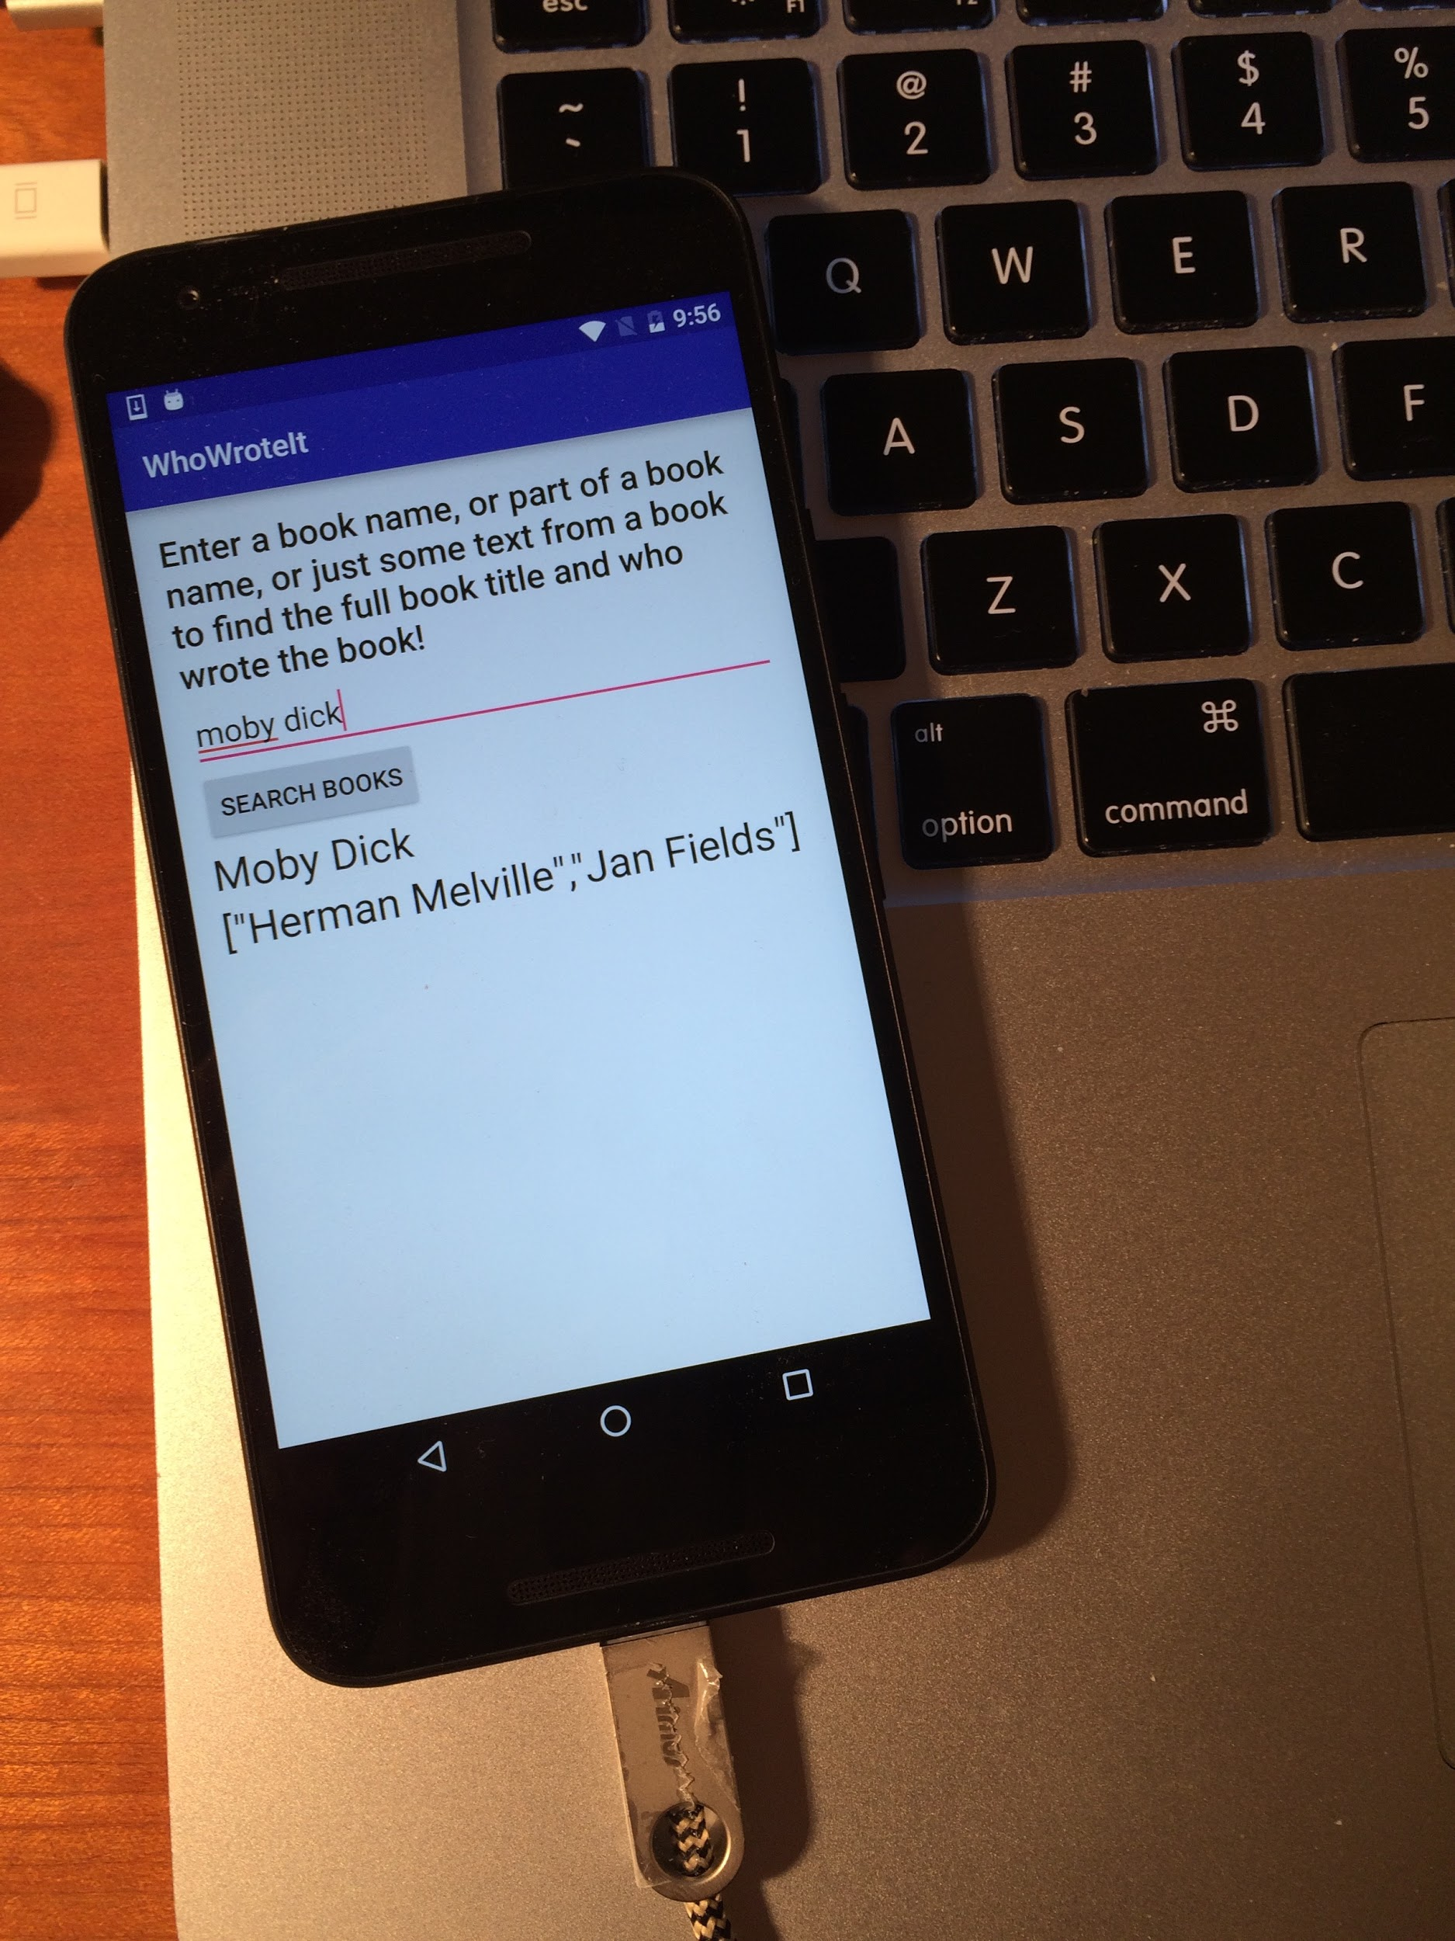
Run on a physical device
Turn on Developer Options:
Settings > About phone
Tap Build number seven times
Turn on USB Debugging
Settings > Developer Options > USB Debugging
Connect phone to computer with cable
Windows/Linux additional setup:
Using Hardware Devices
Windows drivers:
OEM USB Drivers

Slide 25
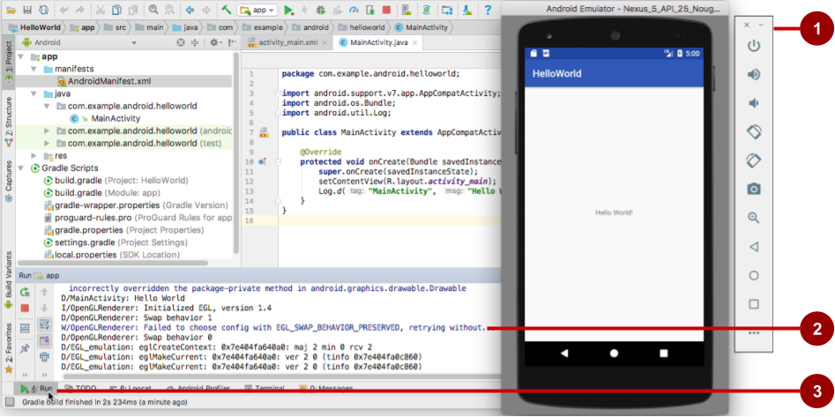
Get feedback as your app runs
Emulator running the app
Run pane
Run tab to open or close the Run pane

Slide 26
Adding logging to your app
As the app runs, the Logcat pane shows information
Add logging statements to your app that will show up in the Logcat pane
Set filters in Logcat pane to see what's important to you
Search using tags

Slide 27
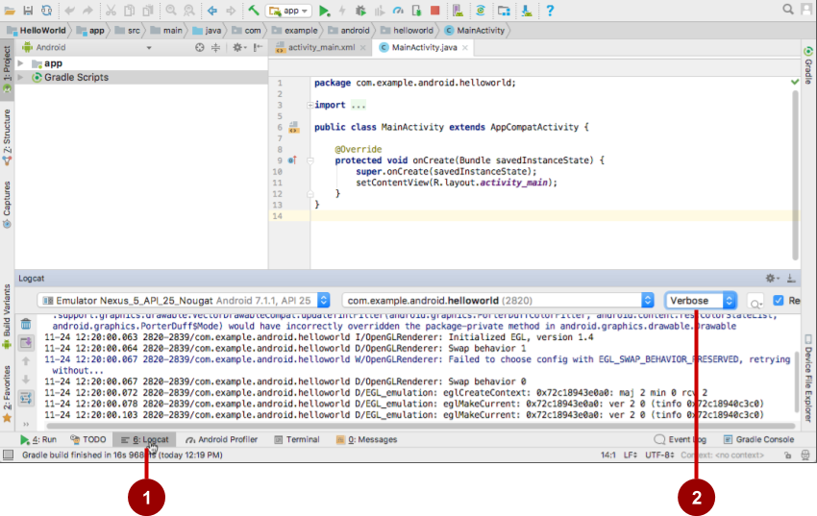
The Logcat pane
Logcat tab to show Logcat pane
Log level menu

Slide 28
Logging statement
import android.util.Log;
// Use class name as tag
private static final String TAG = MainActivity.class.getSimpleName();
// Show message in Android Monitor, logcat pane
// Log.<log-level>(TAG, "Message");
Log.d(TAG, “Creating the URI…”);

Slide 29
Learn More
Meet Android Studio
Official Android documentation at developer.android.com
Create and Manage Virtual Devices
Supporting Different Platform Versions
Supporting Multiple Screens

Slide 30
Learn even more
Gradle Wikipedia page
Google Java Programming Language style guide
Find answers at Stackoverflow.com

Slide 31
END
Questions ?

