Slide 1

Lesson 5
More on Views

Slide 2
Text and scrolling views
TextView
ScrollView

Slide 3
TextView for text
TextView is View subclass for single and multi-line text
EditText is TextView subclass with editable text
Controlled with layout attributes
Set text:
Statically from string resource in XML
Dynamically from Java code and any source

Slide 4
Creating TextView in XML
<TextView android:id="@+id/textview"
android:layout_width="match_parent"
android:layout_height="wrap_content"
android:text="@string/my_story"/>

Slide 5
Common TextView attributes
android:text—text to display
android:textColor—color of text
android:textAppearance—predefined style or theme
android:textSize—text size in sp
android:textStyle—normal, bold, italic, or bold|italic
android:typeface—normal, sans, serif, or monospace
android:lineSpacingExtra—extra space between lines in sp

Slide 6
Formatting text in string resource
Use <b> and <i> HTML tags for bold and italics
All other HTML tags are ignored
String resources: one unbroken line = one paragraph
\n starts a new a line or paragraph
Escape apostrophes and quotes with backslash (\", \')
Escape any non-ASCII characters with backslash (\)

Slide 7
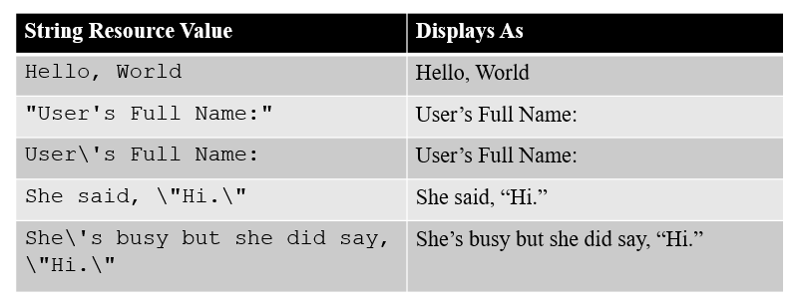
Formatting text in string resource

Slide 8
Formatting text in string resource
You can also add three HTML-style attributes to string resources.
For example:
<string name="txt">
<b>Bold</b>,<i>Italic</i>,<u>Line</u>
</string>

Slide 9
Formatting text in string resource
You can create format strings, but you need to escape all bold, italic, and underlining tags.
For example, this text shows a score and the
“win” or “lose” string:
<string name="winLose">
Score: %1$d of %2$d! You %3$s.
</string>

Slide 10
Formatting text in string resource
String mySimpleWinString;
mySimpleWinString =
getResources().getString(R.string.winLose);
String resultText =
String.format(mySimpleWinString,5,5,escapedWin);
The resulting text in the resultText variable is:
Score: 5 of 5! You Won

Slide 11
Working with String Arrays
You can specify lists of strings in resource files.
This is a good way to store menu options and drop-down list values.
String arrays are appropriately tagged with the <string-array> tag.
They usually include a number of <item> child tags, one for each string in the array.

Slide 12
Working with String Arrays
<?xml version="1.0" encoding="utf-8"?>
<resources>
<string-array name="flavors">
<item>Vanilla</item>
<item>Chocolate</item>
<item>Strawberry</item>
<item>Coffee</item>
<item>Sherbet</item>
</string-array>
<string-array name="soups">
<item>Vegetable minestrone</item>
<item>New England clam chowder</item>
<item>Organic chicken noodle</item>
</string-array>
</resources>

Slide 13
Working with String Arrays
Accessing string array resources is easy.
The method getStringArray() retrieves a string array from a resource file, in this case one named flavors:
String[] aFlavors = getResources().getStringArray(R.array.flavors);

Slide 14
Formatting active web links
<string name="article_text">... www.rockument.com</string>
<TextView
android:id="@+id/article"
android:layout_width="wrap_content"
android:layout_height="wrap_content"
android:autoLink="web"
android:text="@string/article_text"/>
autoLink values:"web", "email", "phone", "map", "all"
Don’t use HTML for a web link in free-form text

Slide 15
Creating TextView in Java code
TextView myTextview = new TextView(this);
myTextView.setWidth(LayoutParams.MATCH_PARENT);
myTextView.setHeight(LayoutParams.WRAP_CONTENT);
myTextView.setMinLines(3);
myTextView.setText(R.string.my_story);
myTextView.append(userComment);

Slide 16
What about large amounts of text?
News stories, articles, etc…
To scroll a TextView, embed it in a ScrollView
Only one View element (usually TextView) allowed in a ScrollView
To scroll multiple elements, use one ViewGroup (such as LinearLayout) within the ScrollView

Slide 17
ScrollView for scrolling content
ScrollView is a subclass of FrameLayout
Holds all content in memory
Not good for long texts, complex layouts
Do not nest multiple scrolling views
Use HorizontalScrollView for horizontal scrolling
Use a RecyclerView for lists

Slide 18
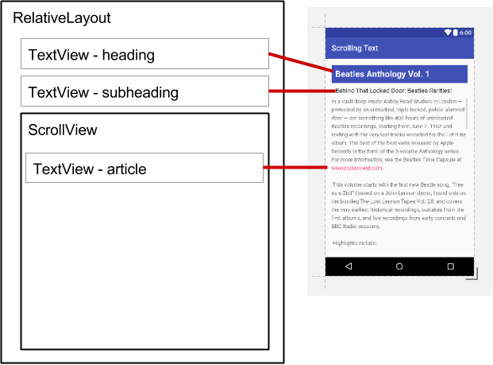
ScrollView layout with one TextView
<ScrollView
android:layout_width="wrap_content"
android:layout_height="wrap_content"
android:layout_below="@id/article_subheading">
<TextView
android:layout_width="wrap_content"
android:layout_height="wrap_content"
.../>
</ScrollView>

Slide 19
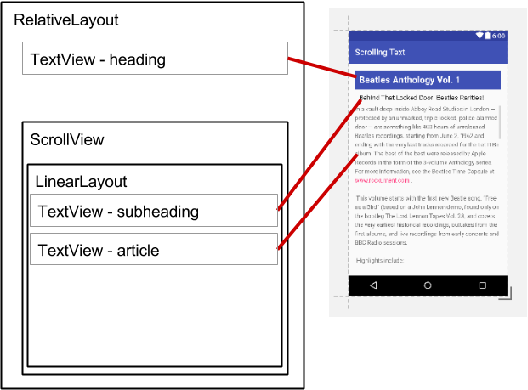
ScrollView layout with a view group
<ScrollView ...
<LinearLayout
android:layout_width="match_parent"
android:layout_height="wrap_content"
android:orientation="vertical">
<TextView
android:id="@+id/article_subheading" .../>
<TextView
android:id="@+id/article" ... />
</LinearLayout>
</ScrollView>

Slide 20
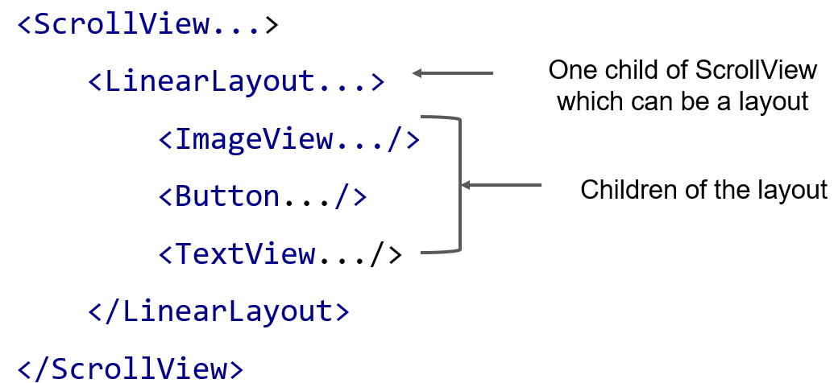
ScrollView with image and button

Slide 21
Users expect to interact with apps
Tapping or clicking, typing, using gestures, and talking
Buttons perform actions
Other UI elements enable data input and navigation

Slide 22
User interaction design
Important to be obvious, easy, and consistent:
Think about how users will use your app
Minimize steps
Use UI elements that are easy to access, understand, use
Follow Android best practices
Meet user's expectations

Slide 23

Button
View that responds to tapping (clicking) or pressing
Usually text or visuals indicate what will happen when tapped
State: normal, focused, disabled, pressed, on/off

Slide 24
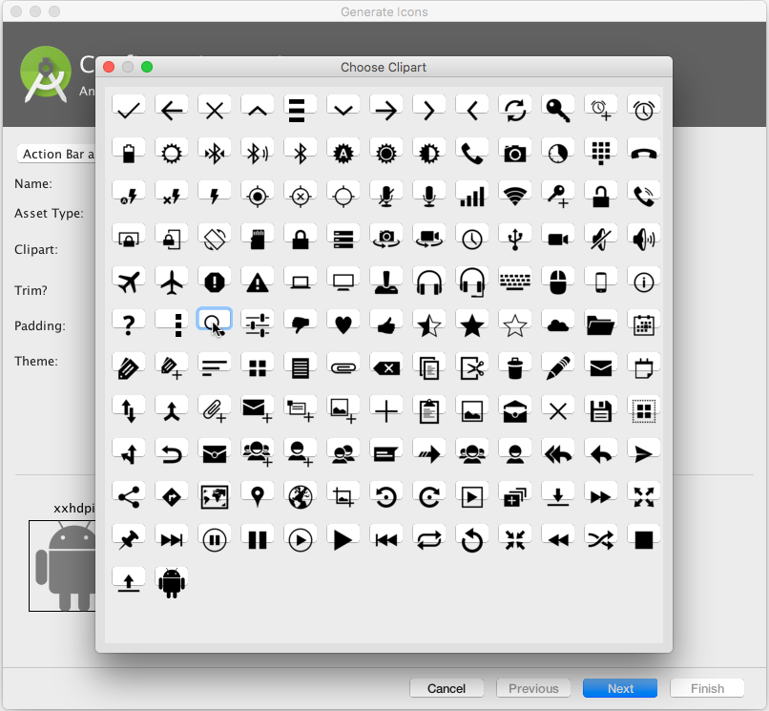
Button image assets
Right-click app/res/drawable
Choose New > Image Asset
Choose Action Bar and Tab Items from drop down menu
Click the Clipart: image (the Android logo)

Slide 25
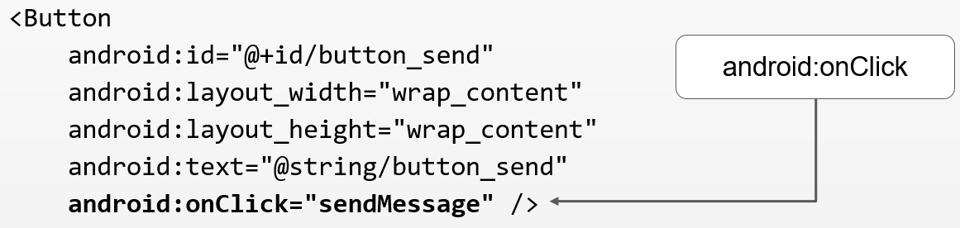
Responding to button taps
In your code: Use OnClickListener event listener.
In XML: use android:onClick attribute in the XML layout:

Slide 26
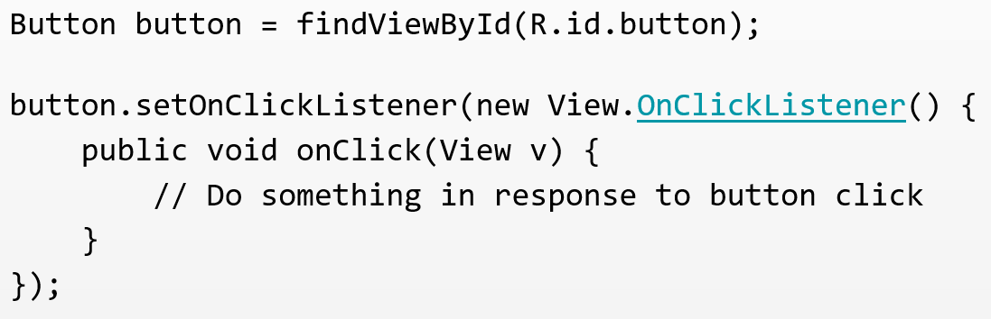
Setting listener with onClick callback

Slide 27
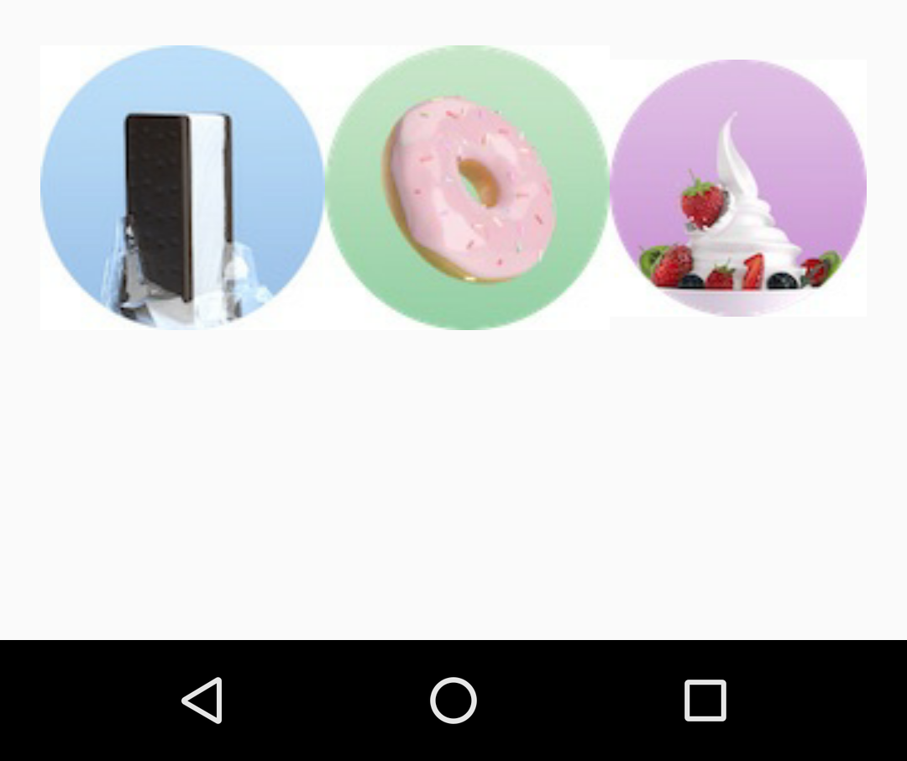
Clickable Image: ImageView
ImageView with android:onClick attribute
Image for ImageView in app>src>main>res>drawable folder in project

Slide 28
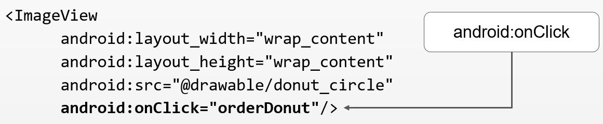
Responding to ImageView taps
In your code: Use OnClickListener event listener.
In XML: use android:onClick attribute in the XML layout:

Slide 29
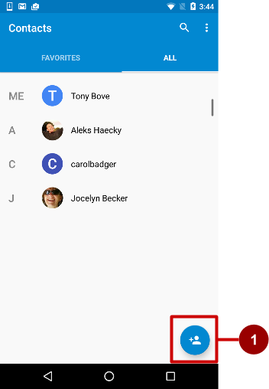
Floating Action Buttons (FAB)
Raised, circular, floats above layout
Primary or "promoted" action for a screen
One per screen
For example:
1 Add Contact button in Contacts app

Slide 30
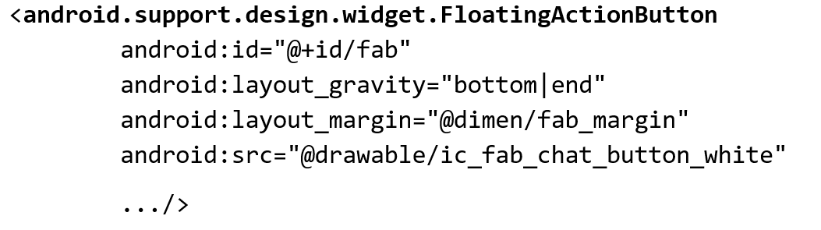
Using FABs
Start with Basic Activity template
Layout:

Slide 31
FAB size
56 x 56 dp by default
Set mini size (30 x 40 dp) with app:fabSize attribute:
app:fabSize="mini"
Set to 56 x 56 dp (default):
app:fabSize="normal"

Slide 32
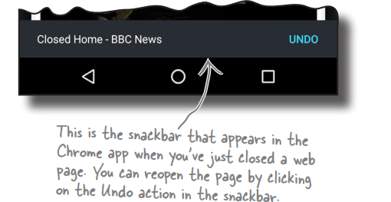
Snackbar
A snackbar is like a toast except that you can interact with it.
It’s a short message that appears at the bottom of the screen that’s used to give the user information about an operation.
Unlike with a toast, you can add actions to a snackbar, such as an action to undo an operation.

Slide 33
How to create a Snackbar
To create a snackbar, you call the Snackbar.make() method.
This method takes three parameters: the View you want to hold the snackbar, the text you want to display, and an int duration.
CharSequence text = "Hello, I'm a Snackbar!"; int duration = Snackbar.LENGTH_SHORT; Snackbar snackbar = Snackbar.make(findViewById(R.id.coordinator, text, duration);

Slide 34
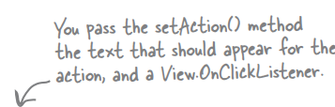
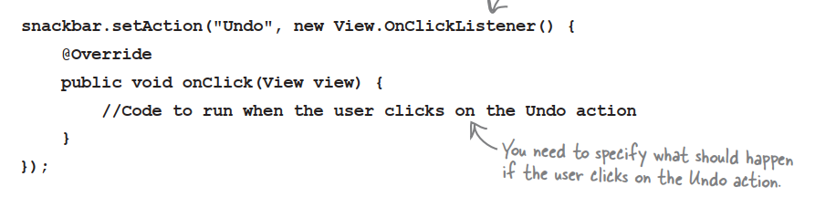
How to response with Snackbar
You can add an action to the snackbar by calling its setAction() method.

Slide 35

How to response with Snackbar
Once you’ve finished creating the snackbar, you display it using its show() method:

Slide 36
Learn More
Developer Documentation:
TextView
ScrollView and HorizontalScrollView
String Resources
Input Controls
Drawable Resources
Buttons
Other:
Android Developers Blog: Linkify your Text!
Codepath: Working with a TextView

