Slide 1
Midterm Test Next Week
Date: 8/3/2021
Time: 8:30 am to 10:00 am
2 Sections
8:30 - 9:05 am (Part 1 MCQ)
9:10 – 10:00 am (Part 2 Structure + Program code + Strings.xml [write some string values]).
Please do the revision for all the lab exercises
Please use flashback to record your video. Upload to the given links before 1 pm.
I will open 2 sessions in Teams (BK + GT Group). Login to your respective group.

Slide 2

Lesson 6
Android Views Part 2 & User Interaction

Slide 3
Accepting user input
Freeform text and numbers: EditText (using keyboard)
Providing choices: CheckBox, RadioButton, Spinner
Switching on/off: Toggle, Switch
Choosing value in range of values: SeekBar

Slide 4
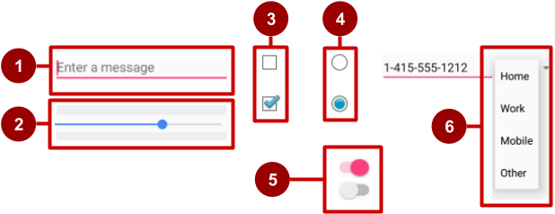
Examples of input controls
EditText
SeekBar
CheckBox
RadioButton
Switch
Spinner

Slide 5
How input controls work
Use EditText for entering text using keyboard
Use SeekBar for sliding left or right to a setting
Combine CheckBox elements for choosing more than one option
Combine RadioButton elements into RadioGroup — user makes only one choice
Use Switch for tapping on or off
Use Spinner for choosing a single item from a list

Slide 6
View is base class for input controls
The View class is the basic building block for all UI components, including input controls
View is the base class for classes that provide interactive UI components
View provides basic interaction through android:onClick

Slide 7
View Class
The View that receives user input has "Focus"
Only one View can have focus
Focus makes it unambiguous which View gets the input
Focus is assigned by
User tapping a View
App guiding the user from one text input control to the next using the Return, Tab, or arrow keys
Calling requestFocus() on any View that is focusable
EditText text = findViewById(R.Id.text_name);
text.requestFocus(true); //move the focus edit text

Slide 8
Clickable versus focusable
Clickable—View can respond to being clicked or tapped
Focusable—View can gain focus to accept input
Input controls such as keyboards send input to the view that has focus

Slide 9
Guiding users
Visually indicate which view has focus so users knows where their input goes
Visually indicate which views can have focus helps users navigate through flow
Predictable and logical—no surprises!

Slide 10
Guiding focus
Arrange input controls in a layout from left to right and top to bottom in the order you want focus assigned
Place input controls inside a view group in your layout
Specify ordering in XML
android:id="@+id/top"
android:focusable="true"
android:nextFocusDown="@+id/bottom"

Slide 11
Set focus explicitly
Use methods of the View class to set focus
setFocusable() sets whether a view can have focus
requestFocus() gives focus to a specific view
setOnFocusChangeListener() sets listener for when view gains or loses focus
onFocusChanged() called when focus on a view changes

Slide 12
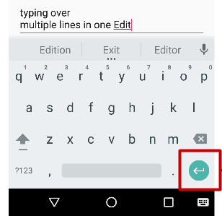
EditText for multiple lines of text
EditText default
Alphanumeric keyboard
Suggestions appear
Tapping Return (Enter) key starts new line
Return key

Slide 13
EditText Controls
The EditText class is derived from TextView.
Most of its functionality is contained within TextView but is enabled when created as an EditText.
<EditText
android:id="@+id/EditText01"
android:layout_height="wrap_content"
android:hint="type here"
android:lines="4"
android:layout_width=“match_parent" />

Slide 14
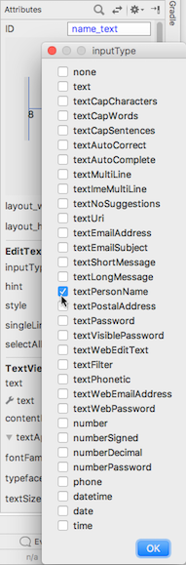
Customize with inputType
Set in Attributes pane of layout editor
XML code for EditText:
<EditText
android:id="@+id/name_field"
android:inputType =
"textPersonName"
...

Slide 15
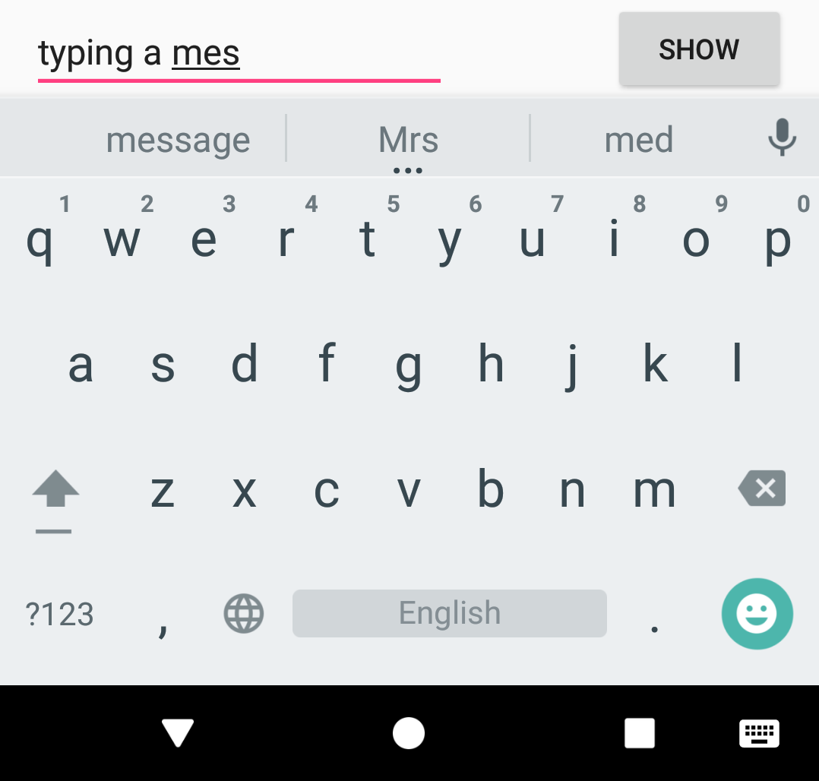
EditText for message
android:inputType ="textShortMessage"
Single line of text
Tapping Emoticons key changes keyboard to emoticons
Emoticons

Slide 16
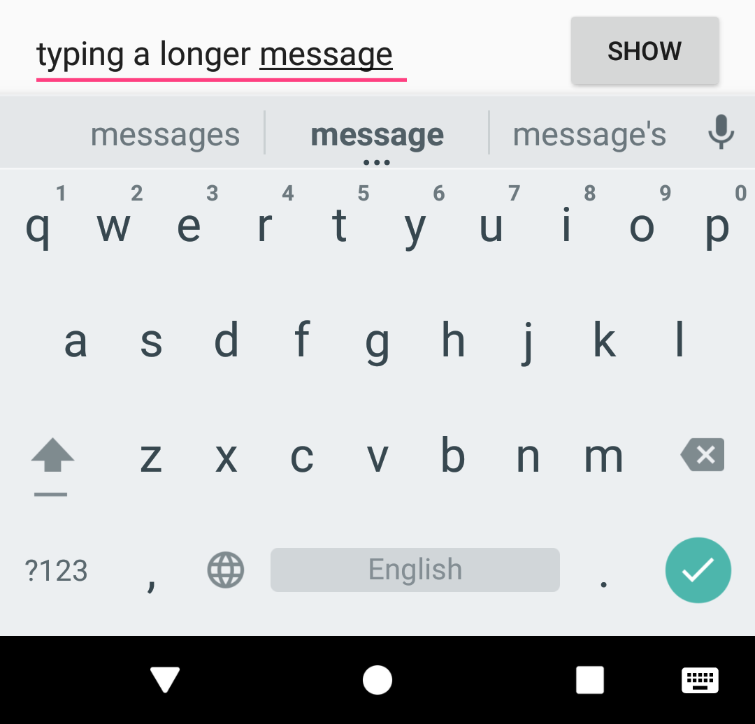
EditText for single line
Both work:
android:inputType ="textLongMessage"
android:inputType ="textPersonName"
Single line of text
Tapping Done key advances focus to next View
Done key

Slide 17
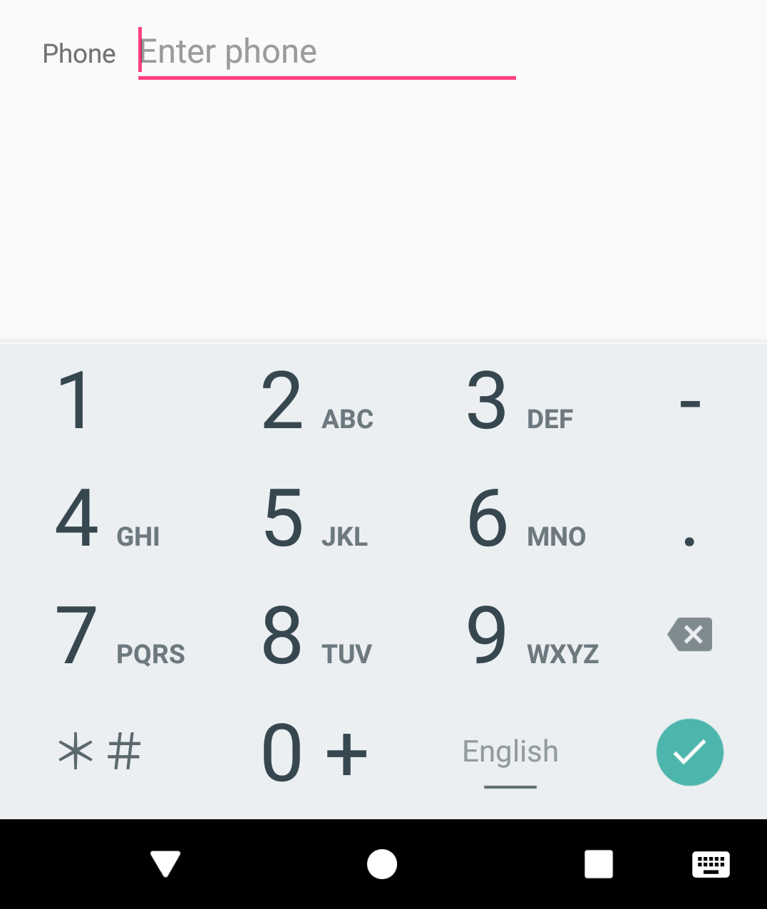
EditText for phone number entry
android:inputType ="phone"
Numeric keypad (numbers only)
Tapping Done key advances focus to next View
Done key

Slide 18
Getting text
Get the EditText object for the EditText view
EditText simpleEditText = //binding findViewById(R.id.edit_simple);
Retrieve the CharSequence and convert it to a string
String strValue = simpleEditText.getText().toString();

Slide 19
Common input types
textCapCharacters: Set to all capital letters
textCapSentences: Start each sentence with a capital letter
textPassword: Conceal an entered password
number: Restrict text entry to numbers
textEmailAddress: Show keyboard with @ conveniently located
phone: Show a numeric phone keypad
datetime: Show a numeric keypad with a slash and colon for entering the date and time

Slide 20
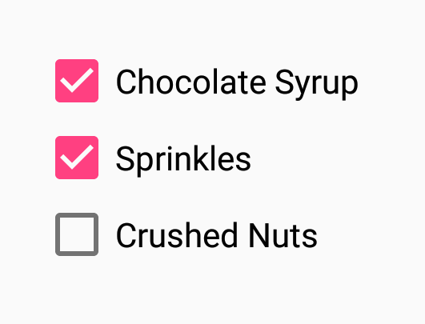
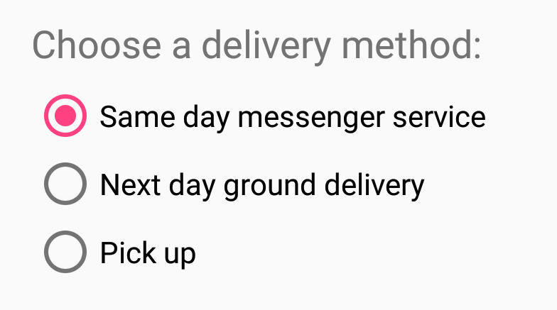


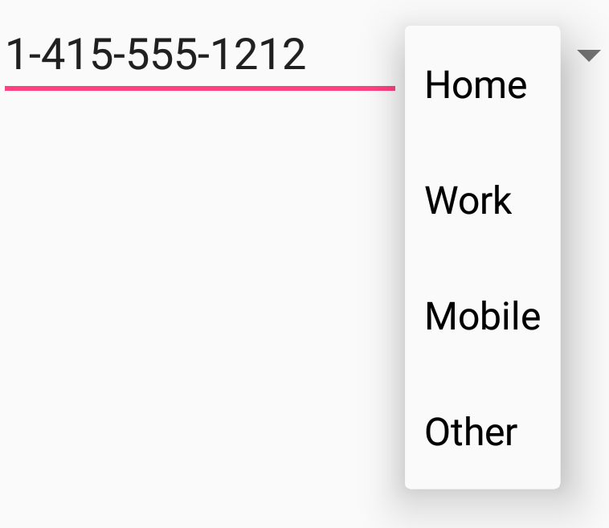
UI elements for providing choices
CheckBox and RadioButton
ToggleButton and Switch
Spinner

Slide 21
Giving Users Choices Using Spinner Controls
You can limit user inputs via Spinner control.
Spinner can come from an Adapter. (Dynamic)
You can also set the available choices in the layout definition by using the entries (Static) attribute with an array resource.
Specifically, this is a string array that is referenced as something, such as @array/state-list.

Slide 22
Giving Users Choices Using Spinner Controls
<Spinner
android:id="@+id/Spinner01"
android:layout_width="wrap_content"
android:layout_height="wrap_content"
android:entries="@array/colors"
android:prompt="@string/spin_prompt" />

Slide 23
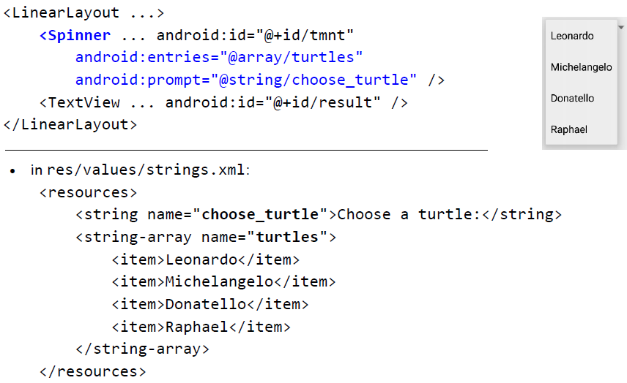
Giving Users Choices Using Spinner Controls

Slide 24
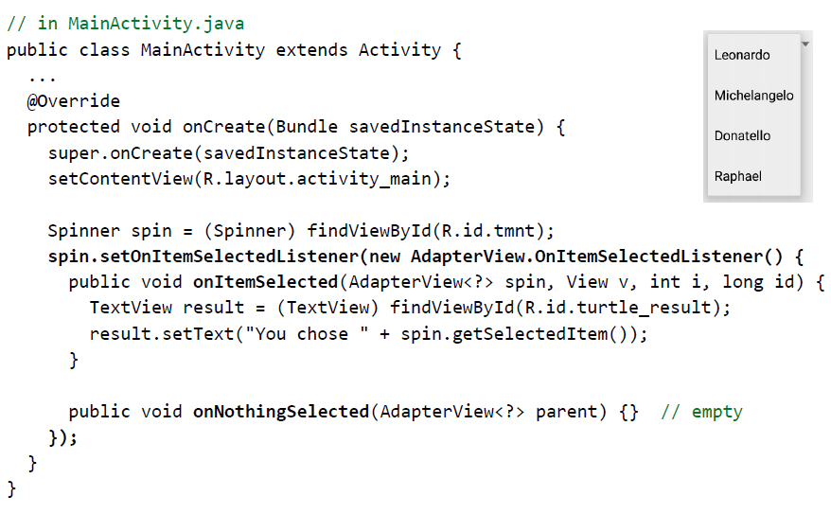
Giving Users Choices Using Spinner Controls

Slide 25
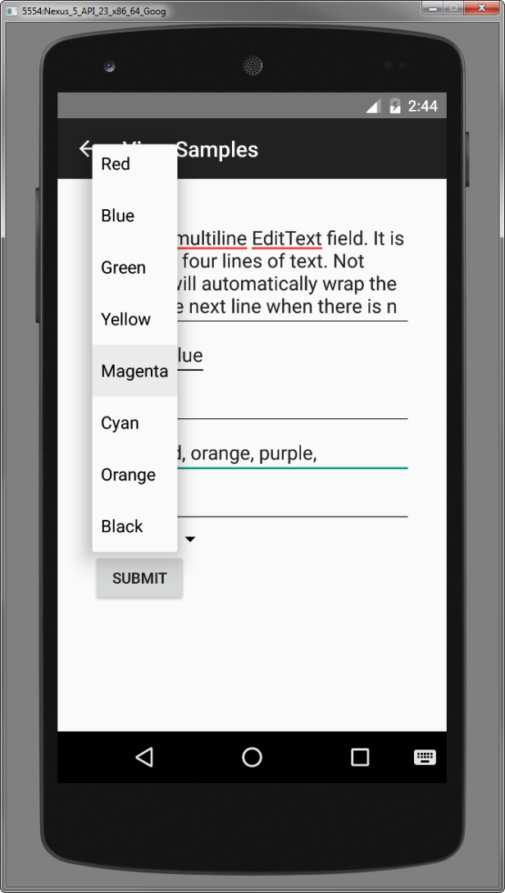
Giving Users Choices Using Spinner Controls

Slide 26
Giving Users Choices Using Spinner Controls
Because the Spinner control is not a TextView but a list of TextView objects, you cannot directly request the selected text from it.
Instead, you have to retrieve the specific selected option (each of which is a TextView control) and extract the text directly from it:
final Spinner spin = findViewById(R.id.Spinner01);
TextView text_sel = spin.getSelectedView();
String selected_text = text_sel.getText().toString();

Slide 27
CheckBox Control
User can select any number of choices
Checking one box does not uncheck another
Users expect checkboxes in a vertical list
Commonly used with a Submit button
Every CheckBox is a View and can have an onClick handler

Slide 28
CheckBox Control
<CheckBox
android:id="@+id/checkbox"
android:layout_width="wrap_content"
android:layout_height="wrap_content"
android:text="Check me?" />

Slide 29
CheckBox Control
final CheckBox check_button = (CheckBox) findViewById(R.id.checkbox);
check_button.setOnClickListener(new View.OnClickListener() {
public void onClick (View v) {
CheckBox cb =
(CheckBox)findViewById(R.id.checkbox);
cb.setText(check_button.isChecked() ?
"This option is checked" :
"This option is not checked");
}
});

Slide 30
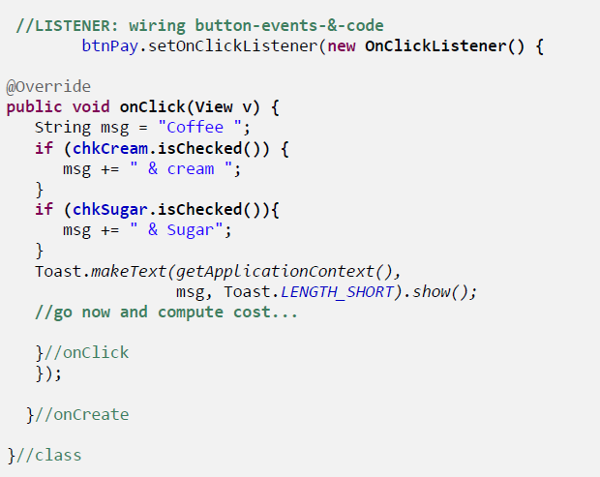
CheckBox Control

Slide 31
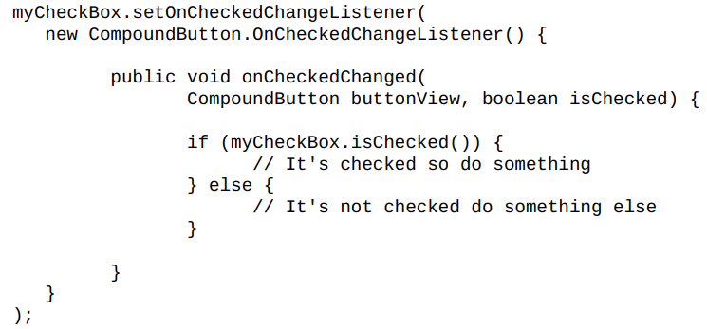
CheckBox Control

Slide 32
ToggleButton Control
A ToggleButton is similar to a CheckBox in behavior but is usually used to show or alter the “on” or “off” state of something.
Like the CheckBox, it has a state (checked or not).
Unlike the CheckBox, it does not show text next to it.

Slide 33
ToggleButton Control
<ToggleButton
android:id="@+id/toggle_button"
android:layout_width="wrap_content"
android:layout_height="wrap_content"
android:text="Toggle"
android:textOff="Disabled"
android:textOn="Enabled" />

Slide 34
RadioButton Control
Put RadioButton elements in a RadioGroup in a vertical list (horizontally if labels are short)
User can select only one of the choices
Checking one unchecks all others in group
Each RadioButton can have onClick handler
Commonly used with a Submit button for the RadioGroup

Slide 35
RadioButton Control
<RadioGroup
android:id="@+id/RadioGroup01"
android:layout_width="wrap_content"
android:layout_height="wrap_content">
<RadioButton android:id="@+id/RadioButton01"
android:layout_width="wrap_content"
android:layout_height="wrap_content"
android:text="Option 1" />
<RadioButton android:id="@+id/RadioButton02"
android:layout_width="wrap_content"
android:layout_height="wrap_content"
android:text="Option 2" />
<RadioButton android:id="@+id/RadioButton03"
android:layout_width="wrap_content"
android:layout_height="wrap_content"
android:text="Option 3" />
<RadioButton android:id="@+id/RadioButton04"
android:layout_width="wrap_content"
android:layout_height="wrap_content"
android:text="Option 4" />
</RadioGroup>

Slide 36
RadioButton Control
final RadioGroup group = (RadioGroup)findViewById(R.id.RadioGroup01);
final TextView tv = (TextView) findViewById(R.id.TextView01);
group.setOnCheckedChangeListener(new
RadioGroup.OnCheckedChangeListener() {
public void onCheckedChanged(
RadioGroup group, int checkedId) {
if (checkedId != -1) {
RadioButton rb = (RadioButton)
findViewById(checkedId);
if (rb != null) {
tv.setText("You chose: " + rb.getText());
}
} else {
tv.setText("Choose 1");
}
}
});

Slide 37
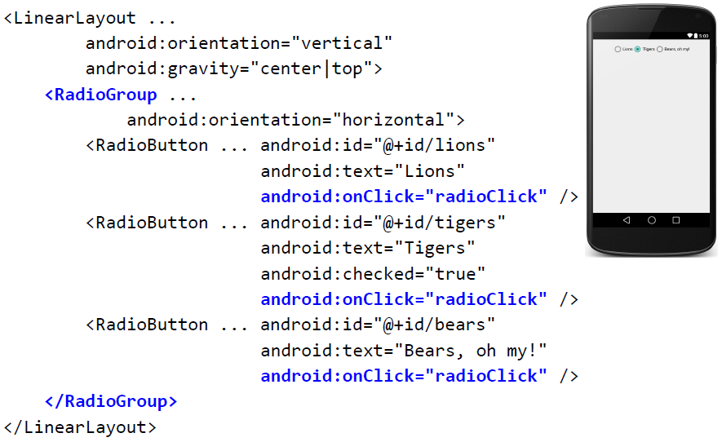
RadioButton Control

Slide 38
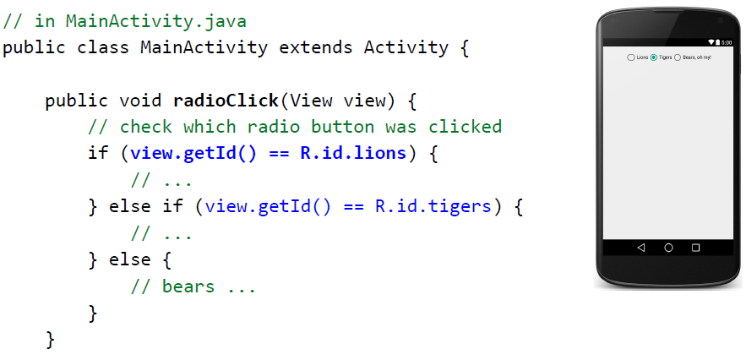
RadioButton Control

Slide 39

SeekBar Control
What if you want to give the user some ability to move the indicator—for example, to set the current cursor position in a playing media file or to tweak a volume setting?
You accomplish this by using the SeekBar control provided by the Android SDK.

Slide 40
SeekBar Control
<SeekBar
android:id="@+id/seekbar1"
android:layout_height="wrap_content"
android:layout_width="240dp"
android:max="500"
android:thumb="@drawable/droidsk1" />

Slide 41
SeekBar Control
SeekBar seek = (SeekBar) findViewById(R.id.seekbar1);
seek.setOnSeekBarChangeListener(
new SeekBar.OnSeekBarChangeListener() {
public void onProgressChanged(
SeekBar seekBar, int progress,boolean
fromTouch)
{
((TextView)findViewById(R.id.seek_text))
.setText("Value: "+progress);
seekBar.setSecondaryProgress(
(progress+seekBar.getMax())/2);
}
});

Slide 42
Learn more
Input Controls
Radio Buttons
Specifying the Input Method Type
Handling Keyboard Input
Text Fields
Spinners

