Slide 1

Lesson 7
Menu and Dialog (Picker)

Slide 2
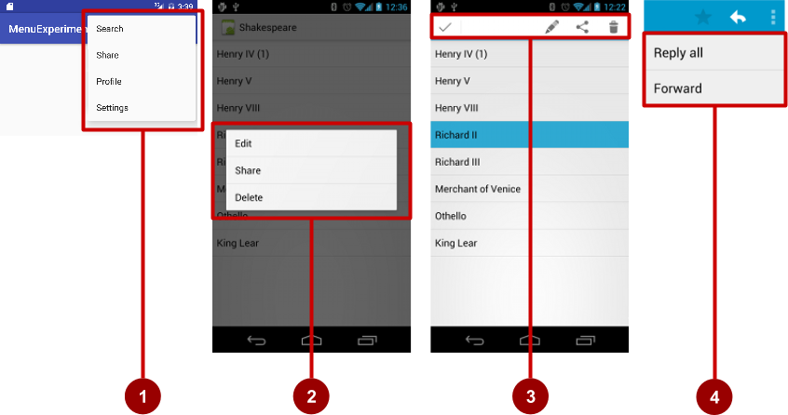
Types of Menus
App bar with options menu
Context menu
Contextual action bar
Popup menu

Slide 3
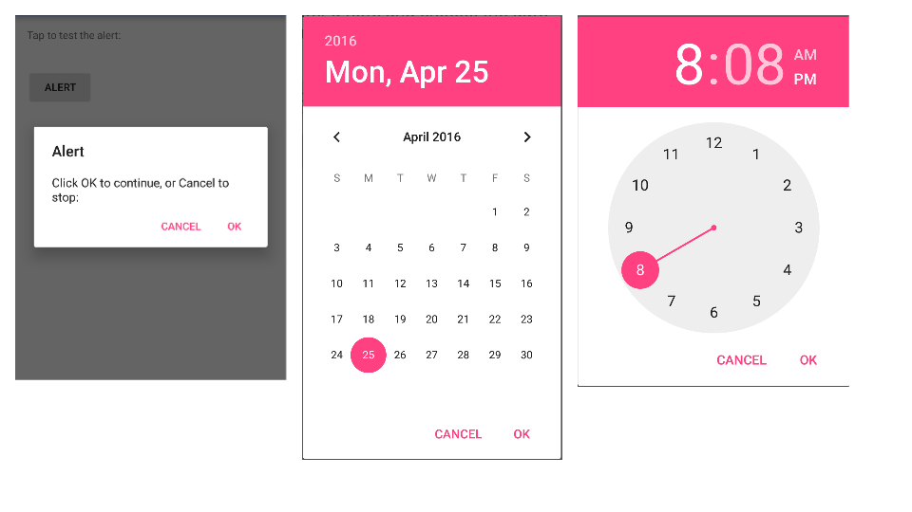
Dialogs and pickers
Alert dialog
Date picker
Time picker
1
2
3

Slide 4
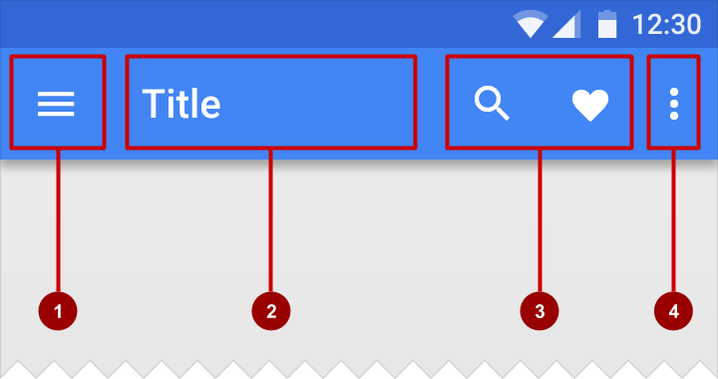
App Bar
Bar at top of each screen—same for all devices (usually)
Nav icon to open navigation drawer
Title of current Activity
Icons for options menu items
Action overflow button for the rest of the options menu

Slide 5
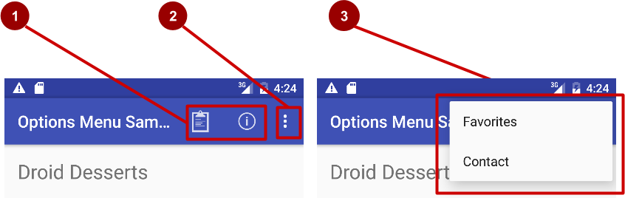
Options menu
Action icons in the app bar for important items (1)
Tap the three dots, the "action overflow button" to see the options menu (2)
Appears in the right corner of the app bar (3)
For navigating to other activities and editing app settings

Slide 6
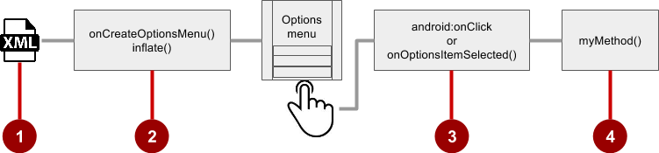
Steps to implement options menu
XML menu resource (menu_main.xml)
onCreateOptionsMenu() to inflate the menu
onClick attribute or onOptionsItemSelected()
Method to handle item click

Slide 7
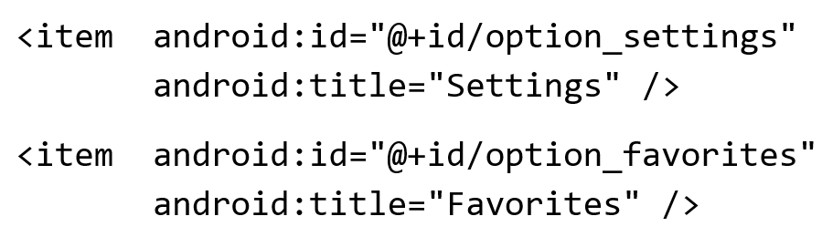
Create menu resource
Create menu resource directory
Create XML menu resource (menu_main.xml)
Add entry for each menu item (Settings and Favorites):

Slide 8
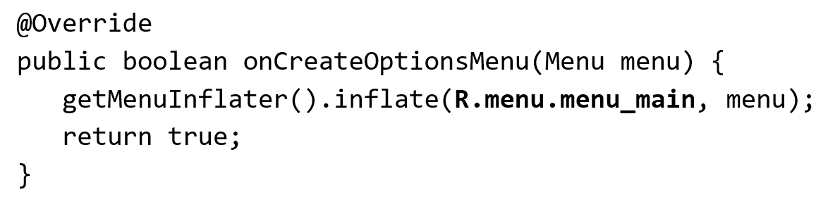
Inflate options menu
Override onCreateOptionsMenu() in Activity

Slide 9
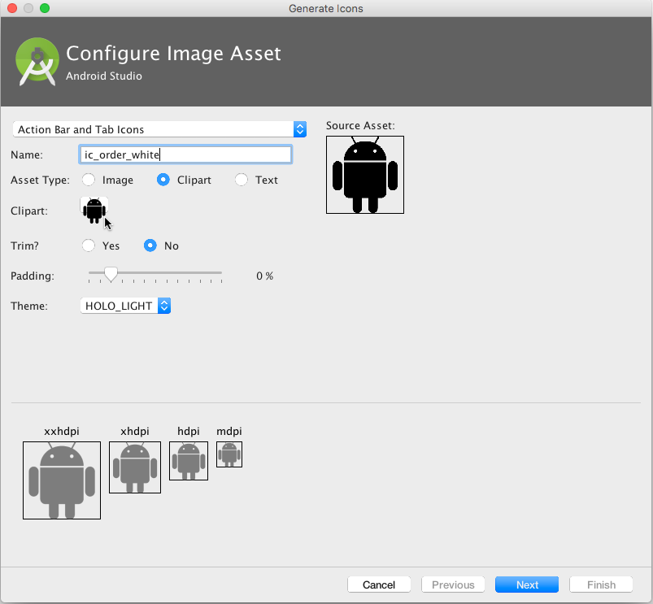
Add icons for menu items
Right-click drawable
Choose New > Image Asset
Choose Action Bar and Tab Items
Edit the icon name
Click clipart image, and click icon
Click Next, then Finish

Slide 10
Add menu item attributes
<item
android:id="@+id/action_favorites"
android:icon="@drawable/ic_favorite"
android:orderInCategory="30"
android:title="@string/action_favorites"
app:showAsAction="ifRoom" />

Slide 11
Override onOptionsItemSelected()
@Override
public boolean onOptionsItemSelected(MenuItem item) {
switch (item.getItemId()) {
case R.id.action_settings:
showSettings();
return true;
case R.id.action_favorites:
showFavorites();
return true;
case R.id.action_highscore:
showHighscoreList();
return true;
default:
return super.onOptionsItemSelected(item);
}
}

Slide 12
What are contextual menus?
Allows users to perform action on selected View
Can be deployed on any View
Most often used for items in RecyclerView, GridView, or other View collection

Slide 13
Types of contextual menus
Floating context menu—long-press on a View
User can modify View or use it in some fashion
User performs action on one View at a time
Contextual action mode—temporary action bar in place of or underneath app bar
Action items affect the selected View element(s)
User can perform action on multiple View elements at once

Slide 14
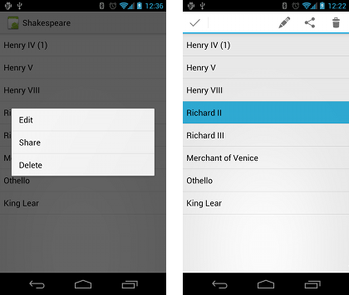
Types of contextual menus

Slide 15
Floating Context Menu
Create XML menu resource file and assign appearance and position attributes
Register View using registerForContextMenu()
Implement onCreateContextMenu() in Activity to inflate menu
Implement onContextItemSelected() to handle menu item clicks
Create method to perform action for each context menu item

Slide 16
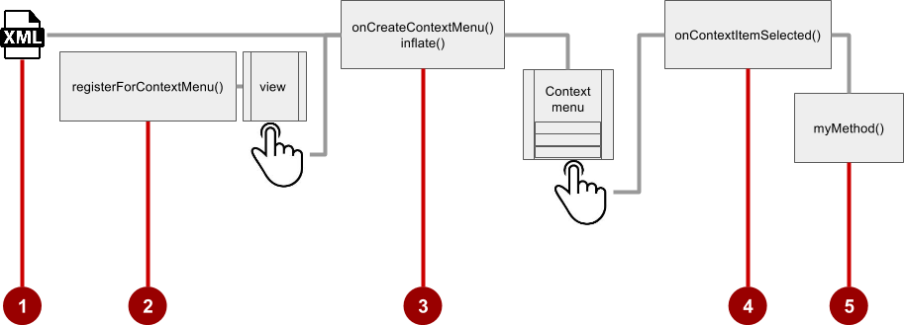
Floating Context Menu

Slide 17
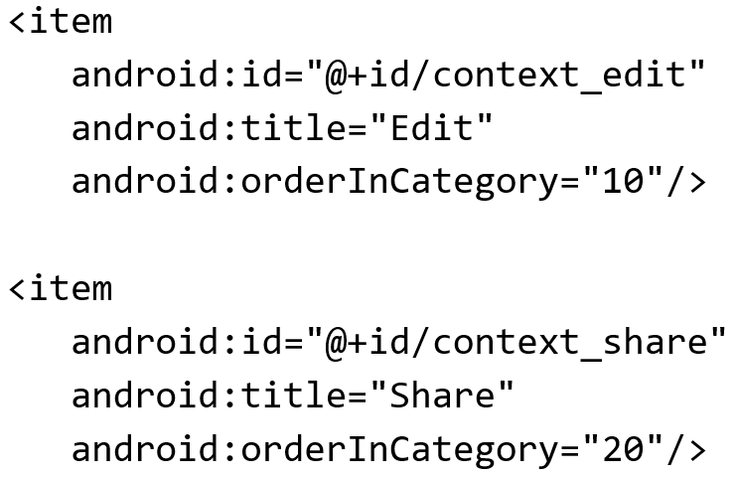
Create menu resource
1. Create XML menu resource (menu_context.xml)

Slide 18
Register a view to a context menu
In onCreate() of the Activity:
2. Register View.OnCreateContextMenuListener to View:

Slide 19
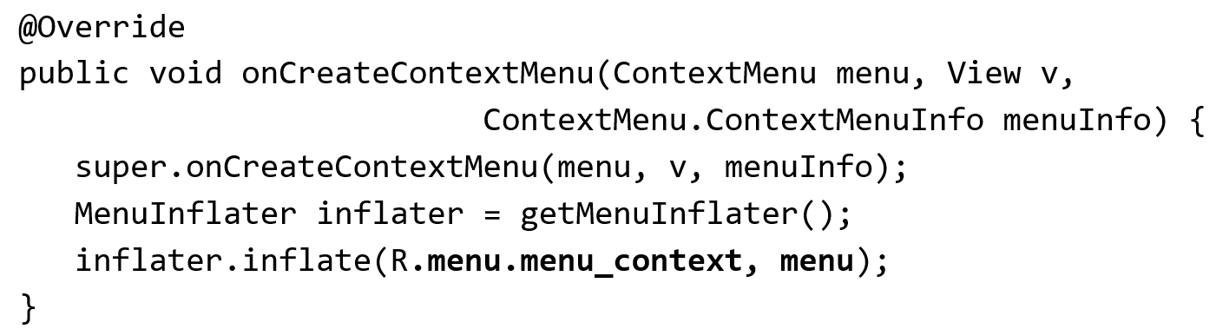
Implement onCreateContextMenu()
3. Specify which context menu

Slide 20
Implement onContextItemSelected()
@Override
public boolean onContextItemSelected(MenuItem item) {
switch (item.getItemId()) {
case R.id.context_edit:
editNote();
return true;
case R.id.context_share:
shareNote();
return true;
default:
return super.onContextItemSelected(item);
}
}

Slide 21
What is Action Mode?
UI mode that lets you replace parts of normal UI interactions temporarily
For example: Selecting a section of text or long-pressing an item could trigger action mode

Slide 22
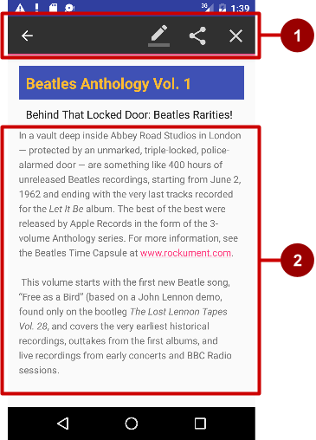
What is a contextual action bar?
Long-press on View shows contextual action bar
Contextual action bar with actions
Edit, Share, and Delete
Done (left arrow icon) on left side
Action bar is available until user taps Done
View on which long press triggers contextual action bar

Slide 23
Steps for contextual action bar
Create XML menu resource file and assign icons for items
setOnLongClickListener() on View that triggers contextual action bar and call startActionMode() to handle click
Implement ActionMode.Callback interface to handle ActionMode lifecycle; include action for menu item click in onActionItemClicked() callback
Create method to perform action for each context menu item

Slide 24
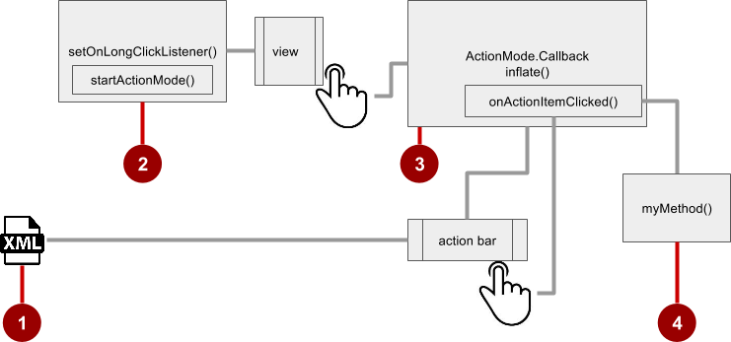
Steps for contextual action bar

Slide 25
Use setOnLongClickListener
private ActionMode mActionMode;
In onCreate():
View view = findViewById(article);
view.setOnLongClickListener(new View.OnLongClickListener() {
public boolean onLongClick(View view) {
if (mActionMode != null) return false;
mActionMode =
MainActivity.this.startActionMode(mActionModeCallback);
view.setSelected(true);
return true;
}
});

Slide 26
Implement mActionModeCallback
public ActionMode.Callback mActionModeCallback =
new ActionMode.Callback() {
// Implement action mode callbacks here.
};

Slide 27
Implement onCreateActionMode
@Override
public boolean onCreateActionMode(ActionMode mode, Menu menu) {
MenuInflater inflater = mode.getMenuInflater();
inflater.inflate(R.menu.menu_context, menu);
return true;
}

Slide 28
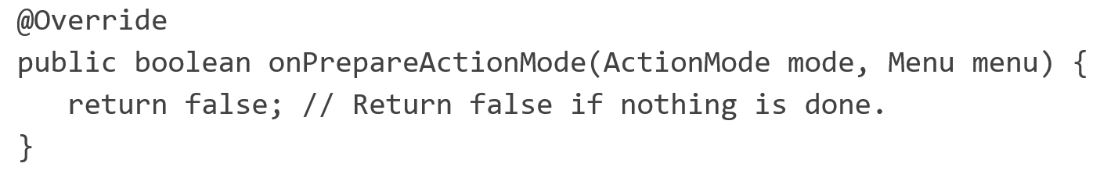
Implement onPrepareActionMode
Called each time action mode is shown
Always called after onCreateActionMode, but may be called multiple times if action mode is invalidated

Slide 29
Implement onActionItemClicked
Called when users selects an action
Handle clicks in this method
@Override
public boolean onActionItemClicked(ActionMode mode, MenuItem item) {
switch (item.getItemId()) {
case R.id.action_share:
// Perform action for the Share menu item.
mode.finish(); // Action picked, so close the action bar.
return true;
default:
return false;
}
}

Slide 30
Implement onDestroyActionMode
Called when user exits the action mode
@Override
public void onDestroyActionMode(ActionMode mode) {
mActionMode = null;
}

Slide 31
Dialogs
Dialog appears on top, interrupting flow of Activity
Requires user action to dismiss

Slide 32
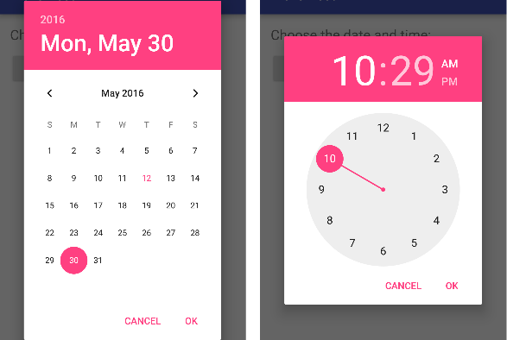
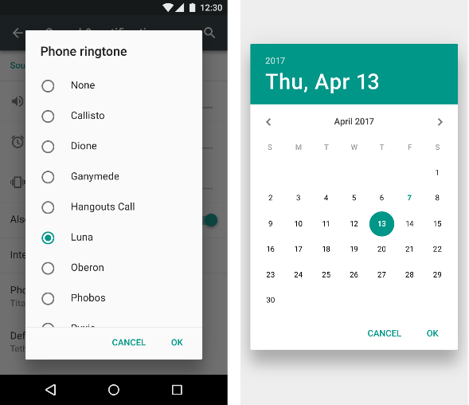
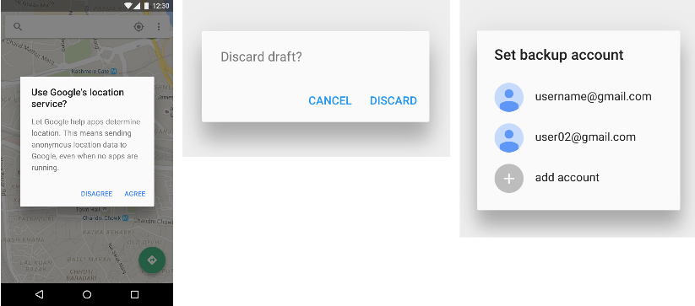
Dialogs
TimePickerDialog
DatePickerDialog
AlertDialog

Slide 33
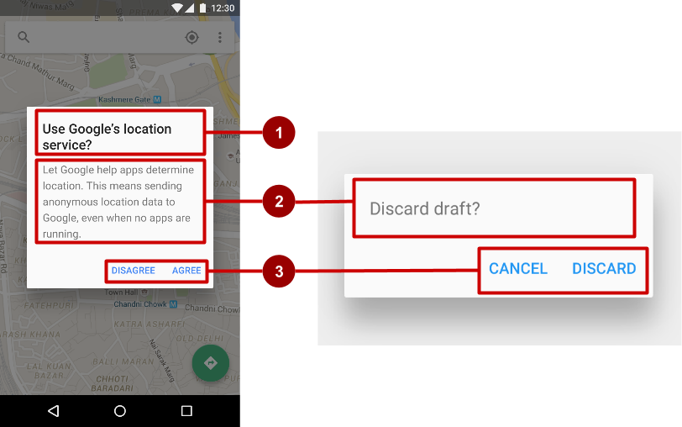
AlertDialog
AlertDialog can show:
Title (optional)
Content area
Action buttons
Positive
Negative
Neutral

Slide 34
Build the AlertDialog
Use AlertDialog.Builder to build alert dialog and set attributes:
public void onClickShowAlert(View view) {
AlertDialog.Builder alertDialog = new
//MainActivity is the context
AlertDialog.Builder(MainActivity.this);
alertDialog.setTitle("Connect to Provider");
alertDialog.setMessage(R.string.alert_message);
// ... Code to set buttons goes here.

Slide 35
Set the button actions
alertDialog.setPositiveButton()
alertDialog.setNeutralButton()
alertDialog.setNegativeButton()

Slide 36
alertDialog code example
alertDialog.setPositiveButton(
"OK", new DialogInterface.OnClickListener() {
public void onClick(DialogInterface dialog, int which) {
// User clicked OK button.
}
});
Same pattern for setNegativeButton() and setNeutralButton()

Slide 37
Full Code of AlertDialog
private void showMyAlertDialog(MainActivity mainActivity) {
String msg;
new AlertDialog.Builder(mainActivity)
.setTitle("Terminator")
.setMessage("Are you sure that you want to quit?")
.setIcon(R.drawable.ic_menu_end_conversation)
.setPositiveButton("Yes",
new DialogInterface.OnClickListener() {
public void onClick(DialogInterface dialog, int whichButton) {
msg = "YES " + Integer.toString(whichButton); }
})// setPositiveButton

Slide 38
Full Code of AlertDialog
.setNeutralButton("Cancel",
new DialogInterface.OnClickListener() {
public void onClick(DialogInterface dialog,
int whichButton) {
// actions serving "CANCEL" button go here
msg = "CANCEL " + Integer.toString(whichButton);
}// OnClick
})// setNeutralButton
.setNegativeButton("NO",
new DialogInterface.OnClickListener() {
public void onClick(DialogInterface dialog, int whichButton) {
// actions serving "NO" button go here
msg = "NO " + Integer.toString(whichButton);
txtMsg.setText(msg);
}
})// setNegativeButton
.create() //Create an AlertDialog object
.show();
}// showMyAlertDialog

Slide 39
Pickers
DatePickerDialog
TimePickerDialog

Slide 40
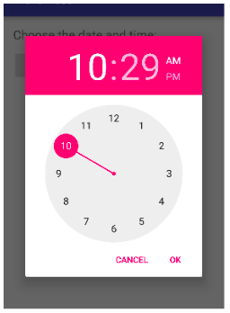
Pickers use fragments
Use DialogFragment to show a picker
DialogFragment is a window that floats on top of Activity window

Slide 41
Introduction to fragments
A Fragment is like a mini-Activity within an Activity
Manages its own own lifecycle
Receives its own input events
Can be added or removed while parent Activity is running
Multiple fragments can be combined in a single Activity
Can be reused in more than one Activity

Slide 42
Creating a date picker dialog
Add a blank Fragment that extends DialogFragment and implements DatePickerDialog.OnDateSetListener
class MyDatePicker extends DialogFragment implements DatePickerDialog.OnDateSetListener {
}
In onCreateDialog() initialize the date and return the dialog. ←You have call the Calendar class to get the current date (year, month & day).
In onDateSet() handle the date
In Activity show the picker and add method to use date

Slide 43
Creating a date picker dialog
final Calendar c = Calendar.getInstance();
mYear = c.get(Calendar.YEAR);
mMonth = c.get(Calendar.MONTH);
mDay = c.get(Calendar.DAY_OF_MONTH);
DatePickerDialog datePickerDialog = new DatePickerDialog(this,
new DatePickerDialog.OnDateSetListener() {
@Override
public void onDateSet(DatePicker view, int year,
int monthOfYear, int dayOfMonth) {
txtDate.setText(dayOfMonth + "-" + (monthOfYear + 1) + "-" + year);
}
}, mYear, mMonth, mDay);
datePickerDialog.show();

Slide 44
Creating a time picker dialog
Add a blank Fragment that extends DialogFragment and implements TimePickerDialog.OnTimeSetListener
In onCreateDialog() initialize the time and return the dialog
In onTimeSet() handle the time
In Activity, show the picker and add method to use time

Slide 45
Creating a time picker dialog
// Get Current Time
final Calendar c = Calendar.getInstance();
mHour = c.get(Calendar.HOUR_OF_DAY);
mMinute = c.get(Calendar.MINUTE);
// Launch Time Picker Dialog
TimePickerDialog timePickerDialog = new TimePickerDialog(this,
new TimePickerDialog.OnTimeSetListener() {
@Override
public void onTimeSet(TimePicker view, int hourOfDay,
int minute) {
txtTime.setText(hourOfDay + ":" + minute);
}
}, mHour, mMinute, false);
timePickerDialog.show();

Slide 46
Learn More
Adding the App Bar
Menus
Menu Resource
Fragments
Dialogs
Pickers
Drawable Resources

