Slide 1

Lesson 11
Data Persistency

Slide 2
Storing data
Shared Preferences—Private primitive data in key-value pairs
Internal Storage—Private data on device memory
External Storage—Public data on device or external storage
SQLite Databases—Structured data in a private database
Content Providers—Store privately and make available publicly

Slide 3
Storing data beyond Android
Network Connection—On the web with your own server
Cloud Backup—Back up app and user data in the cloud
Firebase Realtime Database—Store and sync data with NoSQL cloud database across clients in realtime

Slide 4
Android File System
External storage -- Public directories
Internal storage -- Private directories for just your app
Apps can browse the directory structure
Structure and operations similar to Linux and java.io

Slide 5
Internal storage
Always available
Uses device's filesystem
Only your app can access files, unless explicitly set to be readable or writable
On app uninstall, system removes all app's files from internal storage

Slide 6
External storage
Not always available, can be removed
Uses device's file system or physically external storage like SD card
World-readable, so any app can read
On uninstall, system does not remove files private to app

Slide 7
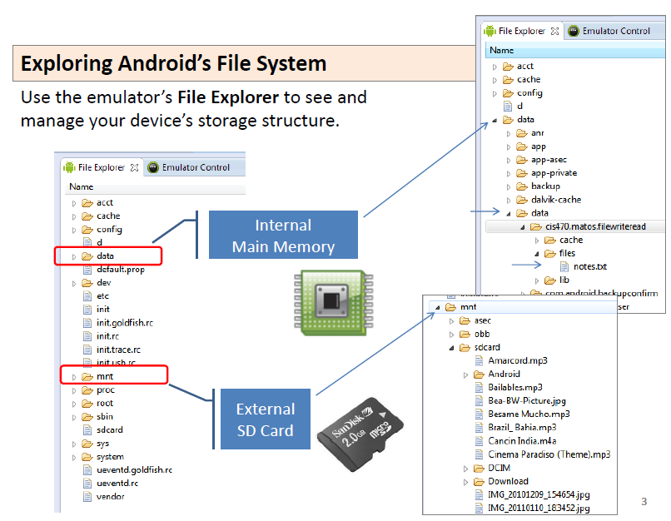
Internal storage

Slide 8
When to use internal/external storage
Internal is best when
you want to be sure that neither the user nor other apps can access your files
External is best for files that
don't require access restrictions and for
you want to share with other apps
you allow the user to access with a computer

Slide 9
Internal Storage
Uses private directories just for your app
App always has permission to read/write
Permanent storage directory—getFilesDir()
Temporary storage directory—getCacheDir()

Slide 10
Internal Storage
getResources().openRawResource(R.raw.id)
- read an input file from res/raw/
openFileInput("name", mode)
- opens a file for reading
openFileOutput("name", mode)
- opens a file for writing

Slide 11
Creating a file
File file = new File(
context.getFilesDir(), filename);
Use standard java.io file operators or streams to interact with files

Slide 12
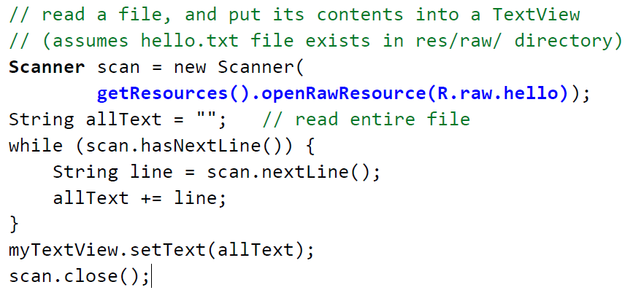
Internal Storage Example 1

Slide 13
Internal Storage Example 2
// write a short text file to the internal storage
PrintStream output = new PrintStream (
openFileOutput("out.txt", MODE_PRIVATE));
output.println("Hello, world!");
output.println("How are you?");
output.close();
...
// read the same file, and put its contents into a TextView
Scanner scan = new Scanner(
openFileInput("out.txt", MODE_PRIVATE));
String allText = ""; // read entire file
while (scan.hasNextLine()) {
String line = scan.nextLine();
allText += line;
}
myTextView.setText(allText);
scan.close();

Slide 14
External Storage
On device or SD card
can be much larger than internal storage (~8-128 gb)
can be removed or transferred to another device if needed
may not be present, depending on the device
read/writable by other apps and users; not private to your app
not wiped when the app is uninstalled, except in certain cases

Slide 15
External Storage
If your app needs to read/write the device's external storage, you must explicitly request permission to do so in your app's AndroidManifest.xml file.
On install, the user will be prompted to confirm your app permissions.

Slide 16
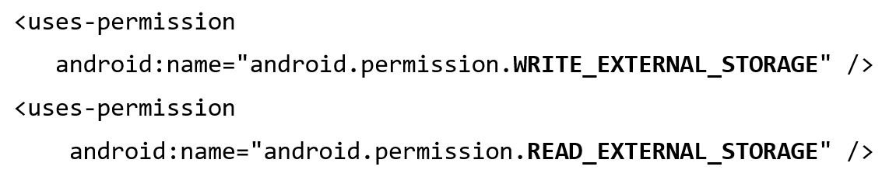
External Storage
Set permissions in Android Manifest
Write permission includes read permission

Slide 17
Always check availability of storage
public boolean isExternalStorageWritable() {
String state =
Environment.getExternalStorageState();
if (Environment.MEDIA_MOUNTED.equals(state)) {
return true;
}
return false;
}

Slide 18
Example external public directories
DIRECTORY_ALARMS and DIRECTORY_RINGTONES
For audio files to use as alarms and ringtones
DIRECTORY_DOCUMENTS
For documents that have been created by the user
DIRECTORY_DOWNLOADS
For files that have been downloaded by the user

Slide 19
Accessing public external directories
Get a path getExternalStoragePublicDirectory()
Create file
File path = Environment.getExternalStoragePublicDirectory(
Environment.DIRECTORY_PICTURES);
File file = new File(path, "DemoPicture.jpg");

Slide 20
How much storage left?
If there is not enough space, throws IOException
If you know the size of the file, check against space
getFreeSpace()
getTotalSpace().
If you do not know how much space is needed
try/catch IOException

Slide 21
Delete files no longer needed
External storage
myFile.delete();
Internal storage
myContext.deleteFile(fileName);

Slide 22
Do not delete the user's files!
When the user uninstalls your app, your app's private storage directory and all its contents are deleted
Do not use private storage for content that belongs to the user!
For example
Photos captured or edited with your app
Music the user has purchased with your app

Slide 23
External Storage Example
public class FileSdCard extends Activity {
// GUI controls
private EditText txtData;
private Button btnWriteSDFile;
private String mySdPath;
@Override
public void onCreate(Bundle savedInstanceState) {
super.onCreate(savedInstanceState);
setContentView(R.layout.main);
// find SD card absolute location
mySdPath = Environment.getExternalStorageDirectory().getAbsolutePath();
// bind GUI elements to local controls
txtData = (EditText) findViewById(R.id.txtData);
txtData.setHint("Enter some lines of data here...");
…….

Slide 24
External Storage Example
btnWriteSDFile = (Button) findViewById(R.id.btnWriteSDFile);
btnWriteSDFile.setOnClickListener(new OnClickListener() {
@Override
public void onClick(View v) {
// WRITE on SD card file data taken from the text box
try {
File myFile = new File(mySdPath + "/mysdfile.txt");
OutputStreamWriter myOutWriter = new OutputStreamWriter(
new FileOutputStream(myFile));
myOutWriter.append(txtData.getText());
myOutWriter.close();
Toast.makeText(getBaseContext(),
"Done writing SD 'mysdfile.txt'",
Toast.LENGTH_SHORT).show();
} catch (Exception e) {
Toast.makeText(getBaseContext(), e.getMessage(),
Toast.LENGTH_SHORT).show();
}
}// onClick
}); // btnWriteSDFile

Slide 25
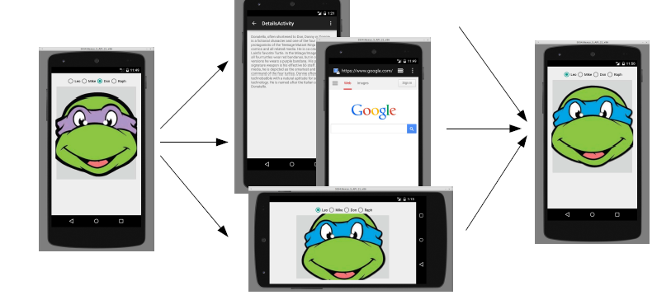
Shared Preferences
Several actions can cause your activity state to be lost:
When you go from one activity to another and back, within same app
When you launch another app and then come back
When you rotate the device's orientation from portrait to landscape

Slide 26
Shared Preferences
When an activity is being destroyed, the event method onSaveInstanceState is also called.
This method should save any "non-persistent" state of the app.
non-persistent state: Stays for now, but lost on shutdown/reboot.
Accepts a Bundle parameter storing key/value pairs.
– Bundle is passed back to activity if it is recreated later.
public void onSaveInstanceState(Bundle outState) {
super.onSaveInstanceState(outState); // always call super
outState.putInt("name", value);
outState.putString("name", value);
...
}

Slide 27
Shared Preferences
When an activity is recreated later, the event method onRestoreInstanceState is called. *
This method can restore any "non-persistent" state of the app.
Bundle from onSaveInstanceState from before is passed back in.
public void onRestoreInstanceState(Bundle inState) {
super.onRestoreInstanceState(inState); // always call super
int name = inState.getInt("name");
String name = inState.getString("name");
...
}

Slide 28
Shared Preferences
SharedPreferences object can store permanent settings and data for your app
Read and write small amounts of primitive data as key/value pairs to a file on the device storage
SharedPreference class provides APIs for reading, writing, and managing this data
Save data in onPause() restore in onCreate()

Slide 29
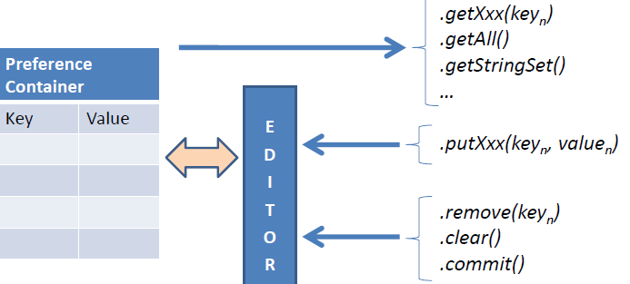
Shared Preferences
Using Preferences API calls
Each of the Preference mutator methods carries a typed-value content that can be manipulated by an editor that allows putXxx… and getXxx… commands to place data in and out of the Preference container.

Slide 30
Shared Preferences vs. Saved Instance State
Persist data across user sessions, even if app is killed and restarted, or device is rebooted
Data that should be remembered across sessions, such as a user's preferred settings or their game score
Common use is to store user preferences
Preserves state data across activity instances in same user session
Data that should not be remembered across sessions, such as the currently selected tab or current state of activity.
Common use is to recreate state after the device has been rotated

Slide 31
Creating Shared Preferences
Need only one Shared Preferences file per app
Name it with package name of your app—unique and easy to associate with app
MODE argument for getSharedPreferences() is for backwards compatibility—use only MODE_PRIVATE to be secure

Slide 32
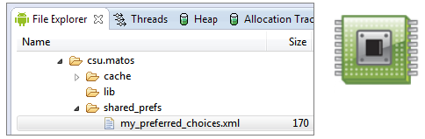
Shared Preferences File
SharedPreference containers are saved as XML files in the application’s internal memory space. The path to a preference files is /data/data/packageName/shared_prefs/filename.
For instance in this example we have:

Slide 33
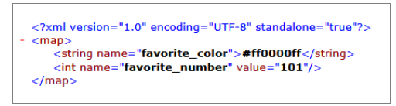
Shared Preferences File
If you pull the file from the device, you will see the following

Slide 34
getSharedPreferences()
private String sharedPrefFile = "com.example.android.hellosharedprefs";
mPreferences = getSharedPreferences(sharedPrefFile, MODE_PRIVATE);

Slide 35
Saving Shared Preferences
SharedPreferences.Editor interface
Takes care of all file operations
put methods overwrite if key exists
apply() saves asynchronously and safely

Slide 36
SharedPreferences.Editor
@Override
protected void onPause() {
super.onPause();
SharedPreferences.Editor preferencesEditor =
mPreferences.edit();
preferencesEditor.putInt("count", mCount);
preferencesEditor.putInt("color",
mCurrentColor);
preferencesEditor.apply();
}

Slide 37
Restoring Shared Preferences
Restore in onCreate() in Activity
Get methods take two arguments—the key, and the default value if the key cannot be found
Use default argument so you do not have to test whether the preference exists in the file

Slide 38
Getting data in onCreate()
mPreferences = getSharedPreferences(sharedPrefFile, MODE_PRIVATE);
if (savedInstanceState != null) {
mCount = mPreferences.getInt("count", 1);
mShowCount.setText(String.format("%s", mCount));
mCurrentColor = mPreferences.getInt("color", mCurrentColor);
mShowCount.setBackgroundColor(mCurrentColor);
mNewText = mPreferences.getString("text", "");
} else { … }

Slide 39
Clearing Shared Preferences
Call clear() on the SharedPreferences.Editor and apply changes
You can combine calls to put and clear. However, when you apply(), clear() is always done first, regardless of order!

Slide 40
Clearing Shared Preferences
SharedPreferences.Editor preferencesEditor = mPreferences.edit();
preferencesEditor.clear();
preferencesEditor.apply();

Slide 41
Shared Preferences Example
Saving preferences for the activity (in onPause, onStop):
SharedPreferences prefs = getPreferences(“filename”, MODE_PRIVATE);
SharedPreferences.Editor prefsEditor = prefs.edit();
prefsEditor.putInt("name", value);
prefsEditor.putString("name", value);
...
prefsEditor.apply(); // or commit();

Slide 42
Shared Preferences Example
Loading preferences later (e.g. in onCreate):
SharedPreferences prefs = getPreferences(MODE_PRIVATE);
int i = prefs.getInt("name", defaultValue);
String s = prefs.getString("name", "defaultValue");
...

Slide 43
Other Storage Options
Firebase
Network connection

Slide 44
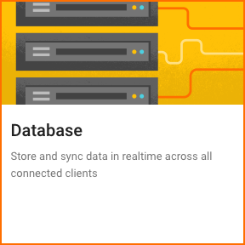
Use Firebase to store and share data
Store and sync data with the Firebase cloud database
Data is synced across all clients, and remains available when your app goes offline
firebase.google.com/docs/database/

Slide 45

Firebase Realtime Database
Connected apps share data
Hosted in the cloud
Data is stored as JSON
Data is synchronized in realtime to every connected client

Slide 46
Network Connection
You can use the network (when it's available) to store and retrieve data on your own web-based services
Use classes in the following packages
java.net.*
android.net.*

Slide 47
Learn more about files
Saving Files
getExternalFilesDir() documentation and code samples
getExternalStoragePublicDirectory() documentation and code samples
java.io.File class
Oracle's Java I/O Tutorial

Slide 48
Learn more Shared Preferences
Saving Data
Storage Options
Saving Key-Value Sets
SharedPreferences
SharedPreferences.Editor
Stackoverflow
How to use SharedPreferences in Android to store, fetch and edit values
onSavedInstanceState vs. SharedPreferences

