Slide 1

Lesson 12
Android: Animation

Slide 2
Android Animation
Android provides two types of animation:
Frame and
Tween animation.
Frame animation, also called frame-by-frame animation, assigns a sequence of photos to play as in a slide show with a predefined interval between images.
Tween animation creates an animation by performing a series of transformations on a single image such as position, size, rotation, and transparency on the contents of a View object.

Slide 3
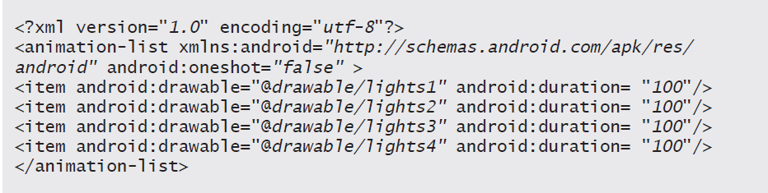
Android Animation
Frame-by-frame animations are also known as drawable animations.
For example, in the XML code, an animation-list root element references four Northern Lights images stored in the folder.

Slide 4
Android Animation
The animation-list code includes the oneshot property, which is set to true by default. By setting the android:oneshot attribute of the animation-list to false, as shown in the previous code, the animation plays repeatedly.
When the XML file is added to the Android project, the Android resource type is selected and animation-list is specified as the root element of the XML code.
Store the animations.xml file in the drawable folder.

Slide 5
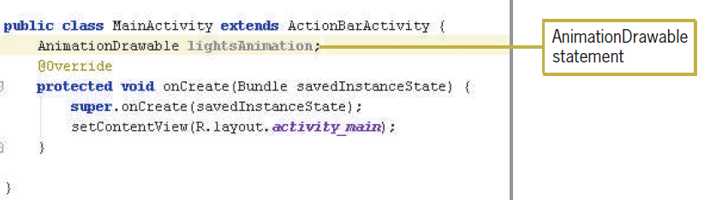
Android Animation
The AnimationDrawable class provides the methods for drawable animations to create a sequence of frame-by-frame images. In Android development, frame-based animations and image transitions are defined as drawables.

Slide 6
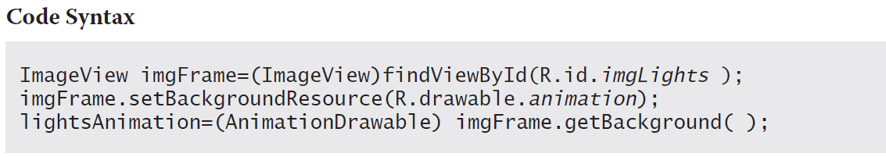
Android Animation
The imgFrame instance is the image that you want to animate and is set to the animation drawable as its background.

Slide 7
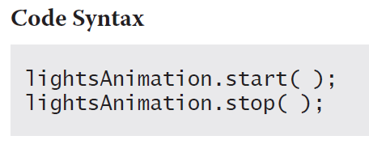
Android Animation
After associating AnimationDrawable with the animation images, you can use the start( ) and stop( ) methods of the drawable objects to control the Frame animation.
The start() method launches the lightsAnimation.xml file displaying the animation-list items, and the stop( ) method ends the display of the animation-list.

Slide 8
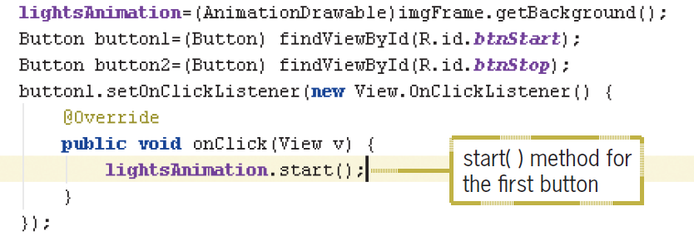
Android Animation

Slide 9
Android Animation
Instead of rendering several images in a sequence in Frame animation, Tween animation manipulates a drawable image by adding tween effects.
Defined in an XML file, tween effects are transitions that change objects from one state to another. An ImageView or TextView object can move, rotate, grow, or shrink.

Slide 10
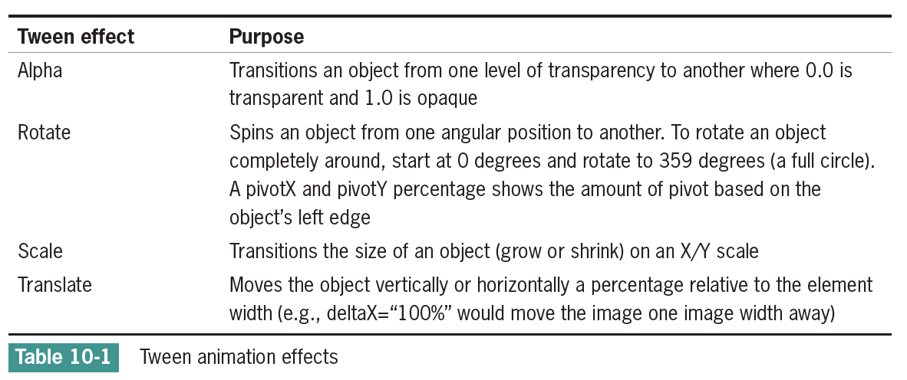
Android Animation
The four Tween animation effects in Table 10-1 can be coded in an XML file and individually configured or nested together to animate an object in any possible direction or size.

Slide 11
Android Animation
Tween Animation takes some parameters such as start value, end value, size, time duration, rotation angle etc., and perform the required animation on that object.
It can be applied to any type of object. So in order to use this, android has provided us a class called Animation.

Slide 12
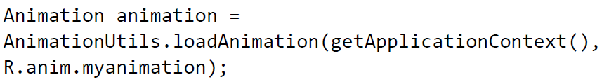
Android Animation
In order to perform animation in android, we are going to call a static function loadAnimation() of the class AnimationUtils. We are going to receive the result in an instance of Animation Object.
Its syntax is as follows:

Slide 13
Android Animation
This animation class has many useful functions which are listed below:
No | Method & Description
1 | start() This method starts the animation.
2 | setDuration(long duration) This method sets the duration of an animation.
3 | getDuration() This method gets the duration which is set by above method.
4 | end() This method ends the animation.
5 | cancel() This method cancels the animation.

Slide 14
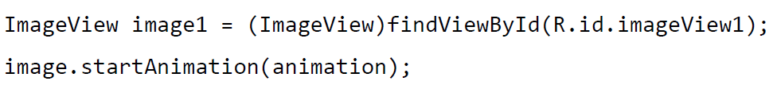
Android Animation
In order to apply this animation to an object, we will just call the startAnimation() method of the object. Its syntax is:

Slide 15
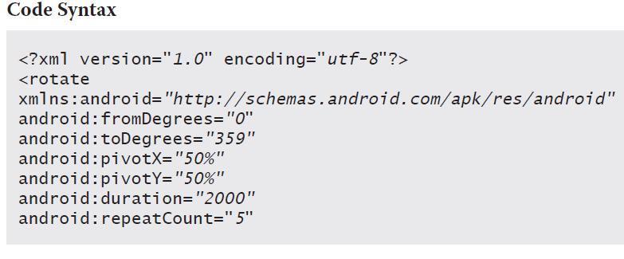
Android Animation
In order to perform a rotation in animation, create an XML file under anim folder under res directory and put this code in the file.

Slide 16
Android Animation
The fromDegrees and toDegrees rotate attributes spin the object from 0 to 359 degrees, which equals 360 degrees for a full circle.
Notice pivotX and pivotY are set to 50% in the code example, which determines that the pivot location is from the center of the object.
The duration for each rotation is set for 2,000 milliseconds.
The repeatCount represents how many times the object rotates after the initial rotation. You can set repeatCount to an integer or to “infinite” if you do not want the rotation to stop.

Slide 17
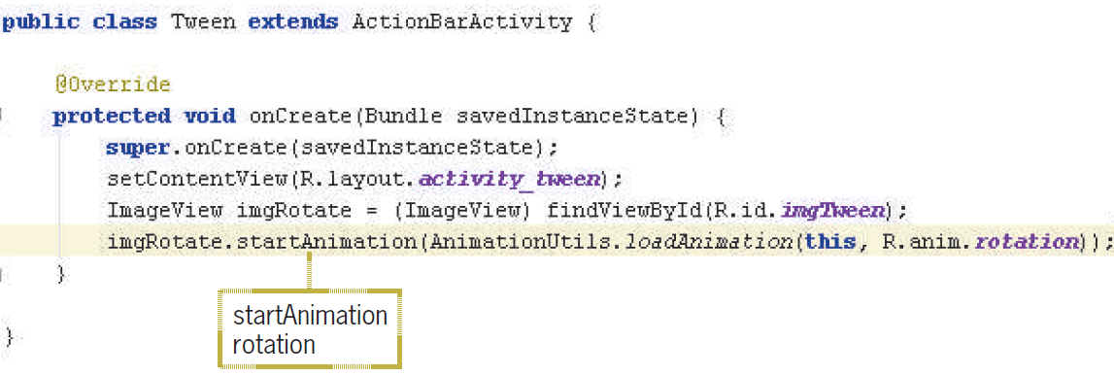
Android Animation

Slide 18
Android Animation
Other Animation property such as:
Fading in and out
Movement
Scaling or stretching

Slide 19
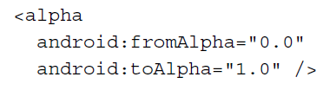
Android Animation
Fading in and out
Alpha is the measure of transparency. So, by stating the starting fromAlpha values and ending toAlpha values, we can fade items in and out.
A value of 0.0 is invisible, and the value 1.0 is an object's normal appearance.

Slide 20
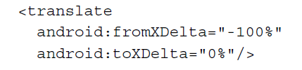
Android Animation
Movement
We can move an object within our UI using a similar technique: fromXDelta and toXDelta can have values set as a percentage of the size of the object that is being animated.
In addition to this, there are the fromYDelta and toYDelta properties that can be used to animate the movements up and down.

Slide 21
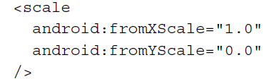
Android Animation
Scaling or stretching
The fromXScale and toXScale values will increase or decrease the scale of an object. As an example, the code shown here will change the object that runs the animation from a normal size to invisible:

Slide 22
Android Animation
The Interpolator defines how the transition is calculated.
A Linear Interpolator will calculate the change evenly over the set duration, whereas
an Accelerate Interpolator function would create a faster movement through the duration. Here is the full list of Interpolators available, along with the XML Identifier:

Slide 23
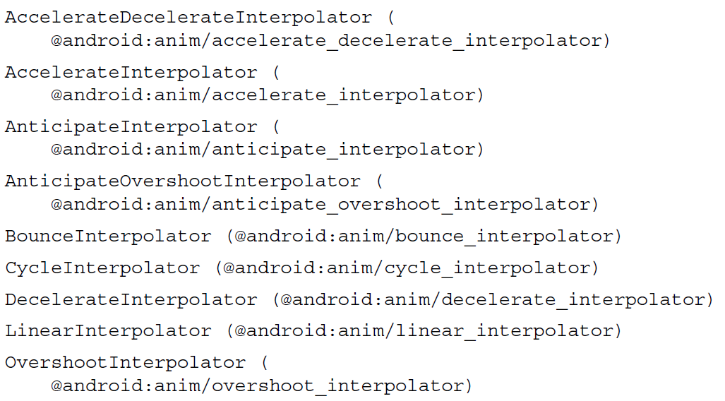
Android Animation

Slide 24
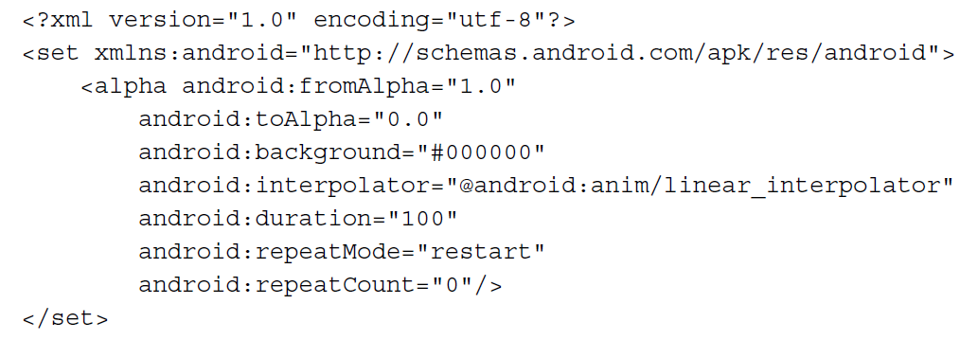
Android Animation
What is the following animation?

Slide 25
Android Multimedia
The two most popular options to play sound include:
SoundPool: This is for short sound clips
MediaPlayer: This is designed for larger sound files (like music) and video files

Slide 26
Android Multimedia
SoundPool is interesting in that it allows us to create special effects with our sounds by changing the play rate and by allowing multiple sounds to play simultaneously.
Popular audio file types supported include:
3GPP (.3gp)
GPP (.3gp)
FLAC (.flac)
MP3 (.mp3)
MIDI Type 0 and 1 (.mid, .xmf, and .mxmf)
Ogg (.ogg)
WAVE (.wav)

Slide 27
Android Multimedia
As is common in Android, new releases to the OS bring changes to the APIs.
The SoundPool is no exception and the original SoundPool constructor was deprecated in Lollipop (API 21).
Rather than setting our minimum API to 21 or relying on deprecated code (that may stop working at some point), we'll implement both the old and the new approach and check the OS version at runtime to use the appropriate method.

Slide 28
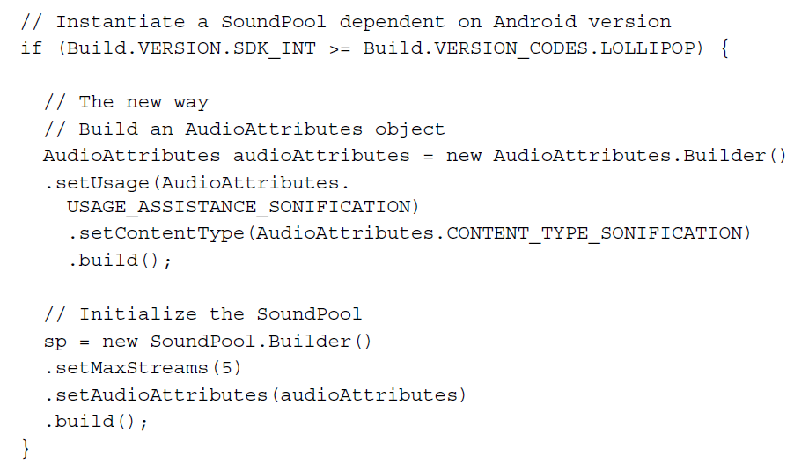
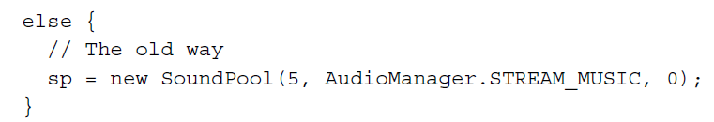
Android Multimedia

Slide 29
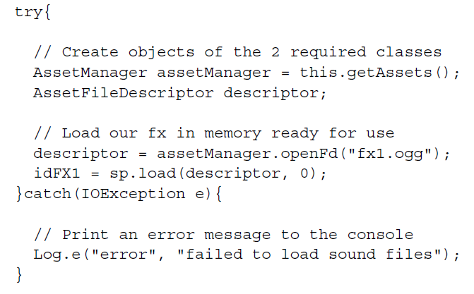
Android Multimedia
We need AssetManager and AssetFileDescriptor in loading the sound files.
AssetFileDescriptor is initialized here using the openFd method of the AssetManager object

Slide 30

Android Multimedia
This is how we play the sound.
It is also very simple to stop a sound when it is still playing with the stop method.

Slide 31
Android Multimedia
MediaPlayer is probably one of the most important classes for adding multimedia capability to your applications. It supports the following media sources:
Project resources
Local files
External resources (such as URLs, including streaming)

Slide 32
Android Multimedia
MediaPlayer supports the following popular audio files:
3GPP (.3gp)
FLAC (.flac)
MP3 (.mp3)
MIDI Type 0 and 1 (.mid, .xmf, and .mxmf)
Ogg (.ogg)
WAVE (.wav)
3GPP (.3gp)
Matroska (.mkv)
WebM (.webm)
MPEG-4 (.mp4, .m4a)

Slide 33
Android Multimedia
If streaming video/audio over Internet (network-based content), request network access permission in AndroidManifest.xml:
If playing back local file stored on user’s smartphone, put video/audio files in res/raw folder

Slide 34
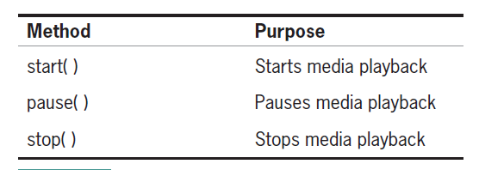
Android Multimedia
The three common states of the audio file are when the music starts, when the music pauses, and when the music stops.

Slide 35

Android Multimedia
Note: Audio file called by create must be encoded in one of supported media formats.
To play audio file saved in app’s res/raw/ directory

Slide 36
Android Multimedia
To play audio from remote URL via HTTP streaming over the Internet

Slide 37
Android Multimedia
MediaPlayer can consume valuable system resources
When done, call release( ) to free up system resources
In onStop( ) or onDestroy( ) methods, call

Slide 38
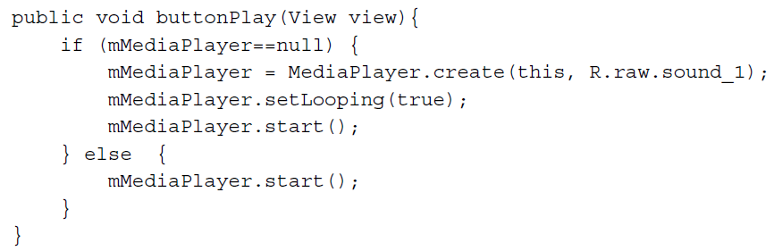
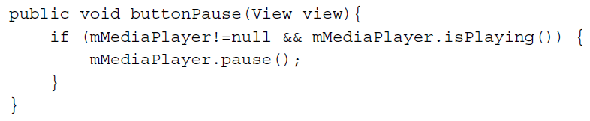
Android Multimedia
Sample code:

Slide 39
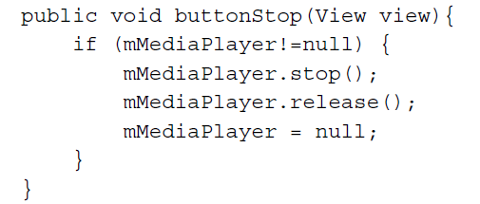
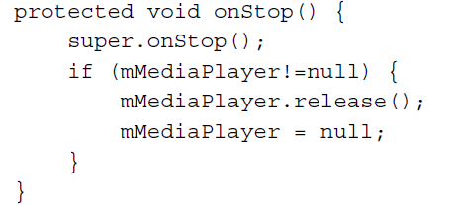
Android Multimedia
Sample Code

