Slide 1
Lesson 1
Introduction to
Visual Basic.NET
Programming In
Visual Basic.NET

Slide 2
Writing Windows Applications with VB
Windows Graphical User Interface
Window = Form
Toolbox of elements called Controls
  Text Box
  Label
  Check Box
  Button

Slide 3
Programming Languages
Procedural
  Program specifies exact sequence
Event Driven
Object Oriented Programming (VB.NET)
  User controls sequence
    Click event
    Double Click event
    Change event

Slide 4
Object Model
Object ==> Noun
  Form and Controls
Property ==> Adjective
  Color of a Form
Method ==> Verb
  Close a Form. Example: Me.Close()

Slide 5
Object Model (cont.)
Event ==> Occur when the user takes action
  User clicks a button
Class ==> Template to create new object
  Each control added is an Instance of a Class (Example: adding a second form to the project – it will have the same properties)

Slide 6
Dot Notation
Used to reference object's properties and methods in code
  Object dot Property
    Form.Text, TextBox.Text
    (Example: lblMessage.Text = "Hello World“)
  Object dot Method
    Form.Hide( ), TextBox.Focus( )
To reference an object's events use an underscore instead of a dot
    Button_Click, ListBox_TextChanged

Slide 7
Object Model Analogy
Class = automobile
Properties = make, model, color, year
Object = each individual car
  Object is also an Instance of the automobile class
Methods = start, stop, speedup, slowdown
Events = car arrives, car crashes
All automobiles will have the same methods and events – but can have different properties(color, etc)

Slide 8
Visual Basic.NET
Included in Visual Studio.NET
  Visual Basic (can also be purchased separately)
  C++
  C#
  .NET Framework

Slide 9
Visual Studio.NET Editions
Academic
Professional
Enterprise Developer
Enterprise Architect

Slide 10
Steps for Writing VB Projects
Design/Define the User Interface
Plan/Set the Properties
Plan/Write the Code
Test and Debug

Slide 11
VB Application Files
Open this file directly to work on a Project
One Solution File .sln
Solution User Options File .suo
Project Files .vbproj
Project User Options File .vbproj.user
Form Files .vb
Resource File for the Form .resx

Slide 12
Visual Studio Environment
Integrated Development Environment (IDE)
Solution Explorer
Form Designer
Properties Window
Editor for entering code
(Tools/Options/Reset Window Layout)
Notes:
Terminology changes:
VB IDE becomes the Visual Studio (VS) IDE
Project Explorer becomes Solution Explorer
Document window has tabs to display various contents:
Form Window becomes the Form Designer
Code Window becomes the Editor window or the VS editor
Note that the tabbed display is the default but can be turned off in
Tools/Options/General/Tabbed Documents

Slide 13
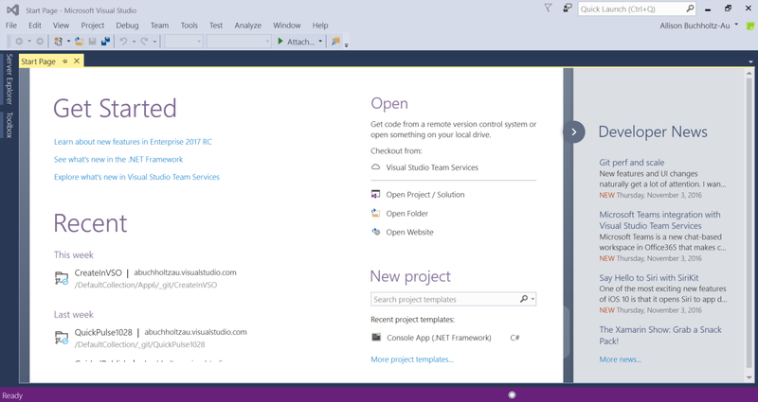
Visual Studio IDE Start Page

Slide 14
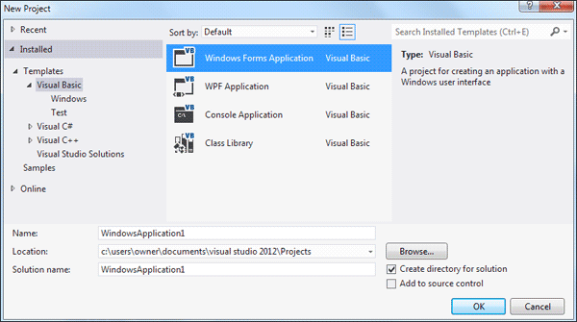
IDE New Project Dialog
Notes:
The IDE automatically crates a new folder for each project.
Do Not create your own, or you will have a folder within a folder.

Slide 15
IDE Main Window
Toolbars
Document Window
Form Designer
Solution Explorer
Properties Window
Toolbox

Slide 16
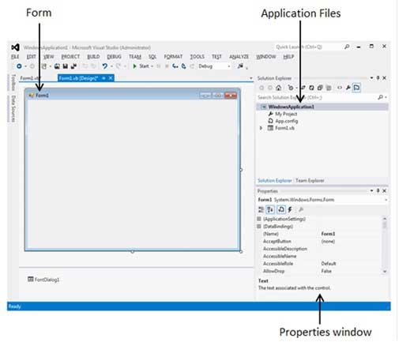
IDE Main Window

Slide 17
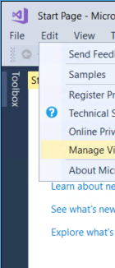
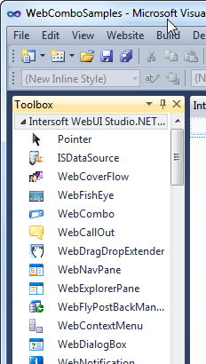
VB Toolbox
Place mouse on the top left most corner named Toolbox to display the toolbox window or click File->View->Toolbox

Slide 18
Visual Studio Help
Extensive Help feature
Includes Microsoft Developer Network library (MSDN)
Entire reference manual
Coding examples

Slide 19
Modes
Design Time
  Creating the user interface and writing code
Run Time
  Testing the project
Break Time
  Pausing project execution or getting a run-time error

Slide 20
Naming Rules
Always use standard names for objects
No spaces or punctuation marks
3 letter lowercase prefix identifies control type
    Button-btn
    Label-lbl
    Form-frm
If multiple words capitalize 1st letter of each word

Slide 21
Recommended Naming Conventions
Object Class Prefix Example
Form frm frmDataEntry
Button btn btnExit
TextBox txt txtPaymentAmount
Label lbl lblTotal
Radio Button rad radBold
CheckBox chk chkPrintSummary
Horizontal ScrollBar hsb hsbRate
Vertical ScrollBar vsb vsbTemperature
PictureBox pic picLandscape
ComboBox cbo cboBookList
ListBox lst lstIndegredients

Slide 22
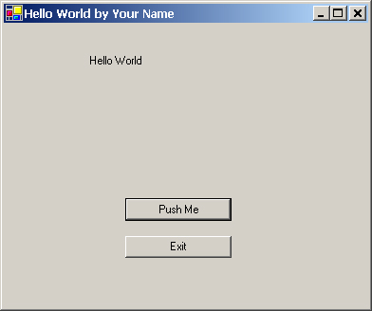
Hello World Project
Design the User Interface
lblMessage
btnPush
btnExit

Slide 23
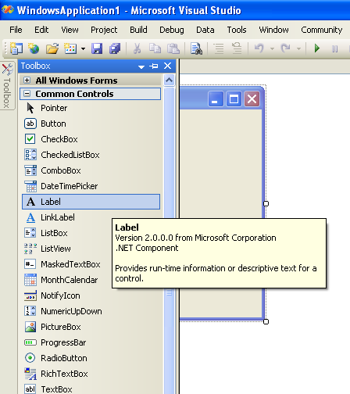
Properties Window-Label1
Steps to add a label to window:
Click on Common controls from the Toolbox to view list of common controls
Double click on the Label to add a label to the window
Note: Click once on the label and then right click once to open the Properties window if you don’t see properties window

Slide 24
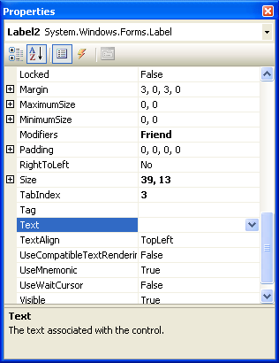
Setting up Properties
Delete the word Label 1 from the Text Properties
Enter the Name for the label such as “lblHello”
Scroll up or down to look for other properties you wish to set

Slide 25
Setup the Properties
Label
  Name lblMessage
  Text leave blank
Button 1
  Name btnPush
  Text Push Me
Button 2
  Name btnExit
  Text Exit
Form
  Name frmHello
  Text Hello World by your name

Slide 26
Set the Project's Startup Object
The default startup object if Form1
The name of the form should always be changed to adhere to naming rules
Using Project menu, Properties change the startup object to match the new name

Slide 27
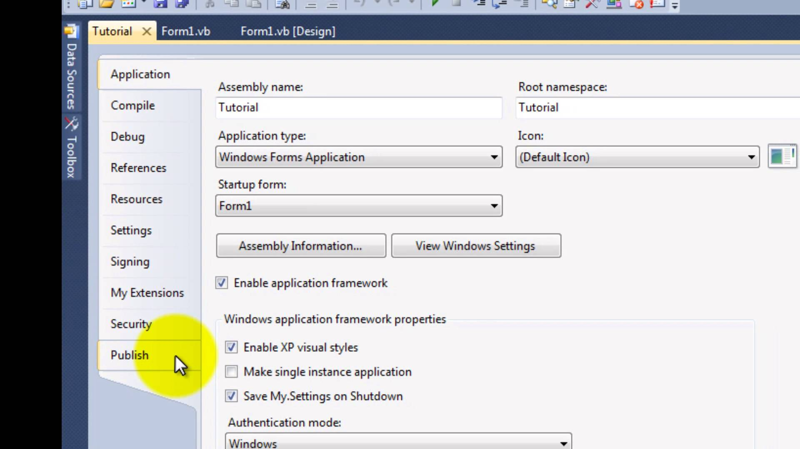
Project Property Page Dialog

Slide 28
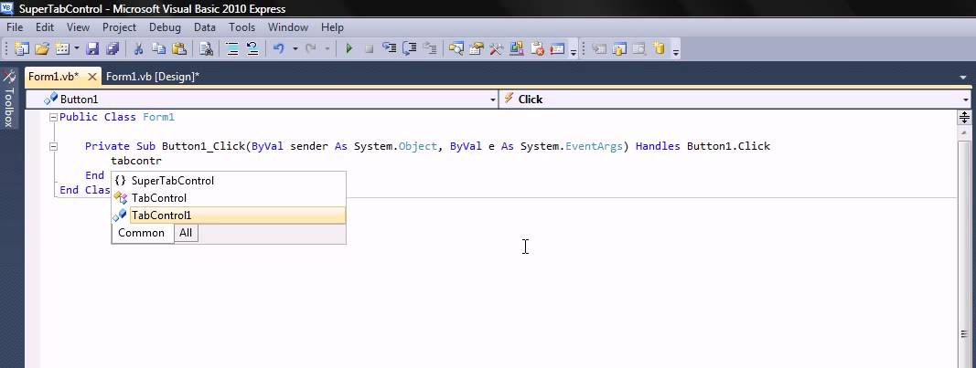
Navigate in VB.NET project
Click on these tabs allows you to switch from the Form Design window to Project Properties setting window or the Start Page window

Slide 29
Write the Code
While the project is running the user can perform actions
Each action by the user causes an Event to occur
Write code for the events you care about, the events you want to respond with code
Code is written as event procedures
VB will ignore events for which you do not write code

Slide 30
Adding Codes to Button
Switch back to the Form Design window (click on the Form1.vb[design] tab)
Double click on the Push Me button
You will see the Editor window is opened – (the Form1.vb* tab)
The Editor window looks like the one found on the next slide

Slide 31
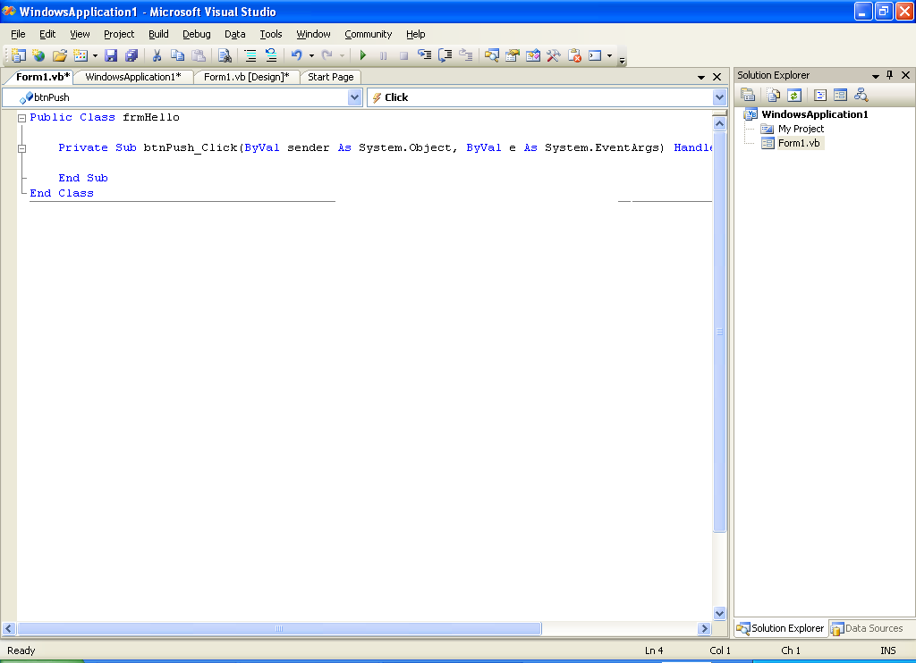
Editor Window
Declarations Section
Class list
Method list
Enter your codes here between the Private and End Sub

Slide 32
Remark Statement
Also known as Comment, used for documentation
Non-executable
Automatically colored Green in Editor
Begins with an apostrophe ( ' )
  On a separate line from executable code
  At the right end of a line of executable code
' Display the Hello World message

Slide 33
Assignment Statement
Assigns a value to a property or variable
Operates from right to left
Enclose text strings in quotation marks (" ")
lblMessage.Text=" Hello World "
VB codes to display “Hello World” in lblMessage label

Slide 34
Ending a Program
Execute the Close Method of the Form
Methods always have parentheses (this will help you distinguish them from Properties which never have parentheses)
Current Form may be referenced as Me
Me.Close( )

Slide 35
Test and Debug
Save Project - File Menu, Save All
Run Project
  Debug Menu, Start
  Start Without Full Compile (F5)
  Start With Full Compile (CTRL F5)
Correct any Errors and Rerun
  Compile errors
  Run-Time Errors
  Logic errors
  Syntax errors
"Help is always available from the Help Menu or by pressing F1."

Slide 36
Print the Code
File Menu, Print
Prints complete code listing

Slide 37
Finding and Fixing Errors
Syntax Errors
Run-Time Errors
Logic Errors

Slide 38
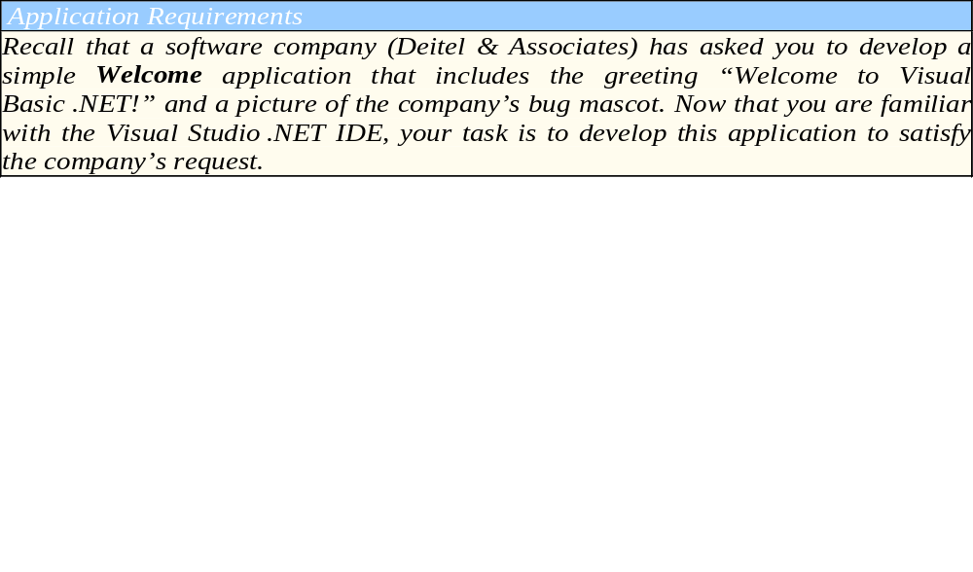
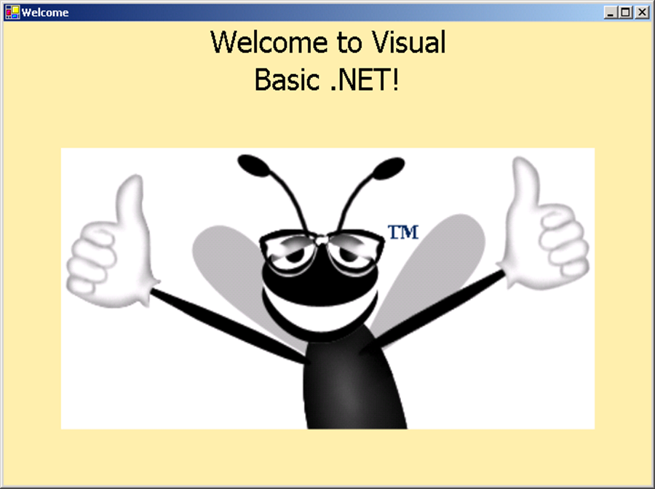
Practice Exercise 1

Slide 39
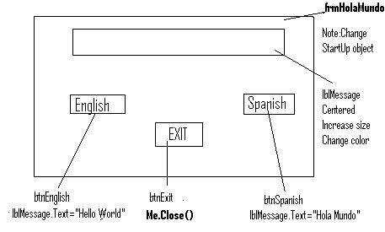
Practice Exercise 2
- Design and Test a project to display a greeting in English and Spanish
- Add remarks to the code

Slide 40
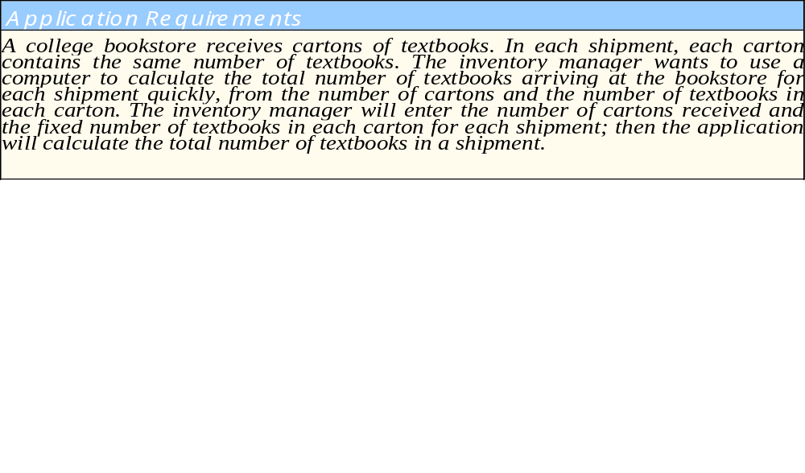
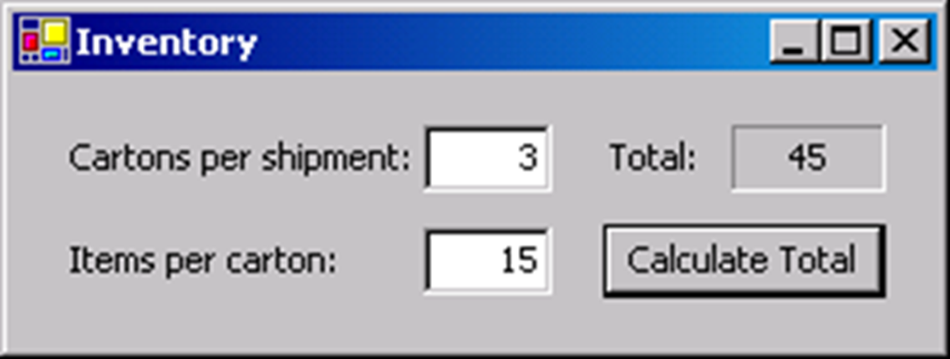
Practice Exercise 2

Slide 41
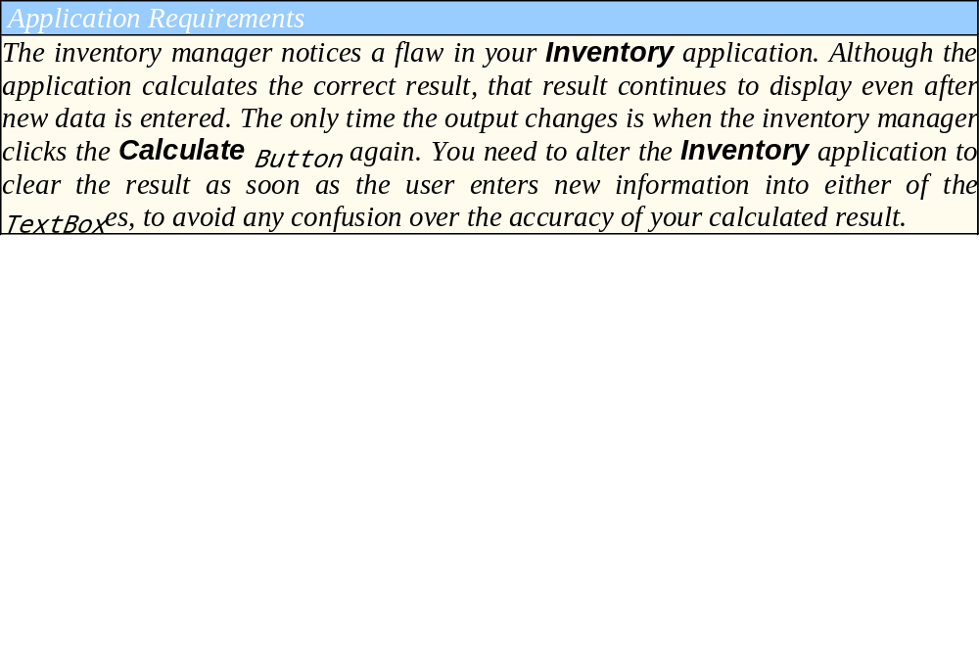
Practice Exercise 3

