Slide 1
Lesson 3
Controls
Programming In
Visual Basic.NET

Slide 2
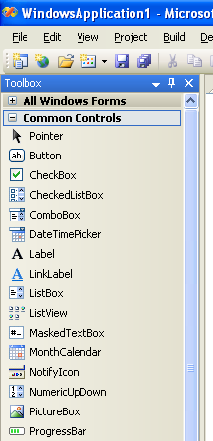
Controls in the Toolbox

Slide 3
Button (btn)
Used to run/activate an Event Procedure
Click event
Notes:
5

Slide 4
Label (lbl)
Used for
  Output on a form
  Identification of objects
  Directions/Information
Cannot by modified by user
Notes:
6

Slide 5
Text Box (txt)
Used for user input/data entry
Text Property
  What is displayed in text box
  What user entered in text box
TextAlign Property
  Controls alignment of text in the Text Box
TextChanged Event
Notes:
7

Slide 6
Group Box (grp)
Used as containers for other controls such as radio buttons and check boxes
Holds related items
Improves readability of form
Text Property
  What is displayed on the top edge of the group box
Notes:
7

Slide 7
Check Box (chk)
Used for user input/data entry
Allows the user to select or deselect 1 or more in any group
Checked Property (stores current state of the Check Box)
  Checked = True
  Unchecked = False
CheckChanged Event
  Occurs when user clicks on one of the Check Boxes
Notes:
10

Slide 8
Radio Button (rad)
Used for user input/data entry
Allows the user to select only 1 in any group
First create a group and then create each radio button inside the group
Checked Property (stores current state of the Radio Button)
Checked = True
  Unchecked = False
CheckChanged Event
  Occurs when user clicks on one of the Radio Buttons
Notes:
9

Slide 9
Picture Box (pic)
Displays/contains a picture/graphic
Image Property (holds the graphic)
  Complete path and filename of graphic
  .bmp, .gif (including animated), .jpg, .png, .ico, .emf, .wmf
SizeMode Property
  StretchImage causes graphic to be resized to match the size of the control
Visible Property
Notes:
11

Slide 10
Borders and Styles
BorderStyle Property
  None
  FixedSingle
  Fixed3D
Notes:
14

Slide 11
Drawing a Line
Use Label Control
  Text=blank
  BorderStyle=None
  BackColor=desired line color
  Size: Width and Height as desired

Slide 12
Selecting Multiple Controls
SHIFT-Click or CTRL-Click to select/deselect multiple controls
Use the mouse to drag a selection box around multiple controls
To deselect all selected controls click elsewhere on the form
Notes:
15

Slide 13
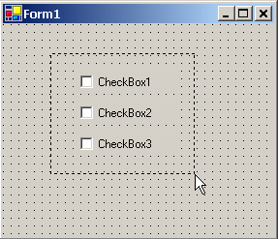
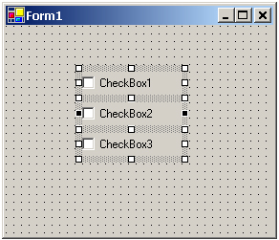
Selecting Multiple Controls (cont.)
Start
here
Drag
to here
Using mouse to drag a selection box around multiple controls
Multiple selected controls,
observe selection handles.

Slide 14
What Can be Done with Multiple Selected Controls?
Use Format Menu or Layout Toolbar to
  Align them to each other
  Make same size
  Modify the spacing between them
Move them as a group
Set their common properties

Slide 15
Designing the User Interface
To the user the Interface should be
  Easy to understand
  Familiar
  Comfortable
  Organized
  Sans Serif Fonts are best, not boldface or large
  Color Neutral Overall
  Keyboard Accessible

Slide 16

Keyboard Access Keys
Also referred to as Hot Keys
Underlined Letter
User presses ALT + underlined letter
Use Windows-Standard Keys
Defined using Text Property
Text=&OK
Text=E&xit
Notes:
17

Slide 17
Default & Cancel Buttons
User presses Enter instead of using the mouse
Default Button
  Identified visually on Form by its darker outline
  Responds to ENTER key
  Form's AcceptButton Property
Cancel Button
  Responds to ESC key
  Form's CancelButton Property

Slide 18
Focus
One control on a Form always has the Focus
Not all control types can receive the focus
TabStop Property (applicable only for controls that are capable of receiving the focus- labels and pictures can’t)
  Designates whether a control is allowed to receive the focus; True or False

Slide 19
Tab Order
User should be able to use TAB key to move the focus through a form in an organized manner; top to bottom, left to right
TabStop property (yes is the defaualt)
TabIndex Property
  Number in tab sequence
  0 for first control to receive the focus when the form loads
Use View Menu, Tab Order to set
Notes:
18

Slide 20
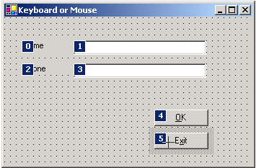
Setting TabIndex Property
Open the form ->View menu->TabOrder
Click on each control in sequence to set TabIndex property of controls automatically

Slide 21
Form's Screen Location
StartPosition Property
  Manual
  CenterScreen
  WindowsDefaultLocation
  WindowsDefaultBounds
  CenterParent

Slide 22
ToolTips
Small label that is displayed when user places pointer on a control and pauses
Usually used with Command Buttons
Steps for creating ToolTips
  Add a ToolTip Control to Form
    Appears in the Component Tray, pane at bottom of Form Designer where nondisplay controls are shown
  Set ToolTip on ToolTip1 Property of each control to the text of tip
Notes:
19

Slide 23
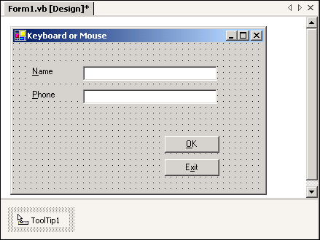
ToolTip Control
Component Tray

Slide 24
Clearing Text Boxes & Labels
Set Text Property equal to the Empty String
  Empty String is 2 quotation marks with no space between them ("")
Use the Clear Method of a Text Box
txtName.Text = ""
lblMessage.Text = ""
txtCourse.Clear( )
Notes:
20

Slide 25
Resetting the Focus
Places the Insertion Point in a Text Box
Use the Focus Method
txtName.Focus( )
Notes:
21

Slide 26
Checked Property of Check Boxes and Radio Buttons
Selects/Deselects Check Box or Radio Button
Set Checked Property
  True = Checked, selected
  False = Unchecked, deselected
radRed.Checked = True
chkBold.Checked = False
Notes:
22

Slide 27
VB Color Constants
ForeColor and BackColor Properties
Use VB Color Constants from the Color Class
View complete list in Help by using the keyword Color followed by a period
txtName.ForeColor = Color.AliceBlue
lblMessage.BackColor = Color.White
Notes:
23

Slide 28
With and End With
Change several properties at once in Code
Will run more efficiently
With txtName
.Visible = True
.Text ="Lynne"
. Focus( )
End With
Notes:
24

Slide 29
Concatenation
Think of it as "glueing" text strings together
Example: txtFName contains First Name
txtLName contains Last Name
lblFullName.Text = txtFName.Text & " " & txtLName.Text
lblNote.Text = "Today's weather is " & txtWeather.Text & "."
Notes:
25

Slide 30
Continuing Lines of Code
For long lines of code it is more readable to continue them to the next line
At the end of the line type Line Continuation Character, a Space followed by an Underscore
lblMessage.Text = txtFName.Text & "" & txtLName.Text & _
", welcome to Aiken Technical College. Today is " & _
txtToday.Text
Notes:
26

