Slide 1
Lesson 3
Decisions and Conditions
Programming In
Visual Basic.NET

Slide 2
If …Then…Else
Used to make decisions
Always indent for readability & debugging
Then must be on same line as If or ElseIf
End If and Else must appear alone on a line
Notice that ElseIf is 1 word, End If is 2 words
Always End with End If

Slide 3
If General Form
(also notice indenting)
If (condition) Then
statements to perform if condition=true
[ElseIf (condition) Then
statements to perform if
1st condition=false and
2nd condition=true]
[Else
statements to perform if
both conditions= false]
End If

Slide 4
Relational Operators for building Conditions
Greater Than >
Less Than <
Equal To =
Not Equal To <>
Greater Than or Equal To >=
Less Than or Equal to <=

Slide 5
Comparison Tips
Negative numbers are always less than
positive numbers
Strings can be compared also (don't forget to enclose the strings in quotes)
  JOAN is less than JOHN
  HOPE is less than HOPELESS
  Joan does not equal JOAN
Numbers are always less than letters
  300ZX is less than Porsche

Slide 6
If Example #1
intCredits=CInt(txtCredits.Text)
If intCredits < 32 Then
radFreshman.Checked = True
ElseIf intCredits < 64 Then
radSophomore.Checked = True
ElseIf intCredits < 96 Then
radJunior.Checked = True
Else
radSenior.Checked = True
End If

Slide 7
If Example # 2
If blnSuccessfulOperation = True Then
. . .
End If
is equivalent to
If blnSuccessfulOperation Then
. . .
End If

Slide 8
ToUpper and ToLower Methods
Use ToUpper and ToLower methods of the String class to convert strings for comparisons
txtGender.Text contains Male
If txtGender.Text.ToUpper = "MALE" Then
. . .
End If

Slide 9
Compound Conditions
Join conditions using Logical Operators
  Or either true evaluates to true
  And both true evaluates to true
  Not reverses the condition, so that true will evaluate false and
  false will evaluate true

Slide 10
Compound Conditions Example # 1
If radMale.Checked = True And CInt(txtAge.Text) < 21 Then
mintMinorMaleCount + = mintMinorMaleCount
End If
radMale not checked False
txtAge greater than 21 False
radMale not checked, txtAge less than 21 False
radMale checked, txtAge 21 or greater False
radMale checked, txtAge less than 21 True

Slide 11
Compound Conditions Example # 2
If radJunior.Checked = True Or radSenior.Checked = True Then
mintUpperClassCount + = mintUpperClassCount
End If
radJunior.Value=True True
radSenior.Value=True True
radJunior.Value=False, radSenior.Value=True True
radJunior.Value=True, radSenior.Value=False True
radJunior.Value=False, radSenior.Value=False False

Slide 12
Nested Ifs
If intTemp > 32 Then
If intTemp > 80 Then
lblComment.Text = "Hot"
Else
lblComment.Text="Moderate"
End If
Else
lblComment.Text="Freezing"
End If

Slide 13
Testing Radio Buttons & Check Boxes
Instead of coding the CheckChanged events, use IFs to see which are selected
Place the IF code in the Click event for a Button, such as btnOK
Private Sub btuDisplay_Click()
  If chkBold.Checked=True Then
  lblMessage.FontBold=True
  End If
End Sub

Slide 14
Enhancing Message Boxes
For longer, more complex messages store the message text in a String variable and use that variable as an argument of the Show method
VB will wrap longer messages to a second line
Include ControlChars to control the line length and position of the line break

Slide 15
ControlChars Constants
  Constant Description
  CR Carriage Return
  CRLF Carriage Return + Line Feed
  NewLine Carriage Return + Line Feed
  Tab Tab Character
  NullChar Character with a Value of Zero
  Quote Quotation Mark Character

Slide 16
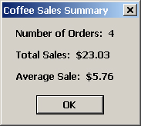
Message Box - Multiple Output Lines
ControlChars.NewLine
Used to force to next line

Slide 17
Message String Example
Dim strMessage as String
Dim strTotalOut as String
Dim strAvgOut as String
strTotalOut=FormatDecimal(mdecTotal)
strAvgOut=FormatNumber(mdecAvg)
strMessage = "Total: " & strTotalOut & _
ControlChars.NewLine & "Average: " & _
strAvgOut
MessageBox.Show(strMessage, "Summary")

Slide 18
Displaying Multiple Buttons
Use MessageBoxButtons Constants to display more than one button in the Message Box
(Constants: AbortRetryIgnore, OK, OKCancel, RetryCancel, YesNo, YesNoCancel)
Message Box's Show Method returns a DialogResult object that can be checked to see which button the user clicked
Declare a variable that can hold an instance of the DialogResult type to capture the outcome of the Show Method

Slide 19
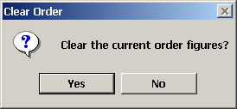
Message Box - Multiple Buttons
MessageBoxButtons.YesNo

Slide 20
Capturing User Response to Message Box
Dim intResult as Integer
Dim strMsg as String
strMessage = "Clear current order figures?"
intResult = MessageBox.Show(strMsg, _
"Clear", MessageBoxButtons.YesNo, _
MessageBoxIcon.Question)
If intResult = DialogResult.Yes Then
'Code to clear the order
End If

Slide 21
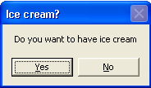
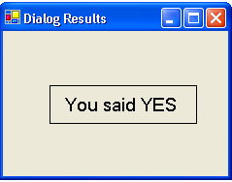
Capturing User Response to Message Box - Example
Dim IntResult As Integer
IntResult = MessageBox.Show("Do you want to have ice cream", "Ice cream?",
MessageBoxButtons.YesNo)
If IntResult = DialogResult.Yes Then
lblMessage.Text = "You said YES"
Else
lblMessage.Text = "You said NO"
End If

Slide 22
Specifying a Default Button
Use a different signature for the Message Box Show method to specify a default button
Add the MessageBoxDefaultButton argument after the MessageBoxIcons argument
MessageBoxDefaultButton Constants
  Button1, Button2, Button3

Slide 23
Input Validation
Check to see if valid values were entered by user in TextBox and use Message Box to notify user if invalid
IsNumeric function checks for numeric values, empty string returns False
  If IsNumeric(txtQuantity.Text) Then ...
Check for required data or not blank
  If txtName.Text <> "" Then ...

Slide 24
Input Validation (cont.)
  Code If structure to determine if value falls within a range of acceptable values
  Use nested If structure to validate multiple values on a form
  Use single If for each value, Else for message to user, and execute Focus Method to reset focus to text box in question
  Order of Ifs should match TabOrder of text boxes on form

Slide 25
Calling Event Procedures
Reusable code
General Form
  [Call] ProcedureName ( )
Examples
  Call btuCalculate_Click (sender, e)
  OR
  btuCalculate_Click (sender, e)

Slide 26
Debugging
Debug Menu
Debug Toolbar
Toggle BreakPoints on/off by clicking Editor's gray left margin indicator
Step through Code, Step Into, Step Over
View the values of properties, variables, mathematical expressions, and conditions

Slide 27
Debugging (cont.)
Output Window
Locals Window
Autos Window

Slide 28
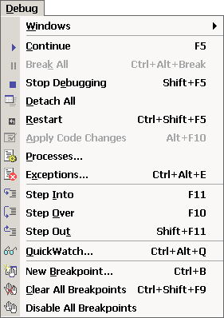
Debug Menu and Toolbar

Slide 29
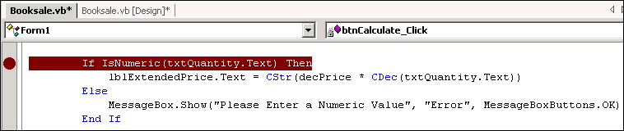
Breakpoints
Toggle Breakpoints On/Off by clicking in Editor's gray left margin indicator

Slide 30
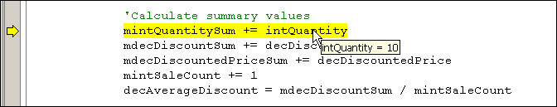
Viewing Current Values During Program Execution
Place mouse pointer over variable or property to view current value

Slide 31
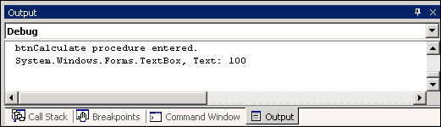
Writing to the Output Window
Debug.WriteLine(TextString)
Debug.WriteLine(Object)
Debug.WriteLine("btnCalculate Procedure entered")
Debug.WriteLine(txtQuantity)

Slide 32
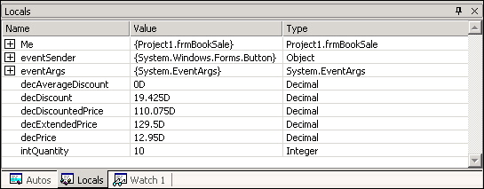
Locals Window

Slide 33
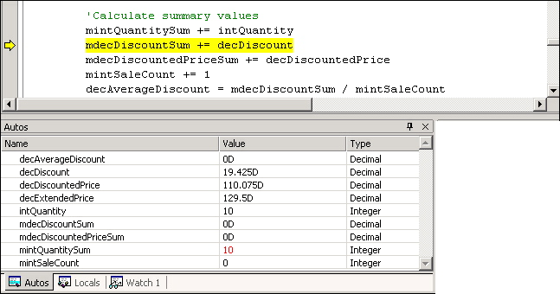
Autos Window

