Slide 1
Lesson 5
Lists and Loops
Programming In
Visual Basic.NET

Slide 2
ListBoxes & ComboBoxes
Provide a list for the user to select from
Various styles, choose based on
  Amount of data to be displayed
  Space available
  User's ability to add to the list

Slide 3
Types of List Controls
ListBox tool
  lst prefix
  Simple List Box with/without scroll bars
ComboBox tool
  cbo prefix
  List may allow for user to add new items
  List may "drop down" to display items in list

Slide 4
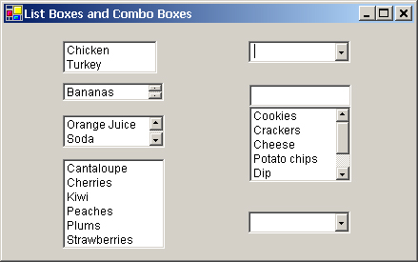
List Controls Visually
Dropdown
Combo Box
Simple
Combo Box
List
Boxes
Dropdown
List Box

Slide 5
Choosing List Type
Many items, little space
  Dropdown Combo Box
  Dropdown List
Few items
  List Box
User allowed to add to the list
  Simple Combo Box
  Dropdown Combo Box

Slide 6
Name and Text Properties
ListBoxes
  Name displayed at Design Time
  Text accessible only at Run Time
ComboBoxes
  Text also accessible at Run Time
  If user enters new data in ComboBox then VB stores it temporarily in the Text property

Slide 7
DropDownStyle Property
Used to indicate the type of ComboBox
  Dropdown Combo = DropDown
  Simple Combo = Simple
  Dropdown List = DropDownList

Slide 8
Items Collection
List of items in a ListBox or ComboBox is a collection
Collections are objects that have properties and methods that allow you to
  Add items
  Remove items
  Refer to individual items
  Count items
  Clear the collection

Slide 9
Index Property
Zero based value used to reference individual items in the collection
Position of an item in the list
  1st item Index = 0 (1-1=0)
  2nd item Index = 1 (2-1=1)
  3rd item Index = 2 (3-1=2)
So we can say that . . .
  nth item Index = n-1

Slide 10
SelectedIndex Property
Use to identify currently selected item in the list
If no item is selected ListIndex = -1
Use to select an item in the list

Slide 11
Items.Count Property
Use to determine number of items in the list
  Remember:
  Items.Count is the actual number of items in the list BUT the SelectedIndex property and Index will be 1 less.
  For example, it there are 20 items in the list:
      Items.Count=20 BUT
      Index =19 for the last item in list

Slide 12
Using the Items Collection
Use the index of the item to reference a specific item in the collection
Remember that the index is zero based so the 1st item in the list is index position zero
lstSchools.Items(5) = "USC"
' Next line references the currently selected item
strSelectedFlavor = lstFlavor.Items(lstFlavor.SelectedIndex)

Slide 13
Filling a List
Design time in properties window
  Items property
  Click on ellipses to open String Collection Editor
  Separate items with ENTER key
Run time methods
  Items.Add
  OR
  Items.Insert

Slide 14
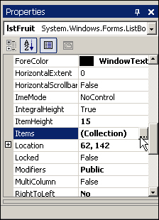
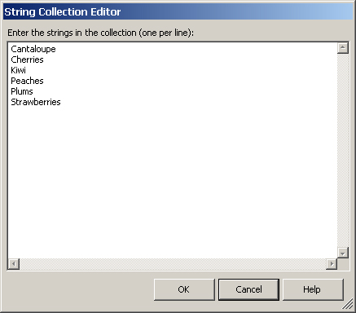
Filling List - Design Time
Click ellipses button to open

Slide 15
Items.Add Method
Use to add new items to the list at run time
General Form
Object.Items.Add(ItemValue)
lstNames.Items.Add("Brandon")
lstDeptNums.Items.Add(100)
cboMajors.Items.Add(txtMajors.Text)
'Next line adds new item user typed in to combo
cboGrade.Items.Add(cboGrade.Text)

Slide 16
Items.Insert Method
Use to add new items to the list at run time at a specific location(index) in the collection
General Format
Object.Items.Insert(IndexPosition, ItemValue)
lstDeptNums.Items.Insert(1, 100)
cboGrade.Items.insert(0, "Freshman")
cboMajors.Items.Insert(11, txtMajors.Text)

Slide 17
Items.RemoveAt Method
Use to specific remove items from the list at run time by specifying the index of the item
General Form
Object.Items.RemoveAt(IndexPosition)
lstDeptNums.Items.RemoveAt(1)
' Next line removes the currently selected item
cboGrade.Items.RemoveAt(cboGrade.SelectedIndex)

Slide 18
Items.Remove Method
Use to specific remove items from the list at run time by specifying the Text of the item
General Form
Object.Items.Remove(TextString)
lstDeptNums.Items.Remove("USC")
' Next line removes the currently selected item
cboGrade.Items.Remove(cboGrade.Text)

Slide 19
Clear Method
Empty the entire list from list box or combo box, remove all the items
General Form
Examples
Object.Items.Clear( )
lstDeptNums.Items.Clear( )
cboGrade.Items.Clear( )

Slide 20
ListBox and ComboBox Events
TextChanged Event
  Occurs when user types text into Combo
  ListBox does not have TextChanged Event
SelectedIndexChanged Event
Enter Event (receive focus)
Leave Event (lose focus)

Slide 21
Loops
Repeating a series of instructions
Each repetition is called an iteration
Types of Loops
  Do
    Use when the number of iterations is unknown
  For Next
    Use when the number of iterations known

Slide 22
Do Loops
Ends based on a condition you specify, either
  Loop While a condition is True
  Loop Until a condition becomes True
Condition can be located at
  Top of Loop, Pretest
  Bottom of Loop, Posttest

Slide 23
Do Loop General Form
Do {While |Until} condition
Statements to execute
Loop
OR
Do
Statements to execute
Loop {While | Until} condition
Top of Loop Condition,
Pretest
Bottom of Loop Condition,
Posttest

Slide 24
Do's - When Evaluated
Top Evaluation, not guaranteed to run once since evaluated BEFORE running
    Do While … Loop
    Do Until … Loop
Bottom Evaluation, will always run at least one time
    Do … Loop While
    Do … Loop Until

Slide 25
For Next Loops
Use when you know the number of iterations
Uses a numeric counter variable, called Loop Index, to control number of iterations
Loop Index is incremented at the bottom of the loop on each iteration
Step value can be included to specify the incrementing amount to increment Loop Index, step can be a negative number

Slide 26
For Next Loop General Form
For LoopIndex = InitialValue To TestValue [Step Increment]
Statements to execute
Next [LoopIndex]

Slide 27
Do Loops / For Next Loops:
Deciding Which To Use
Is the
number of
repetitions
known?
Must
the loop
execute
once?
NO
NO
Top Eval Do Loop
YES
YES
For Next Loop
Bottom Eval Do Loop
Is the
expression
initially
true?
Do Until Loop
Do While Loop
NO
YES

Slide 28
Manually Exiting For Next Loops
In some situations you may need to exit the loop prematurely
Use the Exit For statement inside the loop structure
Generally the Exit For is part of an If statement

Slide 29
Making Entries Appear Selected
In Windows, when a user tabs into a text box or one of the list controls the data in the control is usually selected
Also, when setting the focus in code to a text box or list it is customary to select all the data, for example on invalid data during validation

Slide 30
Making Entries Appear Selected (cont.)
TextBox
  Add the SelectAll method to the TextBoxName_Enter event
ListBox or ComboBox
  Set the SelectedIndex property

