Slide 1
Lesson 6
Formatting ListBoxes and Multiple Forms
Programming In
Visual Basic.NET

Slide 2
Format ListBoxes
ListBoxes can be formatted to display tabular information.
Specify the format of the ListBoxes by using format string.
In order to show neat and tabular report in a ListBox, the FONT property should be set to Courier New.

Slide 3
Format ListBoxes (cont)
Format a ListBox to display a 4-fields report.
fmtStr = "{0,-8}{1,-15}{2,-15}{3,-15}"
fmtstr is a String variable. The 2 numerical values in the curly braces are the field number and width of a column respectively.
For example: {0, -8} denotes the 1st field and -8 is the width of the field – left justified.

Slide 4
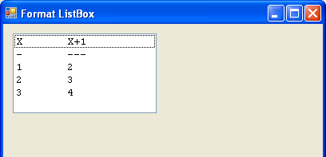
Format ListBoxes Sample
Dim fmtStr As String
Dim intX As Integer
fmtStr = "{0,-8}{1,-15}”
lstData.Items.Add(String.Format(fmtStr, "X", "X+1”))
lstData.Items.Add(String.Format(fmtStr, "-", "---”))
For intX = 1 To 3
lstData.Items.Add(String.Format(fmtStr, intX, intX +1))
Next

Slide 5
Multiple Forms
Multiple forms can be added to enhance a VB.Net application.
Multiple forms can be called by using its form name and its show method.
For example: me.close(),frmMenu.Show(), frmMenu.Close(), etc.

Slide 6
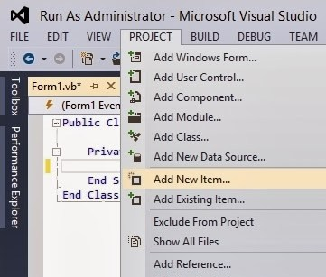
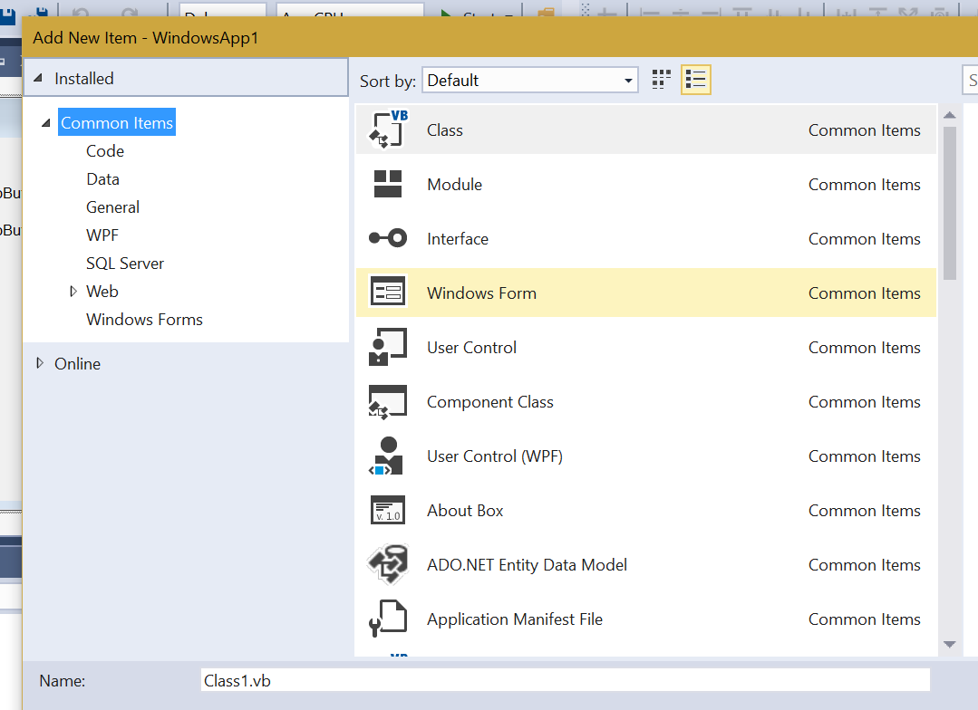
Inserting a New Form

Slide 7
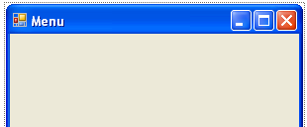
Setting a Form’s Properties
Set form’s property such as Text, otherwise the form name is used instead.

Slide 8
Displaying a Form
Put the form’s show() mehtod in a button to activate a form.
Use the form’s Show method to display a form. The close() method closes a form.
For example: frmMenu.Show() – make the Menu form visible, frmMenu.Close() – closes the Menu form.

Slide 9
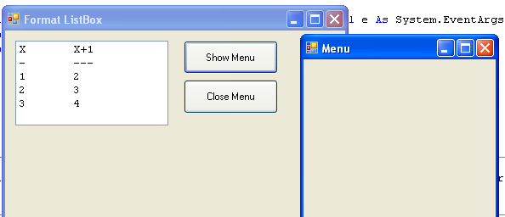
Displaying a Form (cont)
You may also set the value to be displayed in a new form prior to displaying it.

Slide 10
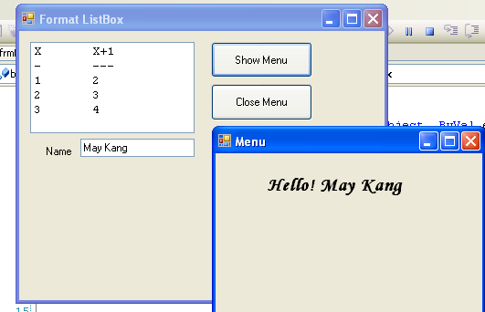
Displaying a Form (cont)
The following VB.Net codes display value from a text box into the frmMenu form.
frmMenu.lblMessage.Text = _ frmMenu.lblMessage.Text & txtName.Text
frmMenu.Show()
NB: The above code is placed
in the Show Menu button.

