Slide 1
Lesson 7
Database
Programming In
Visual Basic.NET

Slide 2
ADO.NET
System.Data.SqlClient namespace
  A collection of classes that are used to programmatically access a SQL Server data source.
SqlConnection
  Establishes a database connection
SqlCommand
  Runs a query against the database

Slide 3
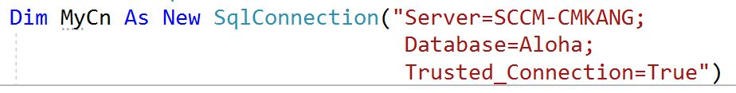
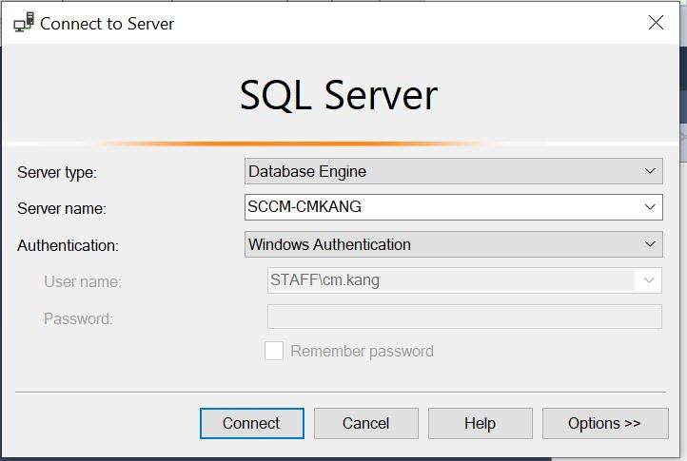
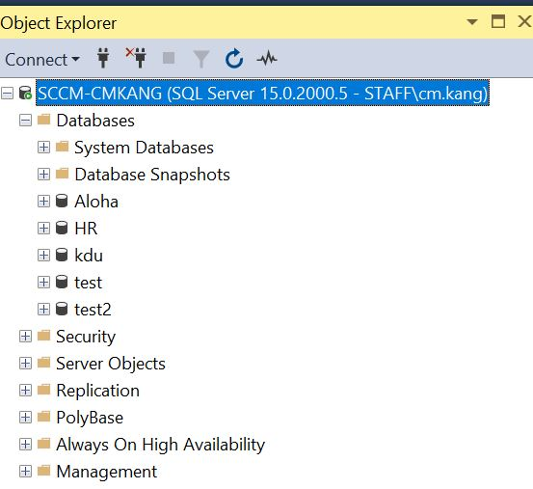
SqlConnection
1
2
3
1
2
3
Windows Authentication, command is fixed.

Slide 4
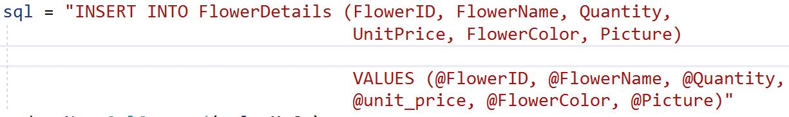
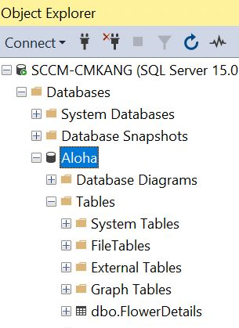
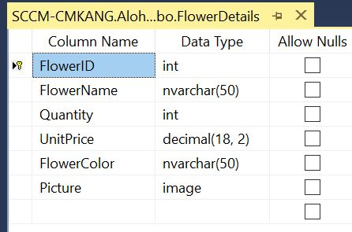
SqlCommand
2
1
3
2
1
3
User-defined meaningful argument names.

Slide 5

Connection
Establish the connection between the SQL INSERT statement (sql) and the connection string (MyCn)
It builds a new SQL command named cmd

Slide 6
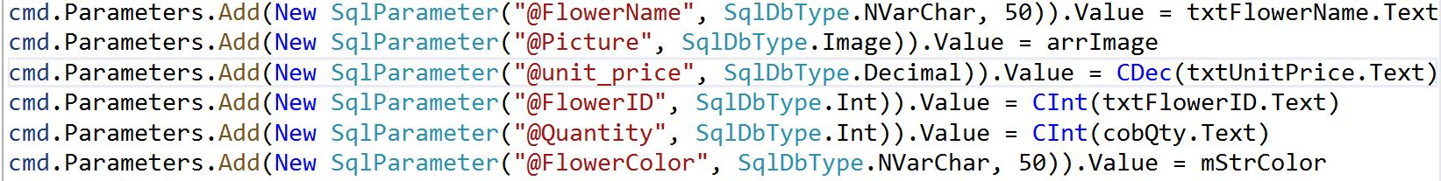
Parameters
Add parameters to the SQL command (cmd)
Each field in the parameter represents the attributes in the Database’s table (FlowerDetails)
Data type adheres to the data type in the SQL table
Binds the respective values from the controls found on the form.

Slide 7
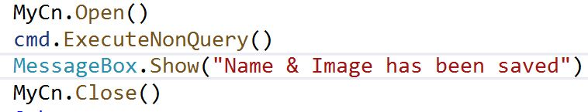
Execute Command
Opens the connection stream
Execute the SQL command
Close the connection
The Open and Close function only need to be performed once

Slide 8
SqlDataAdapter
Serves as a bridge between a DataSet and SQL Server for retrieving and saving data
It provides this bridge by the Fill method
The Fill method changes the data in the DataSet to match the data in the data source
More information on SqlDataAdapter Class at:
  https://docs.microsoft.com/en-us/dotnet/api/system.data.sqlclient.sqldataadapter?view=dotnet-plat-ext-5.0

Slide 9
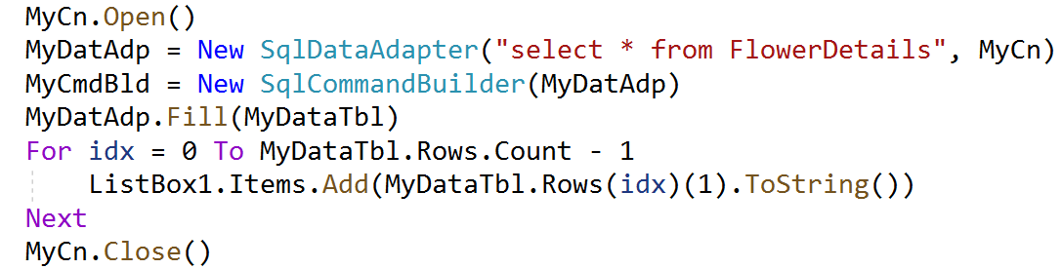
SqlDataAdapter
General format
  SqlDataAdapter(String, SqlConnection)

Slide 10
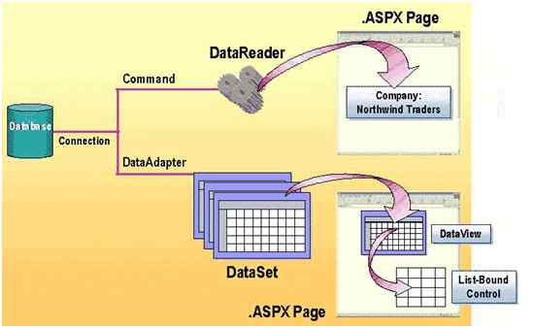
SqlDataAdapter

Slide 11
SqlCommandBuilder
Generate Transact-SQL statements for single-table updates
General format
  SqlCommandBuilder(SqlDataAdapter)
  More information on SqlCommandBuilder class at:
  https://docs.microsoft.com/en-us/dotnet/api/system.data.sqlclient.sqlcommandbuilder.-ctor?view=dotnet-plat-ext-5.0

Slide 12
DataTable
A central object in the ADO.NET library
Other objects that use the DataTable include the DataSet and the DataView
DataTable is case sensitive.
“mydatatable” and “MyDataTable” are different.
Contains a collection of Constraint objects to ensure data integrity
More Infor:
  https://docs.microsoft.com/en-us/dotnet/api/system.data.datatable?view=net-5.0

