Slide 1
Lesson 7
Menus, Sub Procedures and
Sub Functions
Programming In
Visual Basic.NET

Slide 2
Menus
Menu Bar
  Drop-down list of commands
    Have properties
    Have events to write code for
Add MainMenu control to form
  Appears in the Component Tray, pane at bottom of Form Designer where nondisplay controls are shown
  Words "Type Here" appear at the top of the form

Slide 3
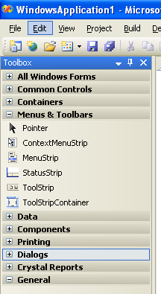
Menu control
Click on Menus & Toolbars to expand the list of controls
Double click on the MenuStrip to open the menu editor in your form
See next slide for sample screen

Slide 4
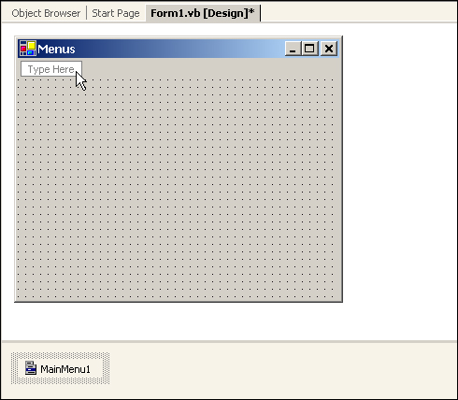
Menu Designer Initially
Type first Menu here
MainMenu Control appears in Component Tray

Slide 5
Using the Menu Designer
To create the menus simply type where the words "Type Here" appear at the top of the form
Include & symbol as you type to indicate Keyboard Access Keys
You are actually entering the Text property for a MenuItem object
Change MenuItem object names in the Properties Window to include mnu prefix

Slide 6
Submenus
Popup to the right of the menu
Filled triangle to the right of the menu item indicates to the user the existence of a submenu
Avoid more than one level deep
Create submenus by moving to the right of a menu item and typing the next item's text

Slide 7

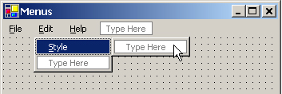
SubMenus (cont.)

Slide 8
Separator Bars
Used for grouping menu items according to their purpose
Visually represented as a bar across the menu
Create using one of two methods
  Typing a single hyphen for the text
  Right-click on Menu Designer where you want separator bar and choose Insert Separator

Slide 9
Menu Properties
Text
Name, prefix = mnu
  Examples: mnuFileExit, mnuHelpAbout, mnuFormatColorRed
Checked, True/False Enabled, True/False
Visible, True/False

Slide 10
Menu Design Standards
Follow the industry standards for Windows for names, order/location, access keys, shortcut keys
Basic Main Menus
File Edit View Format Help

Slide 11
File Menu Edit Menu
New (Ctrl N)
Open (Ctrl O)
Close
Save As
Save (Ctrl S)
Print (Ctrl P)
Exit
Undo (Ctrl Z)
Cut (Ctrl X)
Copy (Ctrl C)
Paste (Ctrl V)
Find (Ctrl F)
Replace (Ctrl H)

Slide 12
Format Menu Help Menu
Font
Paragraph
Alignment
Color
About (F1)
System Information
View Menu
Toolbar
Status Bar

Slide 13
Modifying Menu Items Using Menu Designer
Right-Click the Menu Bar on the Form to
  Insert New menu
  Delete menu
  Insert Separator
  Edit Name, displays menu item Name property rather than Text property on Form
Drag and Drop menu items to new locations

Slide 14
Windows Common
Dialog Boxes (dlg prefix)
Predefined standard dialog boxes for:
  File Open and Saving
  Printing and Previewing
  Color selection
  Font selection
Add the Common Dialog control to form
  Appears in the Component Tray, pane at bottom of Form Designer where nondisplay controls are shown

Slide 15
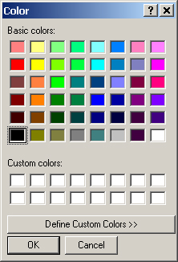
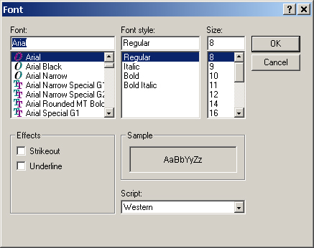
Color & Font Dialogs

Slide 16
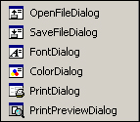
Common Dialog Controls
OpenFileDialog
SaveFileDialog
FontDialog
ColorDialog
PrintDialog
PrintPreviewDialog

Slide 17
Displaying Common Dialog
Use ShowDialog Method to display common dialog at run time
ShowDialog only displays the dialog, it doesn’t do anything else
dlgColor.ShowDialog( )
dlgFont.ShowDialog( )
dlgPrint.ShowDialog( )

Slide 18
Using the Common Dialog Information
Code must be written to retrieve and use the choices made by the user in the Common dialog
Example
  Color Dialog displayed
  User selects color and clicks OK
  Code must be written to apply the selected (dlgColor.Color) color to an object(s)

Slide 19
Set Initial Values for Color or Font Common Dialogs
In Windows, when a Color or Font Common Dialog is displayed it normally displays the current values of the object being updated
Before executing the ShowDialog method, you should therefore assign the Object's existing values

Slide 20
Set Initial Values (cont.)
Examples
  Changing the background color of a form
    Assign the current color to be selected when the Color Dialog displays (otherwise black is selected)
  Changing the font of a label
    Assign the current font name, size, and style to be selected when the Font Dialog displays

Slide 21
Color Dialog Example
Change background color of a form
With dlgColor
' Initialize Color Dialog
.Color = frmMain.BackColor
' Display Color Dialog
.ShowDialog( )
' Apply user choice to object
frmMain.BackColor = .Color
End With

Slide 22
Font Dialog Example
Change font of a Label
With dlgFont
' Initialize Font Dialog
.Font = lblEmployee.Font
' Display Font Dialog
.ShowFont( )
' Apply user choices to object
lblEmployee.Font = .Font
End With

Slide 23
Context Menus
Popup in response to right mouse click on form or on a control
Are specific to the component to which user is pointing when right-clicking
Also called Popup menus or Shortcut menus
Do not have top level menus like the menu bar

Slide 24
Creating Context Menus
Add ContextMenu control
  Appears in the Component Tray, pane at bottom of Form Designer where nondisplay controls are shown
  Words "Context Menu" appear at the top of the form
Click on the words "Context Menu" and the words "Type Here" appear underneath
Proceed as you did for Menu Bar

Slide 25
Connecting Context Menu to Object
Use Context Menu's property window to give it a standard name using the mnu prefix
Modify the ContextMenu property of the associated object so that this Context Menu displays when user right-clicks the object
If there is only one Context Menu connect it to the form and it will display for the form and all of the controls on the form

Slide 26
General Procedures
Reusable code which can be called from multiple procedures
Useful for breaking down large sections of code into smaller units
Two Types
  Sub Procedure performs actions
  Function performs actions AND returns a value

Slide 27
Creating & Using Sub Procedures
In the Editor Window enclose the lines of code with Private Sub and End Sub statements
To use the Sub Procedure, Call it
Private Sub ProcedureName ( )
' Statements to execute
End Sub

Slide 28
Passing Arguments to Procedures
Declare as local variable in 1st procedure (calling procedure)
Must be declared locally as same data type expected by Sub Procedure (called procedure)
Name of local variable does not need to match name in Sub Procedure argument list
Number of arguments and order must match

Slide 29
Passing ByVal or ByRef
ByVal (default)
  Sends a copy, original cannot be altered
ByRef
  Sends a reference to the memory location where the original is stored and therefore the original can be altered

Slide 30
Sub Procedure Example
Private Sub SelectColor(ByVal clrInColor as Color)
With dlgColor
.Color = clrInColor
.ShowDialog( )
End With
End Sub
Sub Procedure
Private Sub btnChangeColor_Click( )
Dim clrOrigColor as Color
clrOrigiColor = lblTitle.ForeColor
SelectColor(clrOrigColor)
lblTitle.ForeColor = dlgColor.Color
End Sub
Calling
Procedure

Slide 31
Functions versus Sub Procedures
Sub Procedures
  Can receive passed values (arguments)
  Performs actions
Functions
  Can receive passed values (arguments)
  Performs actions
  Returns a value of a specific data type to the procedure that called it originally

Slide 32
Creating & Using Functions
In the Editor Window enclose the lines
of code with Private Function and End Function statements
To use the Function, Call it by using it in an expression
Private Sub FunctionName ( ) As Datatype
' Statements to execute
End Function

Slide 33
Functions - Return Values
To return a value to the calling procedure set up a return value
The return value will be placed by VB in a variable with the SAME name as the Function's name
OR
Use the Return statement to return the value

Slide 34
Function Example
Private Function Commission(ByVal decAmt as Decimal) _
as Decimal
If decAmt < 1000 Then
Commission = 0
Else
Commission = 0.15 * decAmt
End Function
Function
Private Sub btnCalcComm_Click( )
Dim decSales as Decimal
If IsNumeric(txtSales.Text) Then
decSales= CDec(txtSales.Text)
lblCommission.Text = FormatNumber(Commission(decSales))
End If
End Sub
Calling
Procedure

Slide 35
Functions with Multiple Arguments
Functions can receive one or more Arguments (Values)
Order of arguments is important!
Example
  Private Function decPayment(curRate as Decimal, curAmt as Decimal) as Decimal
  lblPayment.text = FormatCurrency
  (decPayment(CDec(txtRate.Text),
  CDec(txtAmt.Text)))

