Slide 1
BOOK STORE SYSTEM
TEAM MEMBERS:
LIM ZHE YUAN THOR WEN ZHENG TAN PENG HENG

Slide 2
PROBLEM BACKGROUND
A
To satisfy the need for a bookstore management system
To facilitate tasks in record keeping and logging
B
To make the whereabouts of each stock transparent
From it being order to it being sold.
C
To be able to retrieve book or stock information freely
Through a variety of options and filters
D
To be able detect recent category trends
By determining their popularity based on their generated profit

Slide 3

JUSTIFICATION OF UI DESIGN
Breaking down the face of the program

Slide 4
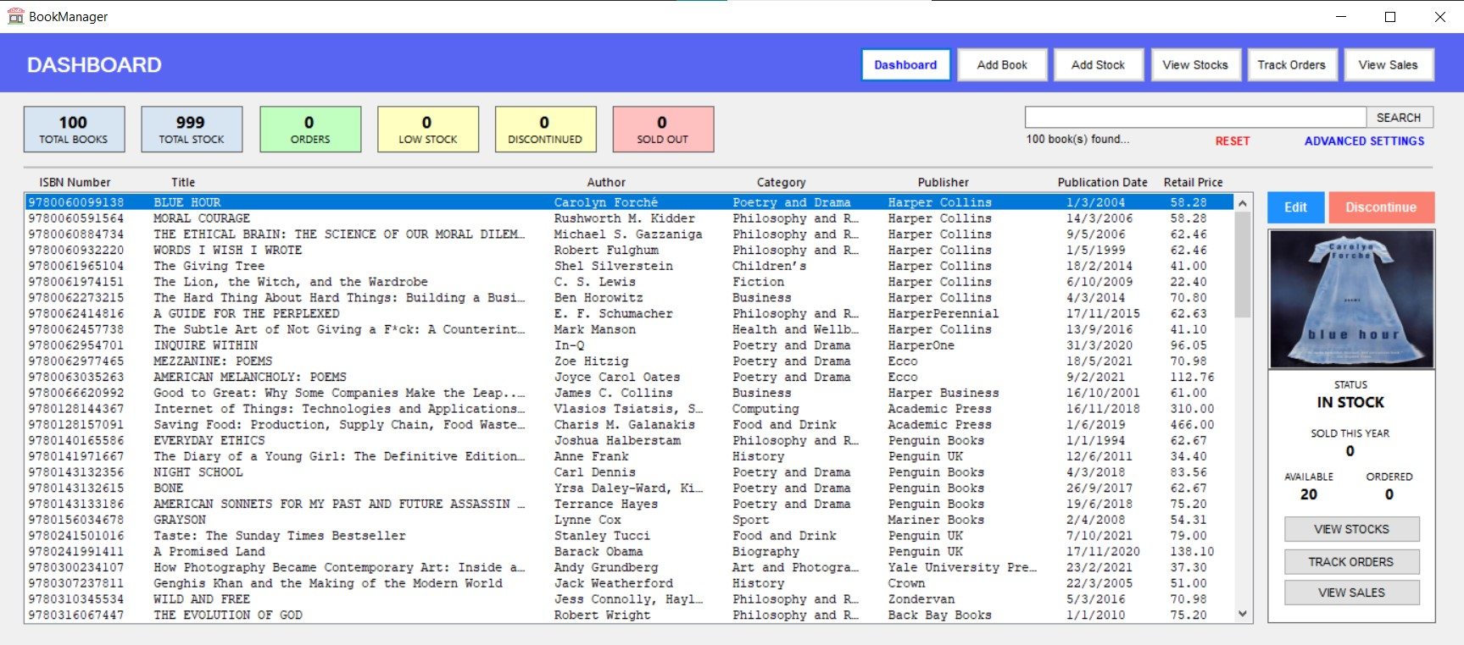
01
Dashboard

Slide 5
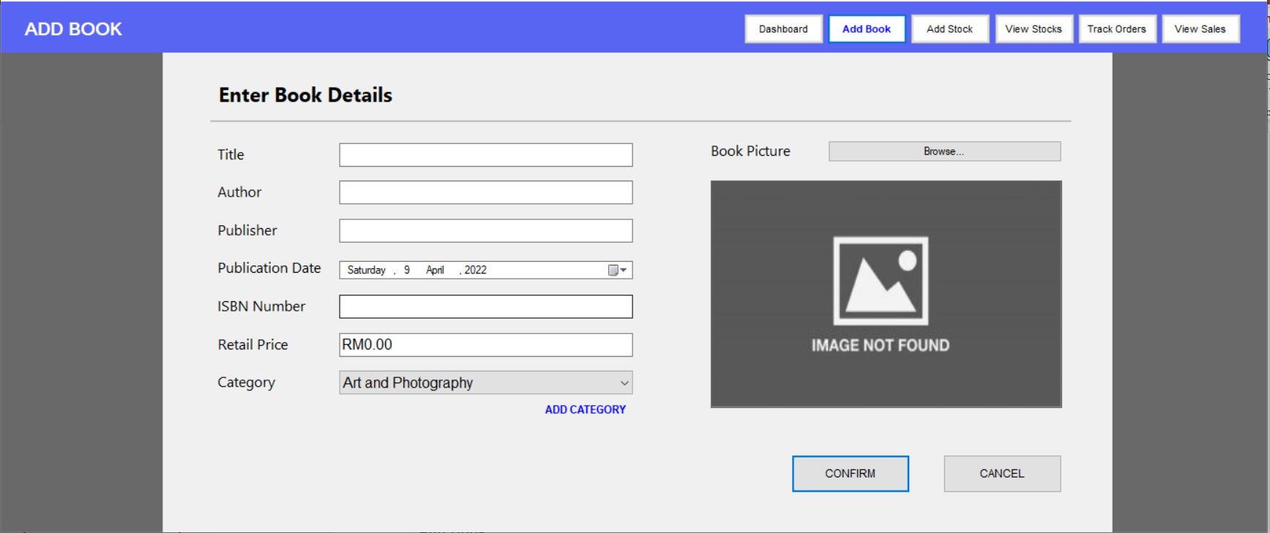
02
Add Book

Slide 6
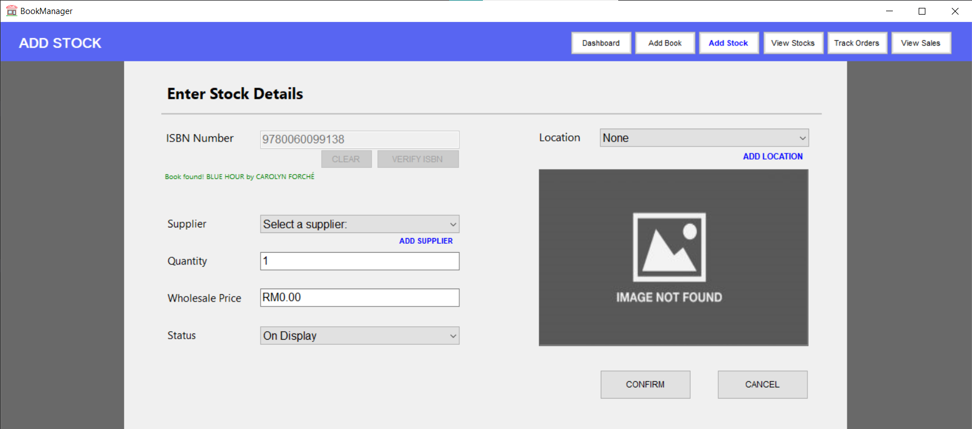
03
Add Stock

Slide 7
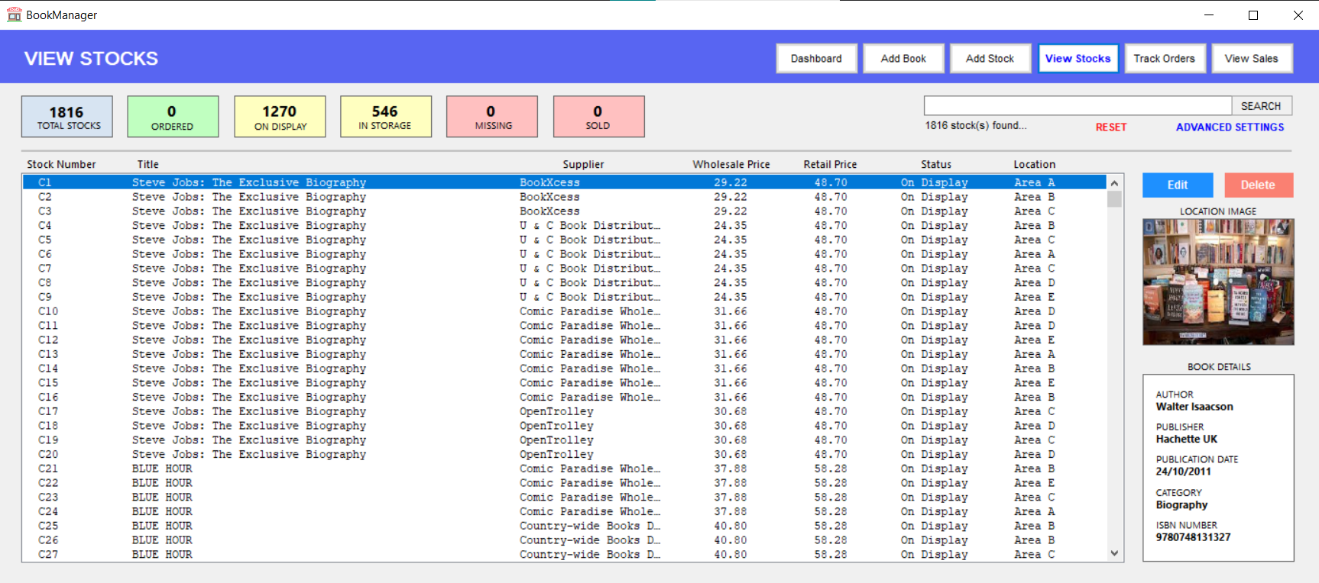
04
View Stocks

Slide 8
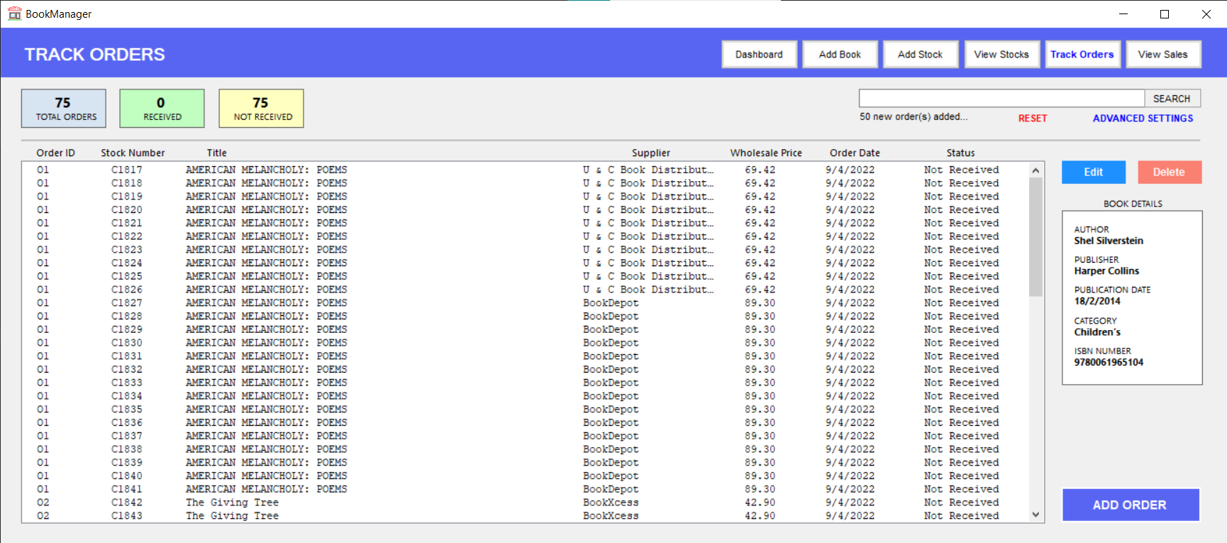
05
Track Orders

Slide 9
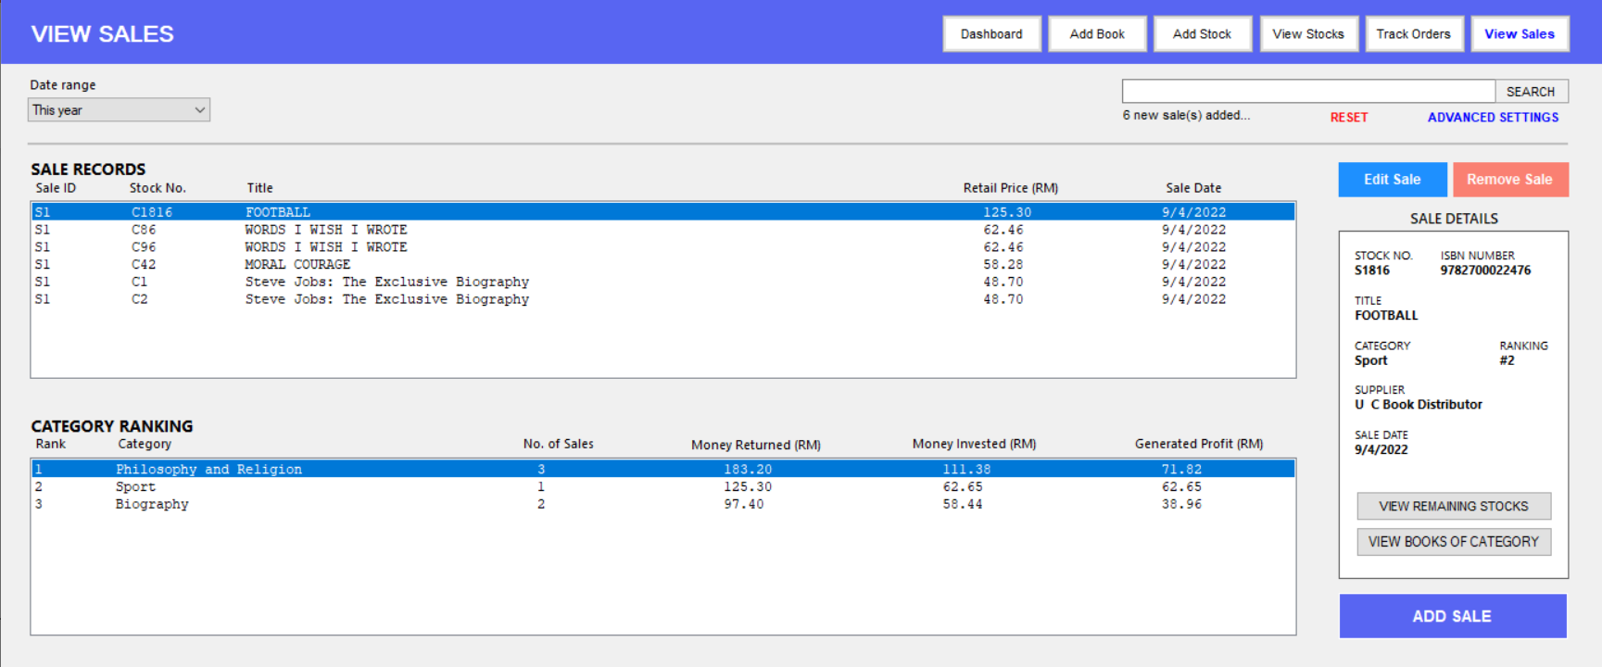
06
View Sales

Slide 10
Justification of UI Design
(based on Nielsen’s 5 Usability Components)
!
EFFICIENCY
LEARNABILITY
MEMORABILITY
SATISFACTION
ERRORS
Strategic placements of frequently used action buttons allow users to choose an action without requiring excessive mouse movements.
Additional hints given when making inputs, such as in the Track Orders and View Sales panel allow users to correct and learn from their mistakes
Consistent page layouts leaves a deeper impression of the program to users, allowing users to memorize and adapt to layouts of other functions in the program much more easily
Attempts to streamline the book recording process by putting the features of the program in a chronological sequence, starting from viewing available books to tracking orders and sales
Reduces the possibilities of errors by validating inputs in real time and provide insightful error messages.

Slide 11

JUSTIFICATION OF DATABASE DESIGN
Breaking down the data handling system

Slide 12
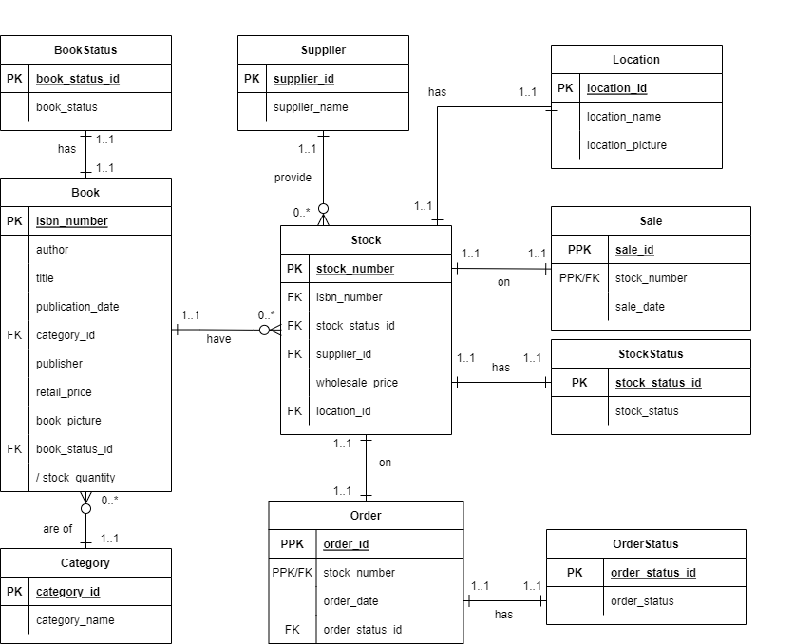
Entity Relationship Diagram (ERD)
Database Information
10 tables in total.
6 strong entities that are independent on other tables and serves to eliminate redundancy
4 weak entities that mainly keeps track of book and business data
Database Relationship
Tables relate to each other by PKs and FKs
Many-to-many relationships are eliminated.

Slide 13


PROBLEMS DURING DEVELOPMENT
Some issues encountered during the process

Slide 14

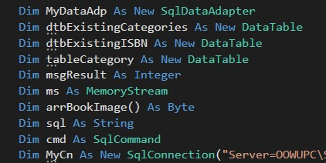
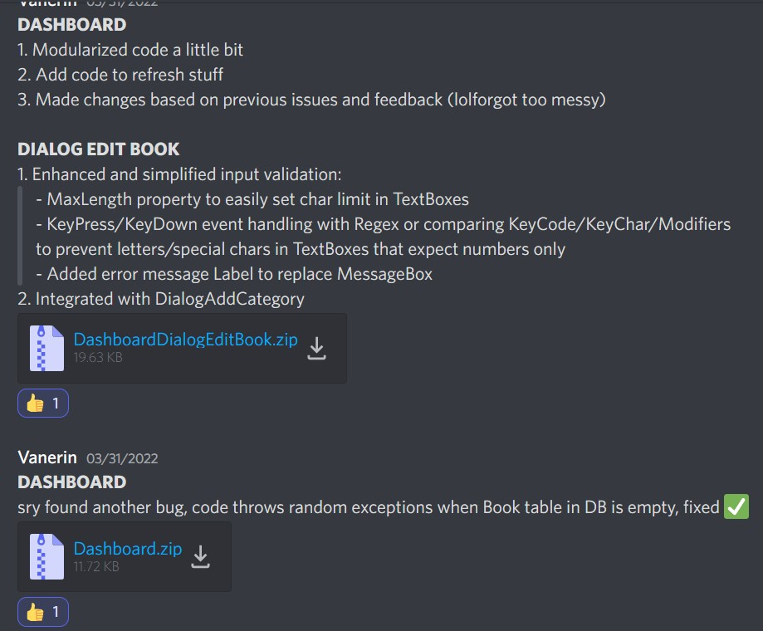
Problems Encountered During Development
01
02
03
Issue with DB connection strings
Integration difficulties
Endless bugs
The DB connection string used in forms that queries data from the database needs to be changed every time program files are transferred between computers
Difficult to standardize algorithms and maintain code quality due to program files being done by different team members
Bugs were encountered in the program frequently and fixes were made in multiple phases, mixing up correct program versions and causing confusion.

Slide 15

PROGRAM STRENGTHS & WEAKNESSES
Everything has its pros and cons

Slide 16
Strengths & Weaknesses Of The Program
User Friendly Features
Occasionally Slow Performance
The program provides convenient alternatives for certain features for efficiency and flexibility.
Some features and processes in the program can sometimes be slow in terms of performance (e.g., refreshing whole form).
Proper Error Handling
STRENGTHS
WEAKNESSES
Memory Usage
The program ensures that errors are always caught and notifies the user when an error occurs.
The program may have considerably high memory usage due to the amount of loaded data.
Ease of Use
Inconsistency in Implementations
Primary features in the program are developed in a way that reduces manual work or extra efforts (e.g., real-time input validation).
Certain similar functions or procedures in the program are implemented differently, which may cause integration or scalability issues.

Slide 17

Conclusion
The program fulfills the project requirements and reaches a decent standard of UI design. Every member’s contributions were imperative to the completion of the project. However, there are many things that can be improved, and mistakes or issues that the development team should learn from. For example:
Lack consideration of performance optimization and memory usage
Lack standardization of coding style
Poor version control methods

Slide 18
THANK YOU
Hope you enjoyed our presentation!

