Slide 1

Lesson 4
Android Activity Life Cycle

Slide 2
What is the Activity Lifecycle?
The set of states an Activity can be in during its lifetime, from when it is created until it is destroyed
More formally:
A directed graph of all the states an Activity can be in, and the callbacks associated with transitioning from each state to the next one

Slide 3
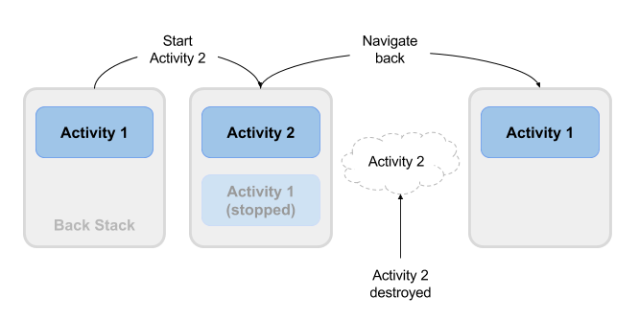
What is the Activity Lifecycle?

Slide 4
Activity states and app visibility
Created (not visible yet)
Started (visible)
Resume (visible)
Paused(partially invisible)
Stopped (hidden)
Destroyed (gone from memory)
State changes are triggered by user action, configuration changes such as device rotation, or system action

Slide 5
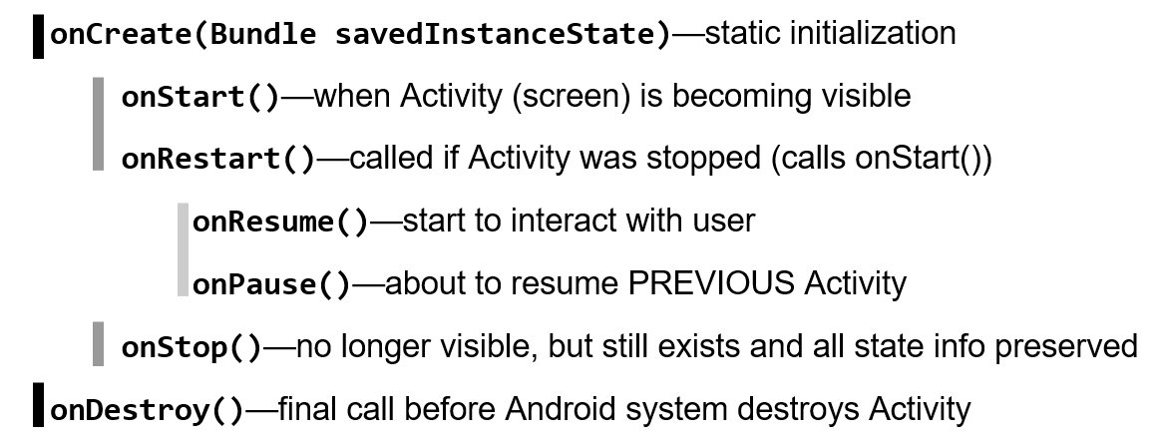
Callbacks and when they are called

Slide 6
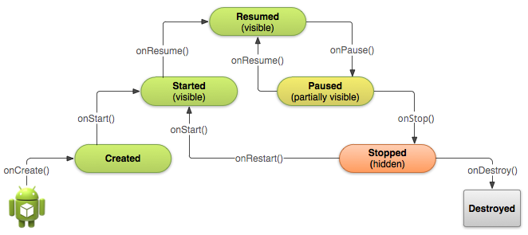
Activity states and callbacks graph

Slide 7
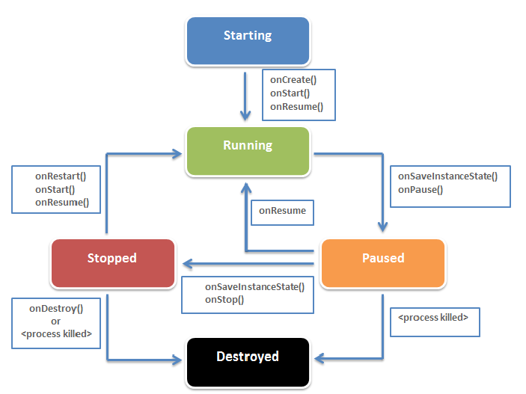
Activity Life Cycle

Slide 8
Another Activity Life Cycle

Slide 9
Implementing and overriding callbacks
Only onCreate() is required
Override the other callbacks to change default behavior

Slide 10
onCreate() –> Created
Called when the Activity is first created, for example when user taps launcher icon
Does all static setup: create views, bind data to lists, ...
Only called once during an activity's lifetime
Takes a Bundle with Activity's previously frozen state, if there was one
Created state is always followed by onStart()

Slide 11
onCreate(Bundle savedInstanceState)
@Override
public void onCreate(Bundle savedInstanceState) {
super.onCreate(savedInstanceState);
// The activity is being created.
}

Slide 12
onStart() –> Started
Called when the Activity is becoming visible to user
Can be called more than once during lifecycle
Followed by onResume() if the activity comes to the foreground, or onStop() if it becomes hidden

Slide 13
onStart()
@Override
protected void onStart() {
super.onStart();
// The activity is about to become visible.
}

Slide 14
onRestart() –> Started
Called after Activity has been stopped, immediately before it is started again
Transient state
Always followed by onStart()

Slide 15
onRestart()
@Override
protected void onRestart() {
super.onRestart();
// The activity is between stopped and started.
}

Slide 16
onResume() –> Resumed/Running
Called when Activity will start interacting with user
Activity has moved to top of the Activity stack
Starts accepting user input
Running state
Always followed by onPause()

Slide 17
onResume()
@Override
protected void onResume() {
super.onResume();
// The activity has become visible
// it is now "resumed"
}

Slide 18
onPause() –> Paused
Called when system is about to resume a previous Activity
The Activity is partly visible but user is leaving the Activity
Typically used to commit unsaved changes to persistent data, stop animations and anything that consumes resources
Implementations must be fast because the next Activity is not resumed until this method returns
Followed by either onResume() if the Activity returns back to the front, or onStop() if it becomes invisible to the user

Slide 19
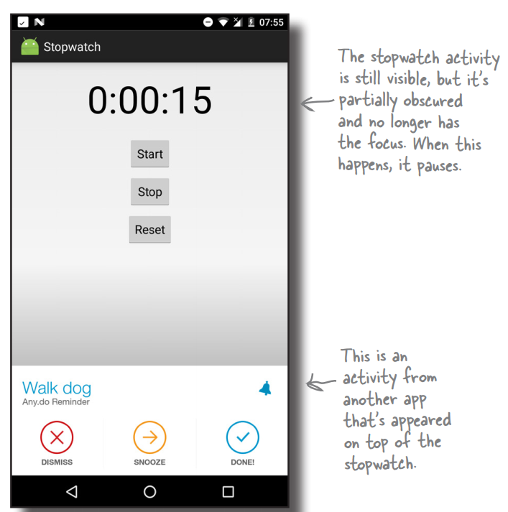
onPause() –> Paused

Slide 20
onPause()
@Override
protected void onPause() {
super.onPause();
// Another activity is taking focus
// this activity is about to be "paused"
}
Any resources and data retrieved in onResume() should be released in onPause()! If they aren’t, some resources may not be cleanly released if the process is terminated!

Slide 21
onStop() –> Stopped
Called when the Activity is no longer visible to the user
New Activity is being started, an existing one is brought in front of this one, or this one is being destroyed
Operations that were too heavy-weight for onPause()
Followed by either onRestart() if Activity is coming back to interact with user, or onDestroy() if Activity is going away

Slide 22
onStop()
@Override
protected void onStop() {
super.onStop();
// The activity is no longer visible
// it is now "stopped"
}

Slide 23
onDestroy() –> Destroyed
Final call before Activity is destroyed
User navigates back to previous Activity, or configuration changes
Activity is finishing or system is destroying it to save space
Call isFinishing() method to check
System may destroy Activity without calling this, so use onPause() or onStop() to save data or state

Slide 24
onDestroy()
@Override
protected void onDestroy() {
super.onDestroy();
// The activity is about to be destroyed.
}

Slide 25
Destroying Static Activity Data in onDestroy()
The onDestroy() method is called for one of two reasons:
The Activity completed its lifecycle voluntarily.
The Activity is being killed by the OS because it needs the resources (but still has the time to gracefully destroy your Activity).

Slide 26
Avoiding Activities Being Killed
If the Activity is killed after onPause(), the onStop() and onDestroy() methods will not be called.
The more resources released by an Activity in the onPause() method, the less likely the Activity is to be killed while in the background without further state methods being called.

Slide 27
Avoiding Activities Being Killed
Under low-memory conditions, the Android operating system can kill the process for any Activity that has been paused, stopped, or destroyed.
The act of killing an Activity does not remove it from the Activity stack.
Instead, the Activity state is saved into a Bundle object, assuming the Activity implements and uses onSaveInstanceState() for custom data, although some View data is automatically saved.
When the user returns to the Activity later, the onCreate() method is called again, this time with a valid Bundle object as the parameter.

Slide 28
When does config change?
Configuration changes invalidate the current layout or other resources in your activity when the user:
Rotates the device
Chooses different system language, so locale changes
Enters multi-window mode (from Android 7)

Slide 29
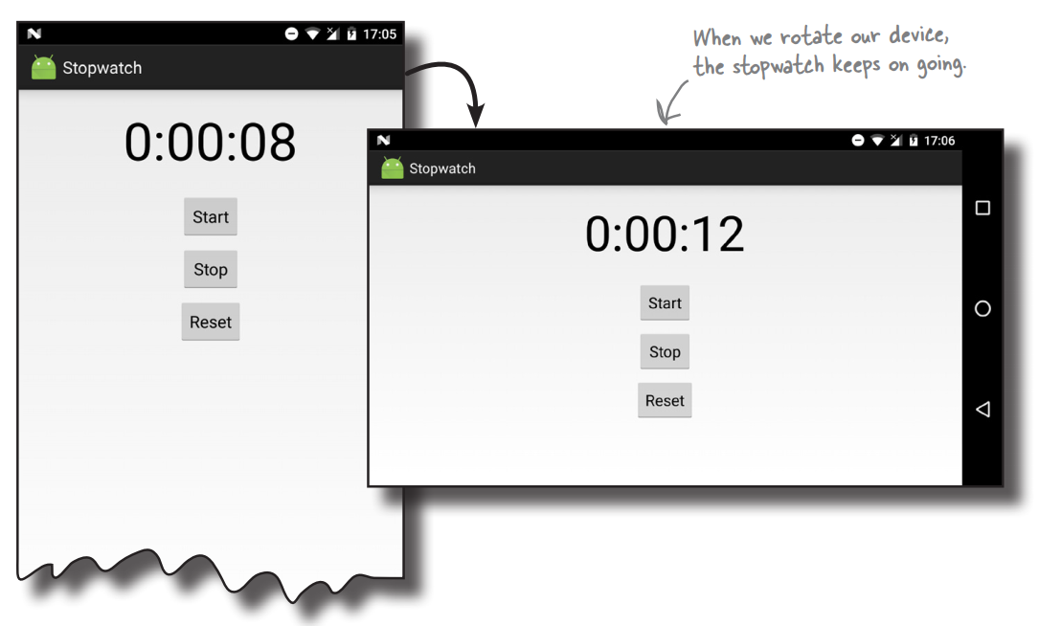
When does config change?

Slide 30
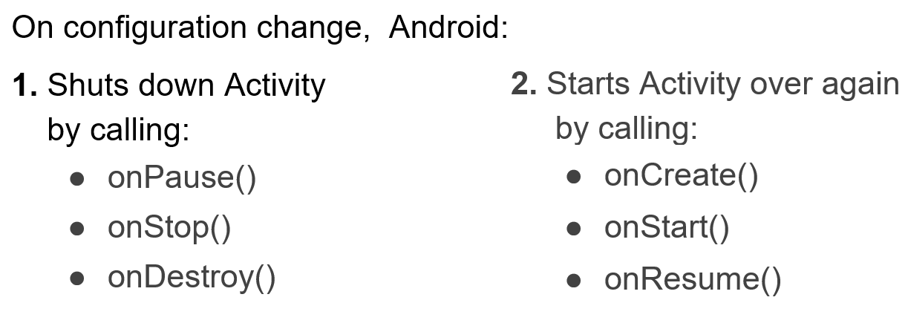
What happens on config change?

Slide 31
Activity instance state
State information is created while the Activity is running, such as a counter, user text, animation progression
State is lost when device is rotated, language changes, back-button is pressed, or the system clears memory

Slide 32
Saving and restoring Activity state
System saves only:
State of views with unique ID (android:id) such as text entered into EditText
Intent that started activity and data in its extras
You are responsible for saving other activity and user progress data

Slide 33
Saving instance state
Implement onSaveInstanceState() in your Activity
Called by Android runtime when there is a possibility the Activity may be destroyed
Saves data only for this instance of the Activity during current session

Slide 34
Saving instance state
If an Activity is vulnerable to being killed by Android, you can save state info to a Bundle with onSaveInstanceState().
This call is not guaranteed, so use onPause() for essential data commits.
What is recommended?
Save important data to persistent storage in onPause(), but use onSaveInstanceState() to start any data that can be used to rapidly restore the current screen to the state it was in (as the name of the method might imply) .

Slide 35
onSaveInstanceState(Bundle outState)
@Override
public void onSaveInstanceState(Bundle outState) {
super.onSaveInstanceState(outState);
// Add information for saving HelloToast counter
// to the to the outState bundle
outState.putString("count",
String.valueOf(mShowCount.getText()));
}

Slide 36
Restoring instance state
Two ways to retrieve the saved Bundle
in onCreate(Bundle mySavedState) Preferred, to ensure that your user interface, including any saved state, is back up and running as quickly as possible
Implement callback (called after onStart()) onRestoreInstanceState(Bundle mySavedState)

Slide 37
Restoring in onCreate()
@Override
protected void onCreate(Bundle savedInstanceState) {
super.onCreate(savedInstanceState);
setContentView(R.layout.activity_main);
mShowCount = findViewById(R.id.show_count);
if (savedInstanceState != null) {
String count =
savedInstanceState.getString("count");
if (mShowCount != null)
mShowCount.setText(count);
}
}

Slide 38
onRestoreInstanceState(Bundle state)
@Override
public void onRestoreInstanceState (Bundle mySavedState) {
super.onRestoreInstanceState(mySavedState);
if (mySavedState != null) {
String count =
mySavedState.getString("count");
if (count != null)
mShowCount.setText(count);
}
}

Slide 39
Instance state and app restart
When you stop and restart a new app session, the Activity instance states are lost and your activities will revert to their default appearance
If you need to save user data between app sessions, use shared preferences or a database.

Slide 40
Bugs
Incorrect or unexpected result, wrong values
Crashes, exceptions, freezes, memory leaks
Causes
Human Design or Implementation Error > Fix your code
Software fault, but in libraries > Work around limitation
Hardware fault or limitation -> Make it work with what's available
Origin of the term "bug" (it's not what you think)

Slide 41
Debugging
Find and fix errors
Correct unexpected and undesirable behavior
Unit tests help identify bugs and prevent regression
User testing helps identify interaction bugs

Slide 42
Android Studio debugging tools
Android Studio has tools that help you
identify problems
find where in the source code the problem is created
so that you can fix it

Slide 43
Logging with Android Studio
Use the LogCat system for logging messages when your app changes states:
analogous to System.out.println debugging for Android apps
appears in the LogCat console in Android Studio

Slide 44
Add Log messages to your code
import android.util.Log;
// Use class variable with class name as tag
private static final String TAG = MainActivity.class.getSimpleName();
// Show message in Logcat pane of Android Studio
// Log.<log-level>(TAG, "Message");
Log.d(TAG, “Hello World”);

Slide 45
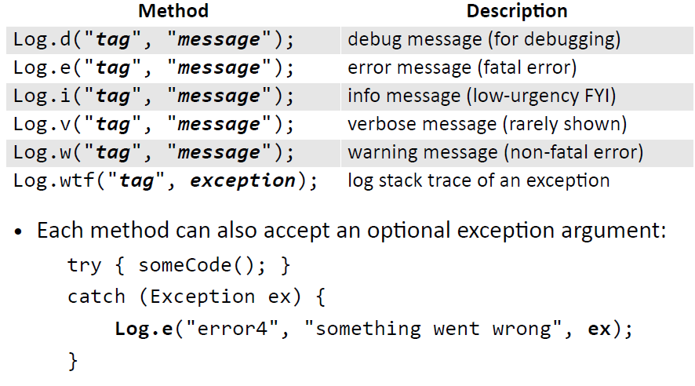
Log Methods

Slide 46
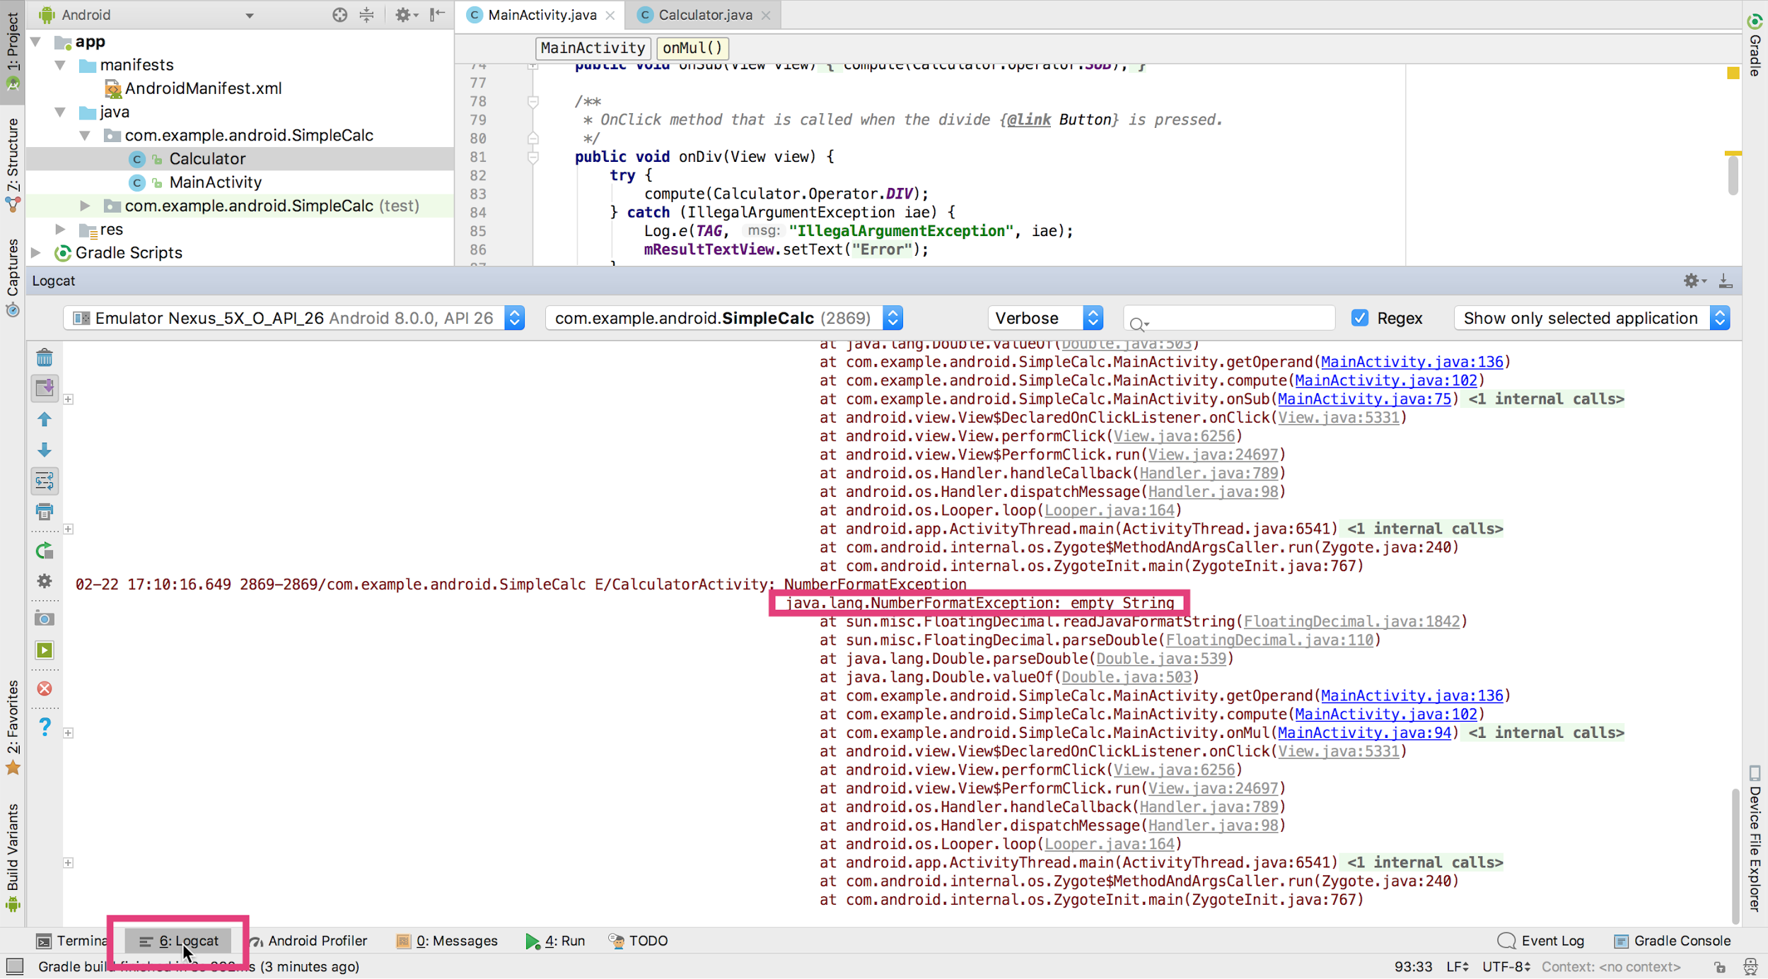
Open Logcat pane
Logcat
pane
Logcat tab

Slide 47
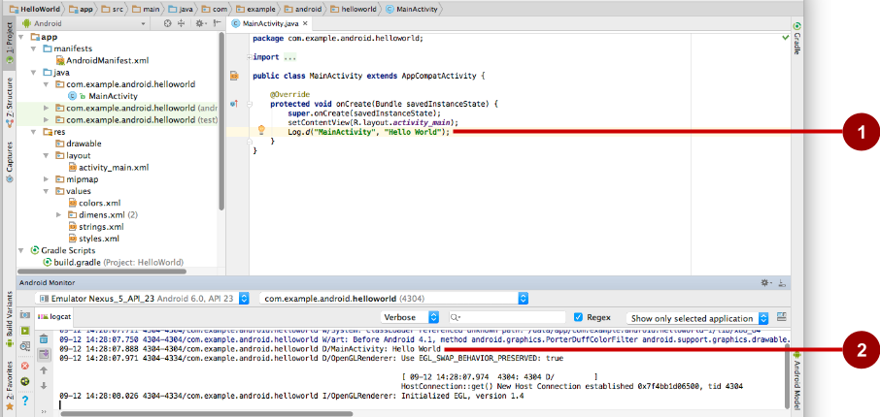
Inspect logging messages
Log.d("MainActivity", "Hello World");
09-12 14:28:07.971 4304 /com.example.android.helloworld D/MainActivity: Hello World

Slide 48
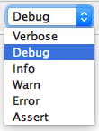
Choose visible logging level
Displays logs with levels at this level or higher

Slide 49
Learn More
Activities (API Guide)
Activity (API Reference)
Managing the Activity Lifecycle
Pausing and Resuming an Activity
Stopping and Restarting an Activity
Recreating an Activity
Handling Runtime Changes
Bundle

Slide 50
END
Questions?

