Slide 1

Lesson 10
Activities and Intent

Slide 2
What is an Activity?
An Activity is an application component
Represents one window, one hierarchy of views
Typically fills the screen, but can be embedded in other Activity or a appear as floating window
Java class, typically one Activity in one file

Slide 3
What is an Activity?
An activity uses the setContentView(...) method to show a given UI.
Activities interact with each other in an asynchronous mode.
An Activity typically has a UI layout
Layout is usually defined in one or more XML files
Activity "inflates" layout as part of being created

Slide 4
What does an Activity do?
Represents an activity, such as ordering groceries, sending email, or getting directions
Handles user interactions, such as button clicks, text entry, or login verification
Can start other activities in the same or other apps
Has a life cycle—is created, started, runs, is paused, resumed, stopped, and destroyed

Slide 5
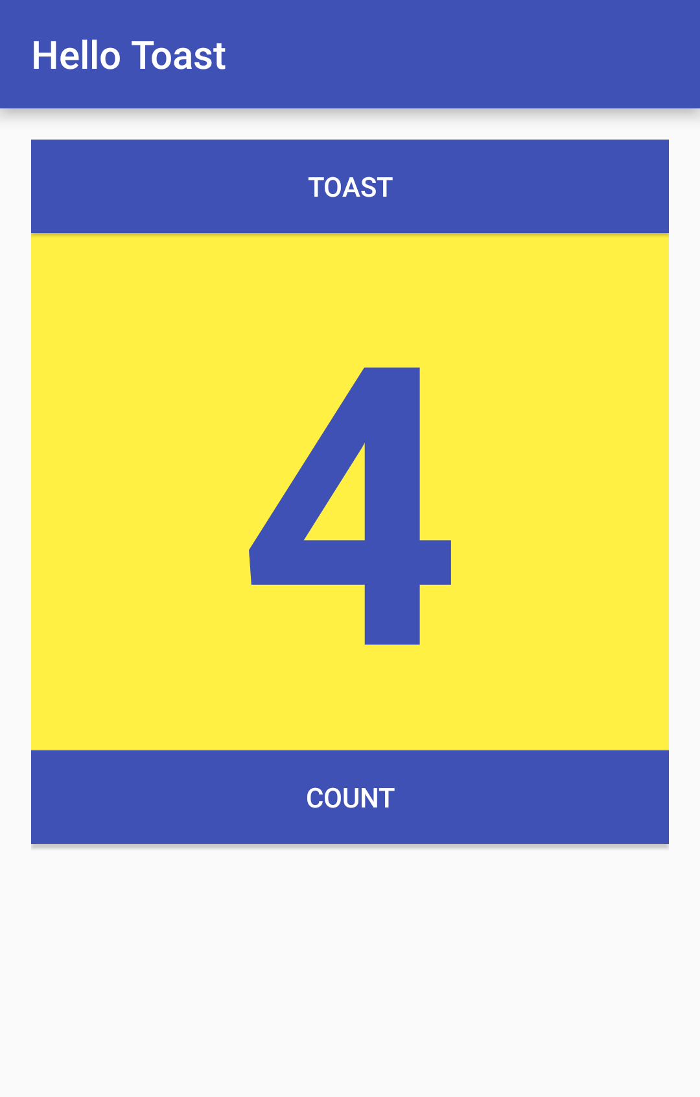
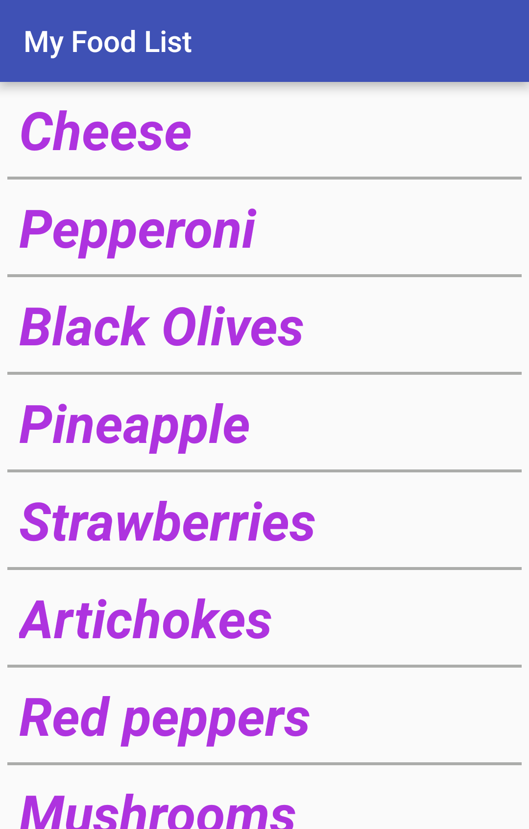
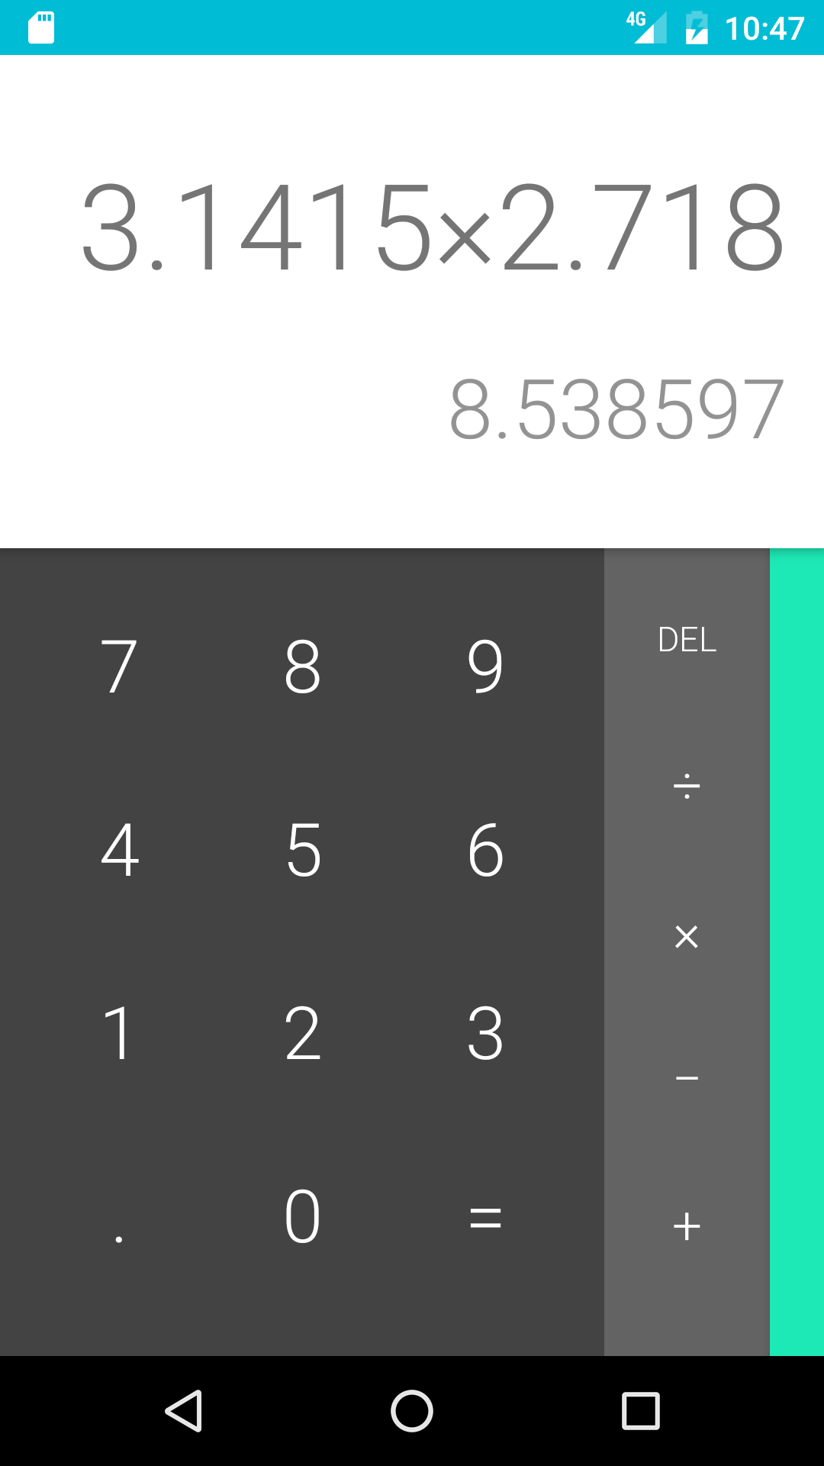
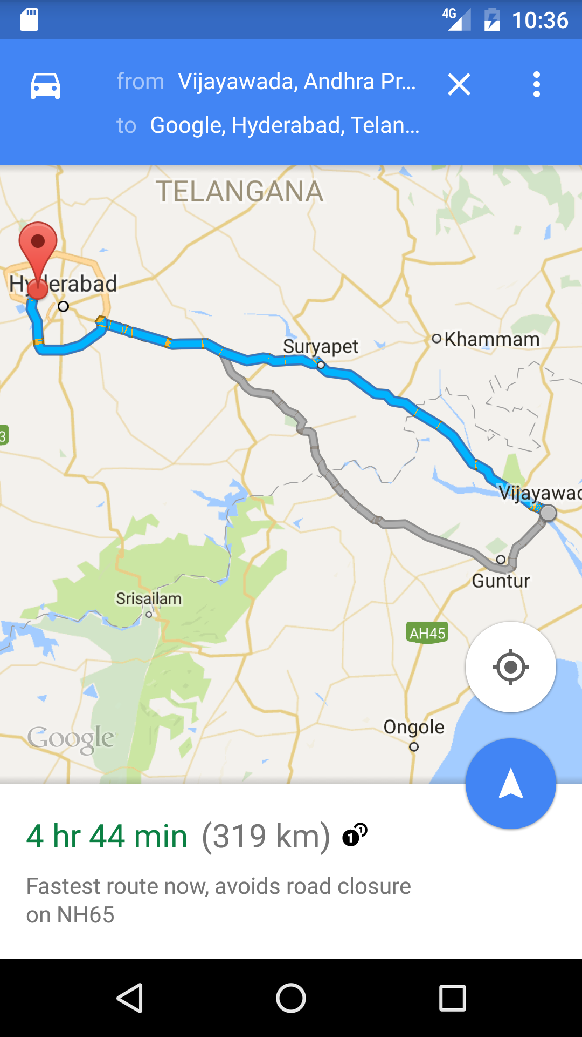
Examples of Activities

Slide 6
Implement new activities
Define layout in XML
Define Activity Java class
extends AppCompatActivity
Connect Activity with Layout
Set content view in onCreate()
Declare Activity in the Android manifest

Slide 7
Define layout in XML
<?xml version="1.0" encoding="utf-8"?>
<RelativeLayout
xmlns:android="http://schemas.android.com/apk/res/android"
android:layout_width="match_parent"
android:layout_height="match_parent">
<TextView
android:layout_width="wrap_content"
android:layout_height="wrap_content"
android:text="Let's Shop for Food!" />
</RelativeLayout>

Slide 8
Define Activity Java class
public class MainActivity extends AppCompatActivity {
@Override
protected void onCreate(Bundle savedInstanceState) {
super.onCreate(savedInstanceState);
}
}

Slide 9
Connect activity with layout
public class MainActivity extends AppCompatActivity {
@Override
protected void onCreate(Bundle savedInstanceState) {
super.onCreate(savedInstanceState);
setContentView(R.layout.activity_main);
}
}
Resource
is layout
in this XML file

Slide 10
Declare activity in Android manifest
Each Activity within the application must be defined with an <activity> tag.
<activity android:name=".MainActivity">

Slide 11
Declare main activity in manifest
MainActivity needs to include intent-filter to start from launcher
<activity android:name=".MainActivity">
<intent-filter>
<action android:name="android.intent.action.MAIN" />
<category
android:name="android.intent.category.LAUNCHER" />
</intent-filter>
</activity>

Slide 12
What is an intent?
An Intent is a description of an operation to be performed.
An Intent is an object used to request an action from another app component via the Android system.
Originator
App component
Intent
Action
Android System

Slide 13
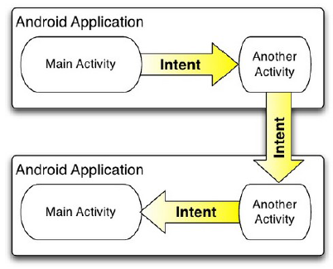
What is an intent?

Slide 14
What can intents do?
Start an Activity
A button click starts a new Activity for text entry
Clicking Share opens an app that allows you to post a photo
Start an Service
Initiate downloading a file in the background
Deliver Broadcast
The system informs everybody that the phone is now charging

Slide 15
Explicit and implicit intents
Explicit Intent
Starts a specific Activity
Request tea with milk delivered by Nikita
Main activity starts the ViewShoppingCart Activity
Implicit Intent
Asks system to find an Activity that can handle this request
Find an open store that sells green tea
Clicking Share opens a chooser with a list of apps

Slide 16
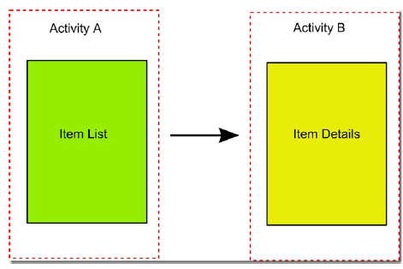
Multiple Activities
Many apps have multiple activities.
Example: In an address book app, the main activity is a list of contacts, and clicking on a contact goes to another activity for viewing details.
An activity A can launch another activity B in response to an event.
The activity A can pass data to B.
The second activity B can send data back to A when it is done.

Slide 17
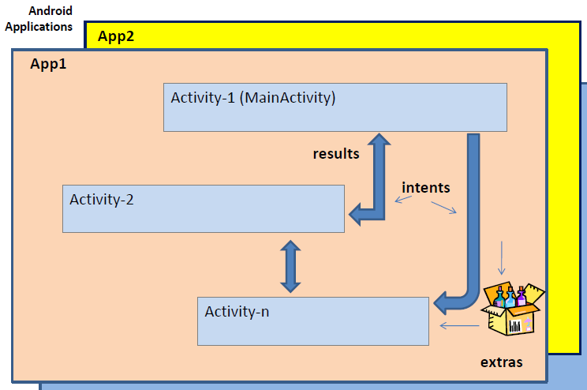
Multiple Activities
Activities call each other using Intents. An intent may include basic and extra data elements. The called activity may return a result to the caller.

Slide 18
Start an Activity with an explicit intent
To start a specific Activity, use an explicit Intent
Create an Intent
Intent intent = new Intent(this, ActivityName.class);
Use the Intent to start the Activity
startActivity(intent);

Slide 19
Two types of sending data with
Data—one piece of information whose data location can be represented by an URI
Extras—one or more pieces of information as a collection of key-value pairs in a Bundle

Slide 20
Sending and retrieving data
In the first (sending) Activity:
Create the Intent object
Put data or extras into that Intent
Start the new Activity with startActivity()
In the second (receiving) Activity:
Get the Intent object, the Activity was started with
Retrieve the data or extras from the Intent object

Slide 21
Putting a URI as intent data
// A web page URL
intent.setData(
Uri.parse("http://www.google.com"));
// a Sample file URI
intent.setData(
Uri.fromFile(new File("/sdcard/sample.jpg")));

Slide 22
Put information into intent extras
putExtra(String name, int value) ⇒ intent.putExtra("level", 406);
putExtra(String name, String[] value) ⇒ String[] foodList = {"Rice", "Beans", "Fruit"}; intent.putExtra("food", foodList);
putExtras(bundle); ⇒ if lots of data, first create a bundle and pass the bundle.

Slide 23
Sending data to an activity with extras
public static final String EXTRA_MESSAGE_KEY = "com.example.android.twoactivities.extra.MESSAGE";
Intent intent = new Intent(this, SecondActivity.class);
String message = "Hello Activity!";
intent.putExtra(EXTRA_MESSAGE_KEY, message);
startActivity(intent);

Slide 24
Get data from intents
getData(); ⇒ Uri locationUri = intent.getData();
int getIntExtra (String name, int defaultValue) ⇒ int level = intent.getIntExtra("level", 0);
Bundle bundle = intent.getExtras(); ⇒ Get all the data at once as a bundle.

Slide 25
Returning data to the starting activity
In order for SecondActivity to be able to return data to MainActivity, SecondActivity must be started as a sub-activity of MainActivity.
This means that we need to call registerForActivityResult() and declare a callback handler to be called when SecondActivity returns.

Slide 26
registerForActivityResult()
registerForActivityResult() takes an ActivityResultContract and an ActivityResultCallback and returns an ActivityResultLauncher which you’ll use to launch the other activity

Slide 27
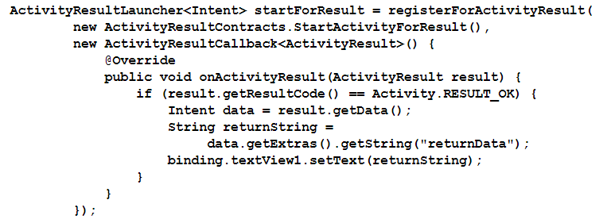
registerForActivityResult() Example

Slide 28
Return data and finish second
In the SecondActivity, we have to implement the finish() method.
The finish() method is triggered when an activity exits.

Slide 29
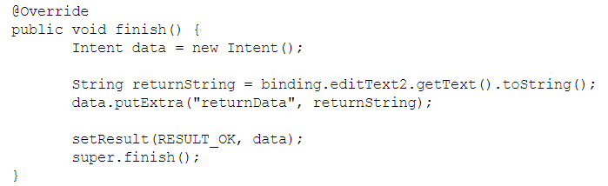
Sending back a result

Slide 30
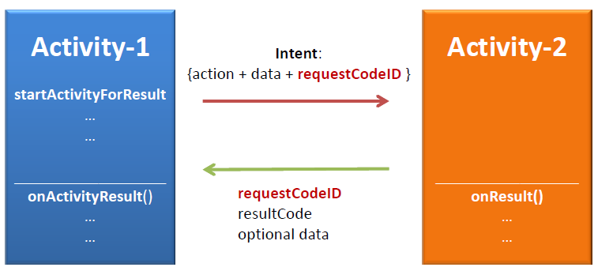
Starting Activities and Getting Results

Slide 31
Implicit Intent
implicit intent: One that launches another app, without naming that specific app, to handle a given type of request or action.
examples: invoke default browser; load music player to play a song

Slide 32
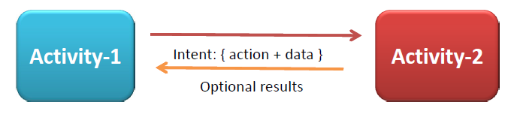
Implicit Intent
The two main components of an Intent are:
Action The built-in action to be performed, such as ACTION_VIEW, ACTION_EDIT, ACTION_CALL, ACTION_SENDTO,... or a user-created-activity
Data Basic argument needed by the intent to work. For instance: a phone number to be called , a picture to be shown, a message to be sent, etc.

Slide 33
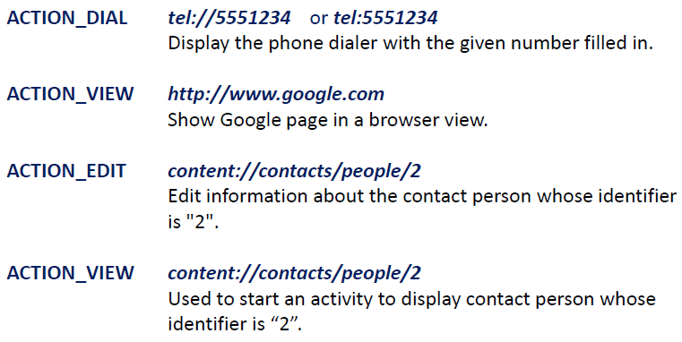
Implicit Intent
Examples of action/data pairs:

Slide 34
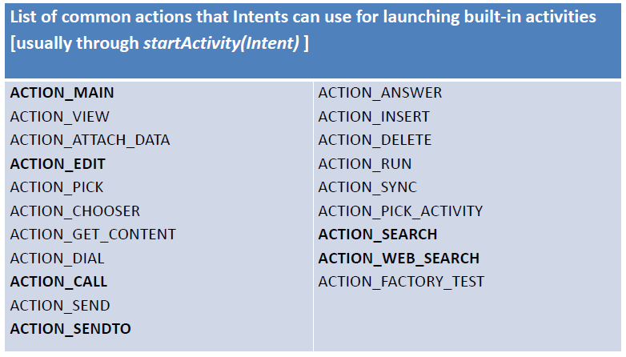
Implicit Intent
Common Built-in Android Actions

Slide 35
Implicit Intent
Data is supplied as an URI, i.e. a string whose prefix indicates the composition of the data item. For instance:
tel://,
http://,
mailto://,
file://,
content://,
geo:,
audio/,
media/,
vnd.android.cursor.dir

Slide 36
Start an Activity with implicit intent
To ask Android to find an Activity to handle your request, use an implicit Intent
Create an Intent
Intent intent = new Intent(action, uri);
Use the Intent to start the Activity
startActivity(intent);

Slide 37
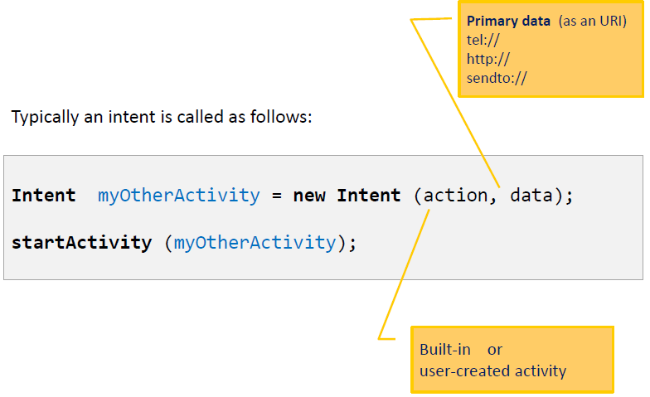
Start an Activity with implicit intent

Slide 38
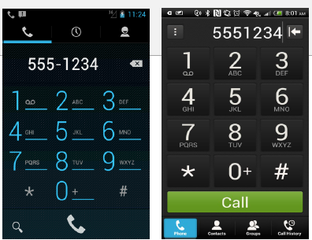
Implicit Intent
ACTION_DIAL Display the phone dialer with the given number filled in.
String myPhoneNumberUri = "tel:555-1234";
Intent myActivity2 = new Intent(Intent.ACTION_DIAL,
Uri.parse(myPhoneNumberUri));
startActivity(myActivity2);

Slide 39

Implicit Intent
Placing an immediate phone call
String myData = "tel:555-1234";
Intent myActivity2 = new Intent(Intent.ACTION_CALL,
Uri.parse(myData));
startActivity(myActivity2);
Needs Permission:
<uses-permission android:name="android.permission.CALL_PHONE" />

Slide 40

Implicit Intent
Passing a string as an Extra argument for a Google Search. The string is a ‘human’ query with keywords.
Intent intent = new Intent(Intent.ACTION_WEB_SEARCH);
intent.putExtra(SearchManager.QUERY,
"straight hitting golf clubs");
startActivity(intent);

Slide 41
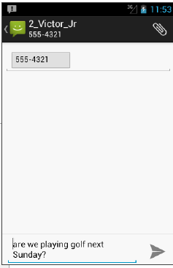
Implicit Intent
Preparing an SMS. The text is supplied as an Extra element. The intent expects such a value to be called “sms_body”
Intent intent = new Intent( Intent.ACTION_SENDTO,
Uri.parse("smsto:555-4321"));
intent.putExtra("sms_body",
"are we playing golf next Sunday?");
startActivity(intent);

Slide 42
Implicit Intent
Displaying the pictures contained in the device’s external storage. The content to be sought is determined by the MIME type given in .setType(…)
Intent intent = new Intent();
intent.setType("image/pictures/*");
intent.setAction(Intent.ACTION_GET_CONTENT);
startActivity(intent);

Slide 43
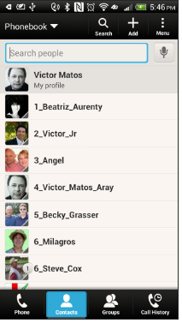
Implicit Intent
Showing all Contacts stored in your device
String myData = "content://contacts/people/";
Intent myActivity2 = new Intent(Intent.ACTION_VIEW,
Uri.parse(myData));
startActivity(myActivity2);

Slide 44
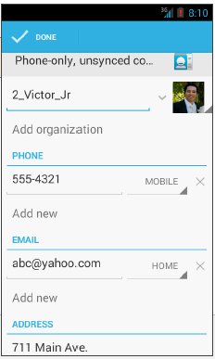
Implicit Intent
Select a particular person (ID 2) from the contact list for editing purposes.
String myData = ContactsContract.Contacts
.CONTENT_URI + "/" + "2";
Intent myActivity2 = new
Intent(Intent.ACTION_EDIT,
Uri.parse(myData));
startActivity(myActivity2);

Slide 45
Implicit Intent
Viewing a web page. The user provides a valid URL pointing to the page.
String myUriString = "http://www.youtube.com";
Intent myActivity2 = new Intent(Intent.ACTION_VIEW,
Uri.parse(myUriString));
startActivity(myActivity2);
Caution. Must add to the Manifest a request for permission to use the Internet:
<uses-permission android:name="android.permission.INTERNET" />

Slide 46
Implicit Intent
Provide a GeoCode holding latitude and longitude (also an addittional zoom ‘&z=xx’ with xx in range 1..23 )
// map is centered aroung given Lat, Long
String geoCode = "geo:41.5020952,-81.6789717&z=16";
Intent intent = new Intent(Intent.ACTION_VIEW,
Uri.parse(geoCode));
startActivity(intent);
Modify the Manifest adding the following requests:
<uses-permission android:name="android.permission.ACCESS_COARSE_LOCATION" />
<uses-permission android:name="android.permission.INTERNET" />

Slide 47
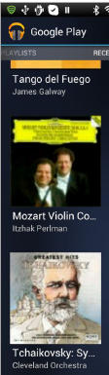
Implicit Intent
Launching Music Player
Intent myActivity2 = new Intent(
"android.intent.action.MUSIC_PLAYER");
startActivity(myActivity2);

Slide 48
Implicit Intent
Sending Email
// send email
String emailSubject = "Department Meeting";
String emailText = "We’ll discuss the new project "
+ "on Tue. at 9:00am @ room 303";
String[] emailReceiverList = {“kmlai@kdupg.edu.my"};
Intent intent = new Intent(Intent.ACTION_SEND);
intent.setType("vnd.android.cursor.dir/email");
intent.putExtra(Intent.EXTRA_EMAIL, emailReceiverList);
intent.putExtra(Intent.EXTRA_SUBJECT, emailSubject);
intent.putExtra(Intent.EXTRA_TEXT, emailText);
startActivity(Intent.createChooser(intent,
"To complete action choose:"));

Slide 49
Learn more
Android Application Fundamentals
Starting Another Activity
Activity (API Guide)
Activity (API Reference)
Intents and Intent Filters (API Guide)
Intent (API Reference)
Navigation

