Slide 1

Lesson 9
ListView & RecyclerView in Android

Slide 2
List-Based Widgets
RadioButtons and CheckButtons are widgets suitable for selecting options offered by a small set of choices.
When the set of values to choose from is large, other Android List-Based Widgets are more appropriate.
Example of List-Based Widgets:
ListViews,
Spinner,
GridView
Image Gallery
ScrollViews, etc.
RecyclerView

Slide 3
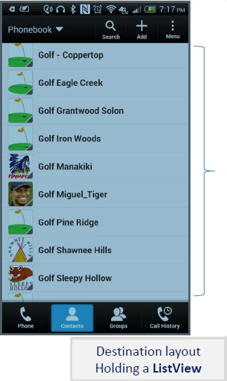
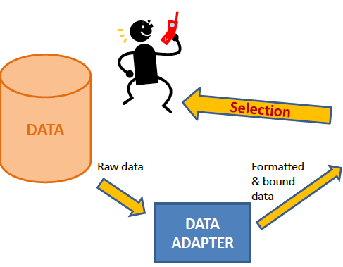
List-Based Widgets
The Android DataAdapter class is used to feed a collection of data items to a List-Based Widget.
The Adapter ‘s raw data may come from a variety of sources, such as small arrays as well as large databases.

Slide 4
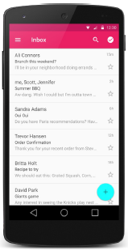
ListView Widget
The Android ListView widget is the most common element used to display data supplied by a data adapter.
ListViews are scrollable, each item from the base data set can be shown in an individual row.
Users can tap on a row to make a selection.
A row could display one or more lines of text as well as images.

Slide 5
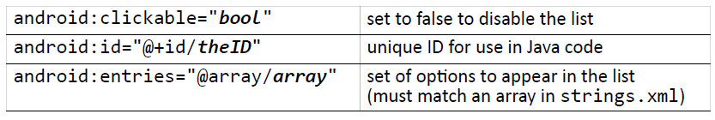
ListView Widget
key attributes in XML:

Slide 6
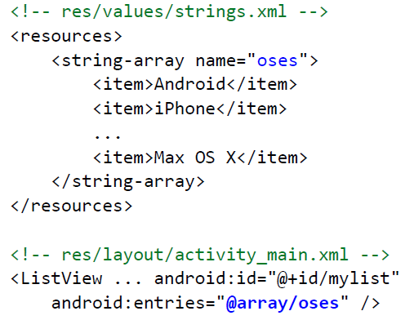
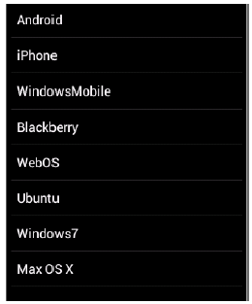
Static Lists
Static list: Content is fixed and known before the app runs.
Declare the list elements in the strings.xml resource file.

Slide 7
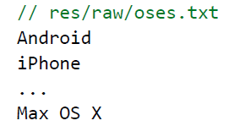
Dynamic Lists
Dynamic list: Content is read or generated as the program runs.
Comes from a data file, or from the internet, etc.
Must be set in the Java code.
Suppose we have the following file and want to make a list from it:

Slide 8
List Adapters
Adapter: Helps turn list data into list view items.
common adapters: ArrayAdapter, CursorAdapter
An ArrayAdapter<T> accepts for input an array (or ArrayList) of objects of some arbitrary type T.
Syntax for creating an adapter:
ArrayAdapter<String> name =
new ArrayAdapter<String>(activity, layout, array);
● the activity is usually this
● the default layout for lists is android.R.layout.simple_list_item_1
● get the array by reading your file or data source of choice
(it can be an array like String[], or a list like ArrayList<String>)

Slide 9
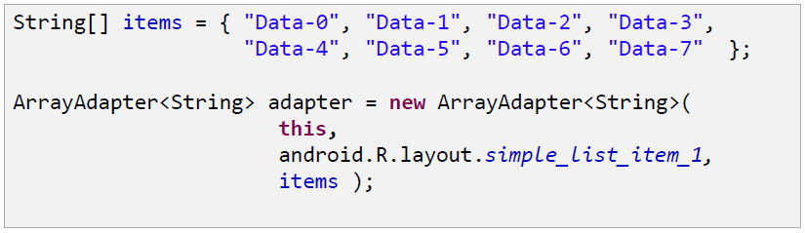
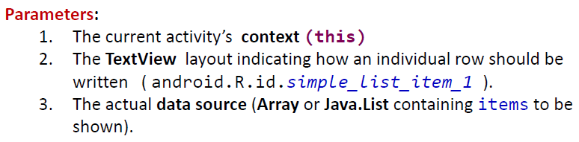
List Adapters
Example of ArrayAdapter:

Slide 10
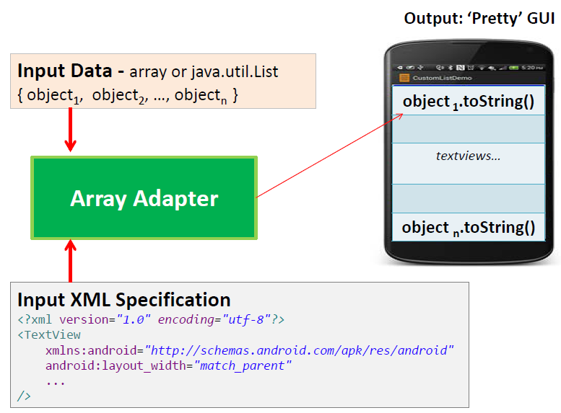
List Adapters

Slide 11
List Adapters
Once you have an adapter, you can attach it to your list by calling the setAdapter method of the ListView object in the Java code.
ListView list = (ListView) findViewById(R.id.mylist);
list.setAdapter(myAdapter);

Slide 12
Handling List Events
Unfortunately lists does not use a simple onClick event.
Several fancier GUI widgets use other kinds of events.
The event listeners must be attached in the Java code, not in the XML.
Understanding how to attach these event listeners requires the use of Java anonymous inner classes.
Anonymous inner class: A shorthand syntax for declaring a small class without giving it an explicit name.
The class can be made to extend a given super class or implement a given interface.
Typically the class is declared and a single object of it is constructed and used all at once.

Slide 13
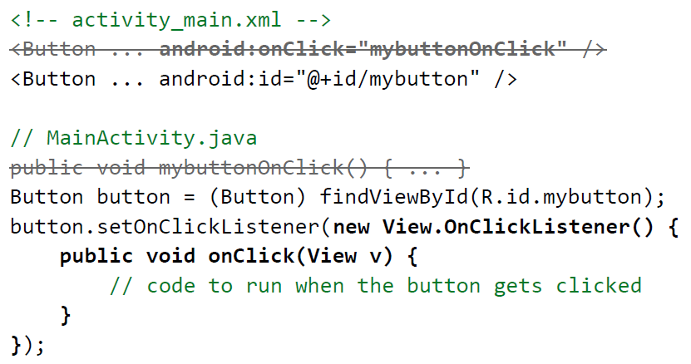
Attaching Event Listener in Java

Slide 14
Handling List Events
List views respond to the following events:
setOnItemClickListener(AdapterView.OnItemClickListener)
Listener for when an item in the list has been clicked.
setOnItemLongClickListener(AdapterView.OnItemLongClickListener)
Listener for when an item in the list has been clicked and held.
setOnItemSelectedListener(AdapterView.OnItemSelectedListener)
Listener for when an item in the list has been selected.
Others:
onDrag, onFocusChanged, onHover,onKey, onScroll, onTouch, ...

Slide 15
List Event Listener Example
ListView list = (ListView) findViewById(R.id.id);
list.setOnItemClickListener(
new AdapterView.OnItemClickListener() {
@Override
public void onItemClick(AdapterView<?> list,
View row, int index, long rowID) {
// code to run when user clicks that item
...
}
}
);

Slide 16
Custom Lists
If you want your list to look different than the default appearance (of just a text string for each line), you must:
Write a short layout XML file describing the layout for each row.
Write a subclass of ArrayAdapter that overrides the getView method to describe what view must be returned for each row.

Slide 17
Custom List – Creating Sub-Class
In order to customize a Data Adapter, you need to:
Create a class extending the concrete ArrayAdapter class
Override its getView(), and
Construct (inflate) your rows yourself.
public class MyCustomAdapter extends ArrayAdapter{
// class variables go here ...
public MyCustomAdapter(...) { }
public View getView(...) { }
}//MyCustomAdapter

Slide 18
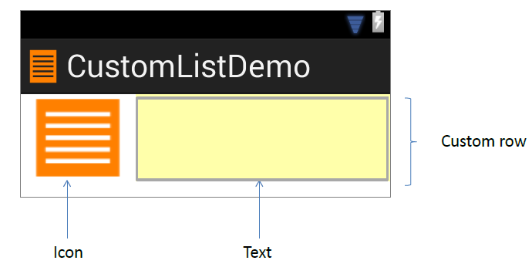
Custom List Example
In our example each UI row will show an icon (on the left side) and text following the icon to its right side.

Slide 19
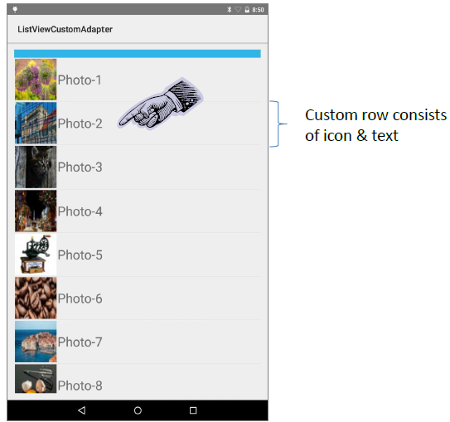
Custom List Example

Slide 20
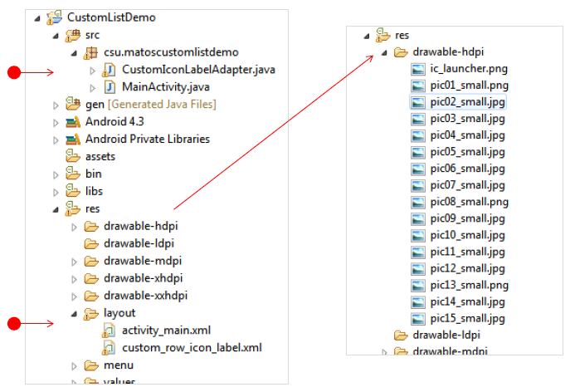
Custom List Example (Project View)

Slide 21
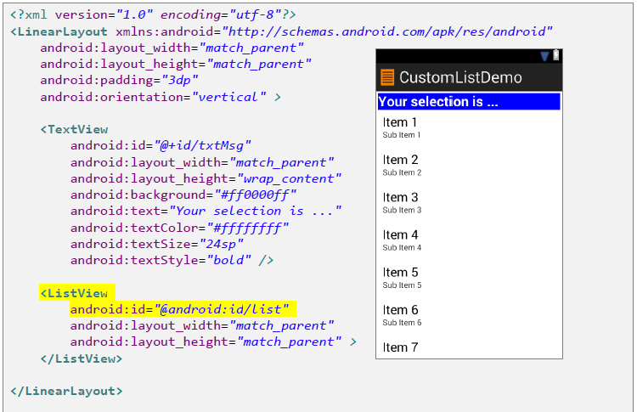
Custom List Example (activity_main.xml)

Slide 22
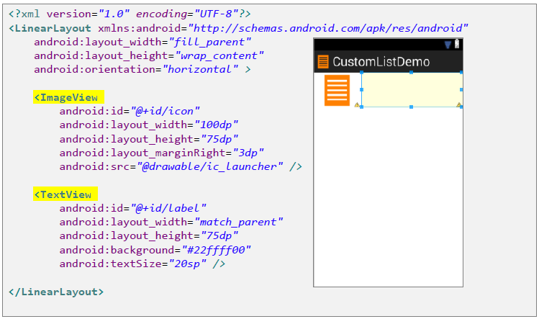
Custom List Example (custom_row_icon_label.xml)

Slide 23
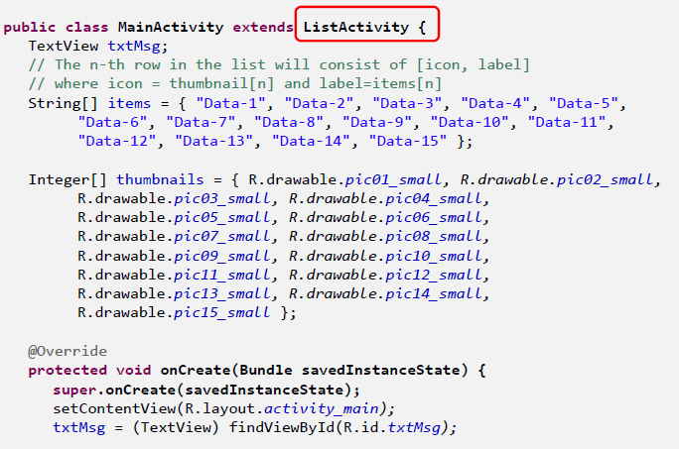
Custom List Example (MainActivity.java)
Extend the MainActivity class to ListActivity instead of Activity.

Slide 24
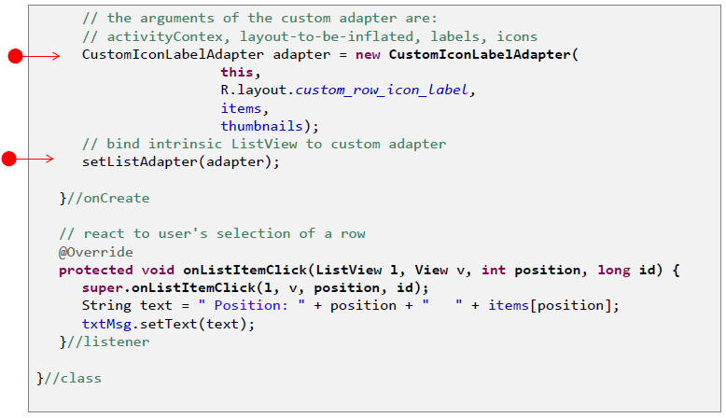
Custom List Example (Creating Customized Adapter Object)

Slide 25
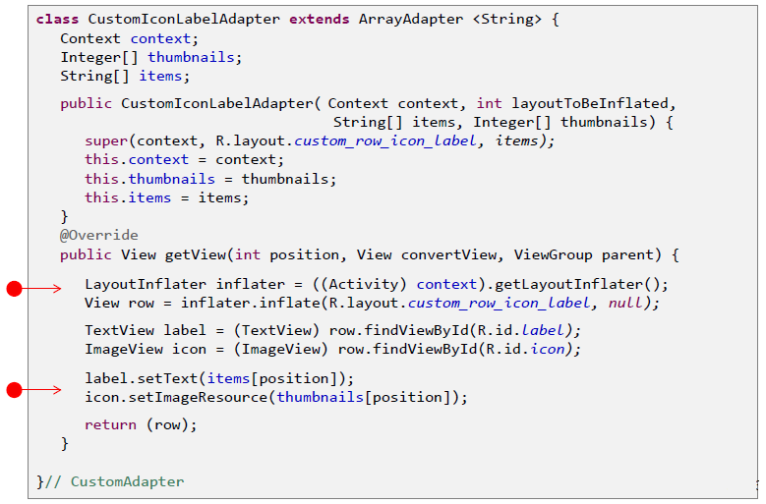
Custom List Example (Implement Adapter Sub-Class)

Slide 26
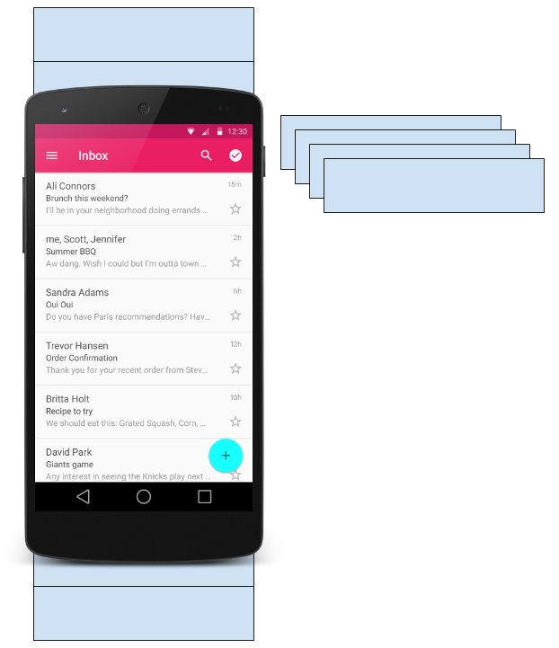
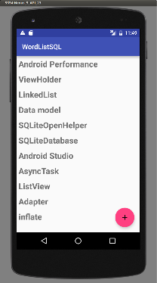
What is a RecyclerView?
RecyclerView is scrollable container for large data sets
Efficient
Uses and reuses limited number of View elements
Updates changing data fast

Slide 27
RecyclerView Components
Data
RecyclerView scrolling list for list items—RecyclerView
Layout for one item of data—XML file
Layout manager handles the organization of UI components in a View—Recyclerview.LayoutManager
Adapter connects data to the RecyclerView—RecyclerView.Adapter
ViewHolder has view information for displaying one item—RecyclerView.ViewHolder

Slide 28
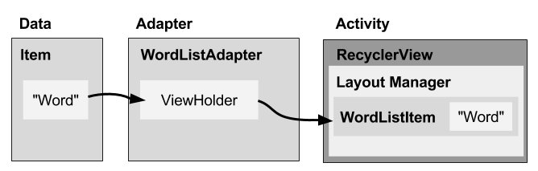
How components fit together

Slide 29
What is a layout manager?
Each ViewGroup has a layout manager
Use to position View items inside a RecyclerView
Reuses View items that are no longer visible to the user
Built-in layout managers
LinearLayoutManager
GridLayoutManager
StaggeredGridLayoutManager
Extend RecyclerView.LayoutManager

Slide 30
What is an adapter?
Helps incompatible interfaces work together
Example: Takes data from database Cursor and prepares strings to put into a View
Intermediary between data and View
Manages creating, updating, adding, deleting View items as underlying data changes
RecyclerView.Adapter

Slide 31
What is a ViewHolder?
Used by the adapter to prepare one View with data for one list item
Layout specified in an XML resource file
Can have clickable elements
Is placed by the layout manager
RecyclerView.ViewHolder

Slide 32
Implementing RecyclerView
Add RecyclerView dependency to build.gradle if needed
Add RecyclerView to layout
Create XML layout for item
Extend RecyclerView.Adapter
Extend RecyclerView.ViewHolder
In Activity onCreate(), create RecyclerView with adapter and layout manager

Slide 33
Add dependency to app/build.gradle
Add RecyclerView dependency to build.gradle if needed:
dependencies {
...
compile 'com.android.support:recyclerview-v7:26.1.0'
...
}

Slide 34
Add RecyclerView to XML Layout
<android.support.v7.widget.RecyclerView
android:id="@+id/recyclerview"
android:layout_width="match_parent"
android:layout_height="match_parent">
</android.support.v7.widget.RecyclerView>

Slide 35
Create layout for 1 list item
<LinearLayout …>
<TextView
android:id="@+id/word"
style="@style/word_title" />
</LinearLayout>

Slide 36
Implement the adapter
public class WordListAdapter extends
RecyclerView.Adapter<WordListAdapter.WordViewHolder> {
public WordListAdapter(Context context,
LinkedList<String> wordList) {
mInflater = LayoutInflater.from(context);
this.mWordList = wordList;
}
}

Slide 37
Adapter has 3 required methods
onCreateViewHolder()
inBindViewHolder()
getItemCount()
Let's take a look!

Slide 38
onCreateViewHolder()
@Override
public WordViewHolder onCreateViewHolder( ViewGroup parent, int viewType) {
// Create view from layout
View mItemView = mInflater.inflate(
R.layout.wordlist_item, parent, false);
return new WordViewHolder(mItemView, this);
}

Slide 39
onBindViewHolder()
@Override
public void onBindViewHolder( WordViewHolder holder, int position) {
// Retrieve the data for that position
String mCurrent = mWordList.get(position);
// Add the data to the view
holder.wordItemView.setText(mCurrent);
}

Slide 40
getItemCount()
@Override
public int getItemCount() {
// Return the number of data items to display
return mWordList.size();
}

Slide 41
Create the view holder in adapter
class WordViewHolder extends RecyclerView.ViewHolder { //.. }
If you want to handle mouse clicks:
class WordViewHolder extends RecyclerView.ViewHolder
implements View.OnClickListener { //.. }

Slide 42
View holder constructor
public WordViewHolder(View itemView, WordListAdapter adapter) {
super(itemView);
// Get the layout
wordItemView = itemView.findViewById(R.id.word);
// Associate with this adapter
this.mAdapter = adapter;
// Add click listener, if desired
itemView.setOnClickListener(this);
}
// Implement onClick() if desired

Slide 43
Create the RecyclerView in Activity onCreate()
mRecyclerView =findViewById(R.id.recyclerview);
mAdapter = new WordListAdapter(this,mWordList);
mRecyclerView.setAdapter(mAdapter);
mRecyclerView.setLayoutManager(new
LinearLayoutManager(this));

Slide 44
Learn more
RecyclerView
RecyclerView class
RecyclerView.Adapter class
RecyclerView.ViewHolder class
RecyclerView.LayoutManager class

