Slide 1
Lesson 3a
IntelliSense in VB.NET
Programming In
Visual Basic.NET

Slide 2
Objects and Classes
Objects
  Contain codes and data that is integrated as a single logical unit
  Controls, Forms and Data Access objects
  Can be created with its own sets of properties and methods
  Like prefabricated building blocks for programs
  Can be reused repeatedly

Slide 3
Objects and Classes
Classes
  Each object in Visual Basic is defined by a class
  A class describes the variables, properties, procedures, and events of an object
  Objects are instances of classes
  You can create as many objects as possible you need once you have defined a class

Slide 4
Objects and Classes Analogy
Cookie cutters and Cookies
  Each object in Visual Basic is defined by a class
  The cookie cutter is the class
  It defines the characteristics of each cookie
    For example, size and shape
  The cookie is an object, and it is created by cookie cutter

Slide 5



Objects and Classes Analogy
Classes
Objects
Instantiate

Slide 6
Objects Members
An object is an element of an application
It is a representation of a class
Fields, properties, methods, and events are the building blocks of objects and constitute their members
Member access
  You access a member of an object by specifying, in order, the name of the object variable, a period (.)
  and the name of the member
  For example: Label1.Text = “Welcome”

Slide 7
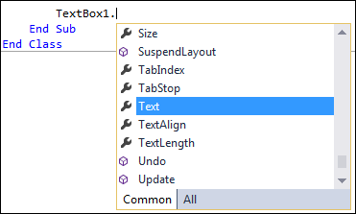
IntelliSense
IntelliSense lists members of a class when you invoke its List Members option
For example: when you type a period (.) as a member-access operator
You can invoke the List Members feature manually by typing Ctrl+J
choosing Edit > IntelliSense > List Members

Slide 8
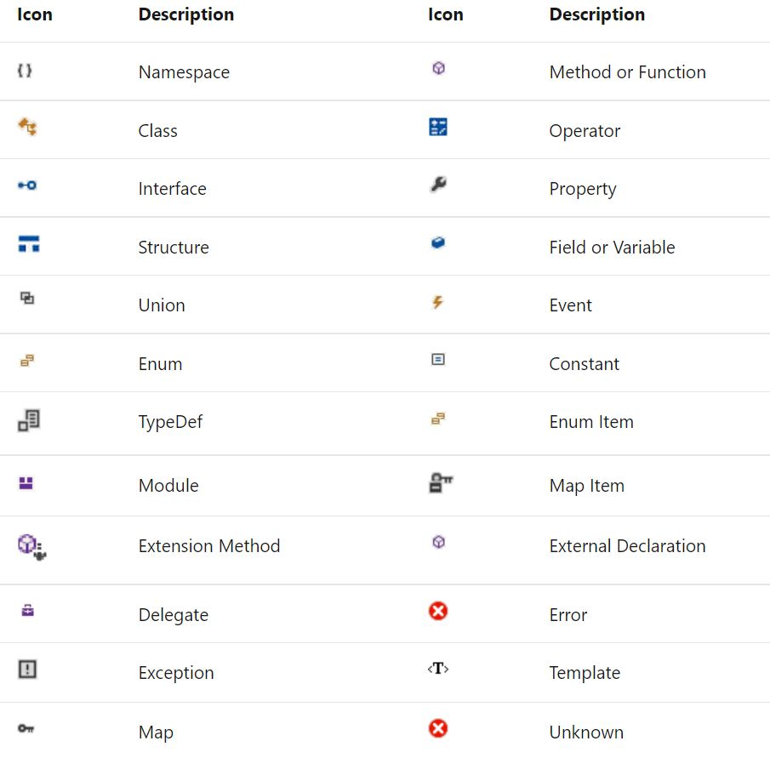
IntelliSense

