Slide 1
Lesson 4
Decisions and Conditions
Programming In
Visual Basic.NET

Slide 2
SELECT CASE structure
A Select Case block is an efficient decision-making structure
Simplifies choosing among several actions
It avoids complex If constructs
If blocks make decisions based on the truth value of a condition
Select Case choices are determined by the value of an expression called a selector

Slide 3
SELECT CASE Example 1
Dim position As Integer 'selector
position = CInt(txtPosition.Text)
Select Case position
Case 1
txtOutcome.Text = "Win"
Case 2
txtOutcome.Text = "Place"
Case 3
txtOutcome.Text = "Show"
Case 4, 5
txtOutcome.Text = "You almost placed in the money."
Case Else
txtOutcome.Text = "Out of the money."
End Select

Slide 4
SELECT CASE Example 2
Dim position As Integer
position = CInt(txtPosition.Text)
Select Case position
Case 1 To 3
txtOutcome.Text = “In the $”
Case Is >= 4
txtOutcome.Text = “Not in the $”
End Select

Slide 5
SELECT CASE Example 3
Dim x As Integer = 2, y As Integer = 3
Dim num As Integer
num = CInt(txtNumber.Text)
Select Case num
Case y - x, x
txtPhrase.Text = "Buckle my shoe."
Case Is <= 4
txtPhrase.Text = "Shut the door."
Case x + y To x * y
txtPhrase.Text = "Pick up sticks."
Case 7, 8
txtPhrase.Text = "Lay them straight."
Case Else
txtPhrase.Text = "Start all over again."
End Select

Slide 6
SELECT CASE Example 4
Dim firstName As String
firstName = txtName.Text.ToUpper
Select Case firstName
Case "THOMAS"
txtReply.Text = "Correct."
Case "WOODROW"
txtReply.Text = “I don’t think so."
Case "PRESIDENT"
txtReply.Text = "Are you for real?"
Case Else
txtReply.Text = "Nice try, but no cigar."
End Select

Slide 7
SELECT CASE Example 5
Dim anyString As String
anyString = txtString.Text.ToUpper
Select Case anyString.Substring(0, 1)
Case “S”, “Z”
txtResult.Text = “Begins with a sibilant.”
Case “A” To “Z”
txtResult.Text = “Begins with a nonsibilant."
Case “0” To “9”
txtResult.Text = “Begins with a digit.”
Case Is < “0”
txtResult.Text = “A character of ANSI < 48.”
Case Else
txtResult.Text = “Begins with a symbol.”
End Select

Slide 8
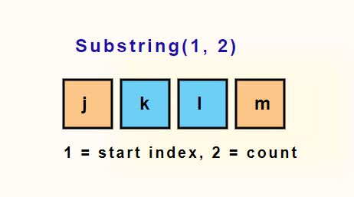
SubString

